Slide 1
BECE355L · ADVANCED CLOUD COMPUTING · FALL 2026–27
Cloud-Native Parallel Image Processing
Object storage · deep-learning operations · a cost-aware planner · work-aware autoscaling
Prapti Kurkuri
Vaanya Garg
Aditya Manoj
Arrnav Trisal
24BVD0185
24BVD0139
24BVD0070
24BVD0064
Faculty: Aparna Mohanty · SENSE, VIT Vellore
Notes:
Introduce the team. One line: we took our tile-parallel image framework and made it cost-aware: where data lives, which operations it can run, how it plans a job and how it scales.

Slide 2
STARTING POINT
Version 1 worked — and showed four limits
Image → halo tiles → one Redis task per tile → stateless worker pods (leases, retries) → stitched output identical to whole-image processing.
226 MB
2 jobs
0.45×
1 tile = 1
of Redis per 8192² job:
every tile byte went through Redis
fit in 1 GB of Redis;
12288² images were rejected
Canny when distributed:
moving a tile cost more than filtering it
autoscaler counted tiles,
but an HED tile costs ~1800× a Canny tile
Four upgrades, one per limit: ① object storage ② deep-learning ops ③ cost-aware planner ④ work-aware autoscaling
Cloud-Native Parallel Image Processing · BECE355L
2
Notes:
v1: FastAPI partitions, Redis reliable queue with Lua scripts, leases and heartbeats, last finisher stitches. Bilateral reached 4x, but four things limited it: memory, cheap ops, manual config, tile-count scaling.

Slide 3
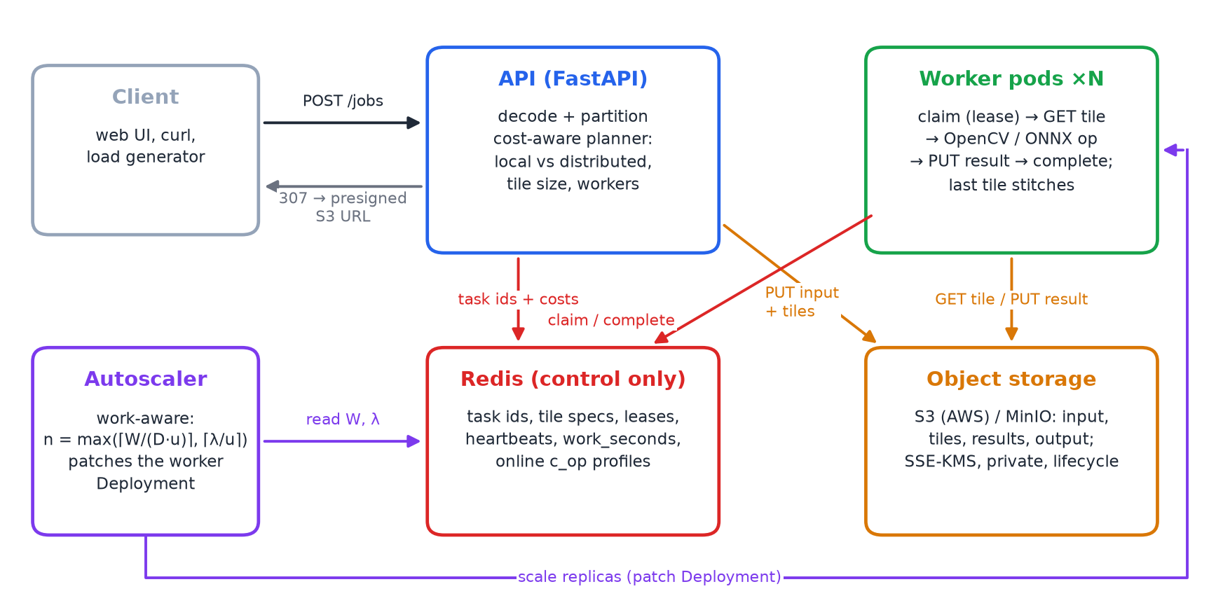
SYSTEM
Architecture after the upgrades
▸ Bytes in S3 / MinIO: input, tiles, results, output
▸ Redis = control plane: task IDs, leases, costs, work-seconds
▸ API plans every job: local or distributed, tile size, workers
▸ Workers: OpenCV or ONNX Runtime, stateless
▸ One image, three ways to run: local · Compose · Kubernetes
Cloud-Native Parallel Image Processing · BECE355L
3
Notes:
Walk the data flow: upload, plan, tiles to bucket, IDs to Redis, workers claim with lease, GET tile, process, PUT result, complete via Lua, last finisher stitches, client gets a presigned URL.

Slide 4
1
UPGRADE 1 · OBJECT STORAGE
Bytes to object storage, IDs to Redis
Claim-check data plane
226 MB → 54 KB
Tiles go to jobs/<id>/tiles/ before any task is queued; a task is just an ID.
Same boto3 code for MinIO (local) and Amazon S3.
Results: 307 redirect to a presigned URL, bytes never pass the API.
Outputs > 150 MP stream into a tiled BigTIFF.
Redis memory per 8192² job
2 → 12+
concurrent 8192² jobs in 1 GB Redis (all 12 tried fit)
Security by design (AWS templates)
Least-privilege IAM: API puts tiles; workers get tiles, put results.
SSE-KMS, Block Public Access, TLS-only bucket policy.
IRSA: pods get roles, no keys in containers.
Lifecycle rule expires job data after 1 day.
+1.3 ms
I/O per tile — the price (7.2 → 8.6 ms)
Cloud-Native Parallel Image Processing · BECE355L
4
Notes:
Redis footprint per job shrinks ~4000x. The trade-off: each tile now costs an S3 PUT and GET; a small bilateral job went from 0.82 to 1.09 s. The planner knows this overhead. AWS templates were written but not deployed - MinIO stood in for S3.

Slide 5
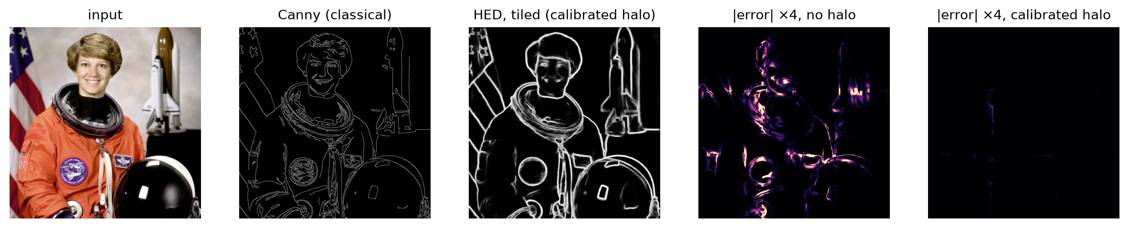
2
UPGRADE 2 · NEURAL OPS
Deep-learning operations: HED edges and Real-ESRGAN ×4
▸ HED (VGG-16, 5 side outputs): we wrote a Caffe→ONNX converter because OpenCV 5 dropped Caffe import
▸ Real-ESRGAN realesr-general-x4v3: ×4 output, so the stitcher scales tile coordinates
▸ ONNX Runtime, 1 thread per process: all parallelism comes from the framework, a fair comparison
Cloud-Native Parallel Image Processing · BECE355L
5
Notes:
Canny gives thin noisy edges, HED gives semantic object contours. The error maps on the right show tiled minus whole-image output with the calibrated halo: essentially zero.

Slide 6
2
UPGRADE 2 · HALO
Calibrating the halo from the effective receptive field
98 → 80 px
HED halo: extra compute 252 % → 164 %
34 → 4 px
Real-ESRGAN halo: extra compute 60 % → 6 %
▸ Criterion: seam PSNR ≥ 40 dB and p99.9 error ≤ 8 grey levels
▸ Stride fix: snap halo edges to 16 px, theoretical halo became bit-exact
Cloud-Native Parallel Image Processing · BECE355L
6
Notes:
Theoretical receptive field is exact but expensive. Luo et al. showed the effective receptive field is much smaller. We sweep the halo and take the smallest that meets the criterion. The 16-px snap fixed a pooling-grid misalignment.

Slide 7
MEASURED CAPACITY CURVE S(N)
Neural ops are memory-bound on one host
5.1× at 8
HED peak, then it falls
≈ 2.2× from 4
Real-ESRGAN plateau
The plan expected near-linear speedup. Measured: activations of many concurrent tiles overflow the caches, so extra workers wait on DRAM. On a multi-node cluster each node adds bandwidth; the planner uses the measured curve either way.
Cloud-Native Parallel Image Processing · BECE355L
7
Notes:
Important honest result: the neural ops do not scale linearly on a single 8-core laptop. Bilateral is compute-bound and keeps scaling to ~7x. This is why the planner needs a capacity curve.

Slide 8
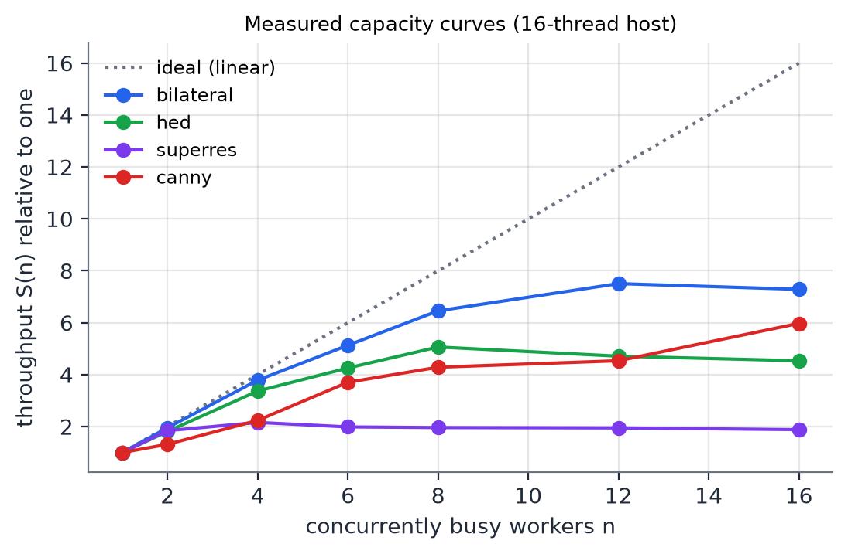
3
UPGRADE 3 · PLANNER
A calibrated cost model decides how to run each job
Tdist = Tsplit + ⌈K/n⌉ · c · p̄ · n / S(n) + overhead + Tstitch
o(p) = o0 + opx · phalo · (1 + s²)
Tlocal = c · P
▸ c: measured cost per pixel of each op (0.3 ns grayscale … 24 µs Real-ESRGAN)
▸ S(n): measured capacity curve per op
▸ Search: tile ∈ {256, 512, 1024, 2048} × every worker count; 20 % margin; near-ties → fewer workers
▸ Online: workers update c with a contention-normalised EMA in Redis
Cloud-Native Parallel Image Processing · BECE355L
8
Notes:
Ernest-style: calibrate a parametric model with a few measurements, then extrapolate. The planner answers three questions: distribute or not, tile size, how many workers.

Slide 9
3
UPGRADE 3 · RESULTS
The planner removes the slowdowns of naive tiling
0.06× → 1.11×
grayscale: planner runs it locally
2.0× → 2.5×
HED: 8 workers beat 16
25 % vs 40 %
prediction error (MAPE), refined vs linear model
Cloud-Native Parallel Image Processing · BECE355L
9
Notes:
Naive tiling made every cheap op slower. Planner keeps them local. Bilateral: chooses 12 workers, within 3% of naive. Neural: picks fewer workers and wins. Full framework with S3 (8 workers): 16 x 1024-px tiles instead of 64 x 512, 4-14% faster for classical ops; cluster MAPE 22%.

Slide 10
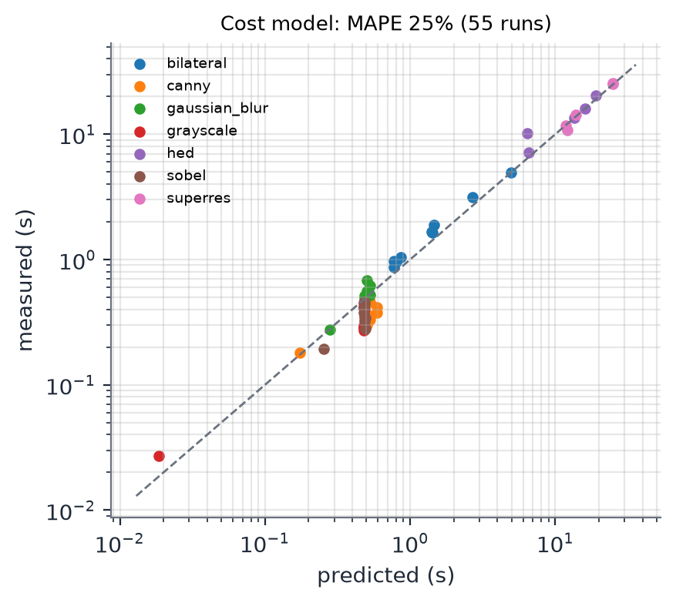
3
UPGRADE 3 · ACCURACY
Modelling contention is what makes predictions useful
Biggest gains on the expensive ops, where a wrong plan costs seconds. Cheap jobs (< 0.2 s) stay noisy, but there a wrong choice costs milliseconds.
Cloud-Native Parallel Image Processing · BECE355L
10
Notes:
A linear model assumes n workers give n-fold throughput. That is wrong for memory-bound ops, so it overpredicts speedup; the capacity curve fixes it.

Slide 11
4
UPGRADE 4 · AUTOSCALING
Scale on queued work, not on queue length
n = clamp( max( ⌈W / (D·u)⌉ , ⌈λ / u⌉ ), 1, 8 )
W — queued work
D, u, λ
Baselines
Each tile's predicted compute-seconds is added when queued and removed exactly (in Lua) on completion, give-up or delete.
D = latency target 30 s − pod start-up 5 s.
u = 0.8 target utilisation.
λ = EMA of the rate at which work arrives.
Idle (W ≈ 0) for 10 s → drop straight to 1 worker.
HPA: CPU 70 % of request, 30 s scale-down window.
KEDA 2.21: Redis list length, 16 tiles per replica, 3 s polling.
Same 1–8 replicas for all.
Cloud-Native Parallel Image Processing · BECE355L
11
Notes:
First term drains the backlog inside the latency target; second keeps up with steady arrivals. Ten HED tiles and ten Canny tiles look identical to KEDA, very different to us.

Slide 12
4
UPGRADE 4 · RESULTS
HPA vs KEDA vs work-aware on the same replayed trace
HPA is cheapest but reacts after 78 s and misses the target. KEDA and work-aware meet it for every job; work-aware uses 25 % fewer pod-seconds because it ignores bursts of cheap tiles (KEDA scales up within 4 s of them), with p95 12.5 s vs 14.8 s. Dropping to 1 worker 10 s after the queue empties saves a further ~12 % over our first version. (Minikube, 8 CPUs; 32 jobs: cheap and expensive bursts; mean of 3 runs each.)
Cloud-Native Parallel Image Processing · BECE355L
12
Notes:
Same seeded trace for all three, interleaved runs. Discuss latency vs cost; HPA reacts late because CPU is averaged over a window, KEDA reacts to tile counts regardless of cost.

Slide 13
DEPLOYMENT & QUALITY
Laptop, Compose, Kubernetes — and the path to AWS
Component | Ran here | On AWS
Object store | MinIO | Amazon S3 + KMS
Queue / state | Redis | ElastiCache
Orchestration | Minikube | Amazon EKS
Pod scaling | Work-aware / HPA / KEDA | same + Karpenter
Credentials | K8s Secret | IRSA roles
Images | Minikube Docker | Amazon ECR
43 tests
all pass · 17 new for the upgrades
▸ Seam-free: tiled = whole image (classical exact; neural ≥ 40 dB seams)
▸ Fault tolerance kept: killed worker → leased tiles re-run
▸ Exact accounting: work counter survives retries and duplicates
▸ AWS templates: written, not deployed
Cloud-Native Parallel Image Processing · BECE355L
13
Notes:
k8s manifests include MinIO with NodePort for presigned downloads, Secret for credentials, RBAC for the autoscaler. deploy/aws has bucket policy, IAM, lifecycle and IRSA - not executed.

Slide 14
DISCUSSION
What we learned, and what is left
Lessons
Limitations & future work
Whether and how finely to distribute matters as much as the parallel machinery.
Object storage trades ~1.3 ms per tile for removing the memory ceiling.
Effective receptive fields are far smaller than theoretical ones.
Neural ops are memory-bound on one host: measure, don't assume.
Single host: a multi-node EKS run would test the model on real networks.
Cheap ops should run in-process at the API, not through the queue.
Not built: GPU workers, spot node pools, COG range reads + deep-zoom viewer, learned cost models.
MAPE 20–25 %: good for decisions, not SLAs.
Cloud-Native Parallel Image Processing · BECE355L
14
Notes:
Be upfront about the single-host setup and the unexecuted AWS templates.

Slide 15
From tile-parallel to cost-aware
①
226 MB → 54 KB of Redis per job
②
HED + Real-ESRGAN, halos 80 px / 4 px, seam-free
③
25 % prediction error; no more slowdowns from naive tiling
④
autoscaling on queued compute-seconds, compared with HPA and KEDA
Thank you · github.com/GHOSTALERT/cloud-native-ing-proc
Notes:
Summarise the four upgrades in one line each and invite questions.

