Slide 1
Sales Insights Brick & Mortar Business [Power BI | SQL]
Gurunatha Hebbar

Slide 2
Agenda
Introduction
Key Insights
Profit Analysis
Performance Insights
Areas of Focus
Summary

Slide 3
Introduction
Designed a Power BI dashboard to understand AtliQ Hardware goods sales trend.
The final dashboard was effective at displaying the sales trend of AtliQ hardware,
allowing users to understand the data and make informed decisions.
This dashboard could help in increasing the revenue at least by 7% in the next quarter.

Slide 4
Key Insights
Total Revenue growth

Slide 5
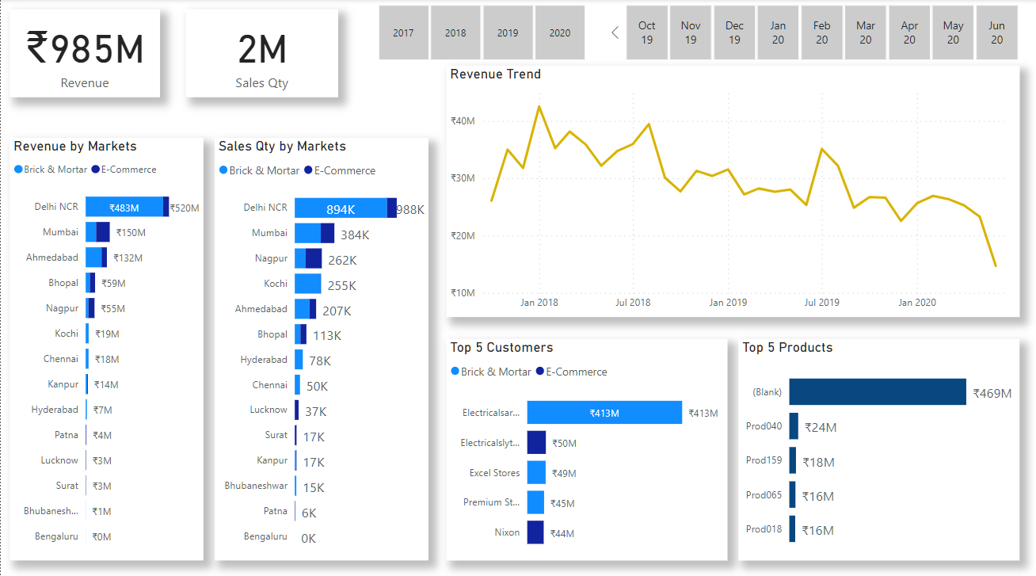
Overall Performance

Slide 6
Key Insights
Total Revenue of the AtliQ Hardware is around ₹985M
Total Sales Quantity is Over 2M
Total Number of Revenue & Sales Quantity by Market are given below as Delhi NCR stands in the Top and followed by Mumbai, Ahmedabad, etc.
There is also classification between Brick & Mortar, &
E-Commerce.

Slide 7
Key Insights
Below the date section there is a Line Chart which shows the Overall Revenue Trend!
You are able to see that the Line chart Revenue is declining!
Below the chart there is the Top 5 Customers and Top 5 Products.
Electricalsara Stores stands Top 1 in Top 5 Customers!

Slide 8
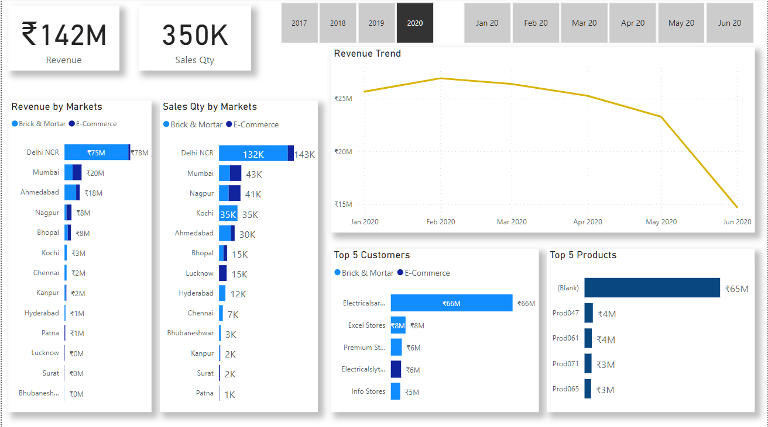
Key Insights (Yr2020)
This Visualization shows about the Total Sales Revenue in the year 2020 and the Revenue Trend Line Chart.
The Company has earned so far ₹142M as Sales revenue and 350K Sales Quantity.
Total Number of Revenue & Sales Quantity by Market are given below as Delhi NCR stands in the Top and followed by Mumbai, Ahmedabad, Nagpur, etc.
Electricalsara Stores stands again Top 1 in Top 5 Customers!

Slide 9
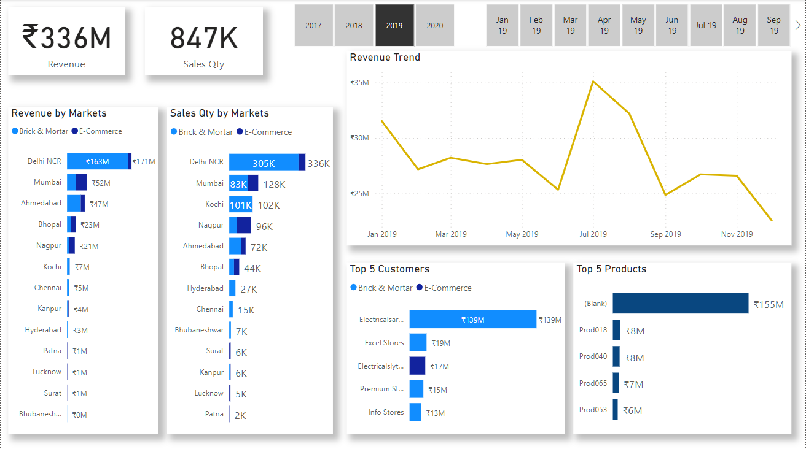
Key Insights (PrevYr2019)
This Visualization shows about the Total Sales Revenue in the year 2019 and the Revenue Trend Line Chart.
The Company has earned so far ₹336M as Sales revenue and 847K Sales Quantity.
Total Number of Revenue & Sales Quantity by Market are given below as Delhi NCR stands in the Top and followed by Mumbai, Ahmedabad, Kochi, etc.
Electricalsara Stores stands again Top 1 in Top 5 Customers!

Slide 10
Profit Analysis
Total Profit Margin

Slide 11
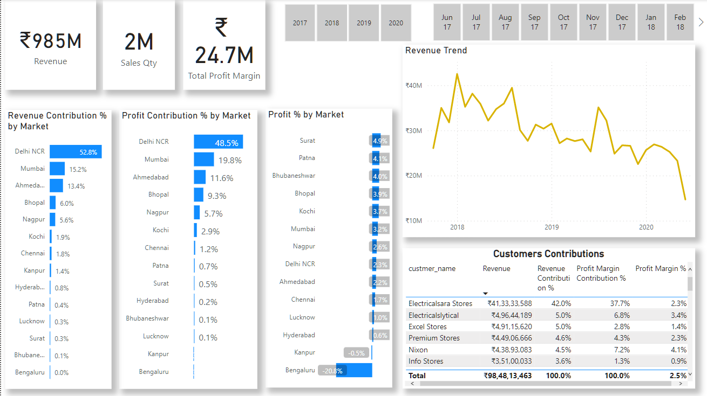
Profit Analysis

Slide 12
Profit Analysis
Total Profit Margin earned so far by the stores is ₹24.7M
The Profit Contribution % and The Revenue Contribution % by each Market is also Visualized below.
The High Profit Margin % has again came from the Delhi NCR, Mumbai, Ahmedabad, etc.
But in the Profit % by Market Surat, Patna, Bhubaneswar are leading by market.

Slide 13
Profit Analysis
The Total Revenue Line Chart will be the same.
There is a Table showing the all Customer Contributions and the Highest number of Revenue generated through those.
Once again Electricalsara Stores contributed more Revenue with a 42% and 37.7% of Profit Margin Contribution %.

Slide 14
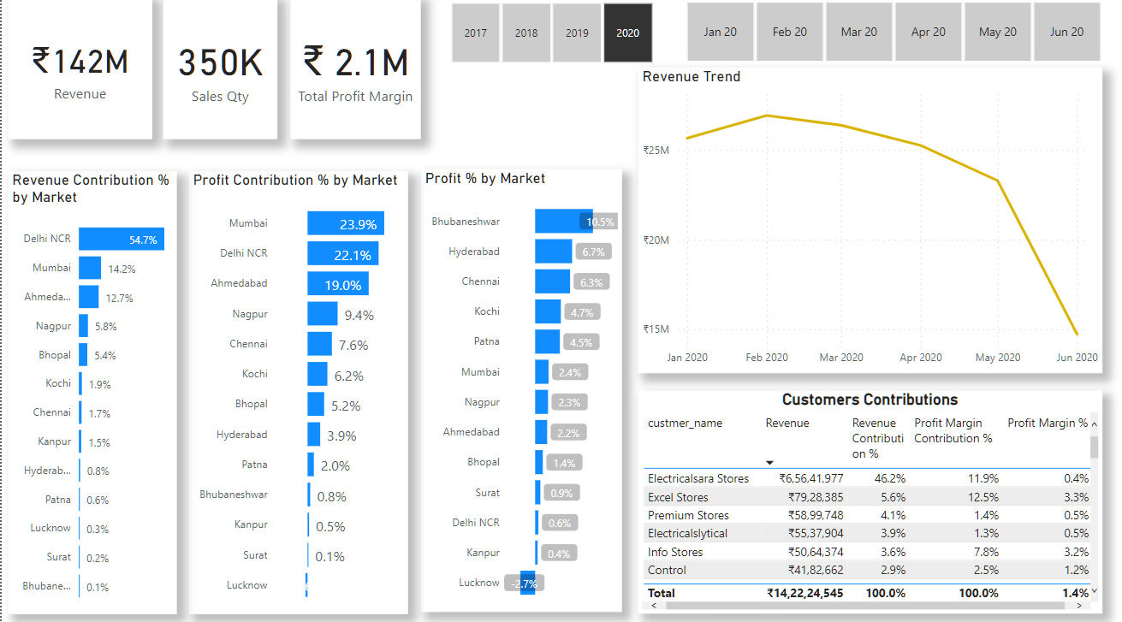
Profit Analysis (Yr2020)
This Visualization shows about the Total Profit Margin in the year 2020 and the Revenue Trend Line Chart.
The Stores has a Total Profit Margin around ₹2.1M.
In the Year 2020 the Profit Contribution % by Market Mumbai Leads with 23.9%. Whereas, Bhubaneshwar Leads in Profit % by Market with 10.5%.

Slide 15
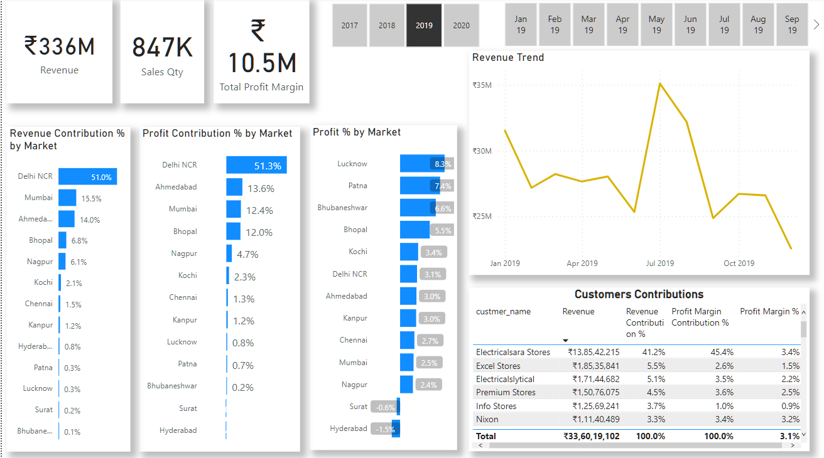
Profit Analysis (PrevYr2019)
This Visualization shows about the Total Profit Margin in the year 2019 and the Revenue Trend Line Chart.
The Stores had a Total Profit Margin of ₹10.5M.
In the Year 2019 the Profit Contribution % by Market Delhi NCR Leads with 51.3%. Whereas, Lucknow Leads in Profit % by Market with 8.3%.

Slide 16
Performance Insights
Profit Target

Slide 17
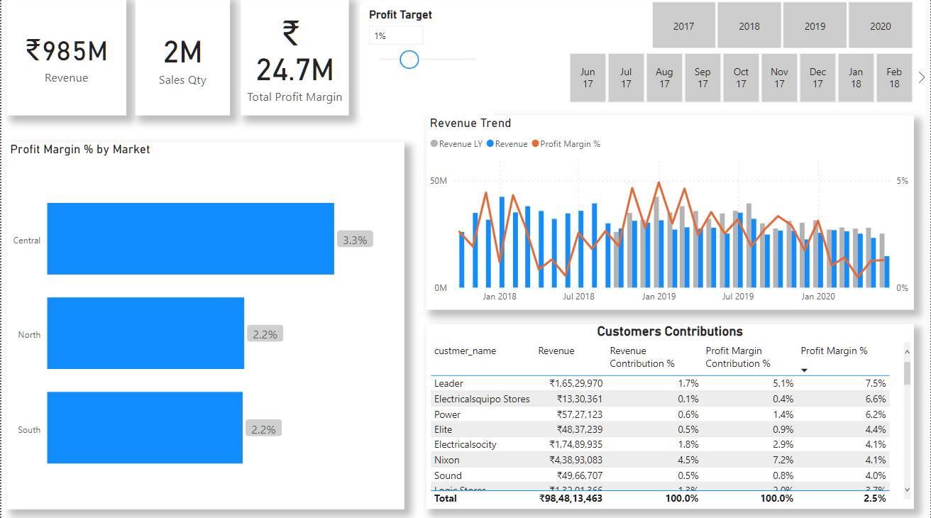
Performance Insights

Slide 18
Performance Insights
The Profit Margin % by Market Bar chart shows the % of Profit from the Regions of India. Where, from Central it’s 3.3%, North and South included it is 2.2%.
Right side of the Total Profit Margin there is Profit Target.
It is the difference between Profit Margin % and Profit Target Value which can be change by moving the slider.

Slide 19
Performance Insights
Here the Revenue Trend is a Vertical Bar chart Showing Current Total Revenue, Last Year Revenue including Line chart of Profit Margin % of all years.
Below the Chart there is Customer Contribution which shows Customer Leader with a highest Profit Margin % of 7.5%

Slide 20
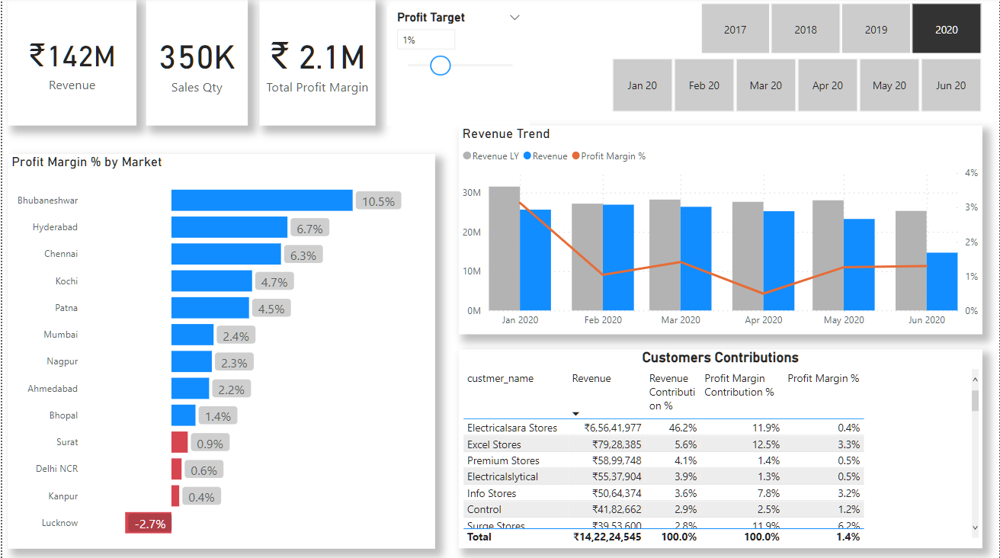
Performance Insights (Yr2020)
The Visualization shows about the Performance Insights in the Year 2020
The Stores has a Total Profit Margin around ₹2.1M.
In the Year 2020 the Profit Margin % by Market Bhubaneswar Leads with 10.5%.
The Revenue Trend Chart Shows the Revenue of Current Year and Last Year i.e 2019 and with Line chart of Profit Margin %
For Now the Profit Target is set to 1% but it can be changed by moving the slider.

Slide 21
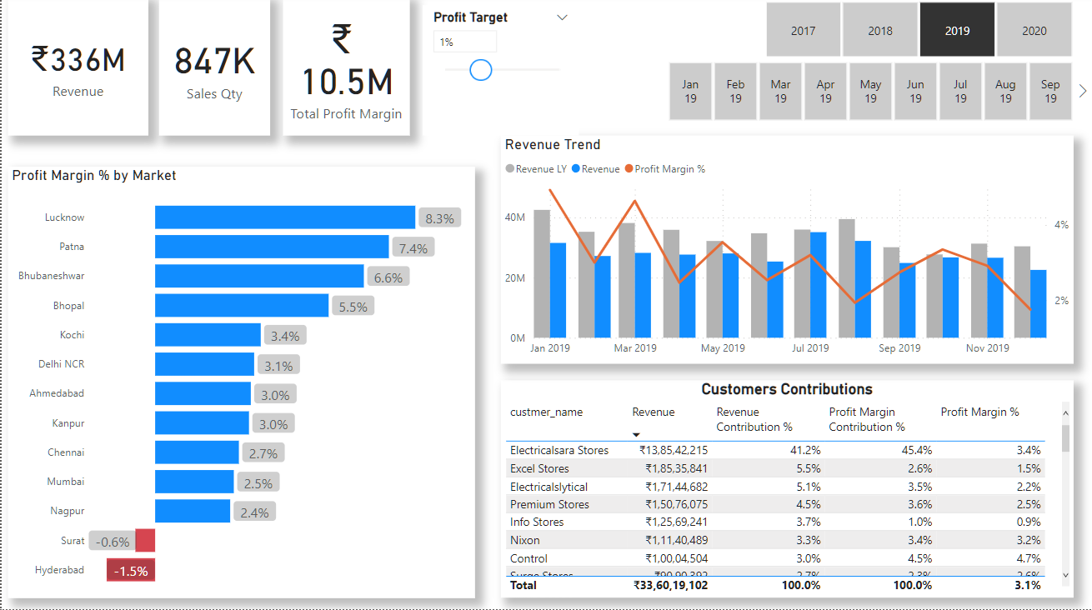
Performance Insights (PrevYr2019)
The Visualization shows about the Performance Insights in the Year 2019.
The Stores had a Total Profit Margin of ₹10.5M.
In the Year 2019 the Profit Margin % by Market Lucknow Leads with 8.3%. Followed by Patna with 7.4%.
The Revenue Trend Chart Shows the Revenue of Current Year and Last Year i.e 2018 and with Line chart of Profit Margin %

Slide 22
With data collection, ‘the sooner the better’ is always the best answer.
“
”
Marissa Mayer

Slide 23
Analysis for Growth
Every Business Growth will take sometime to show profits based on Team’s Hardwork
Product Quality
Quality always matters to the end customer
Promotion/
Advertising
By cracking the Ultimate code of Customer Attraction
Discounts
More Discounts
Communication
More Customers
Healthy Communication between Suppliers
Business Growth
1
2
3
4
5

Slide 24
Areas of focus
Key Insights
Profit Margin
Performance Insights
As the Revenue Trend is Declining over the years focus more on Revenue By Markets
Establish a Relationship where More Customers by the products. Here, Electricalsara Stores is the Top Customer.
In the year 2020 in Key Insights we saw that Delhi NCR is highest in the Revenue but in the Profit Analysis Bhubaneshwar has the highest Profit Margin %
Focus more on Mumbai as it has high Profit Contribution % by Market in 2020
We also must try to focus also on markets like Nagpur as it has Profit Contr. % of 9.4%
Focus more on to Increase Sales on a particular Zones by increasing Sales Employees Promoting/Advertising Products.
Identify the Less Revenue getting Customers and get feedback provide offers and discounts.
Identify the markets where sales is very low and try to avoid unnecessary expenses.

Slide 25
How we get there
ROI
Niche Markets
Supply chains
Through Profit Analysis we must focus on Bhubaneshwar by Optimizing Sales, Introduce new products, Discounts etc.
Identify the Top Revenue getting Customers and Increase Products which have more Price.
Observe the different Revenue Zones and Target those areas where there is more Revenue.
Engage top-line web services with cutting-edge deliverables
Cultivate and maintain good relationship with the Customers for better satisfaction of services.
Maximize timely deliverables for real-time schemas

Slide 26
Summary
This Data Analysis Report is in the perspective of Sales data at a hardware Company AtliQ.
Sales director needs to look into the areas where sales is very less (stop sales in those areas to avoid transport charges and sales employees, this amount can be invest on other areas). Identify Top Revenue getting from Customers (increase products which have more price). Display the return products Quantity from Zone & Customer. Identify which products increasing more Revenue from Market, customer (main objective is to increase sales growth)

Slide 27
Thank you
Gurunatha Hebbar​
Check out my GitHub for Files

