Slide 1
Finding the best location for a new hotel in Amsterdam
IBM Data Science certificate – Capstone Project – Gijs Hendrix

Slide 2
Introduction
I want to open a new hotel in Amsterdam, my hometown. It historic center, museums, restaurants and bars attract a large amount of tourist from both The Netherlands as abroad. As a 30-something-year old myself I will look for locations that would fit a tourist like myself. My interests include restaurants and bars and in this study I will focus on these. Additionally I want to make sure my hotel is unique and attracts customers.
Therefore there are two criteria I will use to select the location:
Location versus competition. As the hotel market in Amsterdam is rather saturated I want to make sure to find a location without much competition.
Vicinity to restaurants and bars. While the city is rather small and accessible my hotel needs to have a lot of restaurants and bars within walking distance.
The target audience is (potential) investors in hotels or existing hotel chains. This report will provide them with options for neighborhoods to open a new hotel in.

Slide 3
Data
Two data sources are used for this study:
Foursquare data on restaurants and bars;
Datasets from the city of Amsterdam, found on : https://data.amsterdam.nl/.

Slide 4
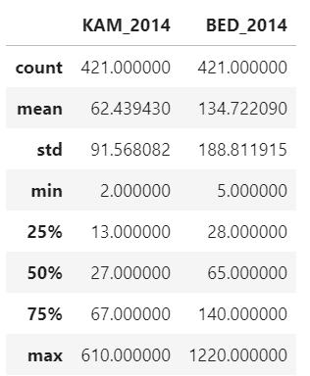

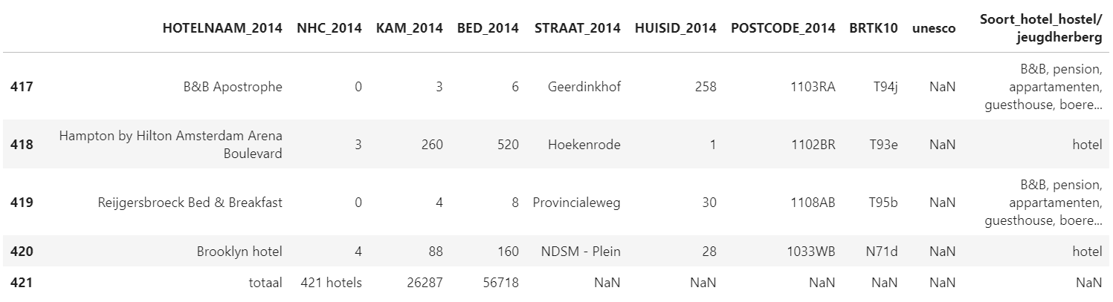
Exploratory data analysis
The hotels dataset looks as follows

Slide 5
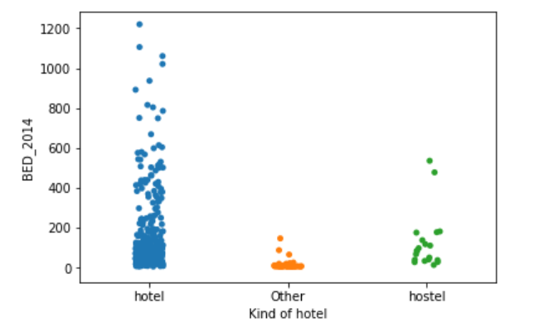
Competition in Amsterdam - Numbers per category of hotel

Slide 6
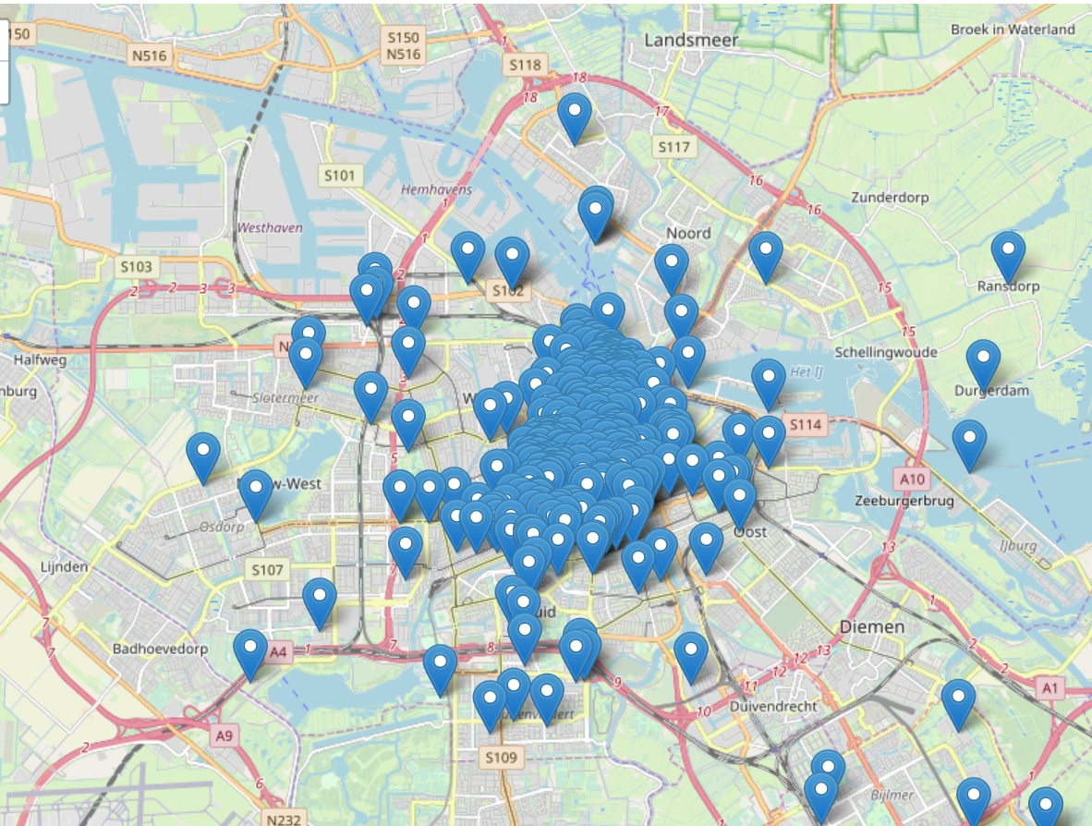
Competition in Amsterdam - Locations

Slide 7
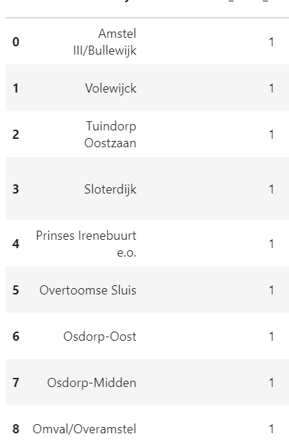
Bottom 10 neighborhoods
The bottom 10 neighbourhoods in terms of amount of hotels / competition:

Slide 8
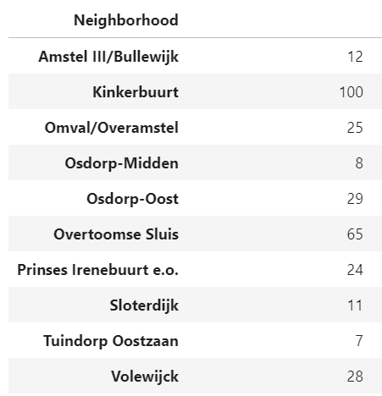
Venues in the bottom 10 neighbourhoods
The 10 neighborhoods with the least hotels have been selected for further analysis. These neighborhoods I want to analyze on attractiveness. This is measured by the venues in the neighborhood. Foursquare is used to get this data. A maximum of hundred venues per neighborhood have been retrieved:

Slide 9
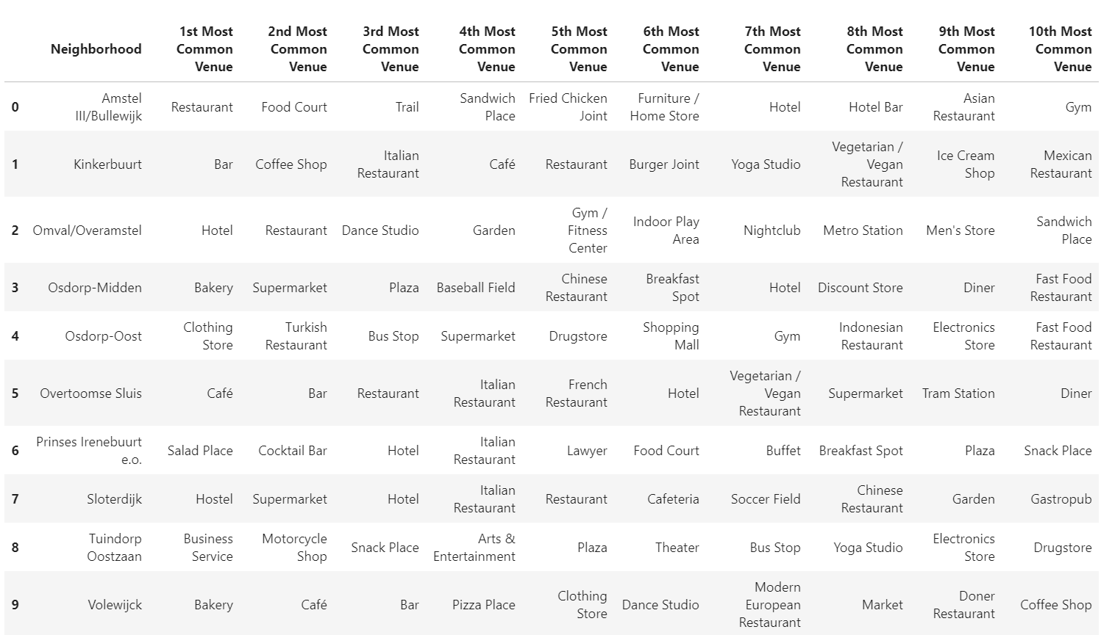
What venues occor most frequent per neighborhood?

Slide 10
Conclusions
Kinkerbuurt and qualifies as the neighbourhood with the most common venues related to food/drinks.
Kinkerbuurt is the only neighborhood with at least 100 venues in/surrounding it
Therefore my hotel will be built in the Kinkerbuurt neighborhood. It has the most venues and the most restaurants/bars venues. Additionally there are almost no competitors in this neighborhood!

Slide 11
Discussion
In this report I analyzed the best spot for a new hotel in Amsterdam, keeping certain criteria in mind (away from competition yet close to restaurants and bars). There are several limitations that could be improved upon in a further study:
More up-to-date information on currents hotels (this dataset is from 2014).
Including additional data on neighborhoods, for example distance to museums or other interesting places.
Including more neighborhoods in the analysis.

