Slide 1
The Silhouette_score and Clainski-Harabasz within different number of clusters
K | Silhouette_score | Clainski-Harabasz
3 | 0.4271 | 6898.41
4 | 0.4151 | 6857.30
5 | 0.3689 | 7178.12
6 | 0.3681 | 6999.02
7 | 0.3463 | 7072.26
Result
When dividing to 3 clusters, the Silhouette_score reaches the best
When dividing to 5 clusters, the Clainski-Harabasz reacher the best

Slide 2
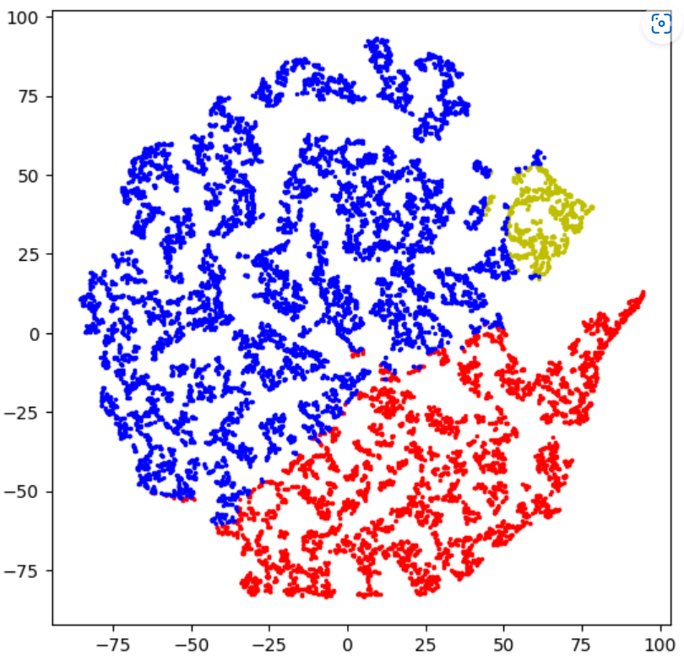
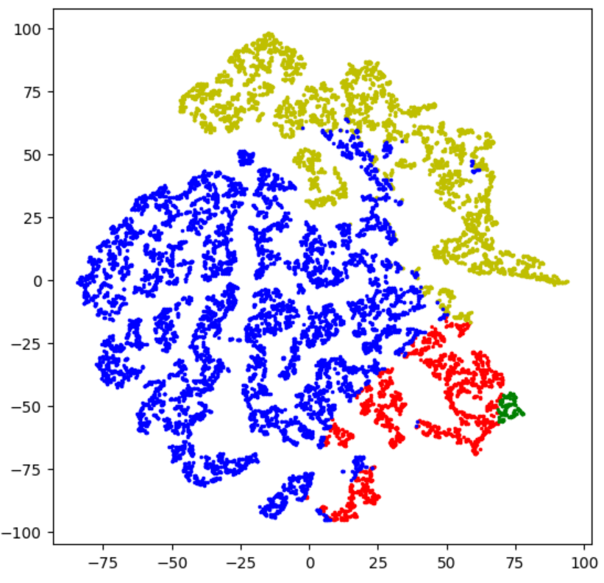
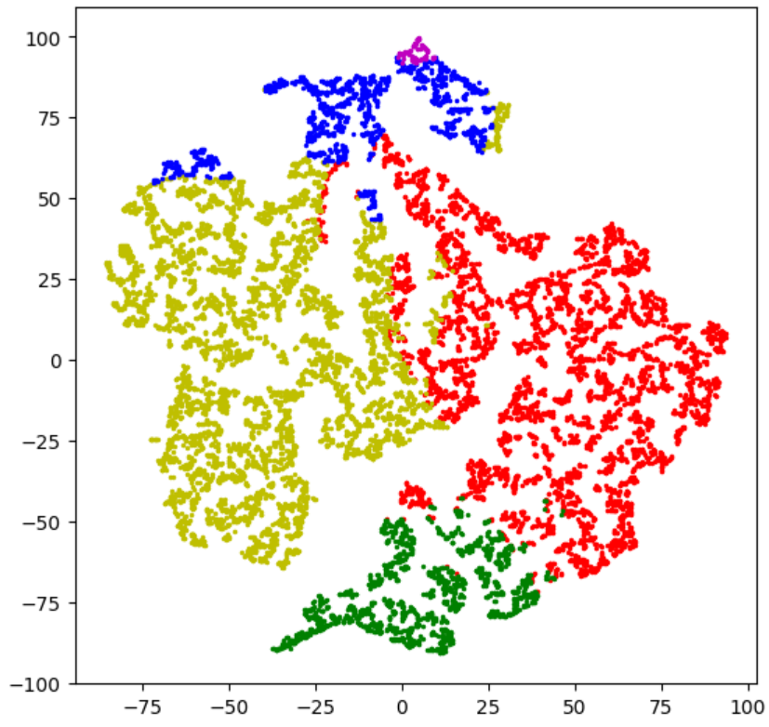
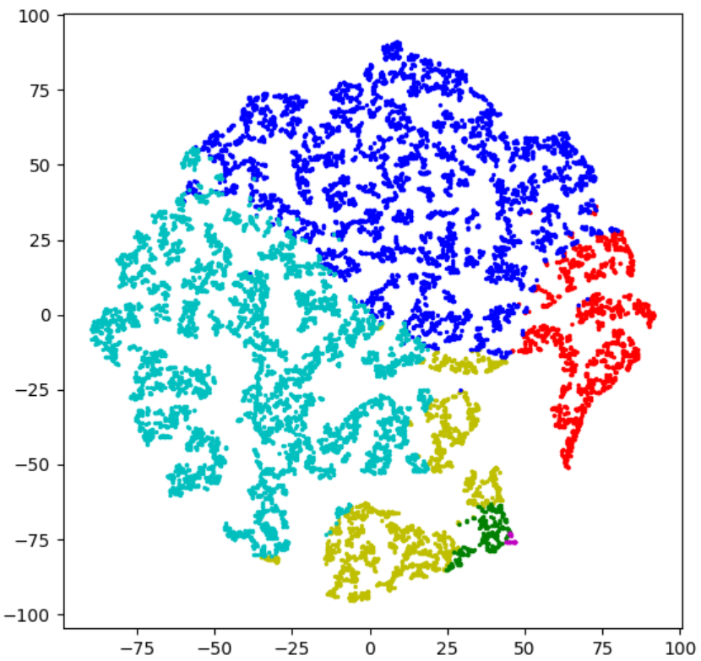
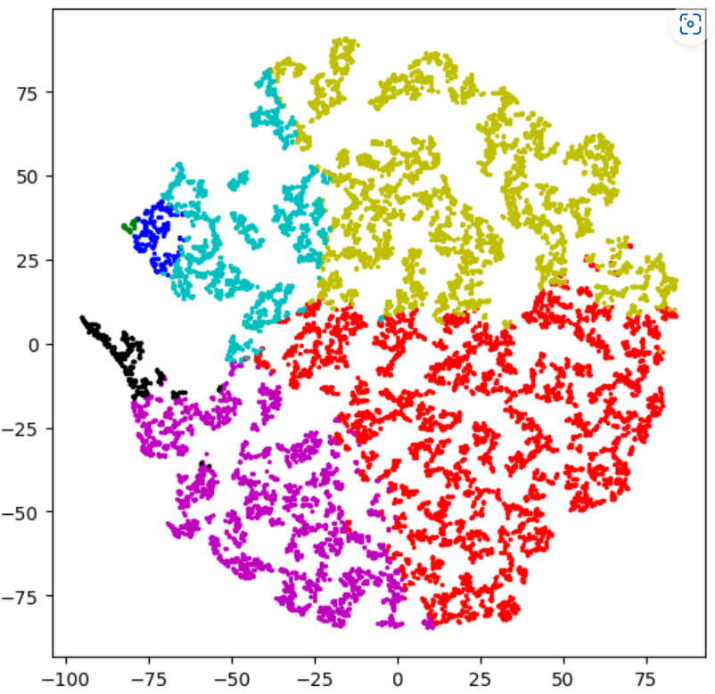
K=3
K=4
K=5
K=6
K=7

