Slide 1

Global Pandemic Covid19

Slide 2
Covid19 which started in December 2019 in Wuhan, China has spread globally and has been declared as Pandemic by World Health Organization
As of June 21 2020 more than 8.9 million cases have been reported across 188 countries and territories, resulting in more than 414k deaths
This deadly infectious disease left the countries in both deep physical and economic depression.
The analysis here is to present cumulative data of confirmed cases, deaths, and recovered cases over time and also to analyze the spread trend of this virus with the right visualizations and graphs.

Slide 3
Data acquisition and cleaning
Covid19 Confirmed Cases , Deaths ,Recoveries and Active data Time-series COVID-19 Data Repository by the Center for Systems Science and Engineering (CSSE) at Johns Hopkins University.
USA country data from Time series public dataset by NYT, located in the GitHub
Dallas County Summary of Cases by City Distribution from Dallas County website.
Dallas county’s Population Data from Census.gov
188 countries data with 14 features was extracted
Unnecessary data were dropped.
Data was Cleaned and used accordingly.

Slide 4
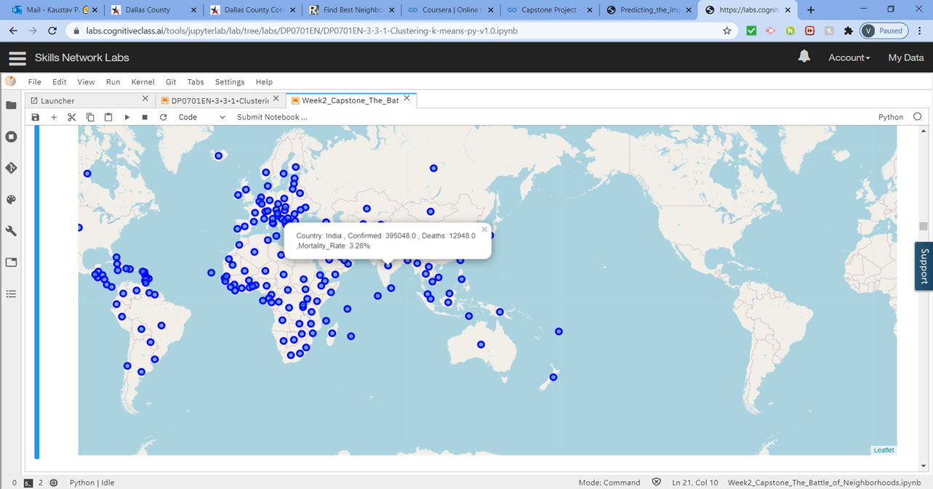
Global Map Displaying the countries stats

Slide 5
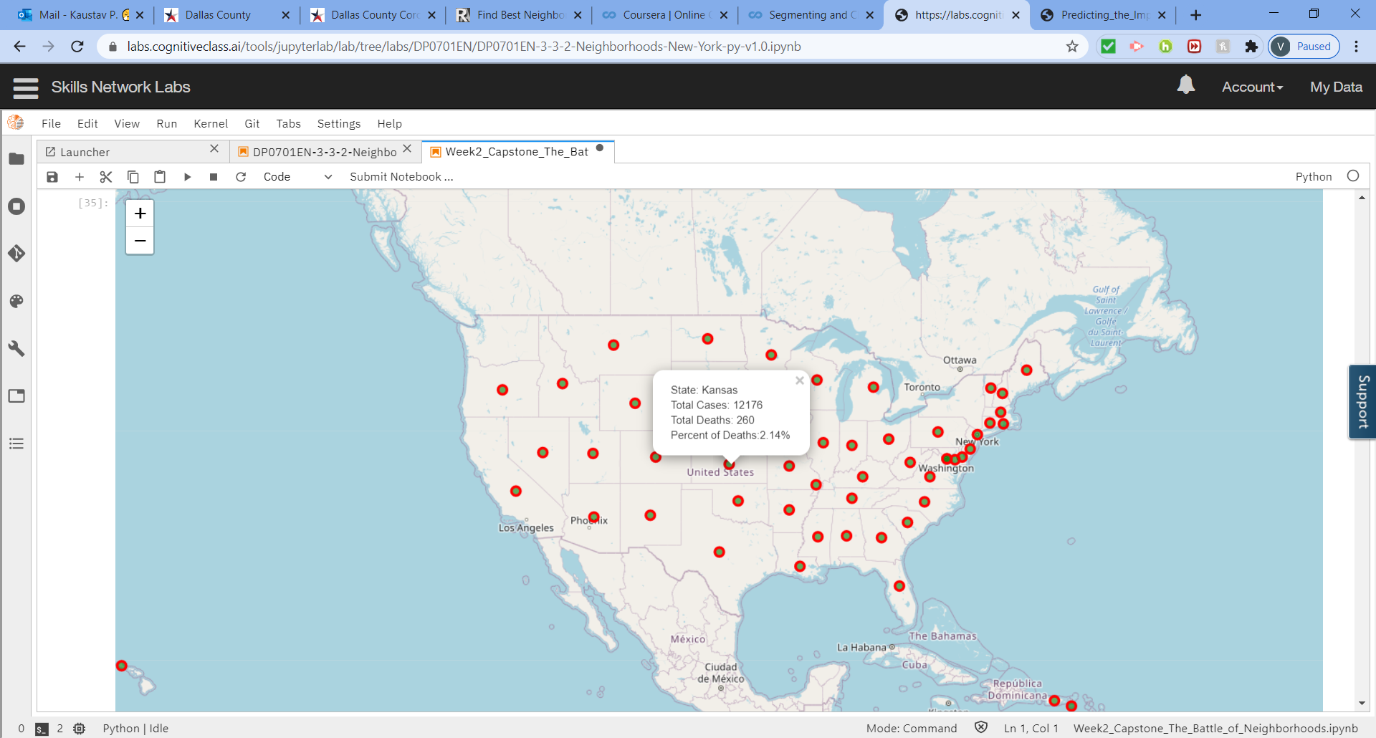
USA Map Displaying the States stats

Slide 6
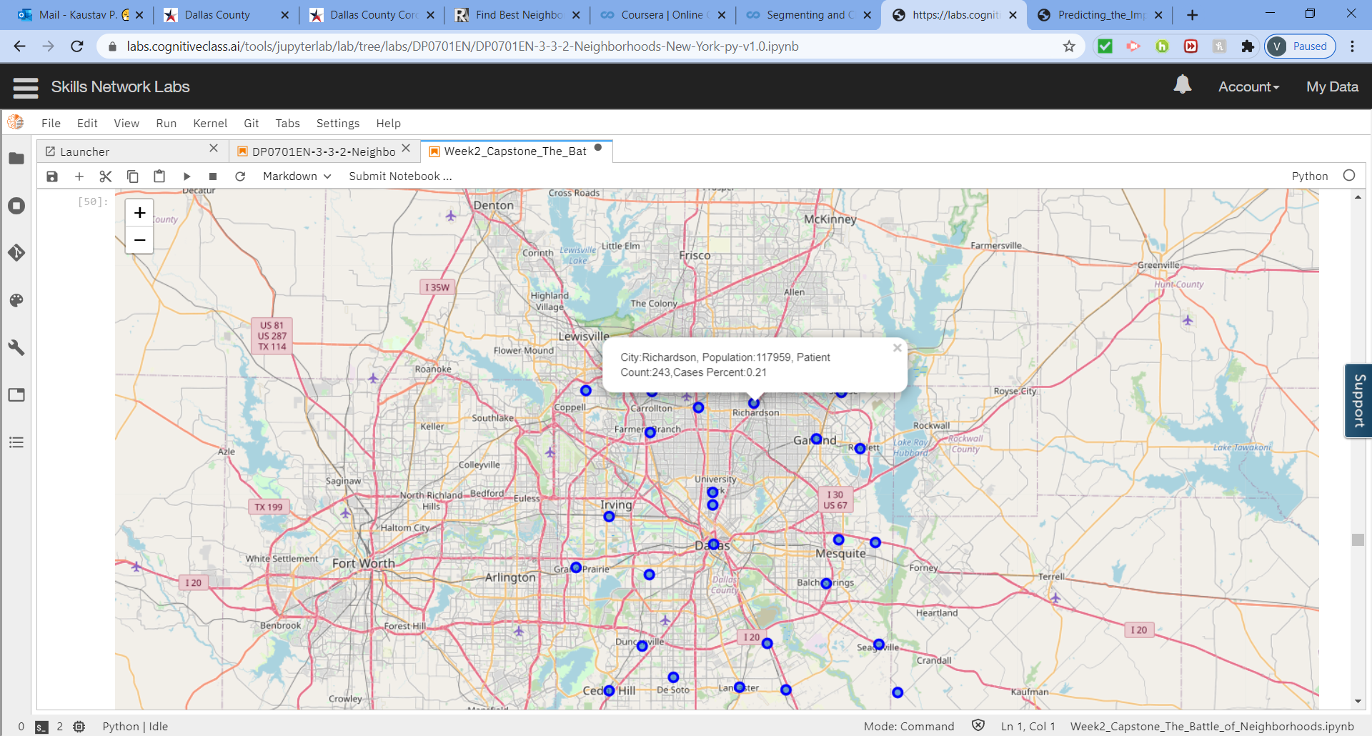
Dallas County Map

Slide 7
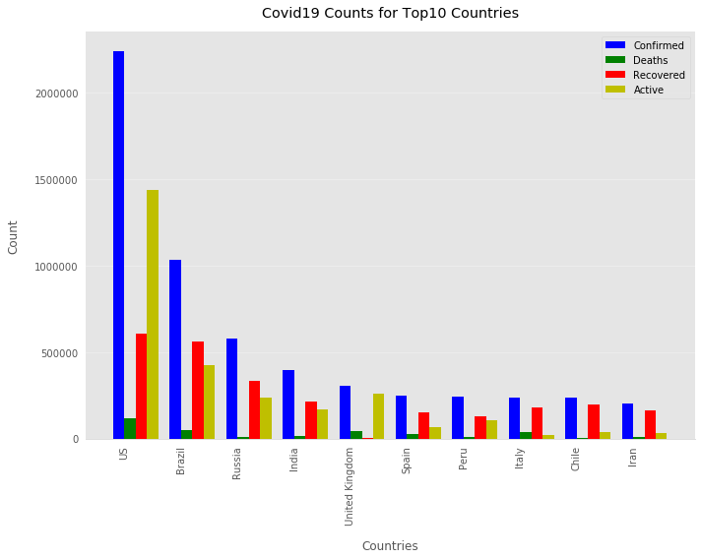
Top10 countries in terms of # of cases .
USA Stands the top country in number of Cases totaling 26% of worldwide cases.

Slide 8
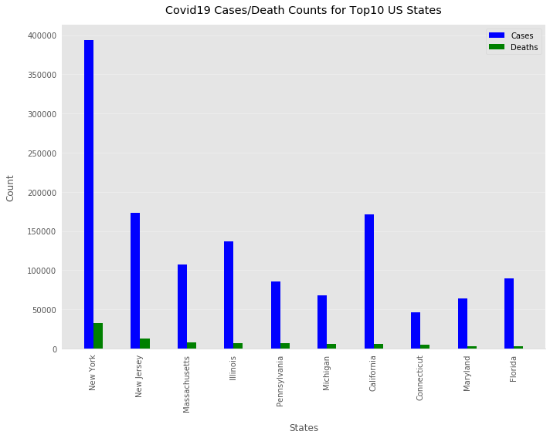
Map Displaying Covid 19 cases across US States, the cases are increasing at an alarming rate though the mortality rate is slowly reclining.

Slide 9
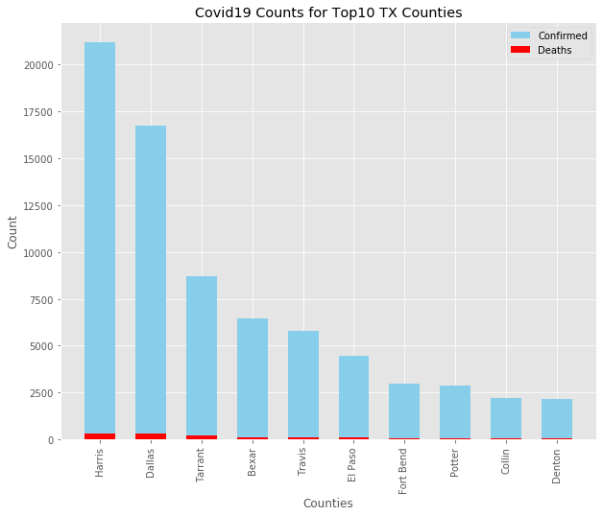
Map Displaying Texas Counties Covid 19 Cases, Dallas which was further analyzed stands second in place with over 16000 cases totalling to 320 deaths.

Slide 10
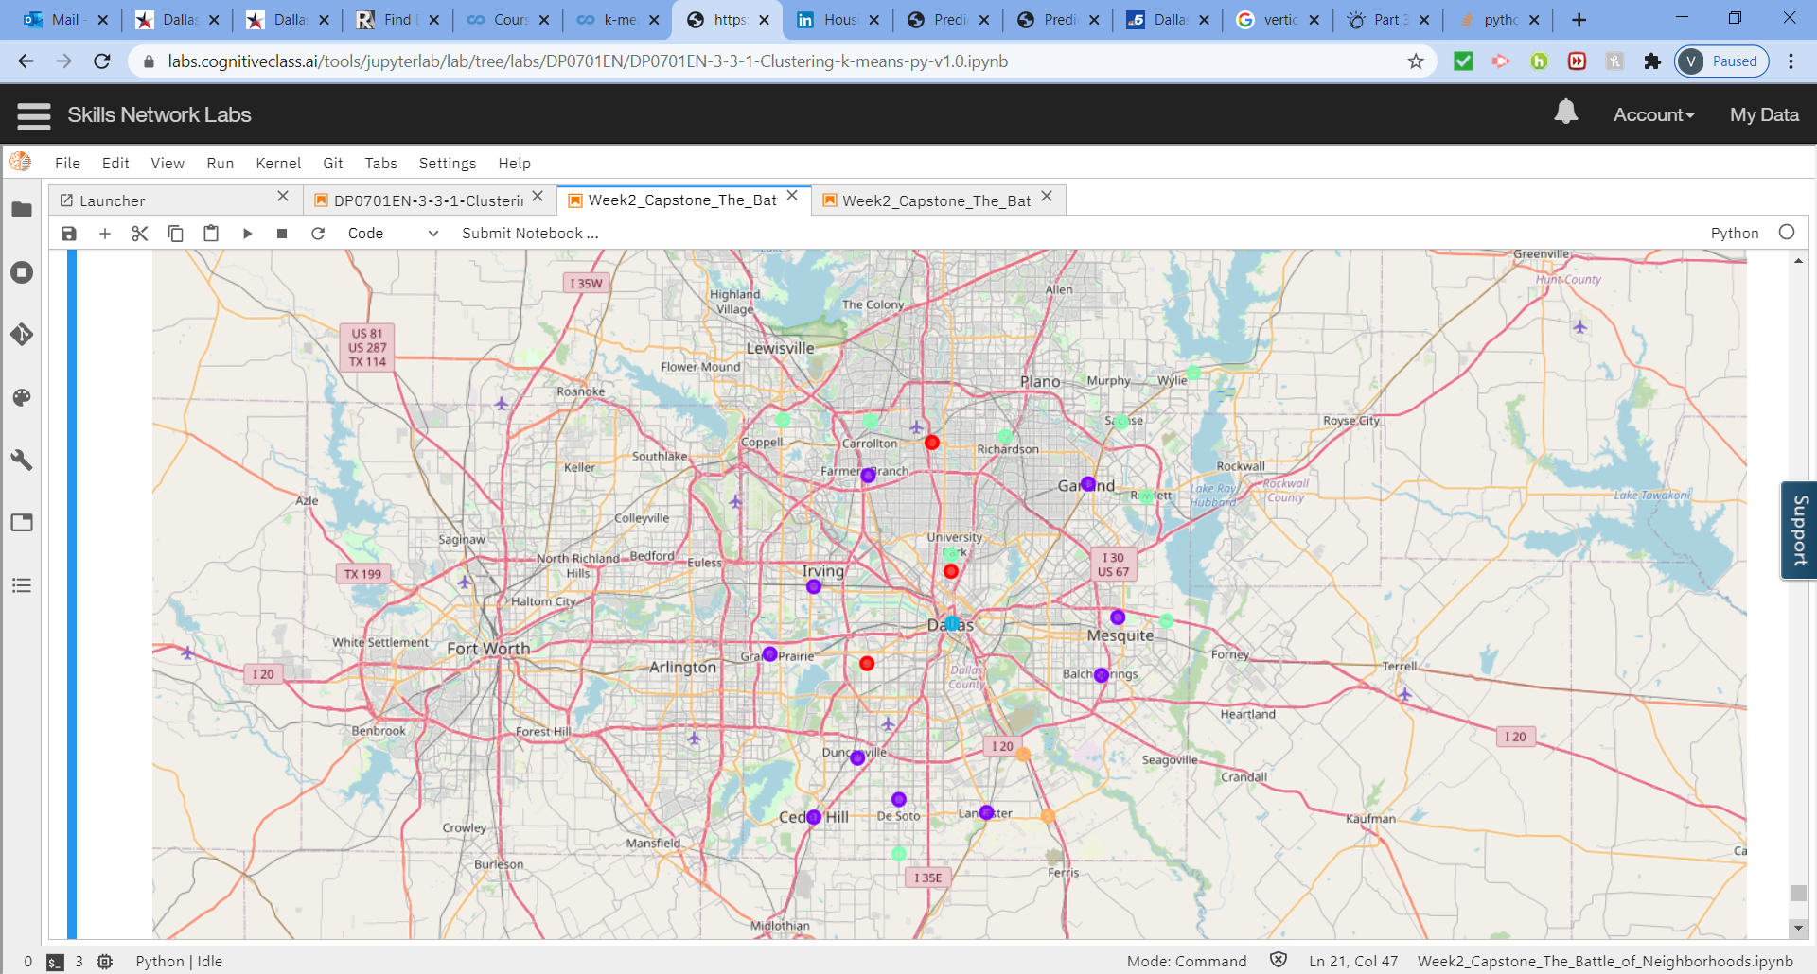
Dallas County has around 26 Cities , this map represents the clustered cities around Dallas with # of Hospitals .
Cluster1:Hospital
Cluster2:MedicalCenter
Cluster3:Hospital Ward
Cluster4: Emergency Room
Cluster5: Doctor’s Office
Calculated
Cities without hospital count: 2
Cities with hospital count: 25

Slide 11
Conclusion and future directions
Created Visualizations and graphs to visualize World, USA, TX and Dallas County Cities to give an idea of the case counts, # of deaths , # of recovered and # of Active cases.
Created Visualizations to view clustered cities of Dallas County.
Built useful models to predict the number of hospitals in Dallas County
The Analysis has lots of room for improvement and can be extended further
Project will be revisited to add more features in future.

