Slide 1
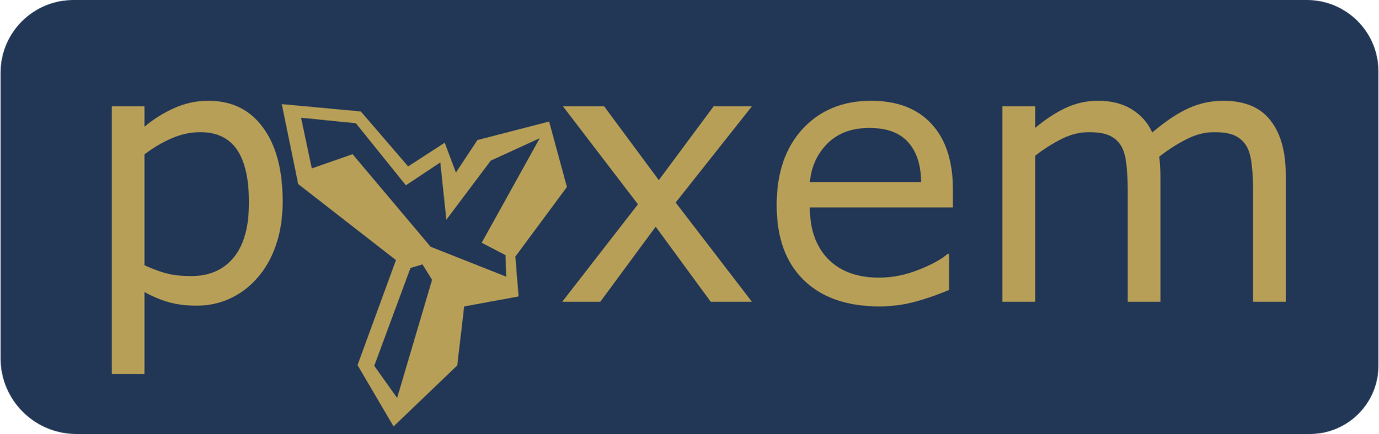
Carter Francis
Direct Electron

Slide 2
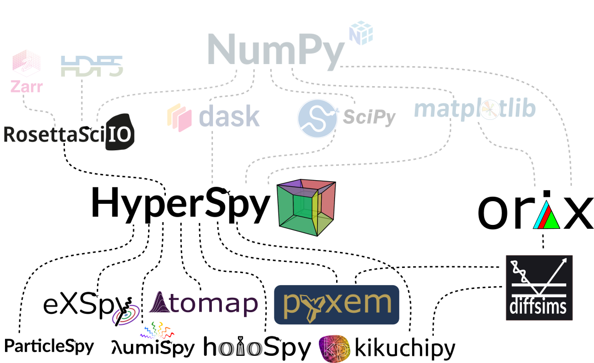
The pyxem Family Tree
cfrancis@directelectron.com| Carter Francis | 2

Slide 3
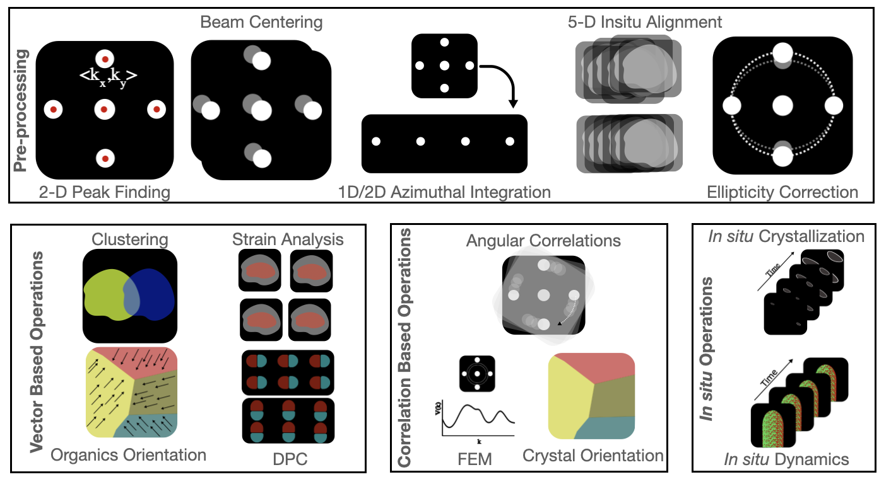
What Can pyxem Do?

Slide 4
Comparing 4D STEM Packages
 | Feature | pyxem | py4DSTEM | LiberTEM
General Information | Started | 2015 | 2018 | 2018
 | Main Developers | NTNU/UW-Madison/Cambridge | Berkeley/ Stanford | Jülich
Design Approach | Out of Memory (Lazy) | x |  | x
 | Sparse Data Support |  |  | x
 | Custom Defined Functions | xxx |  | xxx
 | Parallel Computing | x |  | x
 | GPU Support | x | xxx | x
 | Interactive Plotting | xxx |  | x
 | Live Processing |  |  | xxx
 | ND - Data | xxx
Methods | Ptychography |  | x | x
 | Iterative Ptychography |  | xxx
 | Virtual Imaging | x | x | x
 | 1D Analysis | xxx
 | Peak Finding | x | xxx | x
 | Crystal Orientation Mapping | x | x
 | Amorphous Characterization | xxx | x
 | Strain Mapping | x | x | x
 | DPC | x | x | x
 | Azimuthal Integration | xxx | x
 | Data Preprocessing | xxx | x
 | Dynamical Characterization |  | xxx
 | Vector Orientation Mapping

Slide 5
Please don’t get mad at me ☺
Key Design Differences
pyxem
Extensive visualization tools
Vector-based or frame-based tools
Chain operations together with lazy, multi-CPU, and multi-GPU.
Uses Hyperspy syntax and is thoroughly tested
py4DSTEM
Vector-based analysis
Fast development and new features/ techniques
Cutting-edge development but slightly less stable
Dynamical diffraction and nice experiment driven design
LiberTEM
Fast, optimized for real-time live analysis
Map-reduce model
Direct integration with detectors
Basic 4D STEM tools

Slide 6
Where to get help?
The first place to look is at the documentation
https://pyxem.readthedocs.io/en/stable/
I’ve spent a lot of time creating examples. They cover a wide range of topics, from conducting experiments to techniques for analyzing data to examples on creating publication-quality plots.
Feel free to also ask questions in the github discussions
That is a great way to stay involved and a public place for other people to look for answers to questions.
You can always send me an email (cfrancis@directelectron.com)

