Slide 1
Smart Automated STEM
Gerd Duscher
For MLSTEM 2024 workshop
Main developer of technique:
Austin Houston, Utkarsh Pratiush

Slide 2
Maximal Possible Information in STEM
sample
diffraction pattern
(different convergence angles or only parts),
low-loss EELS,
core-loss EELS
(several energy-windows),
EDS,
Others
(like Cathodoluminescence or secondary electrons)
For
Different volume sizes
Different angles
Ideally with knowledge of number
of incoming electrons

Slide 3
Current State of the Art
sample
diffraction pattern
(only part of pattern
- HAADF:large angles),
one STEM condition
- EDS spectrum
- EELS (high- and low-loss)
- diffraction pattern
For
one volume size
one tilt angle
small area

Slide 4
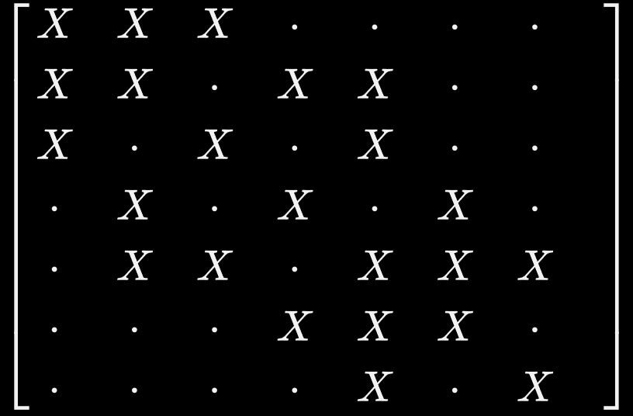
Current Data Collection Strategies
Spectrum Imaging, 4D-STEM:
Grid Scan:
Fully filled matrix
Usually: 90% of data points are unimportant
Compressed sensing (also known as compressive sensing, compressive sampling, or sparse sampling)
(more or less) random selection of points used to interpolate whole dataset.
Sparse matrix
Important parts may be missed

Slide 5
Alternative Data Collection Strategies
Select data points smartly
Use all possibilities of machine learning discussed in this workshop
And select the points of interest.
Collect data remotely
Select various of all available signals of a STEM
Avoid investment in infrastructure and instrument time to collect a lot of data that are never used.

Slide 6
Minimum Requirement for Smart Acquisition
Overview image
Drift Correction
Algorithm to select points
Complexity depends only on computing power
Ability to collect data at selected points

Slide 7
Minimum Requirement for Smart Acquisition for EELS
Get image
Shift beam
Get spectrum
Nice to have but not immediately necessary:
Drift
Set dispersion and energy offset
Get dispersion and energy offset once

Slide 8
Implementation in Digital Micrograph
Make a server software in python
Acquire digiscan image
Set beam position
Get (part) of ccd camera
This functionality is readily available in DM
Several server software packages available in python

Slide 9
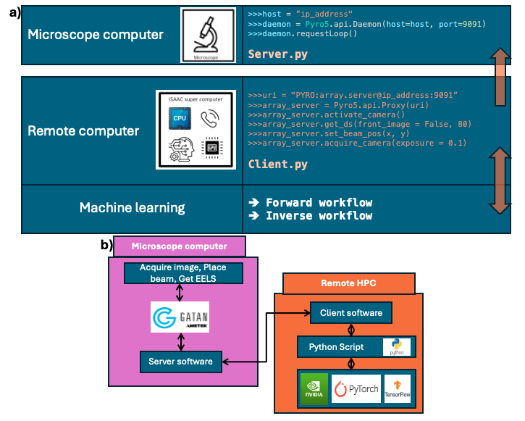
Implementation of Smart Collection

Slide 10
The client
Can be any remote computer
Can be a supercomputer to provide enough computing power for on-the-fly machine learning algorithms.
Jupyter notebook: so data are directly accessible to all python packages

Slide 11
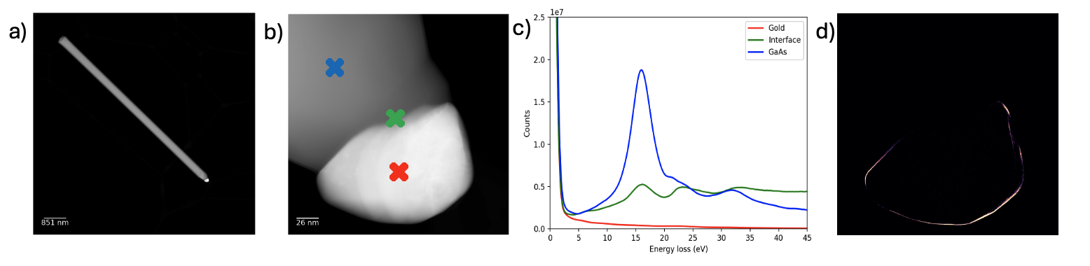
Example
Acquisition of single spectrum is 2 times slower for low loss than in spectrum image.
Acquisition of 1/10000 data points in grid scan.

Slide 12
Advantages
Truly large areas can be investigated
Mostly relevant data points chosen for acquisition
Variation of method to determine data points
Active Learning
Clustering
Edge detection
DCNN
…
Learning algorithms can be applied to increasing data volume

Slide 13
Further Development
Keep STEM at optimum condition
Change STEM optics and detectors
Get diffraction and EELS spectra from same sub pixel areas
Smart drift correction
Get metadata
Develop methods for correlated data

Slide 14
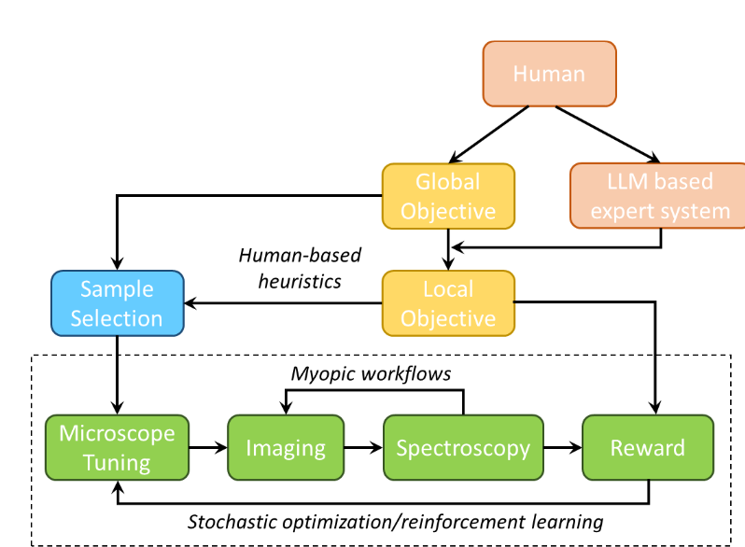
Human in the Loop Workflow

Slide 15
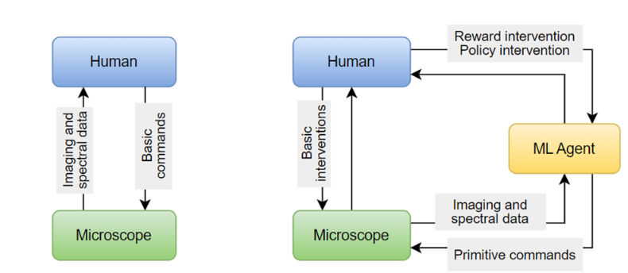
Human in the Loop Workflow

