Slide 1
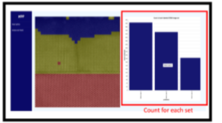

Few Shot Machine Learning for Classifying Electron Microscopy Data
Few Shot GUI – “pyCHIP”
Team members – Shweta Bhushan(MSE), Wenya Chen (CHEM E), Wenqi Cui(ECE) , Christina Doty(MSE), and Shaun Gallagher(Chemistry)
Project Mentors – Dr. Steven Spurgeon and Sarah Akers (PNNL)
Segmentation and analysis of TEM Micrographs
pyCHIP Web App

