Slide 1


EMPLOYEE MANAGEMENT SYSTEM
“

Slide 2


TEAM MEMBERS 1. Bhupathi Pravalika
2. Dhivya j
3. Patibandala GnanaPrasanthi
4. Kamana Vyshnavi
5. Shaik Khushbu Jahan
.

Slide 3


GUIDED BY
MR. BALAKRISHNA PALLA

Slide 4


PROJECT INTRODUCTION
This software application stores all the employee's information in a database. It contains employee information like employee id, name, date of joining, and basic pay.
It is an easy-to-use application and has a user-friendly interface. It is totally built at the administrative end which means that only the admin has access rights to change or modify any records. So, this makes it a safe and reliable application to use.
The main aim of developing this application was to reduce the errors that occur in the manual system. One can search the details easily by just entering an employee id. In earlier systems, there was not such a facility to do so.

Slide 5

EMPLOYEE MODULES
User Registration
User Login
Home Page
Find All Employees
Update User
Delete User
Find Employee By ID
Create New Account
Create New Employee

Slide 6

PROFILE MANAGEMENT
Login
Username/ password
login
Create new Account
Registration
1. Click Sign Up
2. User Id, First Name, last Name, email, Phone, password, confirm Password, address
3. Click submit
4. Click Login

Slide 7


Employee data ENTRY 1.User can add their new employee entries with user Id. Content will be in text format only. 2. They can anytime edit and update the existing employee data. 3. Data can be deleted by the user. 4. user can fetch particular employee details by using find employee by id. 5. User can check all employee data by using find all employee.

Slide 8
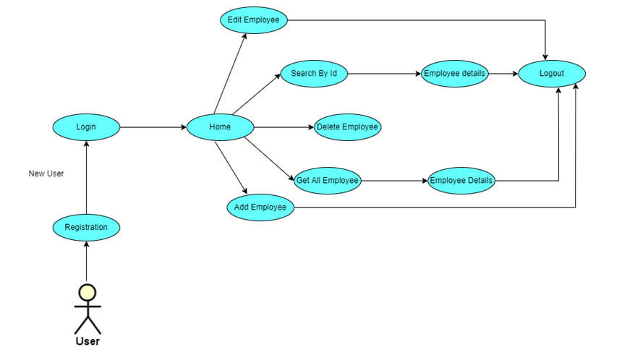
USE CASE DIAGRAM

Slide 9
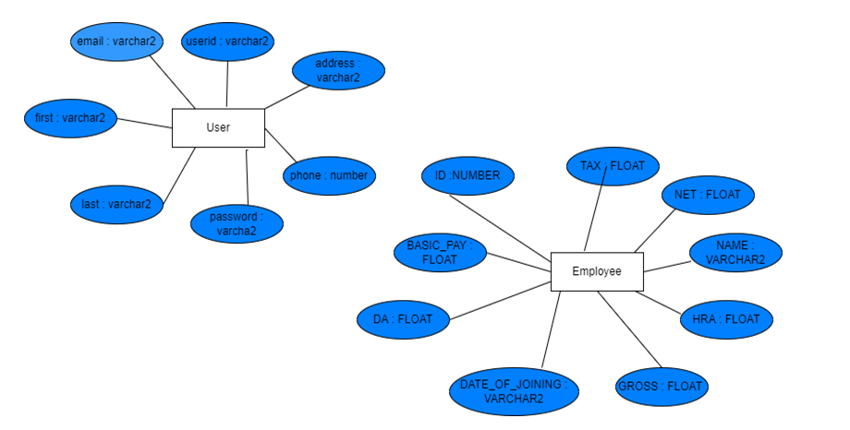
ER-DIAGRAM

Slide 10

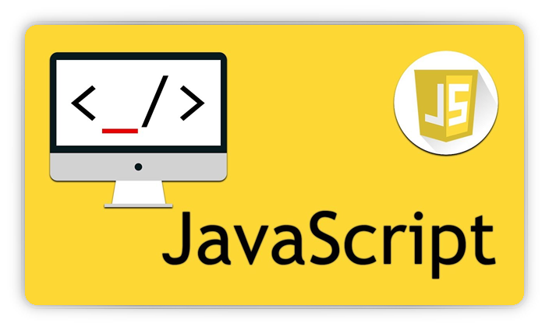





ORACLE DB
HTML CSS
JAVASCRIPT
JAVA ECLIPSE
Spring Boot
Angular 8
USED TOOLS AND TECHNOLOGY

Slide 11
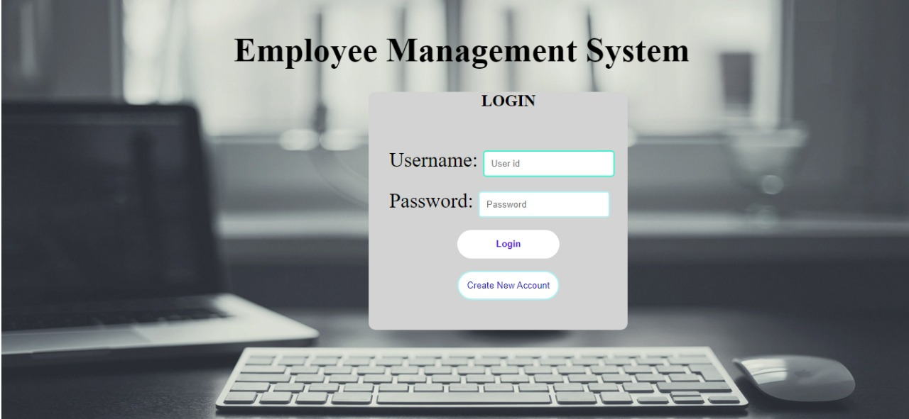
PROJECT DEMONSTRATION

Slide 12
THANKYOU

