Slide 1
ORGANIZATION OF PROGRAMMING LANGUAGES

Slide 2
HISTORY OF PROGRAMMING LANGUAGES
Evolution of Programming Languages
The Early Era (1940s–50s): * Machine Code (Binary) and Assembly.
Fortran (1957): The first high-level language (Scientific computing).
The Structured Revolution (1960s–70s): * ALGOL 60: Introduced block structure and recursion.
C (1972): Systems programming powerhouse.
The Object-Oriented Shift (1980s–90s): * C++ and Java: Focus on encapsulation and reusability.
The Modern Era (2000s–Present): * Python, Rust, Swift: Emphasis on safety, concurrency, and developer productivity.

Slide 3
HISTORY OF PROGRAMMING LANGUAGES
Analytical Machine
Definition: First concept of a general-purpose mechanical computer.
Designed by: Charles Babbage in the 1830s.
Purpose: Perform any calculation using programmable instructions.
Components:
The Store: Memory to hold numbers.
The Mill: Arithmetic operations.
Input/Output: Punch cards for input, printed output.
Significance: Foundation for modern computing.

Slide 4
HISTORY OF PROGRAMMING LANGUAGES
Ada Lovelace and the First Algorithm
Ada Lovelace: Mathematician and collaborator of Babbage.
First Algorithm: Designed to compute Bernoulli numbers on the Analytical Machine.
Key Features of Algorithm:
Sequential steps (instructions).
Loops (repeat operations).
Conditional operations (if-then logic).
Significance: Considered the first computer programmer.

Slide 5
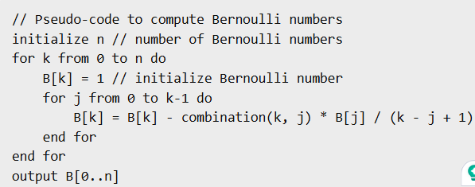
HISTORY OF PROGRAMMING LANGUAGES
Loops through Bernoulli numbers.
Applies mathematical formula using previously calculated numbers.
Mimics step-by-step execution of the Analytical Machine.

Slide 6
Programming Language Definition
A programming language is defined by two primary components:
Syntax: The formal rules governing the structure of the code (The "grammar").
Usually defined using BNF (Backus-Naur Form).
Semantics: The actual meaning or behavior of the code when executed.
Example: x = 5 is syntactically a variable assignment; semantically, it allocates memory and stores a value.

Slide 7
Data Types and Structures
Definition: A data type is a collection of values and a set of predefined operations on those values.
Why they matter: * Provide context for the compiler (memory allocation).
Enhance readability and error detection (Type checking).
Classification:
Primitive: Built-in types.
Composite/User-defined: Built from primitives (Arrays, Records).

Slide 8
Programming paradigm
Programming paradigms are different styles of programming
Each paradigm provides a unique way to solve problems
Some languages support multiple paradigms
They define how programs are structured and organized

Slide 9
Programming paradigm
Imperative Programming
Procedural Programming
Object-Oriented Programming (OOP)
Functional Programming
Declarative Programming
Logic Programming

Slide 10
Procedural Programming
A subtype of imperative programming
Organizes code into functions or procedures
Promotes code reuse
Example languages: C, Pascal

Slide 11
Object-Oriented Programming (OOP)
Based on objects and classes
Concepts: Encapsulation, Inheritance, Polymorphism, Abstraction
Helps model real-world systems
Example languages: Java, C++, C#

Slide 12
Functional Programming
Focuses on functions and mathematical operations
Avoids changing state (immutability)
No side effects
Example languages: Haskell, Lisp, Scala

Slide 13
Declarative Programming
Focuses on what to solve, not how
Describes desired results
Less control flow details
Example: SQL, HTML

Slide 14
LOGIC Programming
Based on formal logic
Uses rules and facts
Program executes queries using inference
Example language: Prolog

Slide 15
Comparison of Paradigms
Imperative → Step-by-step instructions
OOP → Object-based structure
Functional → Function-based computation
Declarative → Result-focused approach
Logic → Rule-based reasoning

Slide 16
ADVANTAGES
Better problem-solving flexibility
Improved code organization
Easier debugging and maintenance
Suitable paradigms for different problems

Slide 17
CONCLUSION
Programming paradigms shape how software is designed
No single best paradigm exists
Many modern languages are multi-paradigm
Choosing the right paradigm improves efficiency

Slide 18
Thank you

