Slide 1



CSG Dicoms Anonymizer
Stephen Larroque
Coma Science Group, GIGA research
University of Liège
07/04/2017

Slide 2
Advantages of CSG Dicoms Anonymizer
Automatically detect name and remove it from any field, even hidden ones
Uniformize names (invariant to typos & words switching)
Can anonymize demographics along (same anon ids)
Can use same demographics file for any set of dicom –> anonymization will shorten to pertinent subjects
Can continue a partial anonymization (eg, bug, access denied, …)
Deterministic anonymization → Can update anonymized demographics
Generate list of missing demographics (ie, dicom files are present but no demographics for them).
Generate a set of csv files to deanonymize. Tip: These files can be encrypted in a 7z (not zip) archive with password and sent to the collaborator, he’ll send it back if need more infos (ie, less work and files storage for us).

Slide 3
Dicoms Anonymizer – Algorithm
Generate list of patient names from dicoms (folders and zips)
Generate unique list of names (disambiguate similar names) → dicom_names.csv
Generate MD5 hash from names (with salt if provided → each lab can generate unique deterministic ids by tweaking the salt)
anonymized id = Shortened MD5 hash → idtonames.csv
If demographics: merge with dicoms names (compute distance matrix using disambiguation based on letters + words normalized levenshtein distance)
Apply anonymized id to dicoms files, folders names and demographics → anonymized dicoms & demographics
Delete non dicom files (pdf, doc, docx, txt, etc.)

Slide 4
Dicoms Anonymizer – Usage
Copy all dicom folders/zips in one folder
Get demographics file (optional)
Open csg-fileutil dicoms anonymizer (using Jupyter Notebook).
Replace parameters (dicom rootpath, demographics file path) under each Part x.
Click Kernel > Restart & Run All
→ Result: anonymized dicoms & demographics

Slide 5
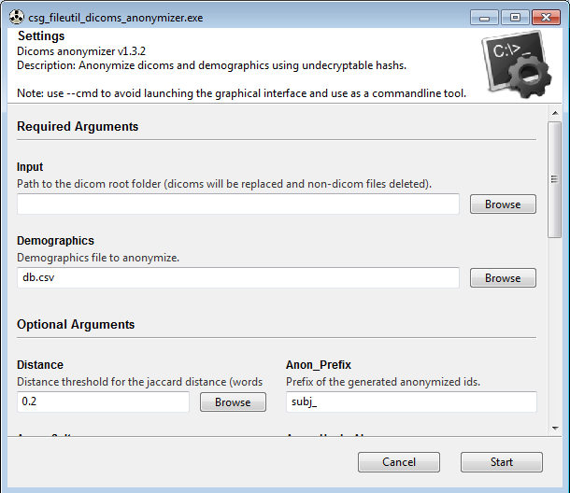
Dicoms Anonymization – GUI

Slide 6
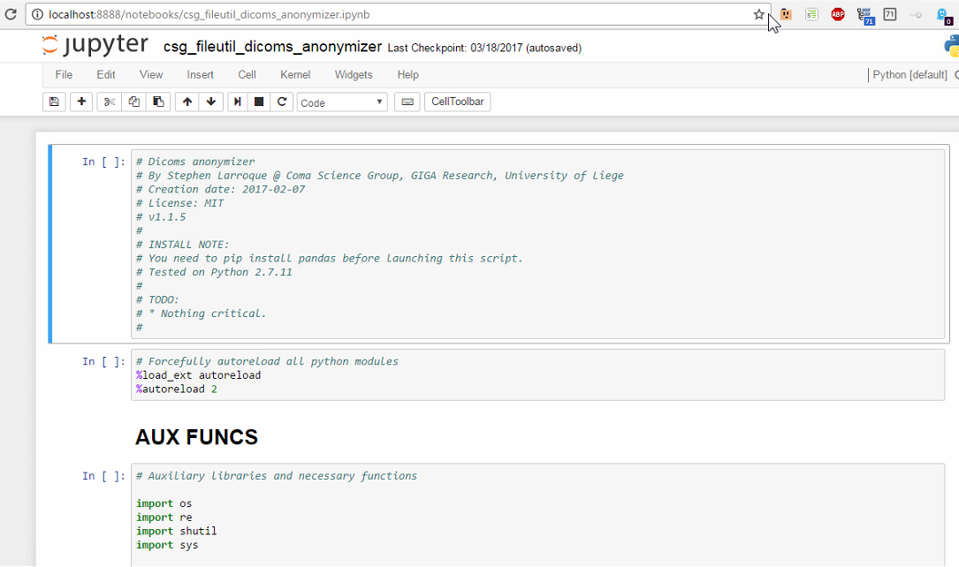
Dicoms Anonymization – Jupyter Notebook (old, please use GUI now)

Slide 7
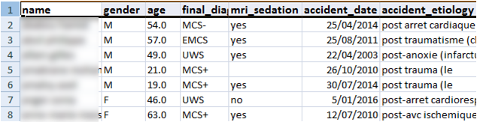
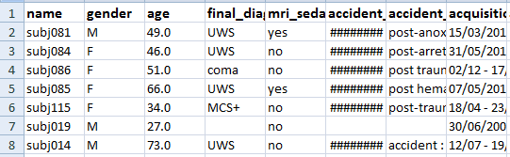
Anonymized demographics

Slide 8
Resulting files
What you can send:
Anonymized dicoms
Anonymized demographics (demographics_anonymized_shortened.csv)
Missing demographics anonymized (missing_demo_anonymized.csv)
What you need to keep (but not send):
idtoname.csv → anonymization mapping, if collaborator might need more info about 1 subject
dicom_names.csv → to regen anon (eg, to update demo)
missing_demo.csv → missing demographics
demographics_shortened.csv (optional)

Slide 9
Dicom Anonymization – Tips & tricks
Dicoms will be replaced, advised to backup (zip) before anonymization (in case something went wrong and you need to restart)
Anonymization can be continued if error or stopped (but disadvised)
Demographics automatically shortened to subjects present in dicoms → can use the same demographics for all anonymizations
Script divided in 3 independent parts: 1. extract dicom names, 2. generate anonymization mapping, 3. anonymize dicoms & demographics. → Can restart at any part (eg, to update demo)

Slide 10







Thank you for your attention

Slide 11
BONUS SLIDES

Slide 12
Dicoms Anonymizer – Old Algorithm
Generate list of patient names from dicoms (folders and zips)
Generate unique list of names (disambiguate similar names) → dicom_names.csv
Generate MD5 hash from names
Reorder names by MD5 hash
New order = anonymized id → idtonames.csv
If demographics: merge with dicoms names (compute distance matrix using disambiguation based on letters + words normalized levenshtein distance)
Apply anonymized id to dicoms files, folders names and demographics → anonymized dicoms & demographics
Delete non dicom files (pdf, doc, docx, txt, etc.)
Future: add salt for anonymized id (so that each lab can generate its own unique deterministic ids)

