Slide 1

A high-quality physics Q&A site
and open peer-review system

Slide 2
Outline
Introductory remarks
The Question&Answers section
The Reviews section
Time for discussion and questions

Slide 3
Why another physics site?
Since Theoretical Physics SE was closed, a high-level site for physics (in analogy to MathOverflow) was missing.
Other existing physics sites and fora such as - Quora: rather popular level Q&A, not only about physics - Physics Forums: content not votable, not an isolated graduate-level site - Physics SE: general physics site for all levels, intended to build up a „clean“ library for the masses of Googlers were not suitable to our needs
Journal peer-reviewing is outdated and sometimes even blatantly sucks Reviews section of PhysicsOverflow

Slide 4
The organisation of PhysicsOverflow
PhysicsOverflow
A free and non-profit discussion forum for graduate-level and above physics
Meta
Chat
High-quality Q&A
Reviews NEW !
Open problems

Slide 5
PhysicsOverflow in a nutshell
Self governement: no externally prescribed goals, rules, guidelines, etc to fullfill
Frankness: “robust” discussions allowed (we are all grown ups)
Community moderation: People who have proven themselves by earning reputation can moderate the content
Meta and Blog: to discuss about the site itself
Software: Modified Question2Answers, with a number of (self-developed) plugins installed
Support: admin@physicsoverflow.org
Detailled site description in the FAQ

Slide 6

The Q&A section
… is meant to be a nice place where the international community of physicists, advanced students and knowledgeable enough enthusiasts can enjoy doing and learning physics together.
On-topic subfields:
Theoretical physics
Phenomenology
Experimental physics
Astronomy
For physicists relevant mathematics
Applied physics
Computational physics
General physics
Community Nowiki
Off-topics:
Engineering
Below graduate-level physics
Non-mainstream physics
Copy-paste of homework
Why is bamboo poisonous to humans but not to pandas
Rhetorical/insincere questions

Slide 7
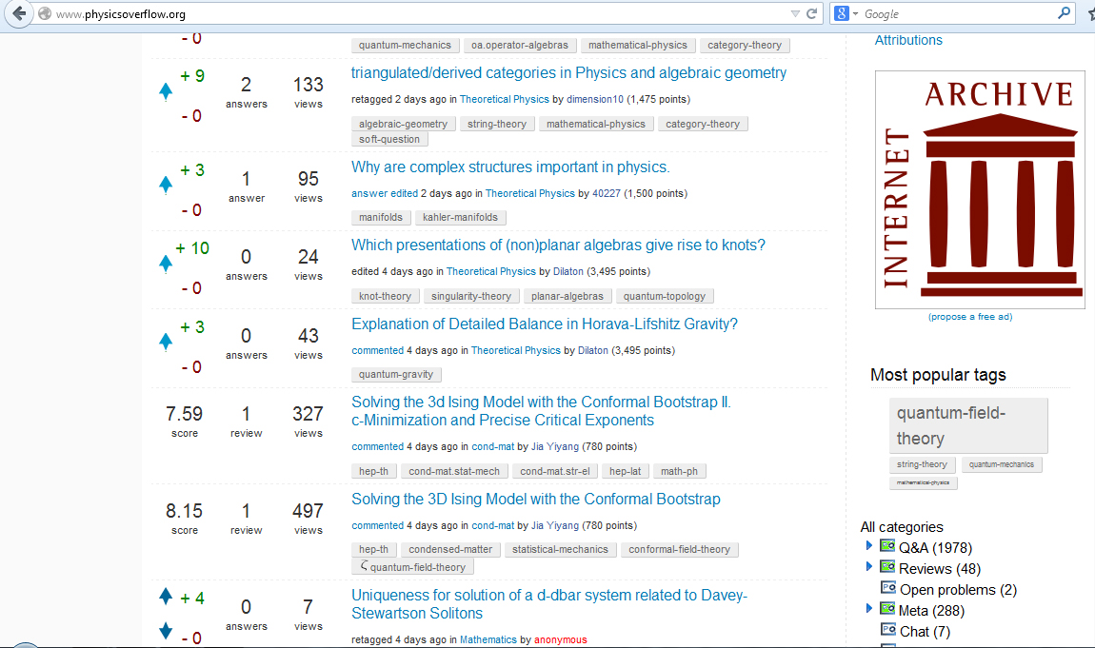
Submission

Slide 8
The Q&A section: How it works
Anyone may ask an (on topic) question
Anyone may answer, partial answers are welcome too
Further discussion may happen in votable comments
Votings: ±5 for questions, ± 10 for answers, comments rep neutral
New users can register or regain access to their account, if it is already imported from a Stack Exchange site

Slide 9
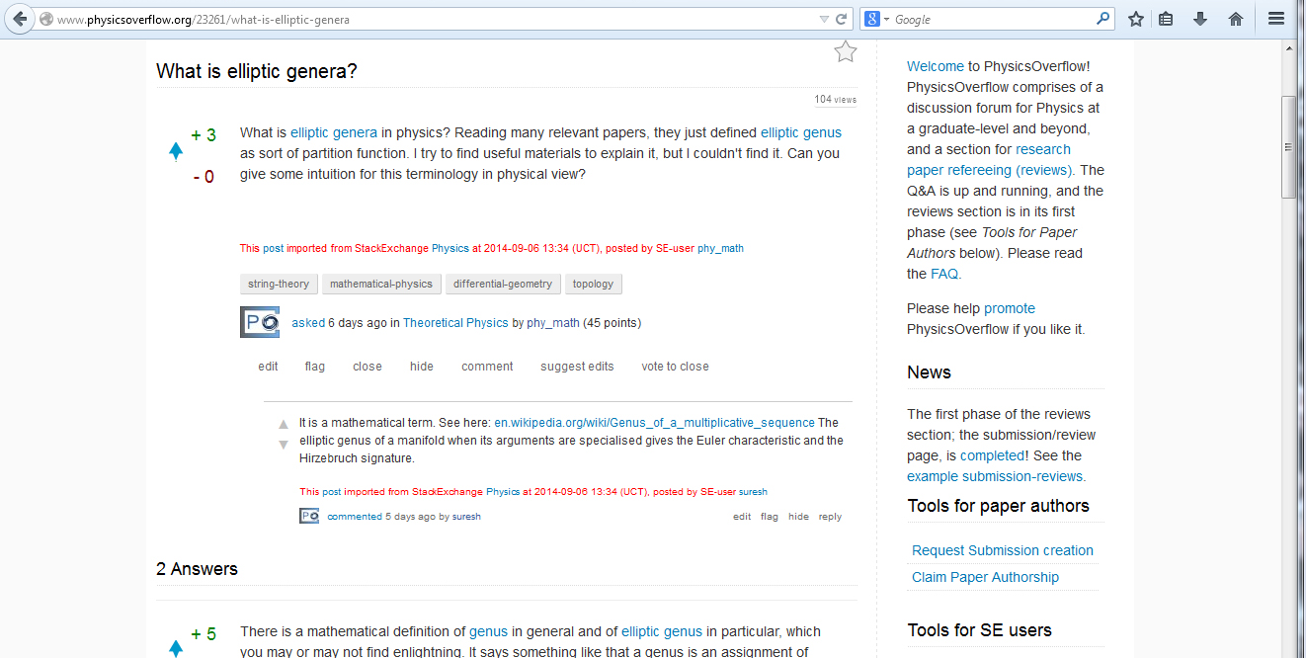
What it looks like: an example
Up- and down-
votes displayed
SE Attribution
Up and down-
votable comment

Slide 10
The reviews section
The Reviews section is intended to facilitate open and efficient public peer reviewing of papers. It is meant to nicely complement and continue what Paul Ginsparg has already achieved by launching the ArXiv.
The trouble with conventional journal peer-reviewing
Paywalls
Journal peer-reviewing is way to slow and inefficient
“Sampling effect”: Only the editor + 2-3 referees judge the paper: -> Good papers can get wrongly rejected (Higgs’s paper, string theory in the 1970 -> Nonsense gets wrongly accepted and globally hyped (!) by popular media channels today

Slide 11
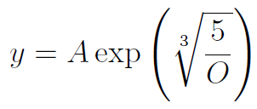
The idea of paper reviewing on PO
Anybody may submit an ArXiv paper to PO
Authors can claim authorship of their papers
The author or anybody else may summarise the paper
Anybody can vote on the originality and accuracy of the paper (from these votes a final score y is calculated)
Anybody can (partially) review the paper and further discussions can take place in comments

Slide 12
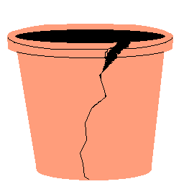
Criteria to accept a paper for reviewing on PhysicsOverflow
In principle, anybody can submit a paper to get a review and discussion, but we do not accept every nonsense …
„New Einsteins“, „Surfer-dudes“, „Biker-dudes“, etc who want to overthrow established physics have to back up their claims by solid theoretical and/or experimental arguments !

Slide 13
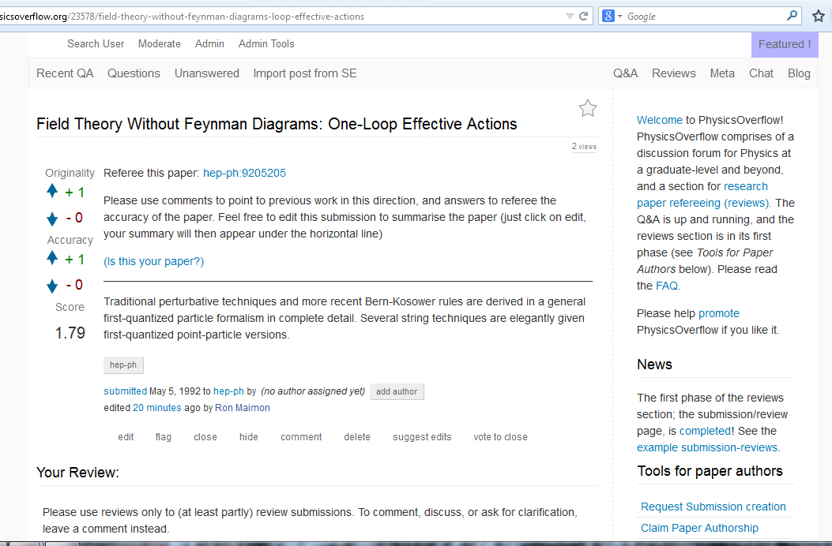
How a submission looks like
Originality
Accuracy
Total score
Add authors

Slide 14
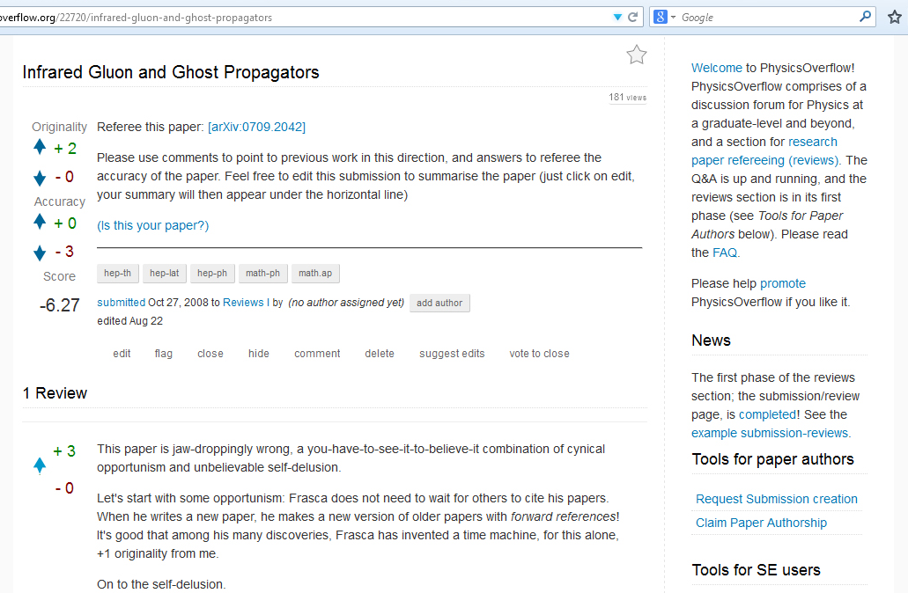
Example: a Negative Review
Paper wants to derive the form of the IR gluon propagator from a mapping between the scalar φ⁴-theory and quantum Yang-Mills
Theory
Relationship between the Lagrangian and the EOMs neglected
Idea is rather original

Slide 15
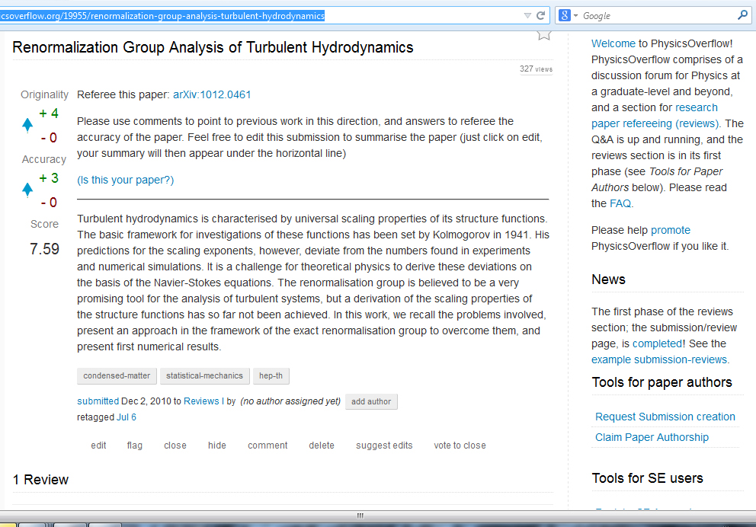
Example: a Positive Review
Paper derives methods to apply the ERG to hydrodynamic turbulence and shows numerical results for simplified test cases
This has not been done before -> original
Accurate mathematical foundation of the method -> accurate

Slide 16
Outlook
β-state -> Full site with Reviews II and beta feature-requests fullfilled
We need a second system developper!
We are are also interested in help other (in particular scientific) online communities to get started by lending our software and some (initial) support -> (technical) collaborations ? An example is the idea of a PhysicsUnderflow for up to under- grad-level physics

Slide 17
Appendix

Slide 18

Community moderation by review threads ( by Mathematics SE)
Accessible to > 500 rep users:
List in the answers things you would like to close, reopen, undelete, delete, etc
People can comment and vote on these answers
If an answer has 3 net close, reopen, undelete, delete votes, a moderator or administrator executes the corresponding action.

Slide 19
Permissions and Privileges
Everyone: ask, answer, comment, suggest edits
Registered Users: search users, view edit history of posts
Registered & Email-Confirmed: flag posts, post on user walls
15 Points: vote on comments
25 Points: vote on questions
50 Points: vote on answers
500 points: community moderation, edit directly
Experts and Editors: close, reopen, and more
Moderators: (un)block users, view voters and flaggers, ect
Administrators, Superadministrator:
System Developper: God (joking) … :-)

Slide 20
Differences between the SE and PO user interface
Hierarchical system of categories in addition to tags
Comments up- and downvotable
Positive and negative votes displayed for everybody
Magnitude of downvote rep changes same as changes by upvotes
Users who contribute negatively can have negative rep
No accepting of answers
No autodeletion of content
Practically infinite comment length
@User pings always and everywhere
Vote reversal always possible
No rep / vote caps
Real private (unmoderated, Big-Brother excluded) communication between users possible.

Slide 21
History of PhysicsOverflow?
2013 a group of people decided that a physics analogue of MathOverflow for graduate-level and above is needed
2013-09-10 Blog for systematic discussions created
2014-02-20 - Technical Private Beta of PhysicsOverflow begins
2014-04-04 - Public beta begins
2014-08-24 - The hierarchial tag system released; leading to the phase Reviews II. The PhysicsOverflow software development has now branched away significantly far from the Question2Answer software development. Currently, the PhysicsOverflow team consists of 1 great system developer and 4 moderators/administrators

Slide 22

SE company mission Academic cummunity
High-level academic community
Mission: Support the international community of professionals and students in doing and learning science
Quality of the content counts
Content useful for a closed spezialised community
Focused on the community and the high-level content
Good long-term expert users are important and highly appreciated
Attracting the exactly right audience including known „real-world“ experts is important
Self-governement of the community is of paramount importance
Stack Exchange Company
Mission: get a clean library of Q&A useful for Googlers written by volunteering contributors
Quantity and mass visibility
Content useful for for an as large as possible general audience
Only the library of Q&As useful for external Googlers counts
Each single user is equaly unimportant and exchangable
Stack Exchange does not care about who the users are
Strictly prescribed network wide rules, policies, and guidelines

Slide 23

The joys of living outside the SE network
No need to fullfill externally prescribed activity and mass visibility criteria (compare Area 51 statistics)
No externally prescribed guidelines, rules, policies, etc …
No interventions into the (daily) moderation business of the community from outer space (no external Overlords)
No rejection of useful and feasible feature requests for dubious external to the community reasons
No closing of questions for non-physics reasons and/or against the will of the community
In Summary: What the PO community likes and appreciates is a good thing and allowed!

