Slide 1


Practical work
Mapping and localization
Degree in Computer Science Education - 4th year
ROBOTICS

Slide 2
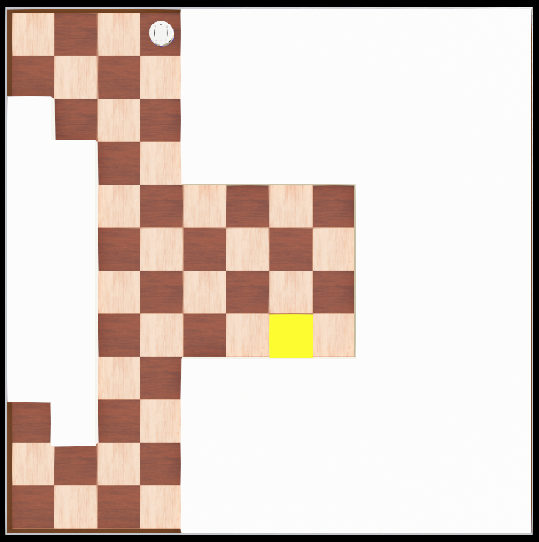
Statement
This practice will consist of the implementation of a hybrid architecture , where the robot will have reactive or deliberative behavior depending on its internal state.
The robot starts from its BASE cell (next to a wall and orientation multiple of 90º)
12 cells
Area of interest (can be detected with the camera)
12 cells
25x25 cm cells

Slide 3
Statement
The practice will be carried out only in simulation and with real robot, using the Robobo robot
Robot objective: patrol an environment following walls with odometry and return to base immediately if an event of interest is detected with the camera (in this case it will be marked with a solid yellow area).
The environment will be discrete (divided into 25x25 cm cells) and of known dimensions (12x12 cells, equivalent to 3x3 m). Therefore, obstacles will never be halfway between two cells. You can use the maze worlds available in RoboboSim
The robot's behavior should be valid for any initial position of the base as long as it is next to a wall (the robot does not know the absolute position of its base).
The execution must be carried out in 2 stages:
An initial reactive stage of exploring the environment by following walls and at the same time creating a map internal of the environment .
A second stage in which the robot takes advantage of the map of the environment it has created (along with deliberative behavior) to improve its performance:
Patrol the environment following walls (you leave the base always leaving walls on the same side).
If you detect an event of interest with the camera (yellow zone), use the internal map to immediately return to the robot station in a more efficient way ( deliberative planning of the return route ).

Slide 4
Statement
WHILE THE ROBOT DOES NOT HAVE A MAP OF THE ENVIRONMENT CREATED: a functionality will be used that allows the map to be updated while the robot explores the environment following walls. Since there are no islands in the environment, you can create a complete map by going around completely until you return to the base.
The base of the robot will be next to a wall ( the robot's starting orientation is unknown , one of north, south, east and west).
An area of interest (yellow) will always be next to a wall. While the map is being created, detecting a yellow zone does not interrupt the wall following behavior. Likewise, there could be no yellow zone at that moment without altering the behavior.
Since we have a discrete environment (divided into cells) and we need to create an occupancy map, the movement will be carried out in discrete advances and turns using odometry , so that it is known at all times in which cell the robot is.
In each cell the robot can use infrared to detect obstacles around it and update the occupancy map .
Detect area of interest (yellow) with camera: it will be considered detected only if the robot sees it from very close (approximately one or two cells away) . A basic detection can be done by the relative size of yellow pixels with respect to all pixels.
Infrared also detects yellow areas, so it is moved to the side as with any other wall.
WHEN THE ROBOT ALREADY HAS A MAP OF THE ENVIRONMENT: a path planning behavior that uses the created map will be added so that the robot efficiently returns to the base when it detects an area of interest (yellow).
What is necessary to navigate to the base will be added.

Slide 5
Statement
MAP
A binary occupancy grid will be defined (occupied cell / free cell).
The occupancy grid can be implemented as a matrix.
It will be updated based on infrared information, which will allow us to know which cells adjacent to the one occupied by the robot are free or occupied.
Tip: perform the infrared reading with the robot standing in the center of each cell (the robot has infrared around its entire body).

Slide 6
Statement
MAP
It is necessary to use odometry to be able to locate the robot on the map.
The motor encoders are used to advance cell by cell on the map and thus be able to know the discrete position coordinates in the environment.
Likewise, the motor encoders can be used to make precise turns multiples of 90º, waiting for the movement to end.
This can be done more accurately in simulation.
In a real environment it would be preferable to use the gyroscope.
Fewer errors accumulate if discrete movements are made cell by cell ( the robot advances or rotates, stops, sensors, advances or rotates again ).

Slide 7
Statement
NAVIGATION
A heuristic search method, such as A*, will be used to plan navigation back to base using the map.
If you want to use another search method, the method must be proposed to the teacher for acceptance.

Slide 8
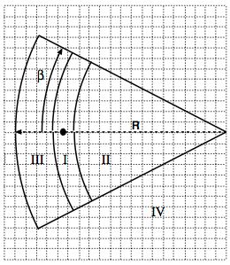


Example of creating an occupancy grid
We start from the sonar sensor model seen in theory
We use the probabilities that a grid[i][j] is Busy or Empty
Region I:
Region II:
Max occupied = 0.98

Slide 9



Example of creating an occupancy grid
Bayes rule:
Bayes rule update:

Slide 10
Example of creating an occupancy grid
Each grid[i][j] element is a P structure with two fields, representing the probability of being busy or empty:
P(Busy) and P(Empty)
It is assumed that initially each grid[i][j] has an equal probability of being busy or empty:
P(Busy) = P(Empty) = 0.5

Slide 11
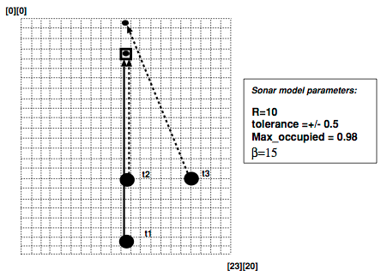
Example of creating an occupancy grid
Suppose a robot must map an unknown area
The occupancy grid is shown in the figure:
12 x 10 units
A 24 x 21 matrix is created
t1, t2 and t3 represent 3 sonar measurements for the grid element [3][10]

Slide 12
Example of creating an occupancy grid
First measurement (t1):
The robot is in grid[22][10]
Sonar measurement for grid[3][10]=9.0
r=9, α=0º
For this sensor reading, the grid[3][10] element must comply:
α<=β in absolute value, so the element is within the angular field of the sensor
r<=s+tolerance, so the element is within the upper limit of the reading range

Slide 13
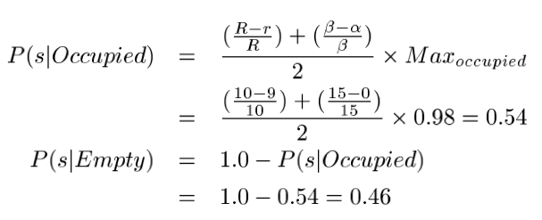
Example of creating an occupancy grid
Next you need to check in which region the measurement falls:
Region I: s-tolerance<=r<=s+tolerance
s=9.0, tolerance=0.5, r=9 so it falls in Region I
You can calculate the probability that sensor s says that grid[3][10] is Busy if there really is something at s=9.0: P(s|Busy)

Slide 14
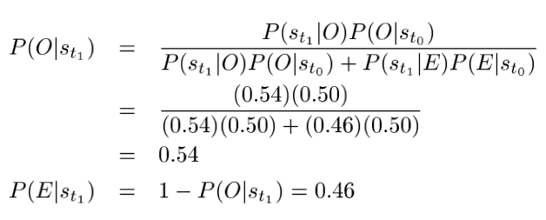
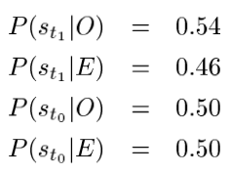
Example of creating an occupancy grid
Next, the value of grid[3][10] must be updated:

Slide 15
Example of creating an occupancy grid
Second measure (t2):
The robot is in grid[16][10]
Sonar measurement for grid[3][10]=6.0
r=6, α=0º
The measurement falls within the sonar field of action and is in Region I
P(s|Busy)=0.69, P(s|Empty)=0.31

Slide 16
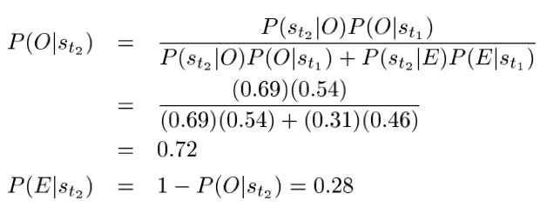
Example of creating an occupancy grid
There is an increase in the probability of occupation:

Slide 17
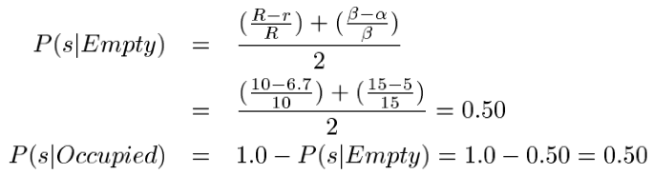
Example of creating an occupancy grid
Third measure (t3):
Sonar measurement for grid[3][10]=8.5
r=6.7, α=5º
The measurement falls within the sonar range and is in Region II

Slide 18

Example of creating an occupancy grid
Updating the odds:

Slide 19
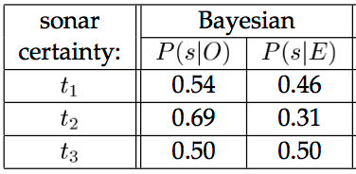
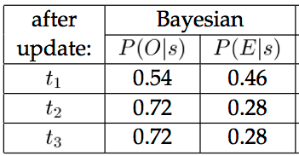
Example of creating an occupancy grid
Summarizing all the measures:

