Slide 1
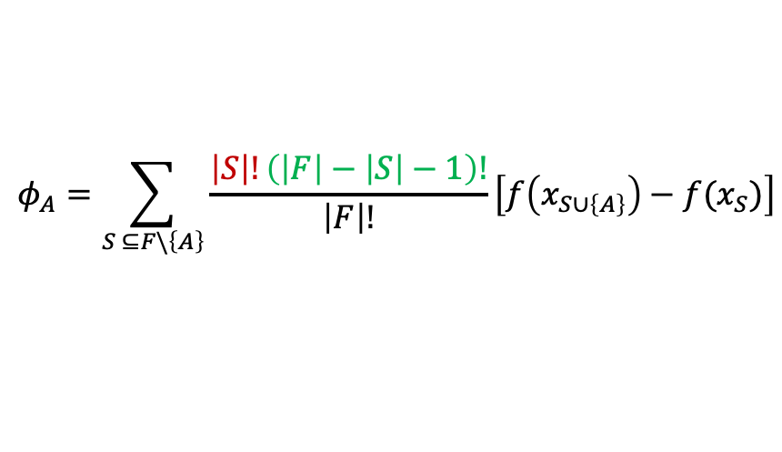
Number of
combinations
before A
Number of
combinations
after A
A’s contribution
to this
coalition
A B C
A C B
B A C
C A B
B C A
C B A
$$φ_{A}=\sum_{S ⊆F\backslash \left\{A\right\}}{\frac{\left|S\right|!\left(\left|F\right|−\left|S\right|−1\right)!}{\left|F\right|!}\left[f\left(x_{S∪\left\{A\right\}}\right)−f(x_{S})\right]}$$
Summation is
over these 4
coalition blocks
Total number of
combinations/
coalitions
Coalition’s
value before
A is added
Coalition’s
value after
A is added

