Slide 1
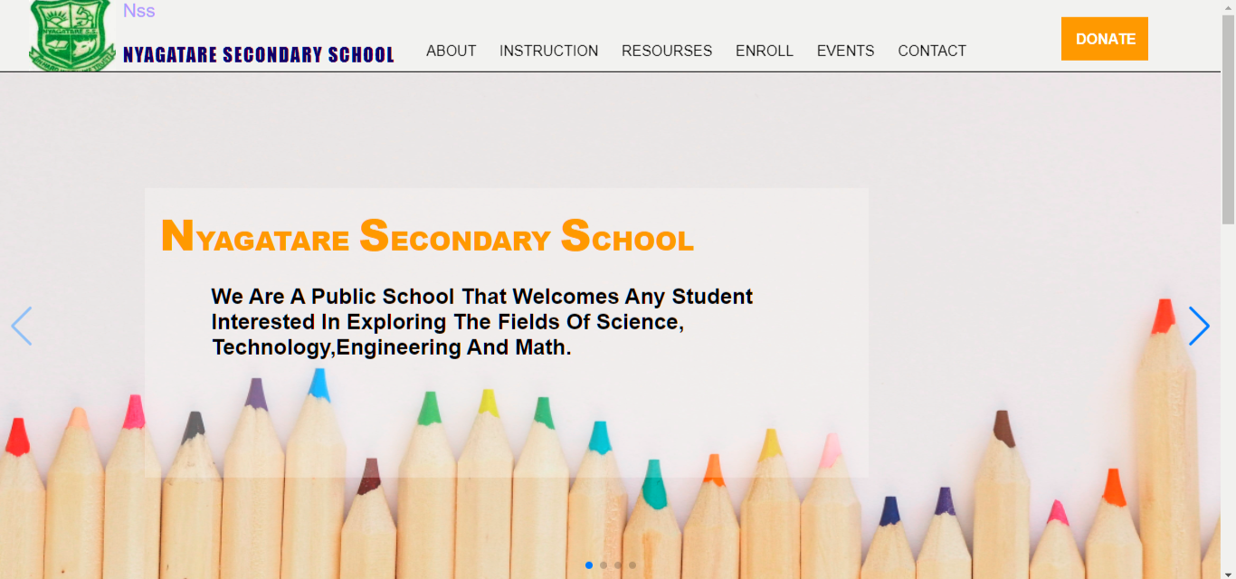

Staff onboarding deck
Nyagatare Secondary School
New Staff User Guide for the NSS Digital System and public website workflows
NSS
Prepared from a full project scan
Public pages, secure staff tools, and everyday role-based workflows
Updated March 22, 2026
No code included
Generated from live project structure and user-facing screens

Slide 2
System At A Glance
This platform combines public communication with protected school operations.
Public Website
Home page, events, blog/news, board members, enrollment, login, and donation pages.
Published content and event updates become visible here for visitors, parents, and applicants.
Secure Staff Workspace
The /system area is role-aware and only shows modules your account can access.
Typical staff modules include dashboard, applications, academics, class operations, content, users, finance, invite, and reports.
Live Records
Most modules use live Firestore data rather than static demo pages.
A change in one desk can affect dashboards, student views, applicant tracking, or public pages.
NSS New Staff User Guide
2

Slide 3
Access And First-Time Onboarding
New staff accounts are usually created through the invite workflow before normal sign-in begins.
1. Receive An Invite
A leadership user creates a one-time invite and chooses your role.
That invite carries the access level you will start with.
2. Create Your Account
Open the invite link, confirm your full name, and create your password.
A valid invite moves you directly into the NSS system after account creation.
3. Sign In Later
Go to the Login page, choose Staff, and enter your school email and password.
Applicants, students, parents, and staff each have separate tabs on the same login screen.
4. Protect Your Access
Do not share passwords or leave the system open on shared computers.
Use My Profile for password changes and sign out from the top bar when finished.
NSS New Staff User Guide
3

Slide 4
Role-Based Access Model
Menus change according to role, so two staff users may not see the same pages.
Leadership Roles
SuperAdmin and Headmaster have the broadest school-wide visibility.
They can oversee users, roles, reports, admissions, finance, discipline, academics, and publishing.
Academic Leadership
DOS, HOD, and DOD focus on academic coordination, class movement, marks visibility, and discipline or content tasks based on role.
They often bridge leadership reporting with classroom activity.
Operational Specialists
Admissions Officer, Bursar, and Content Manager have narrower but important workspaces.
Their access is centered on admissions, finance, or public communication duties.
Teaching And Family Accounts
Teachers mainly work with marks, learning resources, chats, and assigned classes.
Students and parents mostly view academic information rather than manage school records.
NSS New Staff User Guide
4

Slide 5
Daily Navigation And Account Management
Most staff users begin their day from the dashboard and move into their assigned workspaces.
Dashboard Home
The System Home page is role-aware and shows quick actions, alerts, recent activity, and role-relevant statistics.
Use it as the safest place to understand what needs attention first.
My Profile
Update your own full name, department, and password here.
Role and sign-in email stay protected from normal self-service editing.
Users And Roles
Leadership users can search access profiles, inspect role, department, and status, then update or remove non-protected records.
The Roles page shows each role and the permissions attached to it.
Invite Workspace
Authorized users can create one-time invite links, resend invitation emails, change pending invite roles, or regenerate links.
Expired or incorrect invites are handled here instead of creating duplicate accounts.
NSS New Staff User Guide
5

Slide 6
Admissions And Applicant Journey
Public applications and internal admissions review are tightly connected.
Application Intake
Staff can open or close public applications from the Admissions Workspace.
When intake is closed, the enrollment form stops accepting new submissions.
Review Queue
Search by applicant name or application ID and filter by status.
Each record shows applicant details, guardian details, previous school, score, and report links when provided.
Decision Handling
Application statuses include Pending, Review, Admitted, Rejected, and Waitlist.
Staff can save admissions notes, applicant communication notes, and final decision notes.
Applicant Visibility
Applicants can track their status in the Applicant Portal using an application ID.
Decision notes and invite-based applicant account setup can flow back to the applicant side.
NSS New Staff User Guide
6

Slide 7
Class Operations
This desk handles structural class setup before daily teaching begins.
Create Classes
Create a class with name, department, head teacher, subject, academic year, term, and optional student leader.
This is the foundation for later marks, resources, and class communication.
Deploy Teachers
Assign a teacher to a class and subject, then decide whether that assignment allows student invites, parent invites, or class-change action.
Existing assignments can be edited instead of recreated.
Place Or Move Students
Learners can be assigned into a class or moved between classes from one form.
Movement is logged so class changes remain auditable.
Leadership Board
Each class page shows subject coverage, class teacher status, student roster, discipline watch, missing setup items, movement history, and recent actions.
Use this board before making major class decisions.
NSS New Staff User Guide
7

Slide 8
Academics And Student Support
The Academics workspace connects classroom delivery, marks, messaging, and support visibility.
Learning Resources
Teachers and authorized leaders can publish assignments, exercises, holiday packages, notes, and materials by class and subject.
Resources can include due dates and attachment links.
Marks And Comments
Marks are entered by class, student, subject, term, and academic year.
Existing mark records update automatically, and teacher comments can be saved with the mark.
Chats And Follow-Up
Class Conversations include shared class chats and private subject threads.
Students can respond to marks and message subject teachers for follow-up.
What Students See
The Student Dashboard shows class membership, average mark, learning queue, resources, marks, teacher messaging, and discipline notes.
Staff should know this view so communication matches what learners can already see.
NSS New Staff User Guide
8

Slide 9
Content And Public Communication
Publishing work in the Content desk directly shapes what the public sees on the website.
Stories And Announcements
Create, search, filter, publish, edit, or delete news, blog posts, and announcements.
Statuses move through Draft, Review, and Published.
Event Operations
Maintain the live school calendar with title, date, category, status, location, and event description.
Published updates appear on the public Events page.
Board Members
Add or update governance profiles for teacher, leader, and parent board categories.
This information powers the public Board Members page.
Subscribers
Newsletter audiences are collected from the homepage footer and Events page.
Staff can search the list and export subscriber data as CSV when needed.
NSS New Staff User Guide
9

Slide 10
Leadership Operations And Monitoring
Several modules support school-wide oversight beyond day-to-day classroom work.
Control Center
Leadership can review and edit applications, events, donations, and subscriber records from one central page.
Use it for quick whole-school updates when you do not need to enter each separate desk.
Finance
Bursar-focused views track donations, payment status, donor details, references, payment links, and finance health snapshots.
Donation exports are available for reporting and reconciliation.
Discipline
Authorized users monitor discipline cases, severity, ownership, and follow-up status.
Class operations and student support views also surface discipline context where relevant.
AI Hub
Admin users can send operational prompts to the AI Hub for summaries and analytics guidance.
Non-admin users can still view insight cards even when prompt entry is disabled.
NSS New Staff User Guide
10

Slide 11
Public Pages Every Staff Member Should Know
Even internal users should understand the main public journeys because staff work changes these experiences.
Homepage And Login
The public site introduces the school and links visitors into events, enrollment, donations, and secure login.
The Login page separates Applicant, Student, Parent, and Staff entry points.
Enrollment And Applicant Portal
The Enrollment page collects public applications while applications are open.
The Applicant Portal lets applicants track status, decision progress, and application details.
Events And Newsroom
The Events page displays event details and accepts newsletter subscriptions.
The Blog page presents published news, blog posts, and announcements in a searchable newsroom format.
Donations And Governance
Public donations feed finance records that staff later monitor and verify.
The Board Members page presents governance profiles that staff maintain in the Content workspace.
NSS New Staff User Guide
11

Slide 12
First-Week Checklist And Common Issues
Use this checklist to help new staff settle in without changing the wrong records.
Before Day 1
Confirm that your invite email, role, and department are correct.
Know which main workspace you are expected to use: admissions, academics, content, finance, or leadership oversight.
During First Login
Open My Profile, set your preferred name and password, and review your visible menu items.
Visit the dashboard first before editing live records.
If Data Looks Missing
Missing menu items usually mean your role does not include that permission.
Missing student or class data often means the account email, access profile, or class assignment has not been linked yet.
When To Escalate
Ask leadership before changing roles, deleting records, publishing public content, or correcting finance data.
Expired invites, protected accounts, and permission problems should be handled by authorized leadership users.
NSS New Staff User Guide
12

