Slide 1
Compliance as Code using Inpsec
Presented by Joshua Jebaraj

Slide 2
Who Am I
Joshua Jebaraj
Undergrad Student
Intersted in Web,Android Security and DevSecOps

Slide 3
Problem With the Traditional Compliance

Slide 4

Meet Mr John

Slide 5
Developer
Operations

Slide 6
DevOps
Developer
Operation

Slide 7


Slide 8
Security Compliance
Developer
Source : Practical-DevSecops

Slide 9
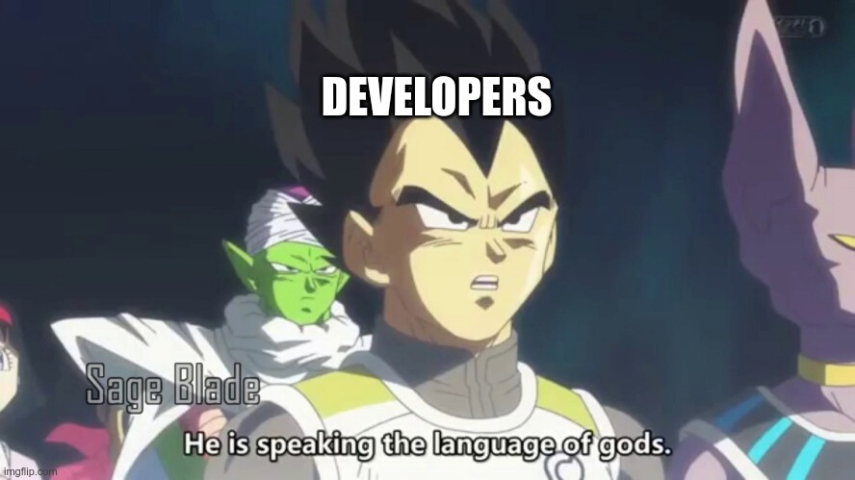

Slide 10
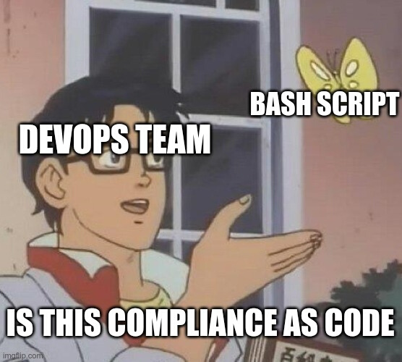

Slide 11
Compliance as Code

Slide 12
Inspec
Inspec open source tool for test for Security and Compliance
Source : https://www.slideshare.net/lnxchk/inspec-june-2018-at-open28be

Slide 13
Why Inspec
Human Readable Language
Easy to integrate into existing workspace
Supports Different Targets
No Dependency

Slide 14
What Inspec Can Do
Speed up Deployement
Reduce the workload
Helps to convert the existing compliance to code
Respect from the Developer Team

Slide 15
What Inspec Cannot Do
Makes you 100% compliant
Makes you 100% secure
Cannot make changes to the system

Slide 16
Workshop Link
https://chef-workshop-oss.netlify.app/

Slide 17
Thanks To
Dinis
Didar
Mario
Josh Moulder
Petera
and all Participants

