Slide 1
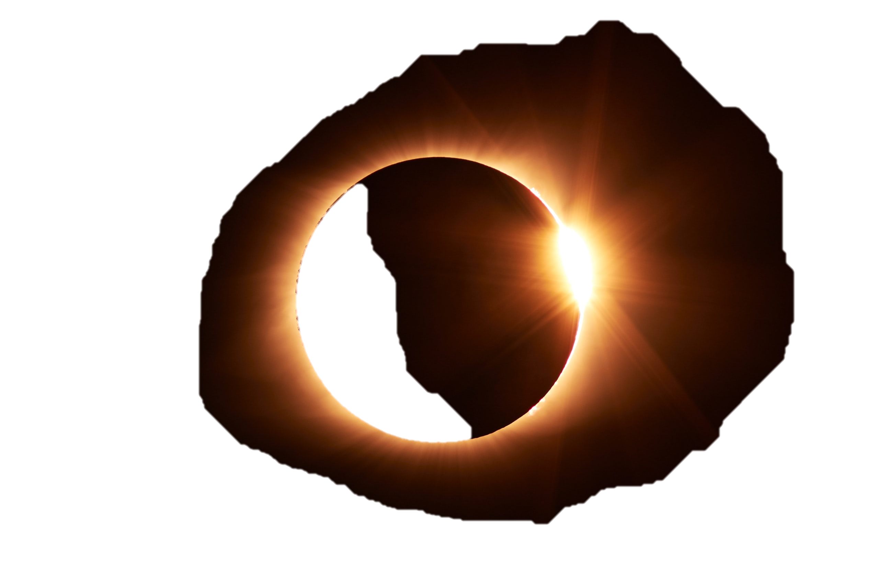
the noise and the noise and the noise and the noise and the noise and the noise and the noise and the noise and the noise and the noise and the noise and the noise and the noise and the signal the noise and the noise and the noise and the noise and the noise and the noise and the noise and the noise and the noise and the noise and the noise and the noise and the noise and the signal and the noise and the noise and the noise and the noise and the noise and the noise and the noise and the noise and the noise and the noise and the noise and the noise and the noise and the noise and the noise and the noise and the noise and the noise and the noise and the noise and the noise and the noise and the noise and the noise and the noise and the noise and the noise and the noise and the noise and the noise and the noise and the noise and the noise and the signal and the noise and the noise and the noise and the noise and the noise and the noise and the noise and the noise and the noise and the noise and the noise and the noise and the noise and the noise and the noise and the noise and the noise and the noise and the noise and the noise and the noise and the noise and the noise and the noise the signal and the noise and the noise and the noise and the noise and the noise and the noise and the noise and the noise and the noise and the noise and the noise and the noise and the noise and the noise and the noise and the noise and the noise and the noise and the noise and the noise and the noise and the noise and the noise and the noise and the noise and the noise and the noise and the noise and the noise
Practical Data science And Data Engineering Vol. 1
Gimpei Kobayashi
Notes:
FROM https://unsplash.com/photos/F-pSZO_jeE8

Slide 2
the noise and the noise and the noise and the noise and the noise and the noise and the noise and the noise and the noise and the noise and the noise and the noise and the noise and the signal the noise and the noise and the noise and the noise and the noise and the noise and the noise and the noise and the noise and the noise and the noise and the noise and the noise and the signal and the noise and the noise and the noise and the noise and the noise and the noise and the noise and the noise and the noise and the noise and the noise and the noise and the noise and the noise and the noise and the noise and the noise and the noise and the noise and the noise and the noise and the noise and the noise and the noise and the noise and the noise and the noise and the noise and the noise and the noise and the noise and the noise and the noise and the signal and the noise and the noise and the noise and the noise and the noise and the noise and the noise and the noise and the noise and the noise and the noise and the noise and the noise and the noise and the noise and the noise and the noise and the noise and the noise and the noise and the noise and the noise and the noise and the noise the signal and the noise and the noise and the noise and the noise and the noise and the noise and the noise and the noise and the noise and the noise and the noise and the noise and the noise and the noise and the noise and the noise and the noise and the noise and the noise and the noise and the noise and the noise and the noise and the noise and the noise and the noise and the noise and the noise and the noise
the noise and the noise and the noise and the noise and the noise and the noise and the noise and the noise and the noise and the noise and the noise and the noise and the noise and the signal the noise and the noise and the noise and the noise and the noise and the noise and the noise and the noise and the noise and the noise and the noise and the noise and the noise and the signal and the noise and the noise and the noise and the noise and the noise and the noise and the noise and the noise and the noise and the noise and the noise and the noise and the noise and the noise and the noise and the noise and the noise and the noise and the noise and the noise and the noise and the noise and the noise and the noise and the noise and the noise and the noise and the noise and the noise and the noise and the noise and the noise and the noise and the signal and the noise and the noise and the noise and the noise and the noise and the noise and the noise and the noise and the noise and the noise and the noise and the noise and the noise and the noise and the noise and the noise and the noise and the noise and the noise and the noise and the noise and the noise and the noise and the noise the signal and the noise and the noise and the noise and the noise and the noise and the noise and the noise and the noise and the noise and the noise and the noise and the noise and the noise and the noise and the noise and the noise and the noise and the noise and the noise and the noise and the noise and the noise and the noise and the noise and the noise and the noise and the noise and the noise and the noise

