Slide 1
KijaniKiosk Capstone Project
Staging, an approval gate, and a serverless chain that actually fires. Track A, built and broken and fixed over one session.
Giovanni Bwayo
August 14, 2026

Slide 2
The problem
kk-payments runs in exactly one place: kijani-project, on local Minikube. There's no staging, so an engineer testing a change is testing it directly against the environment customers would hit. Nothing stops a bad change from landing there either, since there's no approval step of any kind.
1
production namespace
0
staging environments
Same gap Nia called out in the Week 9 readiness review. No isolated place to validate a change before it ships, and nothing automated to stop one that shouldn't.
0
approval gates, before this build
2

Slide 3
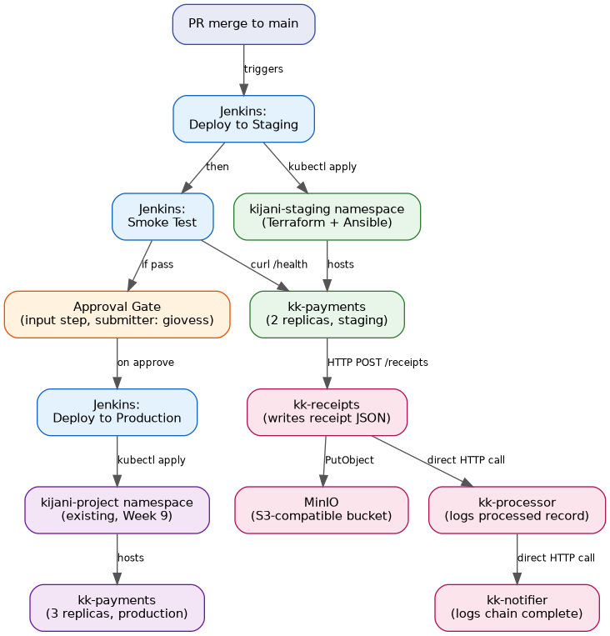
How it fits together
Every connection here has been run at least once and its logs checked, not just assumed.
3

Slide 4
The decision I kept coming back to
Skip MinIO's event webhook. Chain the three functions with plain HTTP calls instead.
Why not the webhook
Why the swap was fine
What production would need
I got mc admin config set to report success on enable=on, but the setting never actually stuck on the named target. Tried it three times.
Traced it to a config-persistence bug in this MinIO build, not a network or auth problem. The endpoint itself connected fine.
Direct HTTP needs zero MinIO configuration and behaves the same everywhere.
It's also the pattern the coursework already point to for local serverless work, no cloud account required, which is the policy I've followed since Week 4 anyway.
A queue between the functions, something SQS-shaped.
Right now, if kk-processor is down when kk-receipts calls it, that call just fails. No retry, no record of it happening.
4

Slide 5
Where AI actually helped, and where it didn't
Full write-up in docs/ai-governance-log.md. Two entries below.
Entry 1: the MinIO webhook rabbit hole
Got right: It caught two real bugs along the way. serverless-offline was only listening on 127.0.0.1, invisible to the container, and the runtime string said Node 18 when the box is running 22.
Got wrong: It assumed enable=on would stick the same way endpoint did. That assumption cost a few rounds of debugging before I recognized it as a persistence bug in MinIO itself and just switched approaches.
Entry 2: running the governance checklist on terraform/main.tf
Got right: Naming, tagging, and the no-hardcoded-secrets check all came back accurate, with specifics I could verify.
Got wrong: First pass marked least privilege as not applicable, reasoning that there's no IAM block in the file. That misses the point. The kubeconfig doing the applying has full cluster-admin rights. I corrected it to an actual gap.
5

Slide 6
What's not production-ready yet
Jenkins can talk to the cluster, but only because I copied a kubeconfig in by hand
Gap. That kubeconfig goes stale the moment anyone runs minikube delete && start, since the cluster certs rotate.
Fix. A Kubernetes ServiceAccount token, or a real CI credential-injection step. Not a copied admin config sitting in a container.
Terraform state lives on one machine
Gap. Found this the hard way during self-review: clone the repo a second time and apply against the same cluster, and Terraform has no idea the namespace already exists. It tries to create it again and fails.
Fix. A shared remote backend, MinIO's S3-compatible storage would do it, same pattern used back in Week 4 IaC.
The three serverless functions call each other directly, no safety net
Gap. kk-receipts, kk-processor, and kk-notifier are chained with plain HTTP. If one is down when the next one calls it, that call is just gone.
Fix. Put a queue or broker between them so a downstream outage doesn't silently drop work.
6

Slide 7
Testing it myself, since no one else was free
No peer had time in the window, so I cloned the repo fresh and worked through it as if I'd never seen it. Found three real problems, fixed one and closed it through a GitHub Issue.
1
A second clone collides with the first over Terraform state
logged as an accepted limitation
blocks setup
2
Nothing in setup ever creates the MinIO receipts bucket
fixed, README updated
blocks functionality
3
serverless-offline never gets installed if you follow the README as written
fixed, closes Issue #1
blocks functionality
7

