Slide 1
Android Application Development
Week 1: Planning and Basics.

Slide 2
Who is this guy?
Has developed 4 paid android apps. (and 1 IOS app)
General software engineering nerd.

Slide 3
Pre-requirements
You need to know how to code.
Some appreciation for Inheritance/Object-orientation

Slide 4
Where do I start?
Business need
Idea
Mock-up
Prototype
Application. (Agile)

Slide 5
That’s great for a business student, but I want to actually make an app.

Slide 6
So then what do I do?
Learn the framework.
Identify useful components and good ways of using them. (Patterns)
Then you can bring up your idea.
Build your idea out of these components.
Why?

Slide 7
So what are we actually doing today:
Identifying basic android building blocks.
Intents
Activities
Views
Understanding the underlying systems of Android
MVC
View Trees
Appreciating android design decisions.
Action Bar, navigation Drawer, etc.

Slide 8
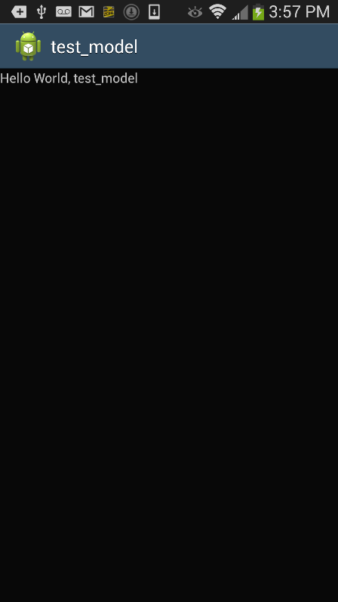
What is an Activity
A single, focused thing that the user can do. Usually full-screen.
Similar to a “Window” on a desktop.
Holds its own operating content.
Has a single View (or ViewGroup) as its content.

Slide 9
What is a View?

Slide 10
Everything you can see!
Everything you can view(hehe)

Slide 11
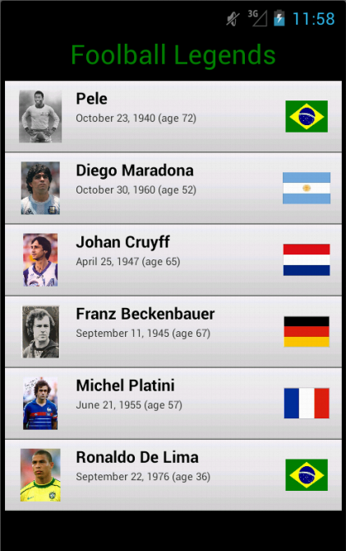
Seriously: What is a view?
A view:
A single unit of content or user engagement
E.g. A textbox, an imageView
A viewgroup:
A view that contains another view.

Slide 12
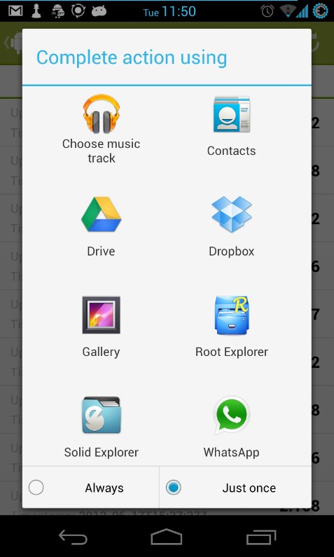
What is an intent?
It’s the way that the OS calls an activity to action.
Sometimes it includes additional information.
An intent is launched when you click an app icon

Slide 13
Well, let’s get to it. Let’s make an app.

