Slide 1

PostGIS Raster
Notes:
Click to add notes

Slide 2
Why do I need PostGIS raster ???????
Web data
WKT
XML
  KML
  GML
JSON
  GeoJson
Read and write using OGR

Slide 3
Initial remarks
- One DB for multiple users!!
- Raster type is different from geometry type!
  - The two types can work together.
- More than 140 raster functions and growing! → https://postgis.net/docs/RT_reference.html
  - ST_Clip
  - ST_Slope
  - ST_Reclass
  - ST_MapAlgebra → A super powerful tool!!
- Supports rasters in-database and out-of-db.
  - In out-of-db mode, raster's will be accessed by postgresql in read only mode!
- raster2pgsql is the way to load an existing raster into a db.
- Gdal supports reading postgis rasters and therefore can be used to export and access postgis rasters from outside.

Slide 4
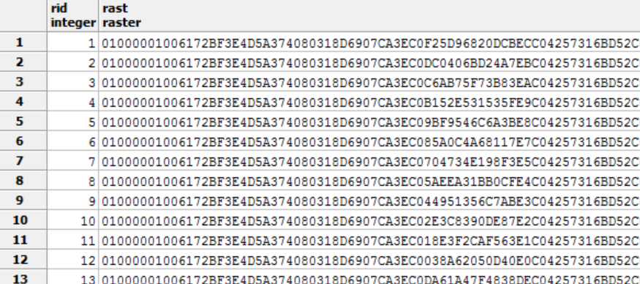
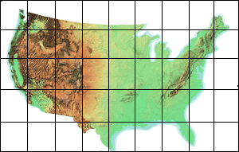
PostGIS raster tiles
- Tiles are not mandatory but most of the time they are recommended.
  - Depends on the raster size and database structure.
- We are going to use tiles.
- In PostGIS raster each record represents one tile.

Slide 5
Importing rasters
Raster2pgsql
http://postgis.refractions.net/docs/using_raster.xml.html#RT_Raster_Loader
- s : SRID
- t : tile size
-d : drop table, create new one and populate it with raster(s)
- R : Register raster outside BD (filesystem)
- N : “no data” value
- I : Adds gist spatial index
- C : Apply raster constraints -- srid, pixelsize etc. to ensure raster is properly registered in raster_columns view.
- M : Vacuum analyze the raster table.

Slide 6
The workshop is available at
https://github.com/GIP-ITC-UniversityTwente/workshop-postgis-raster

