Slide 1


PostGIS Vector
Luis Calisto & Andre Mano
Notes:
1

Slide 2
Initial remarks
With PostGIS you can have the best of two worlds:
> The Atomicity Consistency Isolation Durability properties of a database;
> The spatial analytical capabilities of a GIS;
But, what does that mean?
If it is spatial data PostGIS will handle it!
Notes:
2

Slide 3
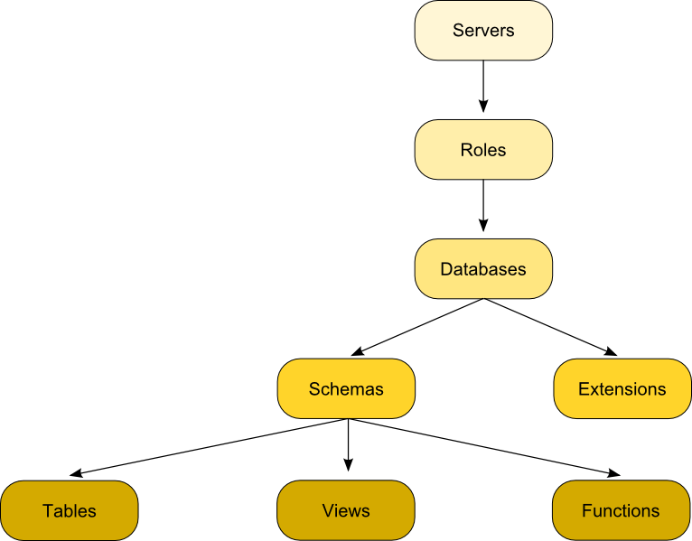

Before we start…
PostGIS is an extension to PostgreSQL
Notes:
3

Slide 4



Before we start…
PostGIS is based on OGC’s Simple Feature Access standard
Point
POINT (30 10)
Linestring
LINESTRING (30 10, 10 30, 40 40)
Polygon
POLYGON ((30 10, 40 40, 20 40, 10 20, 30 10))
Interior
boundary
Exterior
Notes:
4

Slide 5
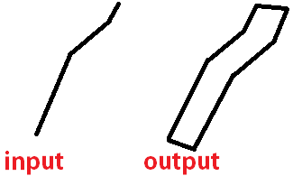


Before we start…
It is essential to learn a bit of SQL
ST_Buffer
SELECT id, ST_Buffer(geom, 100)
FROM rivers
WHERE rivername = ‘Tejo’
ST_Within
SELECT a.id, ST_Within(a.geom, b.geom)
FROM lamps as a, squares as b
ST_Intersection
SELECT a.id, ST_Intersection(a.geom, b.geom)
FROM buldings as a, squares as b
Notes:
5

Slide 6
The workshop is available at
https://github.com/lcalisto/workshop-postgis-vector
Notes:
6

