Slide 1
An Effective Smart Event Planner and Cost Management System
Branch: CE-SE
Guide: Dr S Anthoniraj
Team: CoEPCL-0027
Girish R V: 23BTRSN022
Nilin Rose: 23BTRSN034
Anamika H: 23BTRSN012
Tanish Balwal L: 23BTRSN048

Slide 2
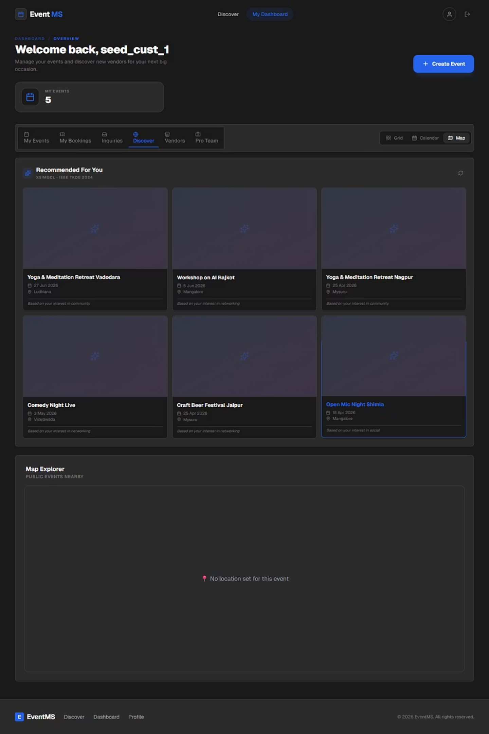
Introduction
Event planning involves critical tasks such as vendor selection, budget allocation, attendance estimation, and discovering relevant events, all of which are traditionally done manually.
Organizers spend significant time comparing vendors without data-driven trade-off analysis, leading to overspending or poor event quality.
Attendance predictions are often inaccurate, resulting in underbooked or over-capacity venues.
EventMS addresses these challenges by integrating five machine learning algorithms:
XSimGCL and GNN-CF for personalized event recommendations
MOEA/D-DRA-NEF for multi-objective budget optimization
iTransformer for attendance forecasting
GAT+K-Means for community detection
into a unified platform connecting organizers, vendors, and attendees.

Slide 3
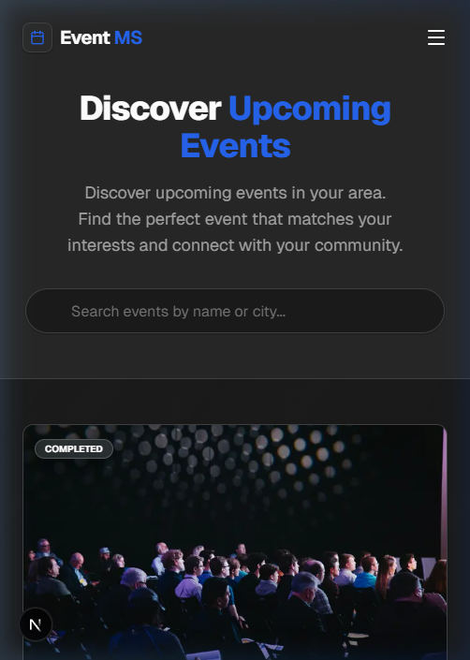
Abstract
EventMS is a scalable, role-based event management platform that integrates machine learning directly into the organizer workflow.
The system is planned with 5 core algorithms with 2 implemented so far:
MOEA/D-DRA-NEF (IEEE2025): for multi-objective budget optimization, generating optimal vendor bundles that simultaneously minimize cost, maximize quality, and maximize category coverage.
iTransformer (ICLR2024): for attendance forecasting, predicts how many people will attend an event over the next 7 or 14 days.
Future work will extend the ML layer with XSimGCL and GNN-CF for personalized event recommendations, and GAT+K-Means for community detection.

Slide 4





Objectives
Automate Vendor Selection
Forecast Attendance
Optimize Budgets
Apply optimization algorithms to identify optimal vendor combinations
Forecast event turnout over 7–14 day horizons with confidence intervals
Generate cost-quality trade-off bundles within organizer budget constraints
Unified Platform
Evaluate & Report
AI Event Assistant
Context-aware chatbot to help users
discover events and answer queries
in real time
Connect organizers and vendors through integrated system
Built-in Algorithm Lab for running,
evaluating, and exporting ML results

Slide 5



Problem Statement
Vendor Problem
Organizers must manually compare dozens of vendors across cost, quality, and category
no way to find the best trade-off objectively
Leads to overspending or poor service quality
Attendance Problem
No reliable way to predict turnout before the event
Results in overbooking (wasted resources) or underbooking (poor attendee experience and lost revenue)
Discovery Problem
Attendees struggle to find relevant events matching their interests
New users get no personalized suggestions — everyone sees the same generic listings

Slide 6
Related Work
Event-Based Social Networks
Multi-Objective Optimization
Time Series Forecasting
Liu et al. (2012, KDD) and Qiao et al. (2014, WWW) — linking online/offline social worlds and location-based event recommendations
MOEA/D (Zhang & Li, 2007) extended with dynamic resource allocation and neighbourhood-enhanced fitness — MOEA/D-DRA-NEF (Tan et al., 2025)
Informer (Zhou et al., 2021) evolved to iTransformer (Liu et al., 2024, ICLR) — SOTA inverted attention mechanism treating each time step as a token
Graph-Based Rec…
Community Detection
Dynamic User Modeling
LightGCN (He et al., 2020) extended with contrastive learning in XSimGCL (Yu et al., 2024); GNN-CF (Goel & Sinha, 2024) for cold-start users
GAT (Veličković et al., 2018) combined with K-Means clustering for graph-based community detection (Ippatapu & Bhadra, 2024)
Yin et al. (2015) and Lu et al. (2015) — social-aware location discovery and dynamic user preference modeling in event networks
Existing work addresses individual aspects in isolation — no unified platform integrating budget optimization, attendance forecasting, personalized recommendations, and community detection for event management
Research
Gap

Slide 7
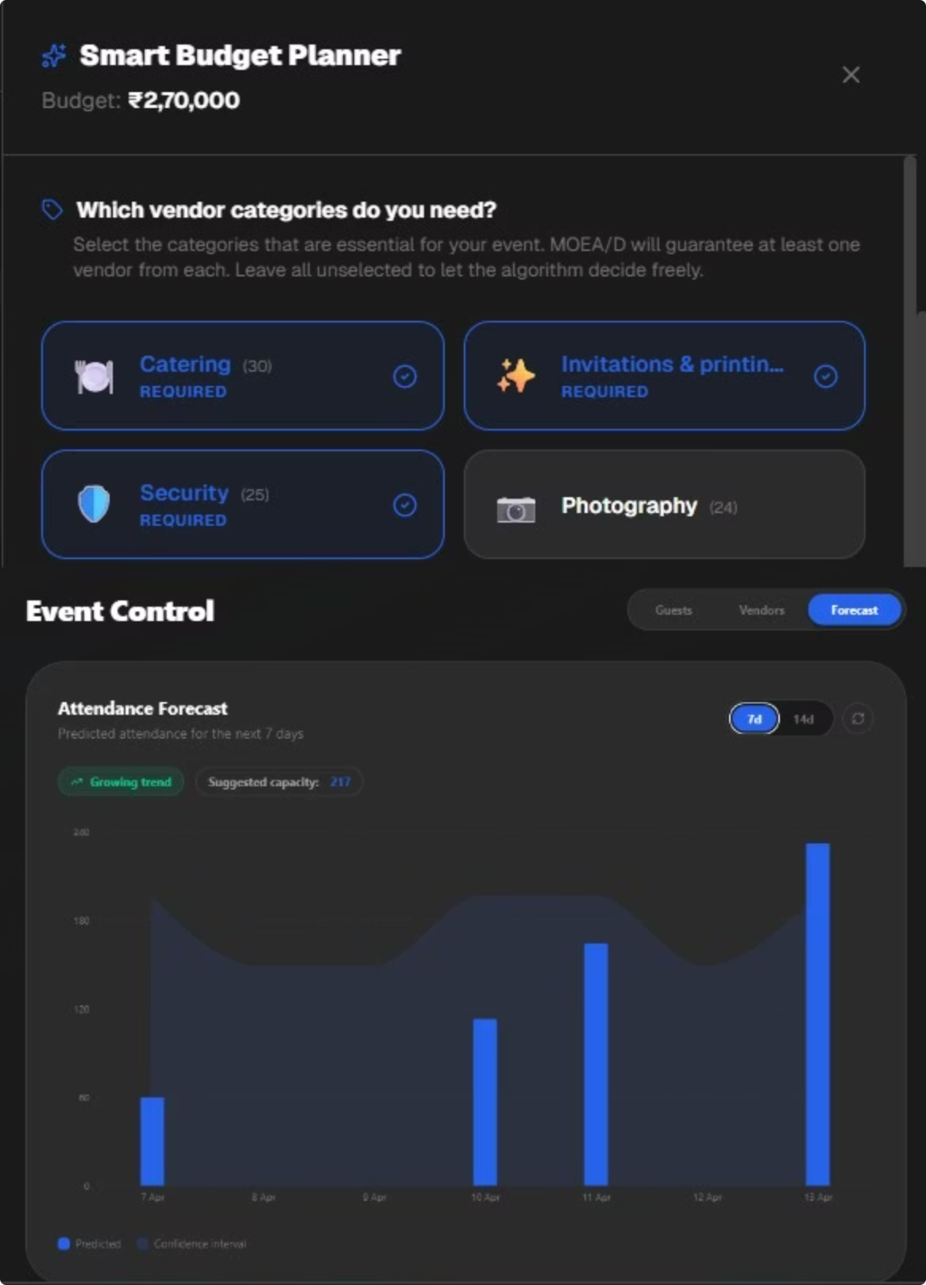
Proposed Work
EventMS Platform
01
Budget Optimizer
Uses MOEA/D-DRA-NEF (IEEE 2025) — multi-objective evolutionary optimization
Generates 3–5 Pareto-optimal vendor bundles:
Budget option
Best value
Premium option
02
Attendance Forecaster
Uses iTransformer (ICLR 2024) — inverted attention over time steps
Outputs:
Daily predictions with confidence intervals
Trend detection (increasing / decreasing / stable)
Recommended capacity

Slide 8




System Architecture (wip)
Frontend
API Layer
React / Next.js dashboards
User roles: Customer, Vendor, Admin
AI Chatbot (HuggingFace LLM)
Budget optimization API
Forecasting API
Chat API
Algorithm Layer
Backend
MOEA/D-DRA-NEF
— budget optimization
iTransformer
— attendance forecasting
Supabase (PostgreSQL)
Authentication + Storage
Row-Level Security (RLS)
Algorithm result caching

Slide 9
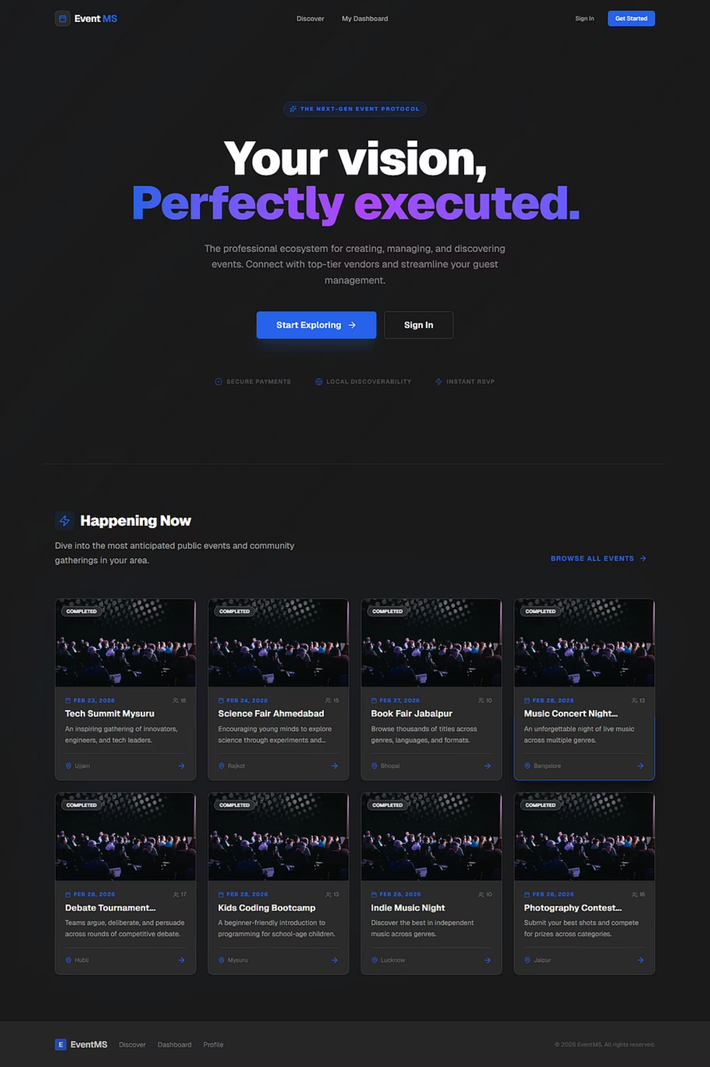
Key Outputs
Budget Optimizer
3–5 Pareto-optimal vendor bundles (Budget Pick, Best Value, Premium)
Cost vs. quality vs. coverage trade-off analysis
Category coverage guarantee for required vendor types
Optimizes across 200 vendor candidates simultaneously
Attendance Forecaster
Daily predictions over 7 or 14-day horizons
Configurable confidence intervals (80%–99%)
Trend detection: increasing / decreasing / stable
Recommended venue capacity based on upper-bound prediction
Platform Outputs
Role-based dashboards for organizers, vendors, and admins
AI chatbot for real-time event assistance
Algorithm Lab with exportable reports (JSON, CSV, PDF)
Result caching with automatic expiry (30–60 min TTL)

Slide 10
Conclusion & Future Work
Conclusion
Future Work
Eliminates guesswork in vendor selection with MOEA/D-DRA-NEF optimization
Predicts attendance trends using iTransformer forecasting
Integrates an AI chatbot for real-time event assistance
Provides a unified platform for organizers, vendors, and admins
XSimGCL — personalized recommendations for returning users
GNN-CF — cold-start recommendations for new users
GAT+K-Means — community detection and event clustering
References
MOEA/D (Zhang & Li, 2007, IEEE)
MOEA/D-DRA-NEF (Tan et al., 2025, IEEE)
iTransformer (Liu et al., 2024, ICLR)
Informer (Zhou et al., 2021, AAAI)
LightGCN (He et al., 2020, SIGIR)
XSimGCL (Yu et al., 2024, IEEE TKDE)
GAT (Veličković et al., 2018, ICLR)

