Slide 1
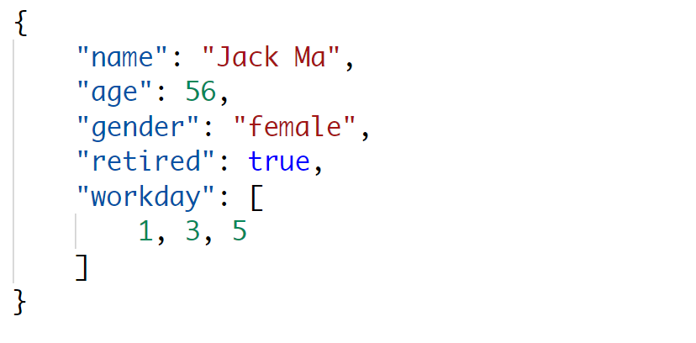
JObject

Slide 2
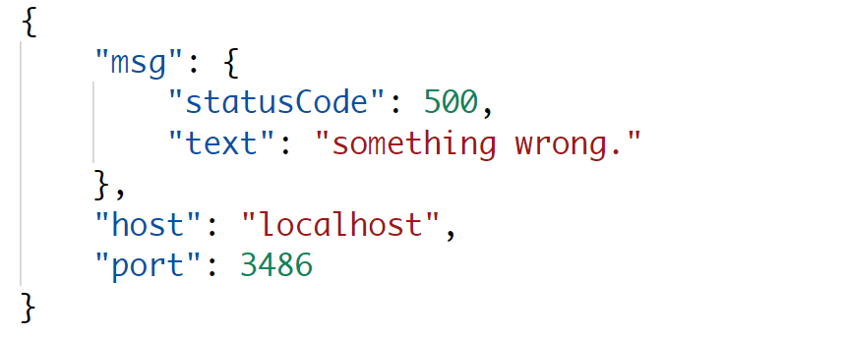
JProperty
JObject

Slide 3
JProperty

Slide 4
JArray

