Slide 1





LightGBM與CatBoost 在類別資料及下之效能探討
A Study on Performance of LightGBM
and CatBoost under categorical datasets
指導教授：蔣明晃 教授 口試委員：林我聰 教授 郭人介 教授
研究生：邵立瑜
延时文字

Slide 2

主目錄
CONTENTS
緒論
研究方法
結論
THE BACKGROUND OF
THE SUBJECT AND CONTENT
THE RESEARCH MENTALITY
AND THE PROCESS
CONCLUSION
AND SUMMARY
1
3
5
2
4
研究結果
文獻探討
THE RESULTS OF
EXPRIMENTAL DATA
RELATED WORKS
延时符

Slide 3
緒論
動機
MOTIVATION
第一部分
目的
OBJECTIVE

Slide 4



動機
MOTIVATION
資料分析
表格式資料(Tabular Data)
分析常用模型：Gradient Boosting Decision Tree(GBDT)衍生之模型
E.g. XGBoost、LightGBM、CatBoost
LightGBM是以XGBoost為基礎下去做改善 CatBoost聲稱其針對Categorical的資料集會有更好的預測準確度

Slide 5
目的
OBJECTIVE
資料特性
1
根據一般現有常見之表格式資料，分析其資料之特性
建模與結果
2
以資料訓練LightGBM與CatBoost模型、預測，評估預測效能
3
模型比較
根據建模結果，對LightGBM與CatBoost進行比較
4
探究原因
找出效能不同的原因
延时符

Slide 6
文獻探討
提升模型簡介
BOOSTING METHODS
第二部分
XGBoost
LightGBM
CatBoost

Slide 7




提升模型簡介
BOOSTING METHODS
Numerical Optimization:
$$P∗=\arg{\max_{P}}ϕ\left(P\right)$$
where
$$ϕ\left(P\right)=E_{y,x}L\left(y,F\left(x;P\right)\right)$$
and then
$$F^{∗}\left(x\right)=F\left(x;P∗\right).$$
Boosting:
$$F_{m}\left(x\right)=F_{m−1}\left(x\right)+β_{m}h\left(x;a_{m}\right)$$
Weak learner(classification tree)
延时符

Slide 8
XGBoost v.s. LightGBM
Pre-sorted & histogram-based algorithm
Gradient-based One-side Sampling(GOSS)
Level-wise tree growth
Leaf-wise tree growth
Leaf with higher gradient/error is used for growing further
延时符

Slide 9

CatBoost
“CATegorical Boosting”
Minimal Variance Sampling(MVS)
Compute Target Statistics for each categorical column(for the problem of high cardinality, The Curse of Dimensionality)
to encode the categorical columns
延时符

Slide 10
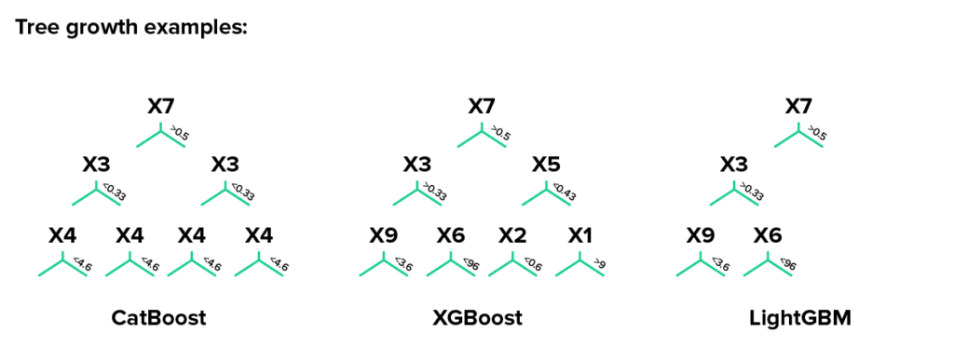
延时符

Slide 11
研究方法
研究流程
RESEARCH FLOW
第三部分
實驗設計
EXPERIMENTAL DESIGN
評價指標
EVALUATION METRIC
資料集
DATASETS
資料前處理
PREPROCESSINGS

Slide 12
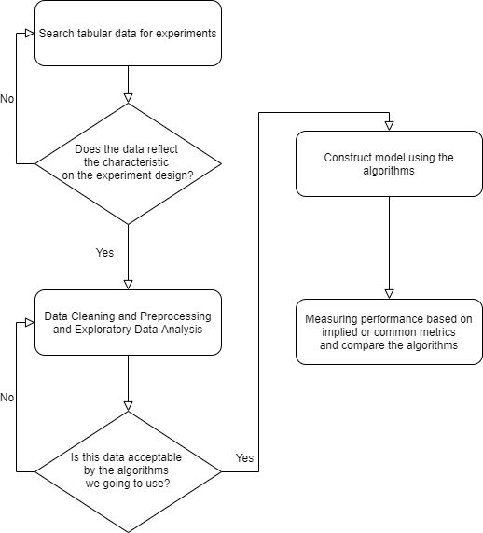
研究流程
RESEARCH FLOW
延时符

Slide 13
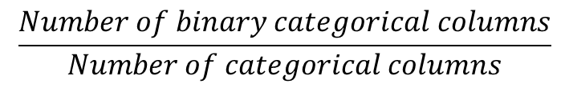
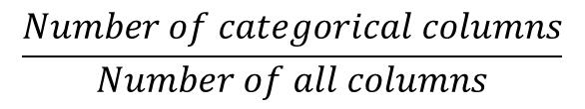
實驗設計
EXPERIMENTAL DESIGN
percentage of binary-valued categorical columns
percentage of categorical columns
$$\frac{Number of categorical columns}{Number of all columns}$$
$$\frac{Number of binary categorical columns}{Number of categorical columns}$$
 | Percentage of categorical variables <=70% | Percentage of categorical variables >70%
Percentage of binary variables <= 25% | Titanic Dataset(size=1309) 55.56% cat, 20% binary | Cat in the dat dataset (size=500000) 100% cat, 17.39% binary
Percentage of binary variables > 25% | Bank marketing dataset (size=4948) 62.5% cat, 30% binary | E-Sun fraud dataset (size = 1943452) 85.71% cat, 27.78% binary
延时符

Slide 14
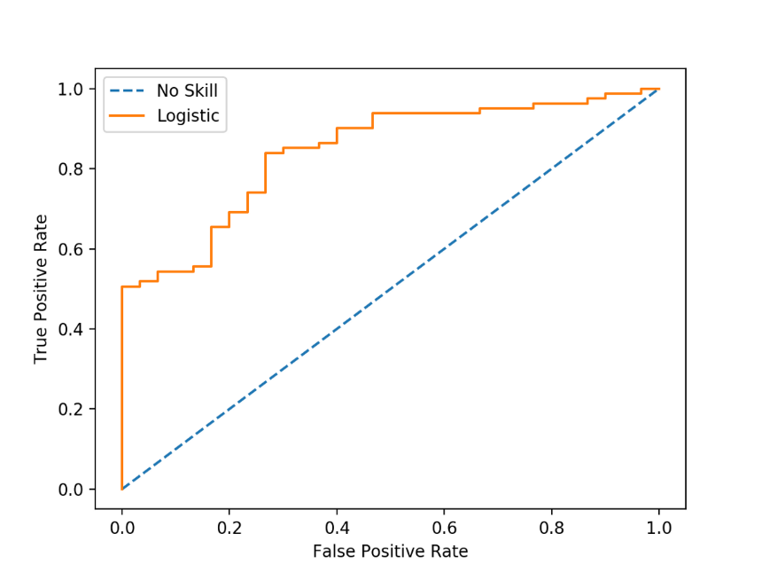
評價指標
EVALUATION METRIC
Area under the ROC curve(AUC)
改善Class Imbalance問題
不用切threshold，在計算AUC時就會以特定方式制定threshold
延时符

Slide 15

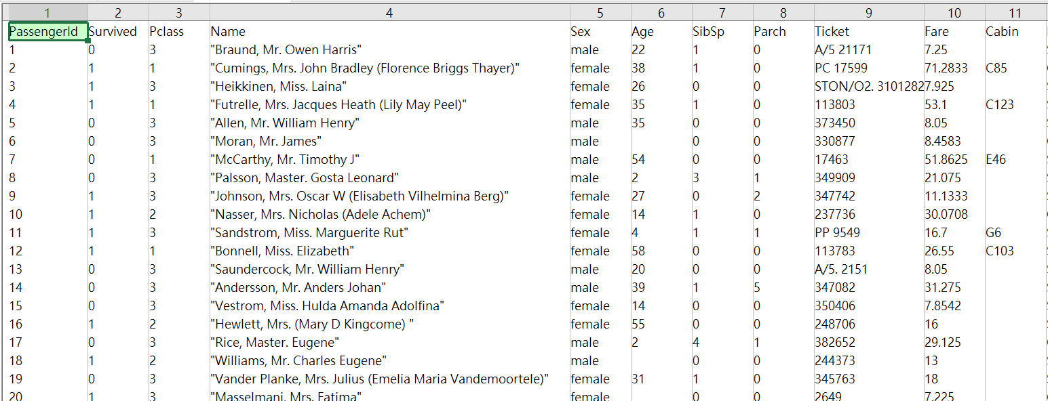
資料集
DATASETS
Binary classification
55.56% categorical columns
20% binary columns
延时符

Slide 16
資料集
DATASETS
Variable | Definition | Key
survival | Survival | 0 = No, 1 = Yes
pclass | Ticket class | 1 = 1st, 2 = 2nd, 3 = 3rd
sex | Sex
Age | Age in years
sibsp | # of siblings / spouses aboard the Titanic
parch | # of parents / children aboard the Titanic
ticket | Ticket number
fare | Passenger fare
cabin | Cabin number
embarked | Port of Embarkation | C = Cherbourg, Q = Queenstown, S = Southampton
延时符

Slide 17

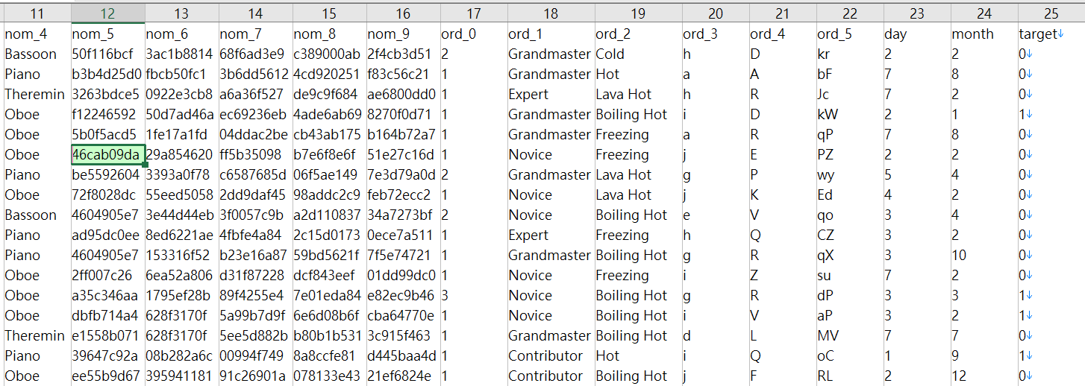
資料集
DATASETS
Cat in the dat
Binary classification
100% categorical columns
17.39% binary columns
延时符

Slide 18
資料集
DATASETS
Target Column: 0, 1
Binary features
Low-and high-cardinality nominal features
Low-and high-cardinality ordinal features
(potentially) cyclical features
延时符

Slide 19
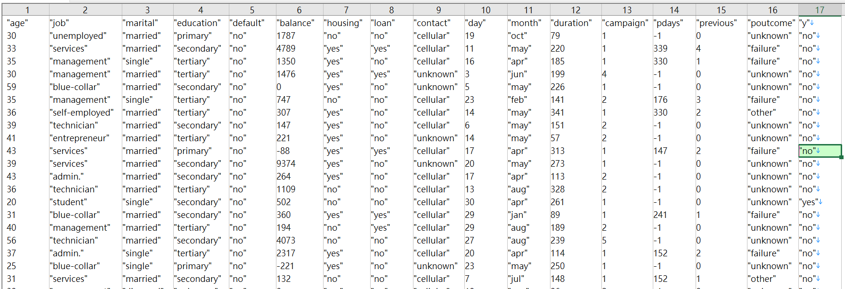

資料集
DATASETS
Bank Marketing
Binary classification
Predict whether the client subsribe a term deposit or not(y = “no” or “yes”)
62.5% categorical columns
30% binary columns
延时符

Slide 20
資料集
DATASETS
12 - duration: last contact duration, in seconds (numeric)
13 - campaign: number of contacts performed during this campaign and for this client (numeric, includes last contact)
14 - pdays: number of days that passed by after the client was last contacted from a previous campaign (numeric, -1 means client was not previously contacted)
15 - previous: number of contacts performed before this campaign and for this client (numeric)
16 - poutcome: outcome of the previous marketing campaign (categorical)
17 - y - has the client subscribed a term deposit? (binary: "yes","no")
1 - age (numeric)
2 – job (categorical)
3 - marital : marital status (categorical)
4 - education (categorical: "unknown","secondary","primary","tertiary")
5 - default: has credit in default? (binary: "yes","no")
6 - balance: average yearly balance, in euros (numeric)
7 - housing: has housing loan? (binary: "yes","no")
8 - loan: has personal loan? (binary: "yes","no")
9 - contact: contact communication type (categorical)
10 - day: last contact day of the month (numeric)
11 - month: last contact month of year (categorical)

Slide 21
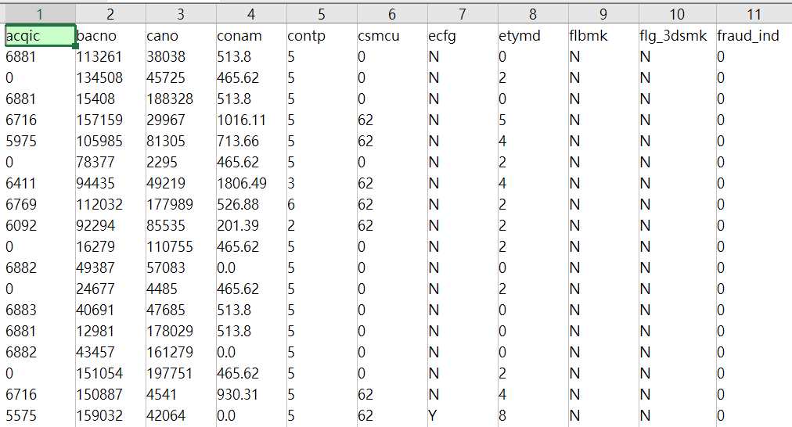

資料集
DATASETS
玉山信用卡盜刷偵測
Binary classification
85.71% categorical columns
27.78% binary columns
延时符

Slide 22
資料集
DATASETS
bacno | The account that makes this transaction
txkey | Transaction ID
locdt | The date of authorization
loctm | The time(hh/mm/ss) of authorization
cano | Credit card number
contp | The type of transaction
etymd | The type of transaction
mchno | The code name of special store
acqic | The code name of receiving bank
mcc | Mcc code
conam | Transaction amount
ecfg | Indicate if it is from online or offline(binary)
insfg | Indicate if it is installment(binary)
iterm | Installment number of periods
stocn | The country that transaction take placed
scity | The city that transaction take placed
stscd | Status code
ovrlt | Indication of above the quota amount(binary)
flbmk | Indication of Fallback(binary)
hcefg | Payment type
csmcu | Currency type which the transaction country uses
flg_3dsmk | Indication of 3DS transaction(binary)
fraud_ind | Whether this transaction is a fraud(target)
延时符

Slide 23
資料前處理
PREPROCESSINGS
For all data:
Missing Values
Numerical Columns
Categorical Columns
Average of the column value
Category = “Missing”
延时符

Slide 24
研究結果
效能總結
PERFORMANCE SUMMARY
第四部分
特徵重要性總結
FEATURE IMPORTANCE SUMMARY

Slide 25
效能總結
PERFORMANCE SUMMARY
 | Percentage of categorical variables <=70% | Percentage of categorical variables >70%
Percentage of binary variables <= 25% | Titanic Dataset(1309) LightGBM(85.10%) CatBoost(86.13%) | Cat in the dat dataset(500000) LightGBM(75.09%) CatBoost(79.48%)
Percentage of binary variables > 25% | Bank marketing dataset(4948) LightGBM(87.09%) CatBoost(78.77%) | E-Sun fraud dataset(1943452) LightGBM(96.54%) CatBoost(97.36%)
當Categorical columns數量較多時，CatBoost > LightGBM
延时符

Slide 26
特徵重要性總結
FEATURE IMPORTANCE SUMMARY
找出每個資料集前四名重要的Features
 | Titanic | Cat in the dat | Bank marketing | E-Sun fraud
LightGBM | AUC: 85.1% Fare(N)(481) Age(N)(476) Pclass(C)(91) Sex(C)(78) | AUC: 75.09% Nom_5(C)(4067) Nom_6(C)(3609) Nom_7(C)(3104) Nom_8(C)(2955) | AUC: 87.09% Duration(N)(634) Balance(N)(587) Age(N)(435) Month(C)(347) | AUC: 96.54% Bacno(C)(1255) Cano(C)(548) Mchno(C)(287) Conam(N)(287)
CatBoost | AUC: 86.13% Sex(C)(54.3) Pclass(C)(15.0) Age(N)(13.1) SibSp(N)(7.3) | AUC: 79.48% Ord_5(C)(12.6) Ord_4(C)(8.9) Ord_2(C)(8.2) Ord_1(C)(7.9) | AUC: 78.77% Duration(N)(33.7) Contact(C)(13.3) Month(C)(12.7) Day(N)(8.7) | AUC: 97.36% Stocn(C)(24.0) Conam(N)(13.3) Cano(C)(12.3) Locdt(C)(12.1)
大致上，CatBoost較偏向於使用Categorical Features，而LightGBM較偏好Numerical Features
延时符

Slide 27
PPT模板下载：WWW.HOMEPPT.COM/moban/ 行业PPT模板：WWW.HOMEPPT.COM/hangye/
节日PPT模板：WWW.HOMEPPT.COM/jieri/ PPT素材下载：WWW.HOMEPPT.COM/sucai/
PPT背景图片：WWW.HOMEPPT.COM/beijing/ PPT图表下载：WWW.HOMEPPT.COM/tubiao/
优秀PPT下载：WWW.HOMEPPT.COM/xiazai/ PPT教程： WWW.HOMEPPT.COM/powerpoint/
Word教程： WWW.HOMEPPT.COM/word/ Excel教程：WWW.HOMEPPT.COM/excel/
资料下载：WWW.HOMEPPT.COM/ziliao/ PPT课件下载：WWW.HOMEPPT.COM/kejian/
范文下载：WWW.HOMEPPT.COM/fanwen/ 试卷下载：WWW.HOMEPPT.COM/shiti/
教案下载：WWW.HOMEPPT.COM/jiaoan/ PPT论坛：www.homeppt.cn
結論
總結
SUMMARY
第五部分
貢獻
CONTRIBUTIONS
研究限制
LIMITS

Slide 28
總結
SUMMARY
1
在表格式資料中，CatBoost一般表現得比較良好。此研究認為，表格資料通常具有大量類別欄位，因此，較善於應用類別欄位的演算法會表現得比較良好
LightGBM在一個資料集具有重要的數值欄位時(當此資料集的Target欄位與此數值欄位高度相關時)，會有更好的預測效果。
2
延时符

Slide 29
貢獻
CONTRIBUTIONS
多個資料集
系統性處理資料
1
過去研究只探討在一個資料集的情況下，演算法之優劣，此實驗除了使用多個資料集，也找出了影響演算法優劣的主要原因
研究
貢獻
2
藉由訂定資料集處理規則以及超參數設定模式，對演算法會有更公平的判斷
延时符

Slide 30
研究限制
LIMITS
No feature engineering
No hyperparameter tuning
Categorical Encoding = Label Encoding(only)
延时符

Slide 31
感謝語
Thank you
THANK YOU!
懇請老師批評與指正！

Slide 32
THANKS
延时符

