Slide 1
Dvr與fm_gateway加密說明
路徑網址加密說明文件

Slide 2
Base64 urlsafe encode 符號轉換
Value Standard URL-safe
----- -------- --------
62 ‘+’ '-'
63 ‘/’ '_'
padding '=' (optional → we strip)

Slide 3
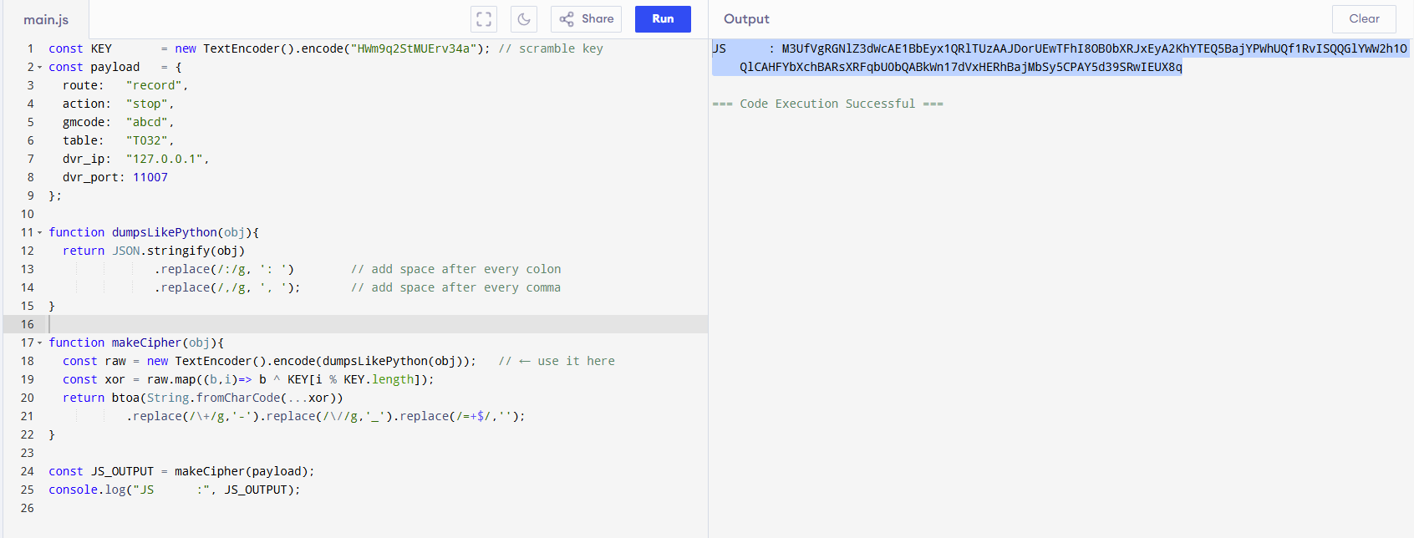
Online js code run

Slide 4
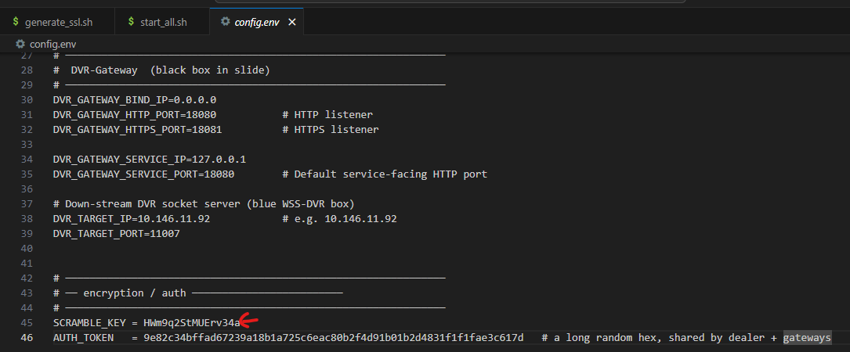
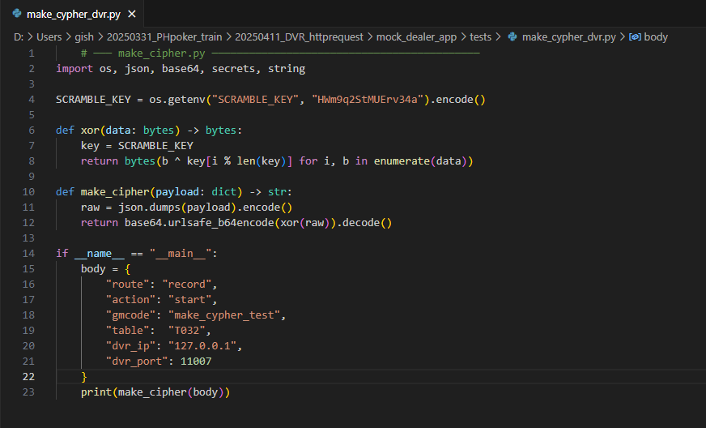
Python encode

Slide 5
JS & PY output verified (XOR then base64safeurl)
JS M3UfVgRGNlZ3dWcAE1BbEyx1QRlTUzAAJDorUEwTFhI8OB0bXRJxEyA2KhYTEQ5BajYPWhUQf1RvISQQGlYWW2h1OQlCAHFYbXchBARsXRFqbU0bQABkWn17dVxHERhBajMbSy5CPAY5d39SRwIEUX8q
Python
M3UfVgRGNlZ3dWcAE1BbEyx1QRlTUzAAJDorUEwTFhI8OB0bXRJxEyA2KhYTEQ5BajYPWhUQf1RvISQQGlYWW2h1OQlCAHFYbXchBARsXRFqbU0bQABkWn17dVxHERhBajMbSy5CPAY5d39SRwIEUX8q

