Slide 1
Detecting Communities in and the Evolutionary Structure of Google Search Trends Related to COVID-19
Prepared for the 2020 Data Science Conference on COVID-19 (DSCC-19)
Philip Waggoner
University of Chicago

Slide 2
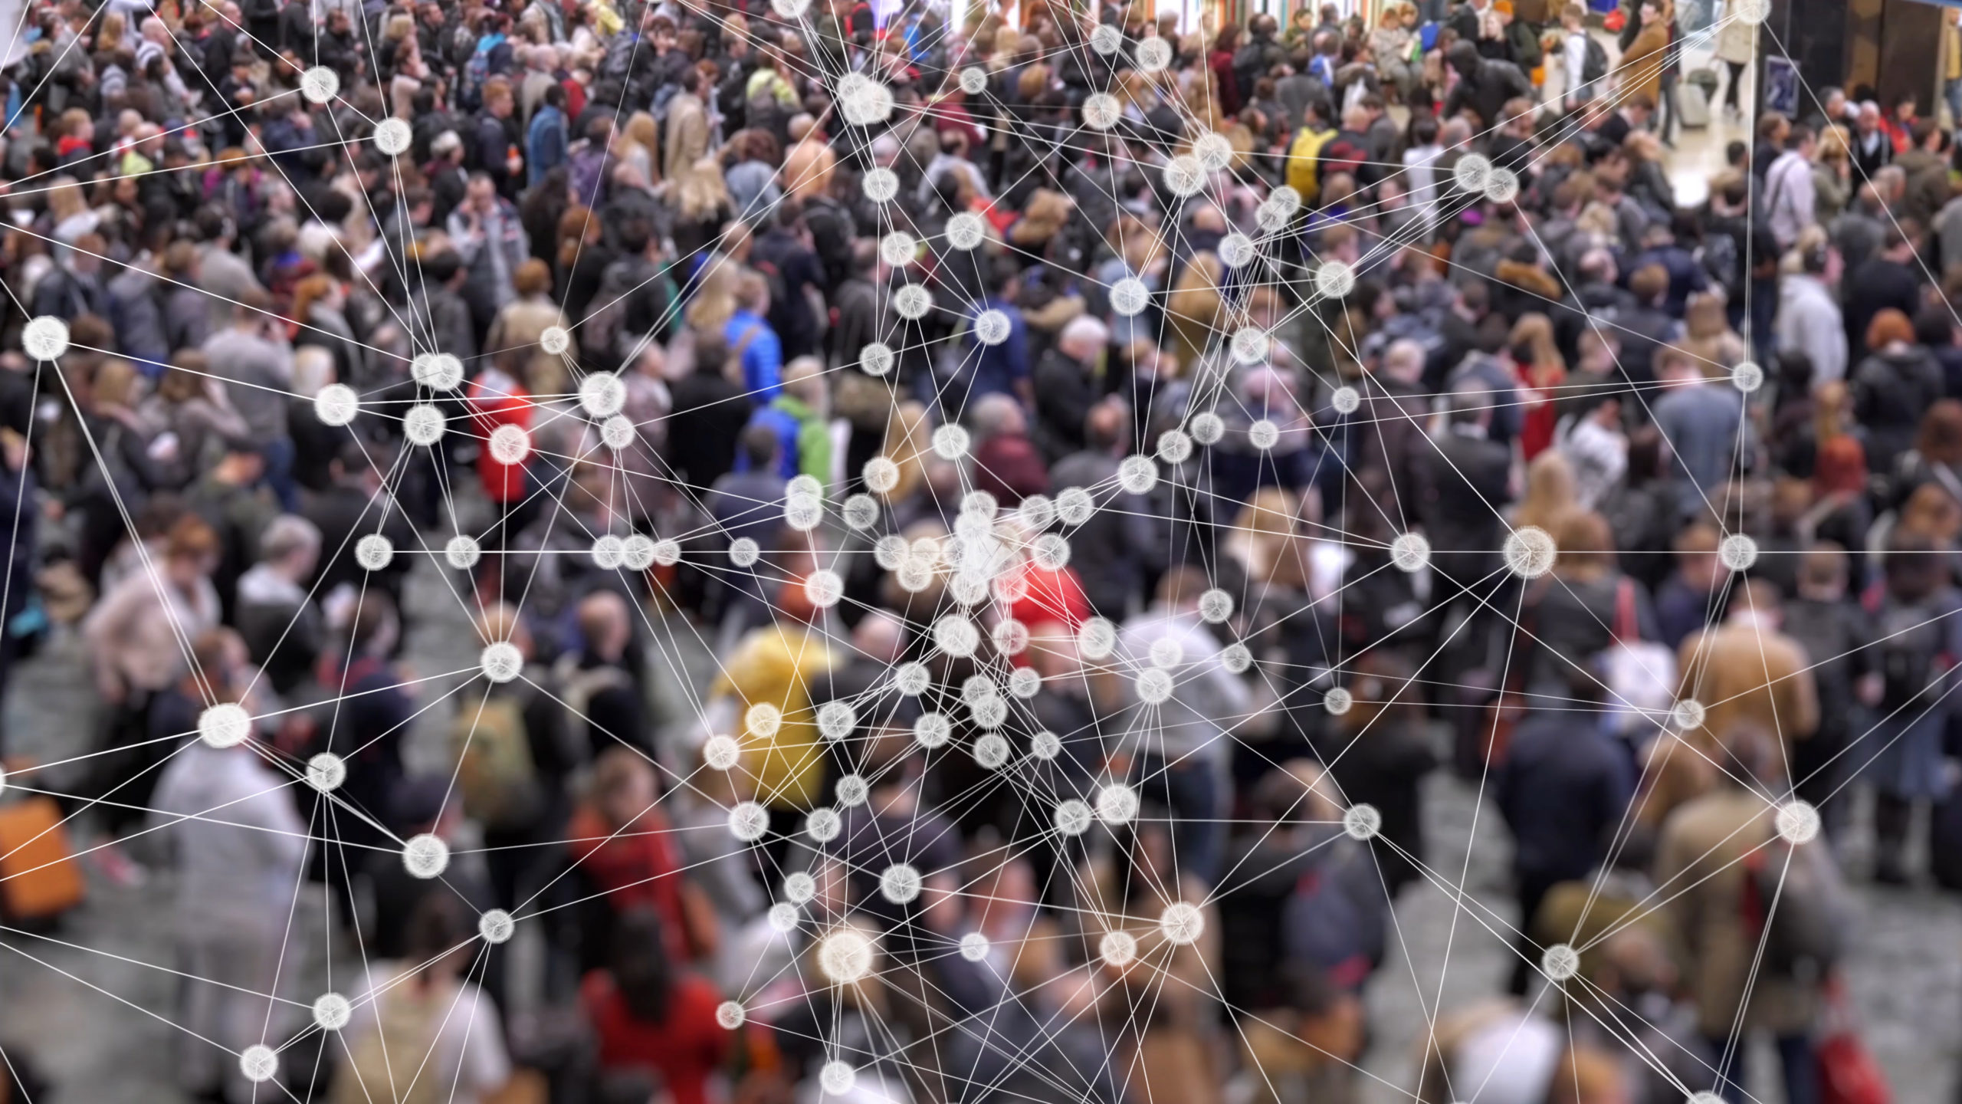

Slide 3
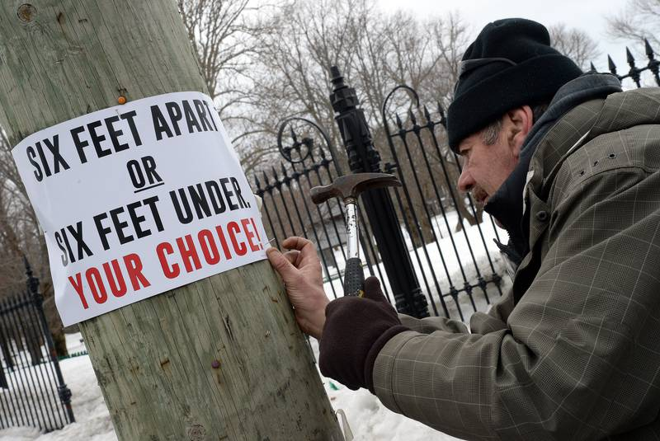

Slide 4
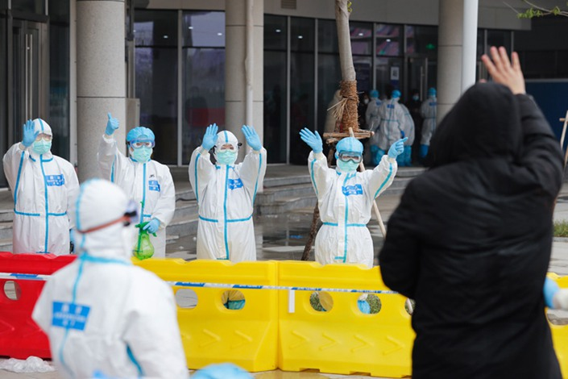

Slide 5
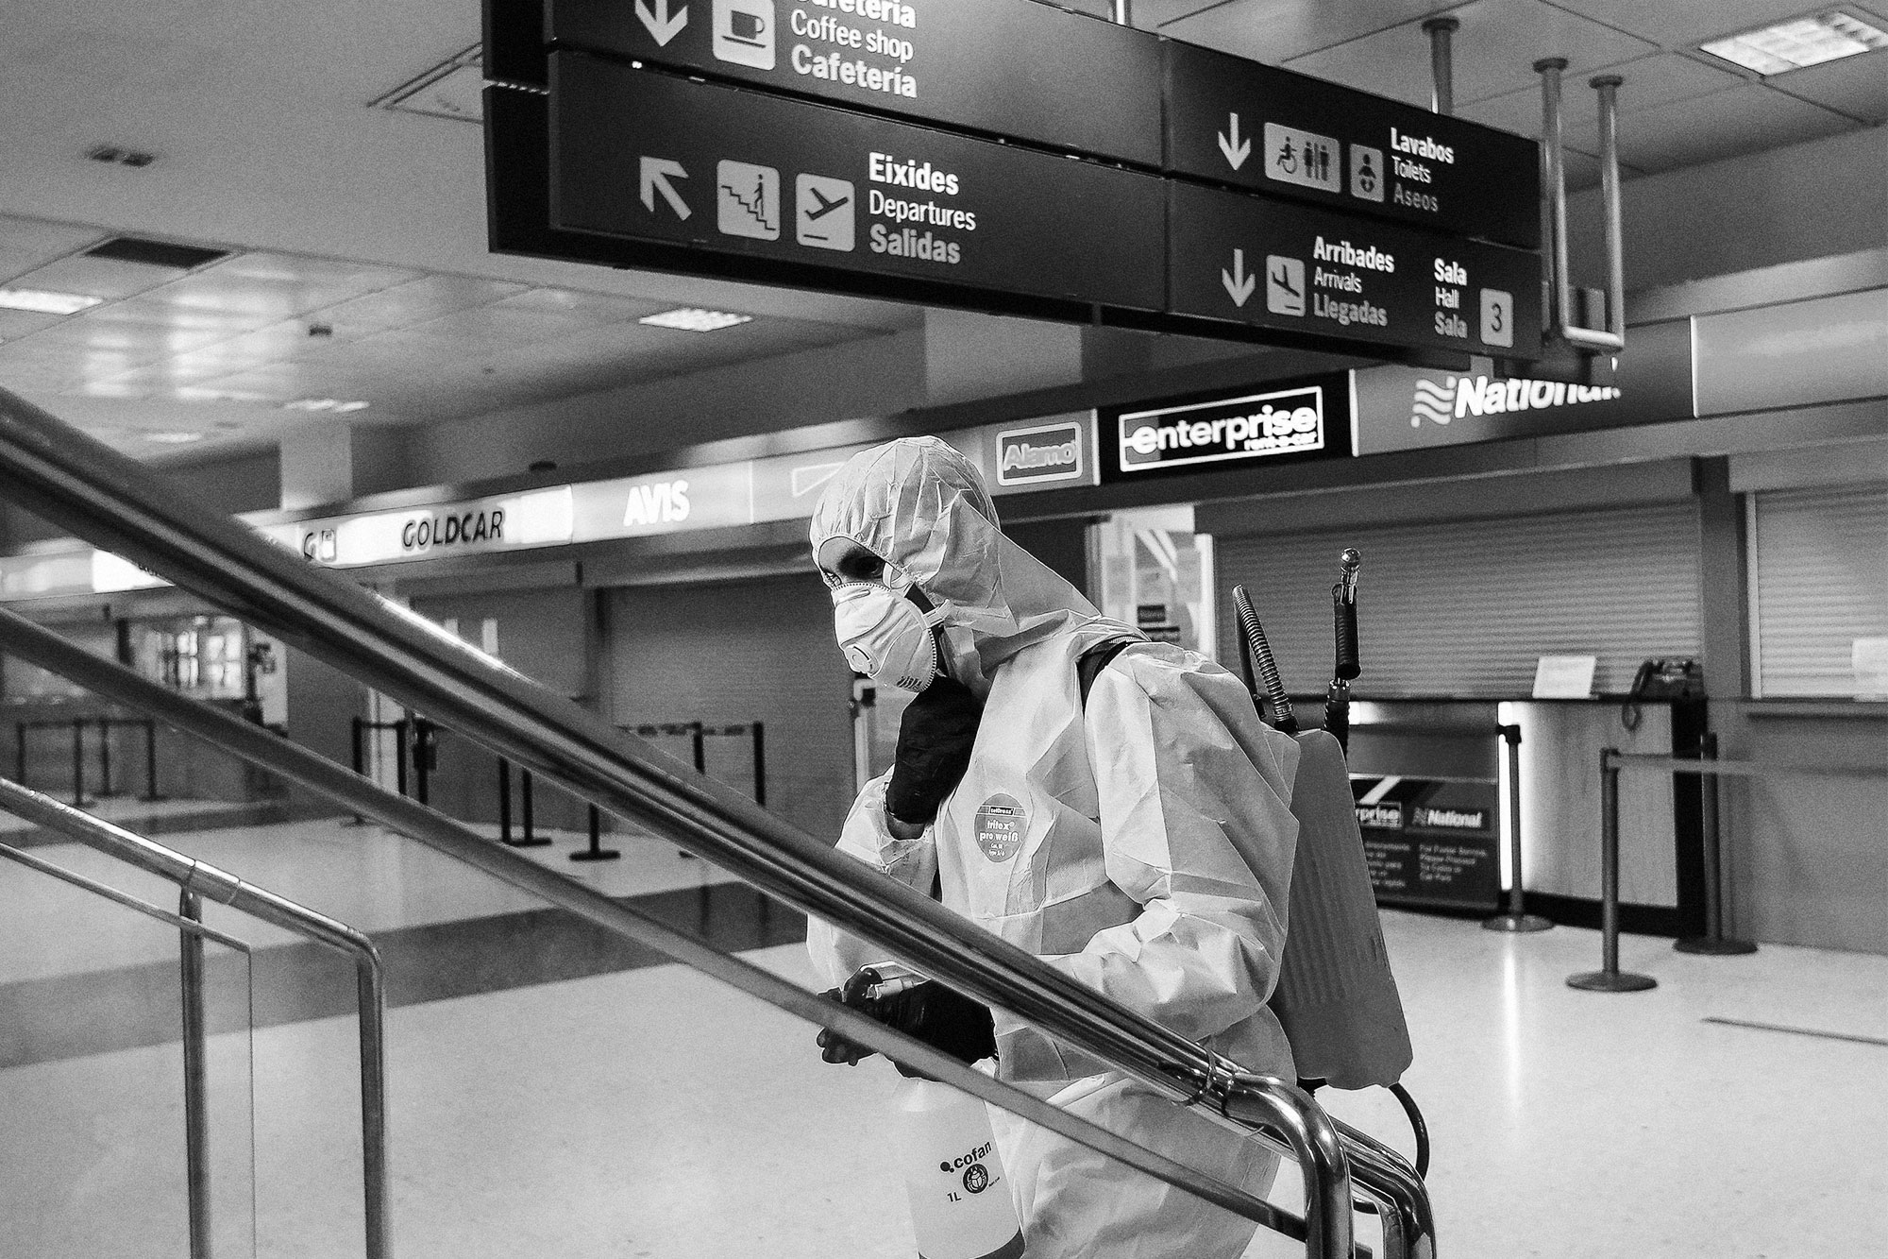

Slide 6


Slide 7
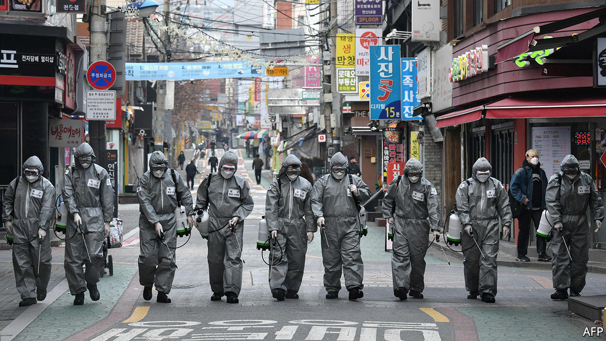

Slide 8


Slide 9
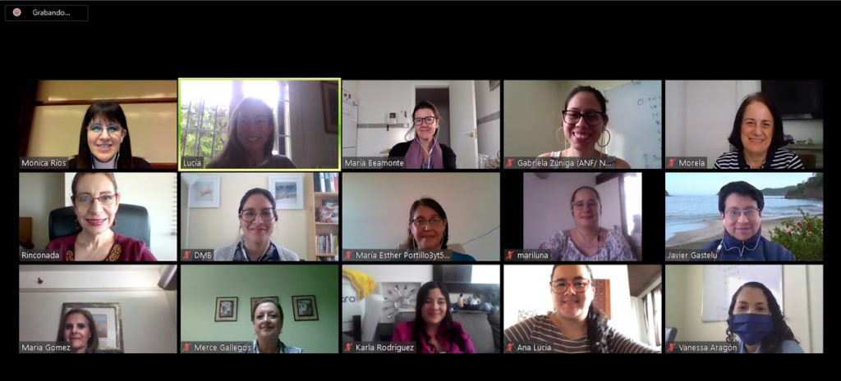

Slide 10


Slide 11
How do people self-educate in a socially-distanced world in…
constant flux
[often] bitter political division
public health crisis
?

Slide 12
Overview
High level description
Social networks
Community detection

Slide 13
Some Particulars
Data
Google trends via API
All queries related to initial search for coronavirus
Code
Code is open source: https://github.com/pdwaggoner/covid_google_dscc19
Process
American queries from January 16 – August 11, 2020
Cleaned, preprocessed, and staged text
Analysis

Slide 14
High Level Exploration

Slide 18
Social Networks

Slide 29
Community Detection

Slide 31
Broad Trends
Evidence of evolution in structure
Only a few communities emerge, but seem to solidify over time
In general, people tend to vary what they care about, and what they search for

Slide 32
Future Work
Anomaly detection
Pair with social media data (e.g., Twitter)
Others?
→ Please reach out if you’re interested in collaborating or have ideas for extending the project

Slide 33
Thank you!
Contact: https://pdwaggoner.github.io/

Slide 34
Appendix // Supporting Information

