Slide 1
Chapter 9. Elementary SCTP Sockets

Slide 2
9.1 Introduction
SCTP is a newer transport protocol, standardized in the IETF in 2000 (compared with TCP, which was standardized in 1981). It was first designed to meet the needs of the growing IP telephony market; in particular, transporting telephony signaling across the Internet. The requirements it was designed to fulfill are described in RFC 2719 [Ong et al. 1999].
SCTP is a reliable, message-oriented protocol, providing multiple streams between endpoints and transport-level support for multihoming. Since it is a newer transport protocol, it does not have the same ubiquity as TCP or UDP; however, it provides some new features that may simplify certain application designs. We will discuss the reasons to consider using SCTP instead of TCP in Section 23.12.

Slide 3
9.1 Introduction
Although there are some fundamental differences between SCTP and TCP, the one-to-one interface for SCTP provides very nearly the same application interface as TCP. This allows for trivial porting of applications, but does not permit use of some of SCTP's advanced features.
The one-to-many interface provides full support for these features, but may require significant retooling of existing applications. The one-to-many interface is recommended for most new applications developed for SCTP.

Slide 4
9.1 Introduction
This chapter describes additional elementary socket functions that can be used with SCTP. We first describe the two different interface models that are available to the application developer. We will develop a version of our echo server using the one-to-many model in Chapter 10.
We also describe the new functions available for and used exclusively with SCTP. We look at the shutdown function and how its use with SCTP differs from TCP. We then briefly cover the use of notifications in SCTP. Notifications allow an application to be informed of significant protocol events other than the arrival of user data. We will see an example of how to use notifications in Section 23.4.

Slide 5
9.1 Introduction
Since SCTP is a newer protocol, the interface for all its features has not yet completely stabilized. As of this writing, the interfaces described are believed to be stable, but are not yet as ubiquitous as the rest of the sockets API.
Users of applications designed to use SCTP exclusively may need to be prepared to install kernel patches or otherwise upgrade their operating system, and applications which need to be ubiquitous need to be able to use TCP if SCTP is not available on the system they are running on.

Slide 6
9.2 Interface Models
There are two types of SCTP sockets: a one-to-one socket and a one-to-many socket.
A one-to-one socket corresponds to exactly one SCTP association. (Recall from Section 2.5 that an SCTP association is a connection between two systems, but may involve more than two IP addresses due to multihoming.) This mapping is similar to the relationship between a TCP socket and a TCP connection.
With a one-to-many socket, several SCTP associations can be active on a given socket simultaneously. This mapping is similar to the manner in which a UDP socket bound to a particular port can receive interleaved datagrams from several remote UDP endpoints that are all simultaneously sending data.

Slide 7
9.2 Interface Models
When deciding which style of interface to use, the application needs to consider several factors, including:
What type of server is being written, iterative or concurrent?
How many socket descriptors does the server wish to manage?
Is it important to optimize the association setup to enable data on the third (and possibly fourth) packet of the four-way handshake?
How much connection state does the application wish to maintain?

Slide 8
9.2 Interface Models
When the sockets API for SCTP was under development, different terminology was used for the two styles of sockets, and readers may sometimes encounter these older terms in documentation or source code. The original term for the one-to-one socket was a "TCP-style" socket, and the original term for a one-to-many socket was a "UDP-style" socket.
These style terms were later dropped because they tended to cause confusion by creating expectations that SCTP would behave more like TCP or UDP, depending on which style of socket was used. In fact, these terms referred to only one aspect of the differences between TCP and UDP sockets (i.e., whether a socket supports multiple concurrent transport-layer associations). The current terminology ("one-to-one" versus "one-to-many") focuses our attention on the key difference between the two socket styles. Finally, note that some writers use the term "many-to-one" instead of "one-to-many"; the terms are interchangeable.

Slide 9
9.2 Interface Models
The One-to-One Style
The one-to-one style was developed to ease the porting of existing TCP applications to SCTP. It provides nearly an identical model to that described in Chapter 4. There are some differences one should be aware of, especially when porting existing TCP applications to SCTP using this style.
Any socket options must be converted to the SCTP equivalent. Two commonly found options are TCP_NODELAY and TCP_MAXSEG. These can be easily mapped to SCTP_NODELAY and SCTP_MAXSEG.
SCTP preserves message boundaries; thus, application-layer message boundaries are not required. For example, an application protocol based on TCP might do a write() system call to write a two-byte message length field, x, followed by a write() system call that writes x bytes of data. However, if this is done with SCTP, the receiving SCTP will receive two separate messages (i.e., the read call will return twice: once with a two-byte message, and then again with an x byte message).
Some TCP applications use a half-close to signal the end of input to the other side. To port such applications to SCTP, the application-layer protocol will need to be rewritten so that the application signals the end of input in the application data stream.
The send function can be used in the normal fashion. For the sendto and sendmsg functions, any address information included is treated as an override of the primary destination address (see Section 2.8).

Slide 10
9.2 Interface Models
A typical user of the one-to-one style will follow the timeline shown in Figure 9.1. When the server is started, it opens a socket, binds to an address, and waits for a client connection with the accept system call. Sometime later, the client is started, it opens a socket, and initiates an association with the server. We assume the client sends a request to the server, the server processes the request, and the server sends back a reply to the client. This cycle continues until the client initiates a shutdown of the association. This action closes the association, whereupon the server either exits or waits for a new association. As can be seen by comparison to a typical TCP exchange, an SCTP one-to-one socket exchange proceeds in a fashion similar to that shown in Figure 4.1.
A one-to-one-style SCTP socket is an IP socket (family AF_INET or AF_INET6), with type SOCK_STREAM and protocol IPPROTO_SCTP.

Slide 11
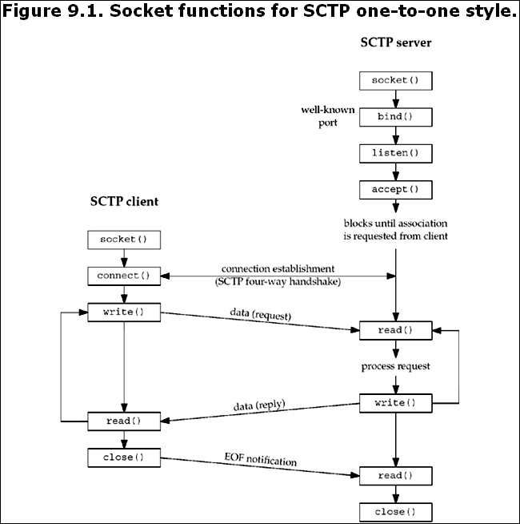
9.2 Interface Models

Slide 12
9.2 Interface Models
The One-to-Many Style
The one-to-many style provides an application writer the ability to write a server without managing a large number of socket descriptors. A single socket descriptor will represent multiple associations, much the same way that a UDP socket can receive messages from multiple clients. An association identifier is used to identify a single association on a one-to-many-style socket. This association identifier is a value of type sctp_assoc_t; it is normally an integer. It is an opaque value; an application should not use an association identifier that it has not previously been given by the kernel. Users of the one-to-many style should keep the following issues in mind:
When the client closes the association, the server side will automatically close as well, thus removing any state for the association inside the kernel.
Using the one-to-many style is the only method that can be used to cause data to be piggybacked on the third or fourth packet of the four-way handshake (see Exercise 9.3).

Slide 13
9.2 Interface Models
Any sendto, sendmsg, or sctp_sendmsg to an address for which an association does not yet exist will cause an active open to be attempted, thus creating (if successful) a new association with that address. This behavior occurs even if the application doing the send has called the listen function to request a passive open.
The user must use the sendto, sendmsg, or sctp_sendmsg functions, and may not use the send or write function. (If the sctp_peeloff function is used to create a one-to-one-style socket, send or write may be used on it.)
Anytime one of the send functions is called, the primary destination address that was chosen by the system at association initiation time (Section 2.8) will be used unless the MSG_ADDR_OVER flag is set by the caller in a supplied sctp_sndrcvinfo structure. To supply this, the caller needs to use the sendmsg function with ancillary data, or the sctp_sendmsg function.
Association events (one of a number of SCTP notifications discussed in Section 9.14) may be enabled, so if an application does not wish to receive these events, it should disable them explicitly using the SCTP_EVENTS socket option. By default, the only event that is enabled is the sctp_data_io_event, which provides ancillary data to the recvmsg and sctp_recvmsg call. This default setting applies to both the one-to-one and one-to-many style.

Slide 14
9.2 Interface Models
When the SCTP sockets API was first developed, the one-to-many-style interface was defined to have the association notification turned on by default as well. Later versions of the API document have since disabled all notifications except the sctp_data_io_event for both the one-to-one- and one-to-many-style interface. However not all implementations may have this behavior. It is always good practice for an application writer to explicitly disable (or enable) the notifications that are unwanted (or desired). This explicit approach assures the developer that the expected behavior will result no matter which OS the code is ported to.
A typical one-to-many style timeline is depicted in Figure 9.2. First, the server is started, creates a socket, binds to an address, calls listen to enable client associations, and calls sctp_recvmsg, which blocks waiting for the first message to arrive. A client opens a socket and calls sctp_sendto, which implicitly sets up the association and piggybacks the data request to the server on the third packet of the four-way handshake. The server receives the request, and processes and sends back a reply. The client receives the reply and closes the socket, thus closing the association. The server loops back to receive the next message.

Slide 15
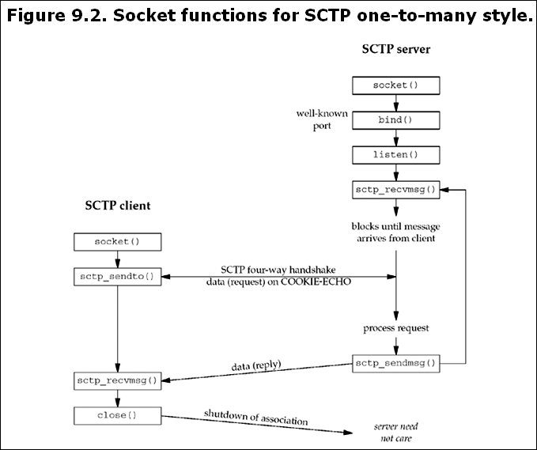
9.2 Interface Models

Slide 16
9.2 Interface Models
This example shows an iterative server, where (possibly interleaved) messages from many associations (i.e., many clients) can be processed by a single thread of control. With SCTP, a one-to-many socket can also be used in conjunction with the sctp_peeloff function (see Section 9.12) to allow the iterative and concurrent server models to be combined as follows:
The sctp_peeloff function can be used to peel off a particular association (for example, a long-running session) from a one-to-many socket into its own one-to-one socket.
The one-to-one socket of the extracted association can then be dispatched to its own thread or forked process (as in the concurrent model).
Meanwhile, the main thread continues to handle messages from any remaining associations in an iterative fashion on the original socket.
A one-to-many-style SCTP socket is an IP socket (family AF_INET or AF_INET6) with type SOCK_SEQPACKET and protocol IPPROTO_SCTP.

Slide 17
9.3 sctp_bindx Function
An SCTP server may wish to bind a subset of IP addresses associated with the host system. Traditionally, a TCP or UDP server can bind one or all addresses on a host, but they cannot bind a subset of addresses. The sctp_bindx function provides more flexibility by allowing an SCTP socket to bind a particular subset of addresses.
#include <netinet/sctp.h> int sctp_bindx(int sockfd, const struct sockaddr *addrs, int addrcnt, int flags);Returns: 0 if OK, –1 on error
The sockfd is a socket descriptor returned by the socket function. The second argument, addrs, is a pointer to a packed list of addresses. Each socket address structure is placed in the buffer immediately following the preceding socket address structure, with no intervening padding. See Figure 9.4 for an example.

Slide 18
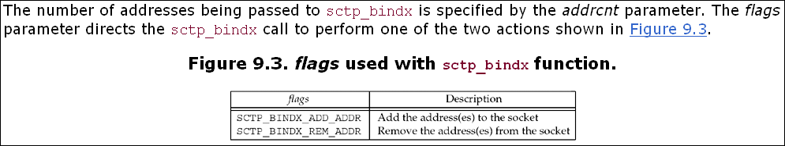
9.3 sctp_bindx Function

Slide 19
9.3 sctp_bindx Function
The sctp_bindx call can be used on a bound or unbound socket. For an unbound socket, a call to sctp_bindx will bind the given set of addresses to the socket descriptor. If sctp_bindx is used on a bound socket, the call can be used with SCTP_BINDX_ADD_ADDR to associate additional addresses with the socket descriptor or with SCTP_BINDX_REM_ADDR to remove a list of addresses associated with the socket descriptor. If sctp_bindx is performed on a listening socket, future associations will use the new address configuration; the change does not affect any existing associations.
The two flags passed to sctp_bindx are mutually exclusive; if both are given, sctp_bindx will fail, returning the error code EINVAL. The port number in all the socket address structures must be the same and must match any port number that is already bound; if it doesn't, then sctp_bindx will fail, returning the error code EINVAL.

Slide 20
9.3 sctp_bindx Function
If an endpoint supports the dynamic address feature, a call to sctp_bindx with the SCTP_BINDX_REM_ADDR or SCTP_BINDX_ADD_ADDR flag will cause the endpoint to send an appropriate message to the peer to change the peer's address lists. Since adding and removing addresses from a connected association is optional functionality, implementations that do not support this functionality will return EOPNOTSUPP.
Note that both ends of an association must support this feature for proper operation. This feature can be useful if the system supports dynamic provisioning of interfaces; for example, if a new Ethernet interface is brought up, the application can use SCTP_BINDX_ADD_ADDR to start using the additional interface on an existing connection.

Slide 21
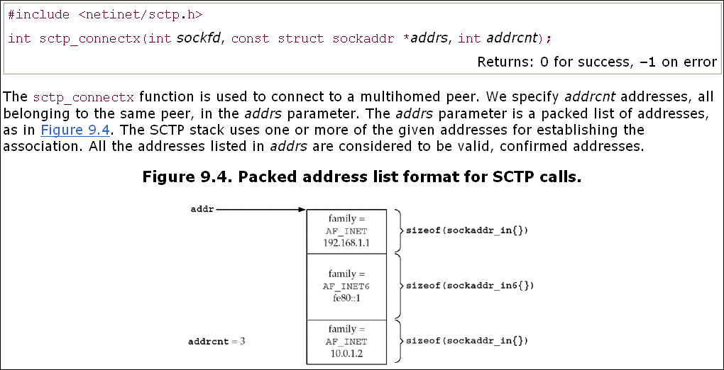
9.4 sctp_connectx Function

Slide 22
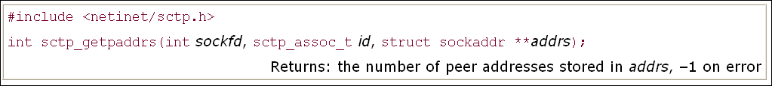
9.5 sctp_getpaddrs Function
The getpeername function was not designed with the concept of a multihoming-aware transport protocol; when using SCTP, it only returns the primary address. When all the addresses are required, the sctp_getpaddrs function provides a mechanism for an application to retrieve all the addresses of a peer.

Slide 23
9.5 sctp_getpaddrs Function
The sockfd parameter is the socket descriptor returned by the socket function. The id is the association identification for a one-to-many-style socket. If the socket is using the one-to-one style, the id field is ignored. addrs is the address of a pointer that sctp_getpaddrs will fill in with a locally allocated, packed list of addresses. See Figures 9.4 and 23.12 for details on the structure of this return value. The caller should use sctp_freepaddrs to free resources allocated by sctp_getpaddrs when finished with them.

Slide 24
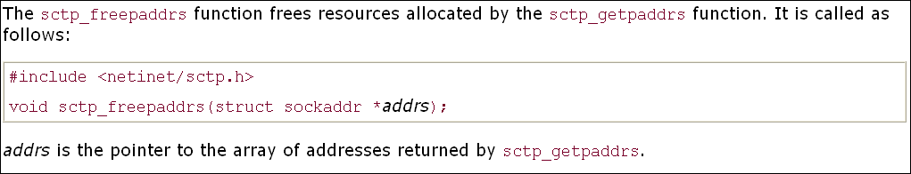
9.6 sctp_freepaddrs Function

Slide 25
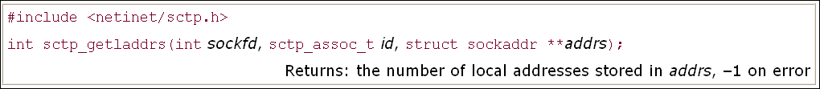
9.7 sctp_getladdrs Function
The sctp_getladdrs function can be used to retrieve the local addresses that are part of an association. This function is often necessary when a local endpoint wishes to know exactly which local addresses are in use (which may be a proper subset of the system's addresses).

Slide 26
9.7 sctp_getladdrs Function
The sockfd is the socket descriptor returned by the socket function. id is the association identification for a one-to-many-style socket. If the socket is using the one-to-one style, the id field is ignored. The addrs parameter is an address of a pointer that sctp_getladdrs will fill in with a locally allocated, packed list of addresses. See Figures 9.4 and 23.12 for details on the structure of this return value. The caller should use sctp_freeladdrs to free resources allocated by sctp_getladdrs when finished with them.

Slide 27
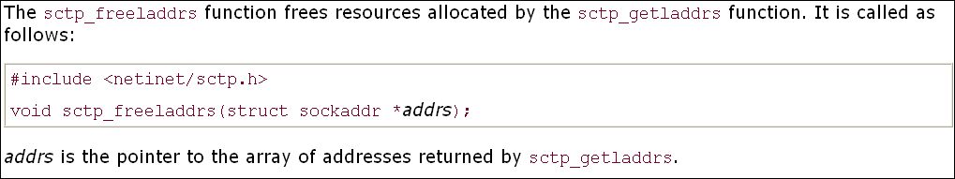
9.8 sctp_freeladdrs Function

Slide 28
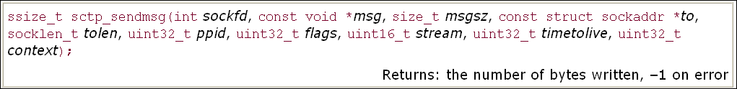
9.9 sctp_sendmsg Function
An application can control various features of SCTP by using the sendmsg function along with ancillary data (described in Chapter 14). However, because the use of ancillary data may be inconvenient, many SCTP implementations provide an auxiliary library call (possibly implemented as a system call) that eases an application's use of SCTP's advanced features. The call takes the following form:

Slide 29
9.9 sctp_sendmsg Function
The user of sctp_sendmsg has a greatly simplified sending method at the cost of more arguments. The sockfd field holds the socket descriptor returned from a socket system call. The msg field points to a buffer of msgsz bytes to be sent to the peer endpoint to. The tolen field holds the length of the address stored in to. The ppid field holds the pay-load protocol identifier that will be passed with the data chunk. The flags field will be passed to the SCTP stack to identify any SCTP options; valid values for this field may be found in Figure 7.16.
A caller specifies an SCTP stream number by filling in the stream. The caller may specify the lifetime of the message in milliseconds in the lifetime field, where 0 represents an infinite lifetime. A user context, if any, may be specified in context. A user context associates a failed message transmission, received via a message notification, with some local application-specific context. For example, to send a message to stream number 1, with the send flags set to MSG_PR_SCTP_TTL, the lifetime set to 1000 milliseconds, a payload protocol identifier of 24, and a context of 52, a user would formulate the following call:

Slide 30
9.9 sctp_sendmsg Function
ret = sctp_sendmsg(sockfd, data, datasz, &dest, sizeof(dest), 24, MSG_PR_SCTP_TTL, 1, 1000, 52);
This approach is much easier than allocating the necessary ancillary data and setting up the appropriate structures in the msghdr structure. Note that if an implementation maps the sctp_sendmsg to a sendmsg function call, the flags field of the sendmsg call is set to 0.

Slide 31
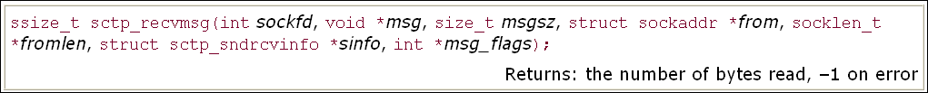
9.10 sctp_recvmsg Function
Just like sctp_sendmsg, the sctp_recvmsg function provides a more user-friendly interface to the advanced SCTP features.
Using this function allows a user to retrieve not only its peer's address, but also the msg_flags field that would normally accompany the recvmsg function call (e.g., MSG_NOTIFICATION, MSG_EOR, etc.).
The function also allows the user to retrieve the sctp_sndrcvinfo structure that accompanies the message that was read into the message buffer. Note that if an application wishes to receive sctp_sndrcvinfo information, the sctp_data_io_event must be subscribed to with the SCTP_EVENTS socket option (ON by default). The sctp_recvmsg function takes the following form:

Slide 32
9.10 sctp_recvmsg Function
On return from this call, msg is filled with up to msgsz bytes of data.
The message sender's address is contained in from, with the address size filled in the fromlen argument.
Any message flags will be contained in the msg_flags argument.
If the notification sctp_data_io_event has been enabled (the default), the sctp_sndrcvinfo structure will be filled in with detailed information about the message as well.
Note that if an implementation maps the sctp_recvmsg to a recvmsg function call, the flags field of the call will be set to 0.

Slide 33
9.11 sctp_opt_info Function
The sctp_opt_info function is provided for implementations that cannot use the getsockopt functions for SCTP. This inability to use the getsockopt function is because some of the SCTP socket options, for example, SCTP_STATUS, need an in-out variable to pass the association identification. For systems that cannot provide an in-out variable to the getsockopt function, the user will need to use sctp_opt_info.
For systems like FreeBSD that do allow in-out variables in the socket option call, the sctp_opt_info call is a library call that repackages the arguments into the appropriate getsockopt call. For portability's sake, applications should use sctp_opt_info for all the options that require in-out variables (Section 7.10).

Slide 34
9.11 sctp_opt_info Function
The call has the following format:
int sctp_opt_info(int sockfd, sctp_assoc_t assoc_id, int opt void *arg, socklen_t *siz);Returns: 0 for success, –1 on error
sockfd is the socket descriptor that the user would like the socket option to affect. assoc_id is the identification of the association (if any) on which the user is performing the option. opt is the socket option (as defined in Section 7.10) for SCTP. arg is the socket option argument, and siz is a pointer to a socklen_t which holds the size of the argument.

Slide 35
9.12 sctp_peeloff Function
As previously mentioned, it is possible to extract an association contained by a one-to-many socket into an individual one-to-one-style socket.
The semantics are much like the accept function call with an additional argument. The caller passes the sockfd of the one-to-many socket and the association identification id that is being extracted.
At the completion of the call, a new socket descriptor is returned. This new descriptor will be a one-to-one-style socket descriptor with the requested association. The function takes the following form:

Slide 36
9.13 shutdown Function
The shutdown function that we discussed in Section 6.6 can be used with an SCTP endpoint using the one-to-one-style interface. Because SCTP's design does not provide a half-closed state, an SCTP endpoint reacts to a shutdown call differently than a TCP endpoint.
When an SCTP endpoint initiates a shutdown sequence, both endpoints must complete transmission of any data currently in the queue and close the association. The endpoint that initiated the active open may wish to invoke shutdown instead of close so that the endpoint can be used to connect to a new peer.
Unlike TCP, a close followed by the opening of a new socket is not required. SCTP allows the endpoint to issue a shutdown, and after the shutdown completes, the endpoint can reuse the socket to connect to a new peer. Note that the new connection will fail if the endpoint does not wait until the SCTP shutdown sequence completes. Figure 9.5 shows the typical function calls in this scenario.

Slide 37
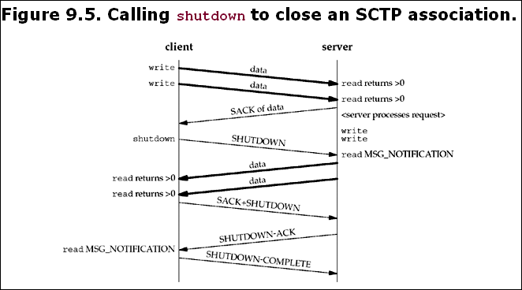
9.13 shutdown Function

Slide 38
9.13 shutdown Function
Note that in Figure 9.5, we depict the user receiving the MSG_NOTIFICATION events. If the user had not subscribed to receive these events, then a read of length 0 would have been returned. The effects of the shutdown function for TCP were described in Section 6.6. The shutdown function howto holds the following semantics for SCTP:
SHUT_RD The same semantics as for TCP discussed in Section 6.6; no SCTP protocol action is taken.
SHUT_WR Disables further send operations and initiates the SCTP shutdown procedures, which will terminate the association. Note that this option does not provide a half-closed state, but does allow the local endpoint to read any queued data that the peer may have sent prior to receiving the SCTP SHUTDOWN message.
SHUT_RDWR Disables all read and write operations, and initiates the SCTP shutdown procedure. Any queued data that was in transit to the local endpoint will be acknowledged and then silently discarded.

Slide 39
9.14 Notifications
SCTP makes a variety of notifications available to the application programmer. The SCTP user can track the state of its association(s) via these notifications. Notifications communicate transport-level events, including network status change, association startups, remote operational errors, and undeliverable messages. For both the one-to-one and the one-to-many styles, all events are disabled by default with the exception of sctp_data_io_event. We will see an example of using notifications in Section 23.7.
Eight events can be subscribed to using the SCTP_EVENTS socket option. Seven of these events generate additional data—termed a notification—that a user will receive via the normal socket descriptor. The notifications are added to the socket descriptor inline with data as the events that generate them occur. When reading from a socket with notification subscriptions, user data and notifications will be interleaved on the socket buffer. To differentiate between peer data and a notification, the user uses either the recvmsg function or the sctp_recvmsg function. When the data returned is an event notification, the msg_flags field of these two functions will contain the MSG_NOTIFICATION flag. This flag tells the application that the message just read is not data from the peer, but a notification from the local SCTP stack.

Slide 40
9.14 Notifications
Each type of notification is in tag-length-value form, where the first eight bytes of the message identify what type of notification has arrived and its total length. Enabling the sctp_data_io_event event causes the receipt of sctp_sndrcvinfo structures on every read of user data (this option is enabled by default for both interface styles). This information is normally received in ancillary data using the recvmsg call. An application can also use the sctp_recvmsg call, which will fill a pointer to the sctp_sndrcvinfo structure with this information.
Two notifications contain an SCTP error cause code field. The values for this field are listed in Section 3.3.10 of RFC 2960 [Stewart et al. 2000] and in the "CAUSE CODES" section of http://www.iana.org/assignments/sctp-parameters.

Slide 41
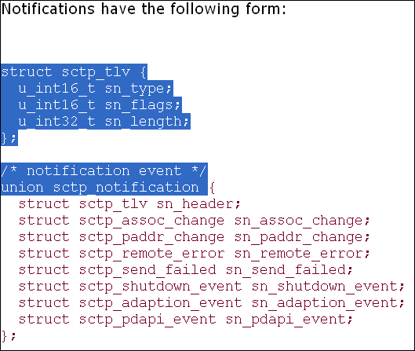
9.14 Notifications

Slide 42
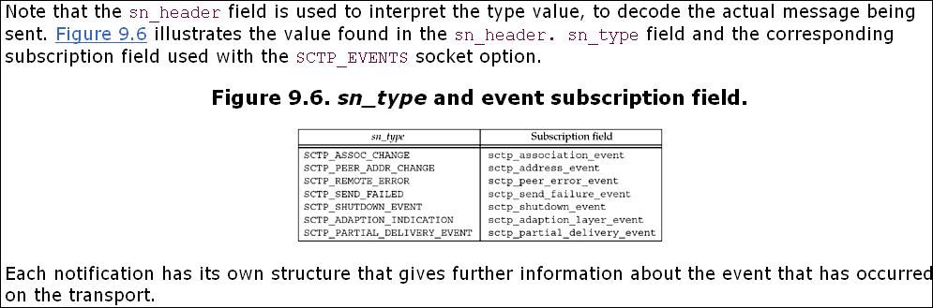
9.14 Notifications

Slide 43
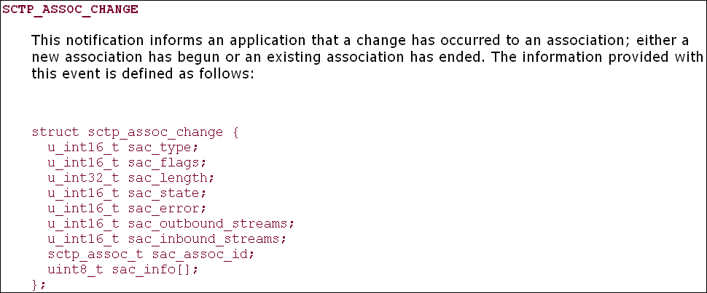
9.14 Notifications

Slide 44
9.14 Notifications
The sac_state describes the type of event that has occurred on the association, and will take one of the following values:
SCTP_COMM_UP This state indicates that a new association has just been started. The inbound and outbound streams fields indicate how many streams are available in each direction. The association identification is filled with a unique value that can be used to communicate with the local SCTP stack regarding this association.
SCTP_COMM_LOST This state indicates that the association specified by the association identification has closed due to either an unreachability threshold being triggered (i.e., the SCTP endpoint timed out multiple times and hit its threshold, which indicates the peer is no longer reachable), or the peer performed an abortive close (usually with the SO_LINGER option or by using sendmsg with a MSG_ABORT flag) of the association. Any user-specific information will be found in the sac_info field of the notification.
SCTP_RESTART This state indicates that the peer has restarted. The most likely cause of this notification is a peer crash and restart. The application should verify the number of streams in each direction, since these values may change during a restart.
SCTP_SHUTDOWN_COMP This state indicates that a shutdown initiated by the local endpoint (via either a shutdown call or a sendmsg with a MSG_EOF flag) has completed. For the one-to-one style, after receiving this notification, the socket descriptor can be used again to connect to a different peer.
SCTP_CANT_STR_ASSOC This state indicates that a peer did not respond to an association setup attempt (i.e., the INIT message).

Slide 45
9.14 Notifications
The sac_error field holds any SCTP protocol error cause code that may have caused an association change. The sac_outbound_streams and sac_inbound_streams fields inform the application how many streams in each direction have been negotiated on the association. sac_assoc_id holds a unique handle for an association that can be used to identify the association in both socket options and future notifications. sac_info holds any other information available to the user. For example, if an association was aborted by the peer with a user-defined error, that error would be found in this field.

Slide 46
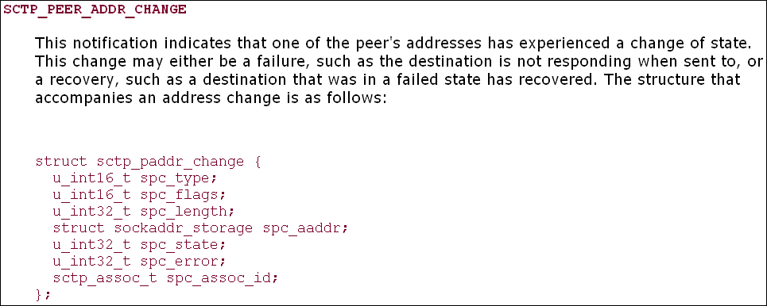
9.14 Notifications

Slide 47
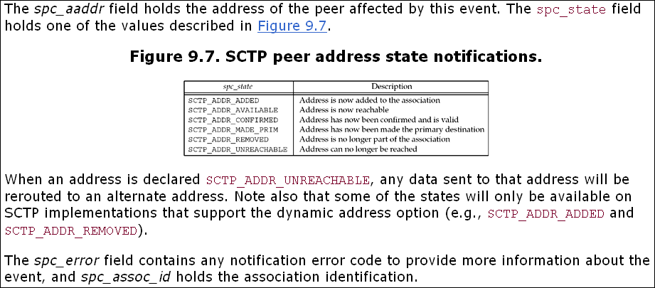
9.14 Notifications

Slide 48
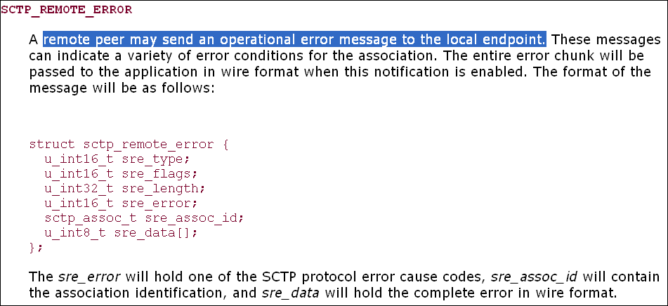
9.14 Notifications

Slide 49
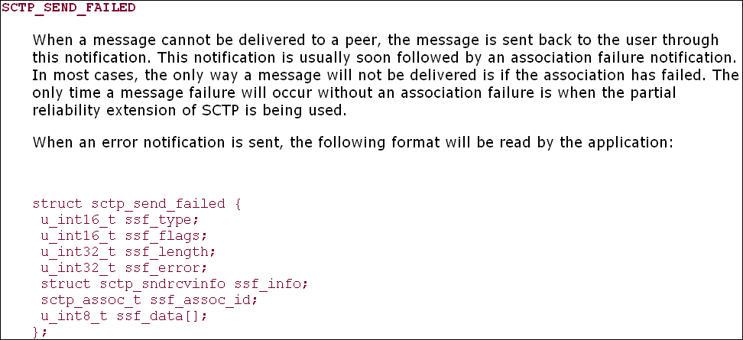
9.14 Notifications

Slide 50
9.14 Notifications
ssf_flags will be set to one of two values:
SCTP_DATA_UNSENT, which indicates that the message could never be transmitted to the peer (e.g., flow control prevented the message from being sent before its lifetime expired), so the peer never received it
SCTP_DATA_SENT, which indicates that the data was transmitted to the peer at least once, but was never acknowledged. In this case, the peer may have received the message, but it was unable to acknowledge it.
This distinction may be important to a transaction protocol, which might perform different actions to recover from a broken connection based on whether or not a given message might have been received. ssf_error, if not zero, holds an error code specific to this notification. The ssf_info field provides the information passed (if any) to the kernel when the data was sent (e.g., stream number, context, etc.). ssf_assoc_id holds the association identification, and ssf_data holds the undelivered message.

Slide 51
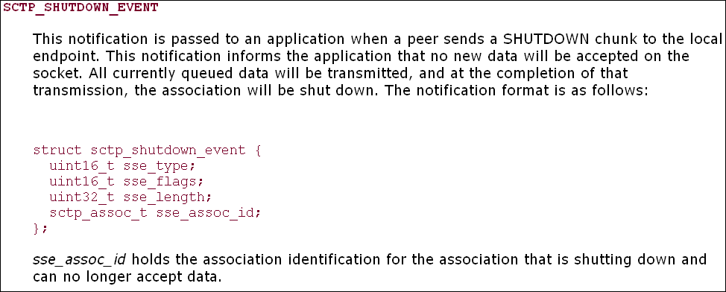
9.14 Notifications

Slide 52
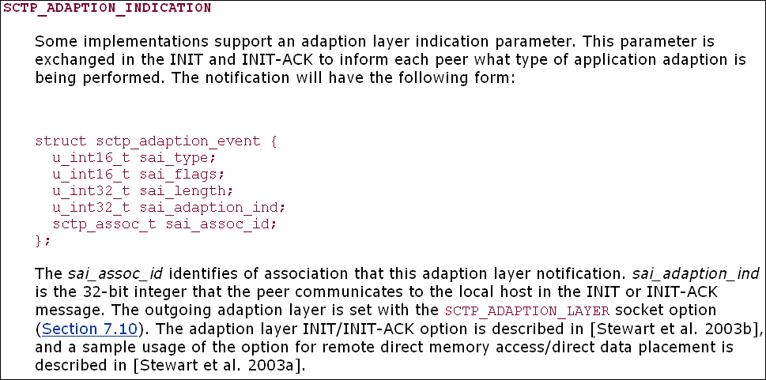
9.14 Notifications

Slide 53
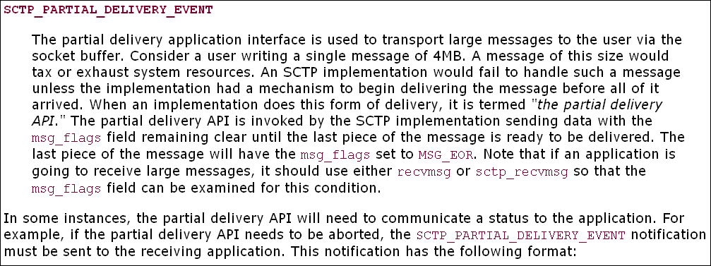
9.14 Notifications

Slide 54
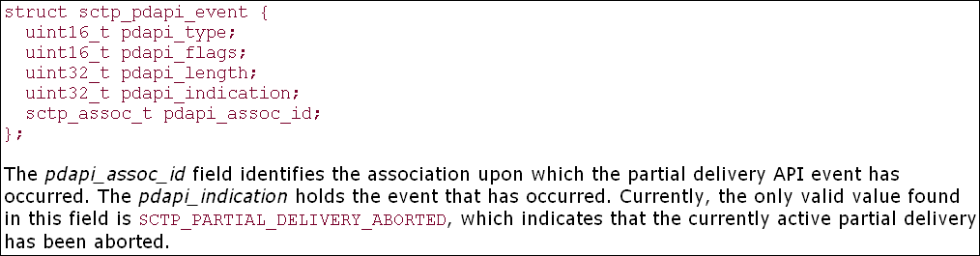
9.14 Notifications

Slide 55
9.15 Summary
SCTP provides the application writer with two different interface styles: the one-to-one style, mostly compatible with existing TCP applications to ease migration to SCTP, and the one-to-many style, allowing access to all of SCTP's features. The sctp_peeloff function provides a method of extracting an association from one style to the other. SCTP also provides numerous notifications of transport events to which an application may wish to subscribe. These events can aid an application in better managing the associations it maintains.
Since SCTP is multihomed, not all the standard sockets functions introduced in Chapter 4 are adequate. Functions like sctp_bindx, sctp_connectx, sctp_getladdrs, and sctp_getpaddrs provide methods to better control and examine the multiple addresses that can make up an SCTP association. Utility functions such as sctp_sendmsg and sctp_recvmsg can simplify the use of these advanced features. We will explore many of the concepts introduced in this chapter in more detail through examples in Chapters 10 and 23.

