Slide 1
Network programming
Changhai Nie (聂长海)
changhainie@nju.edu.cn
705 DCST buiding, NJU Xianlin Campus

Slide 2
几个概念
内核
系统调用
Shell
应用程序接口API
操作系统
应用软件以及实用程序等
shell
应用程序接口API
系统
调用
内核
公共函数库

Slide 3
What is Network Programming
Write programs that communicate with each other using an application program interface (API) known as sockets
You make a call to the socket() system routine. It returns the socket descriptor, and you communicate through it using the specialized send() and recv() socket calls

Slide 4

Sockets
process sends/receives messages to/from its socket
socket analogous to door
  sending process shoves message out door
  sending process relies on transport infrastructure on other side of door which brings message to socket at receiving process
host or
server
host or
server
controlled by
app developer
process
process
socket
socket
TCP with
buffers,
variables
TCP with
buffers,
variables
Internet

Slide 5
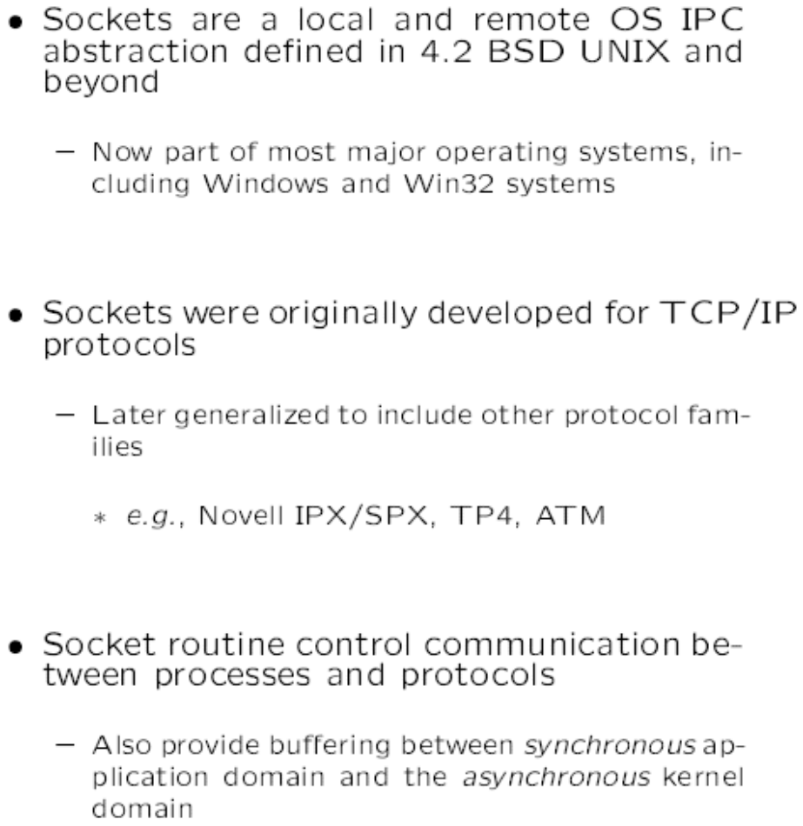
What is socket

Slide 6
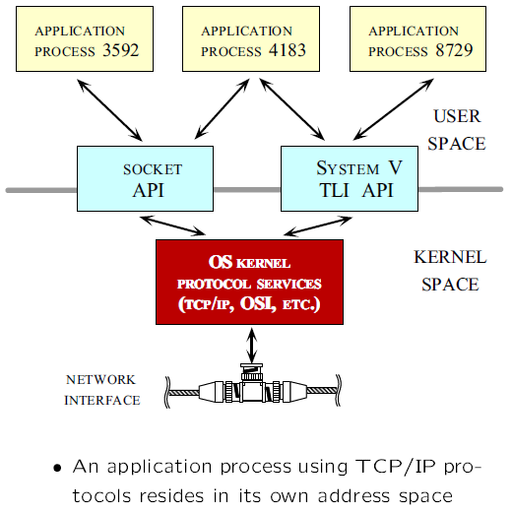
Socket interface

Slide 7
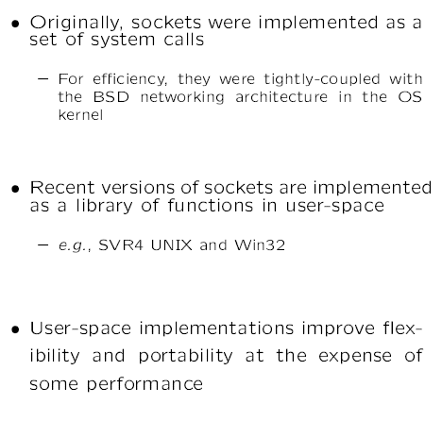
Socket interface

Slide 8
Motivation
offer guidance on network programming for beginners as well as professionals
for those developing new network-aware applications as well as those maintaining existing code
for people who simply want to understand how the networking components of their system function.

Slide 9
Expected study result
developing new network-aware
maintaining existing code
Understand the working principle
Learn some English in this field (read and understand this book)

Slide 10
Basic foundation
Operating system (Unix)
Network principle
C or C++ programming
Easy or difficult?
鲁班学艺的故事
C program
OS
Network

Slide 11
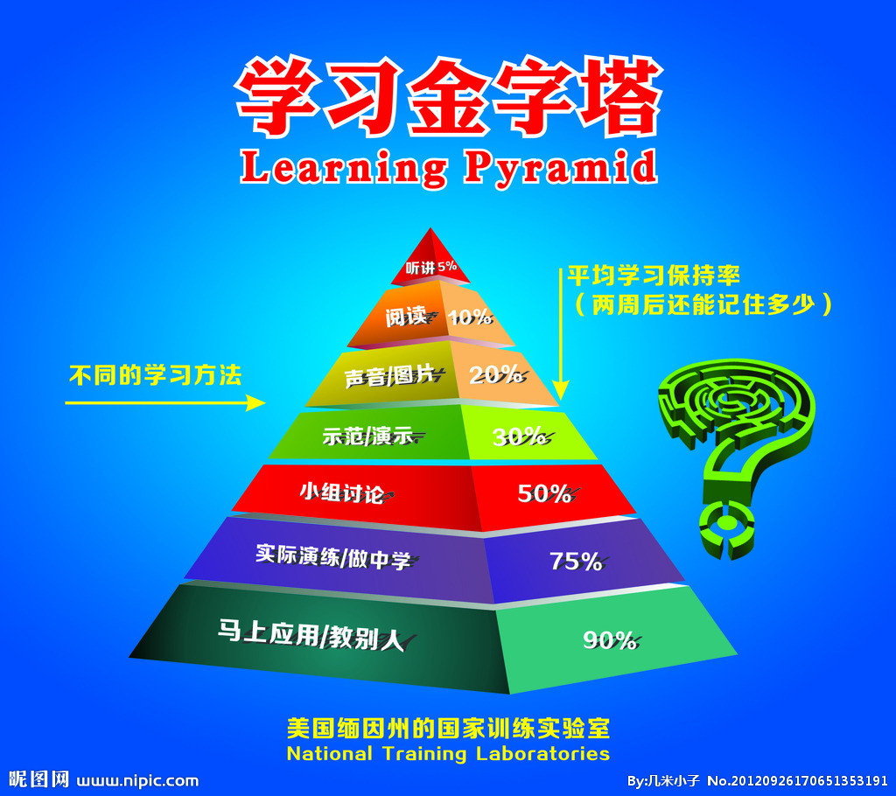
尊重学习规律，探索有效学习方式

Slide 12
Schedule
Teaching content （入门指导）
Watching the procedure(守望)
Experiment
Questions collection and solving
Homework （准备presentation）
Final examination（出勤率10，课堂报告20，考试70）

Slide 13
1.1 Client and server
Client
Client
Application protocol
Server
Client

Slide 14
Client-Server Model
Asymmetric Communication
  Client sends requests
  Server sends replies
Server/Daemon
  Well-known name (e.g., IP address + port)
  Waits for contact
  Processes requests, sends replies
Client
  Initiates contact
  Waits for response
Client
Client
Server
Client
Client

Slide 15
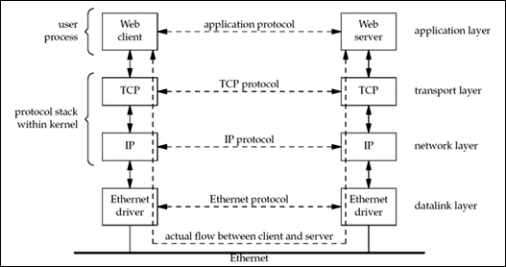
Client and server on the same Ethernet communicating using TCP

Slide 16
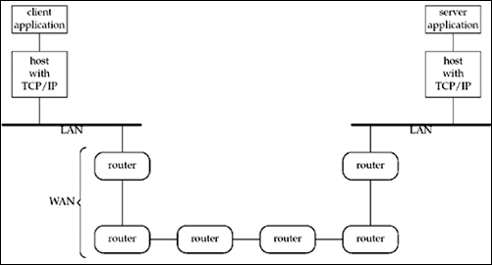
Client and server on different LANs connected through a WAN

Slide 17
1.2 A Simple Daytime Client
Let's consider a specific example to introduce many of the concepts and terms that we will encounter throughout the book. Figure 1.5 is an implementation of a TCP time-of-day client. This client establishes a TCP connection with a server and the server simply sends back the current time and date in a human-readable format.

Slide 18
TCP daytime client
1 #include "unp.h"
2 int
3 main(int argc, char **argv)
4 {
5 int sockfd, n;
6 char recvline[MAXLINE + 1];
7 struct sockaddr_in servaddr;
8 if (argc != 2)
9 err_quit("usage: a.out <IPaddress>");
10 if ( (sockfd = socket(AF_INET, SOCK_STREAM, 0)) < 0)
11 err_sys("socket error");

Slide 19
TCP daytime client
12 bzero(&servaddr, sizeof(servaddr));
13 servaddr.sin_family = AF_INET;
14 servaddr.sin_port = htons(13); /* daytime server */
15 if (inet_pton(AF_INET, argv[1], &servaddr.sin_addr) <= 0)
16 err_quit("inet_pton error for %s", argv[1]);
17 if (connect(sockfd, (SA *) &servaddr, sizeof(servaddr)) < 0)
18 err_sys("connect error");
19 while ( (n = read(sockfd, recvline, MAXLINE)) > 0) {
20 recvline[n] = 0; /* null terminate */
21 if (fputs(recvline, stdout) == EOF)
22 err_sys("fputs error");
23 }
24 if (n < 0)
25 err_sys("read error");
26 exit(0);
27 }

Slide 20
Ipv6
7 struct sockaddr_in6 servaddr;
8 if (argc != 2)
9 err_quit("usage: a.out <IPaddress>");
10 if ( (sockfd = socket(AF_INET6, SOCK_STREAM, 0)) < 0)
11 err_sys("socket error");
12 bzero(&servaddr, sizeof(servaddr));
13 servaddr.sin6_family = AF_INET6;
14 servaddr.sin6_port = htons(13); /* daytime server */
15 if (inet_pton(AF_INET6, argv[1], &servaddr.sin6_addr) <= 0)
16 err_quit("inet_pton error for %s", argv[1]);

Slide 21
1.3 Protocol Independence
Our program in Figure 1.5 is protocol-dependent on IPv4. changes highlighted in bold. We allocate and initialize a sockaddr_in structure, we set the family of this structure to AF_INET, and we specify the first argument to socket as AF_INET.
To modify the program to work under IPv6, we must change the code. Figure 1.6 shows a version that works under IPv6, with the

Slide 22
1.4 Error Handling: Wrapper Functions
In any real-world program, it is essential to check every function call for an error return
we can shorten our programs by defining a wrapper function that performs the actual function call, tests the return value, and terminates on an error. The convention we use is to capitalize the name of the function
sockfd = Socket(AF_INET, SOCK_STREAM, 0)

Slide 23
Wrapper Functions
236 int
237 Socket(int family, int type, int protocol)
238 {
239 int n;
240 if ( (n = socket(family, type, protocol)) < 0)
241 err_sys("socket error");
242 return (n);
243 }

Slide 24
1.5 A Simple Daytime Server
We can write a simple version of a TCP daytime server, which will work with the client from Section 1.2. We use the wrapper functions that we described in the previous section and show this server in Figure 1.9.

Slide 25
A Simple Daytime Server
1 #include "unp.h".
2 #include <time.h>
3 int
4 main(int argc, char **argv)
5 {
6 int listenfd, connfd;
7 struct sockaddr_in servaddr;
8 char buff[MAXLINE];
9 time_t ticks;
10 listenfd = Socket(AF_INET, SOCK_STREAM, 0);

Slide 26
A Simple Daytime Server
11 bzeros(&servaddr, sizeof(servaddr));
12 servaddr.sin_family = AF_INET;
13 servaddr.sin_addr.s_addr = htonl(INADDR_ANY);
14 servaddr.sin_port = htons(13); /* daytime server */
15 Bind(listenfd, (SA *) &servaddr, sizeof(servaddr));
16 Listen(listenfd, LISTENQ);
17 for ( ; ; ) {
18 connfd = Accept(listenfd, (SA *) NULL, NULL);
19 ticks = time(NULL);
20 snprintf(buff, sizeof(buff), "%.24s\r\n", ctime(&ticks));
21 Write(connfd, buff, strlen(buff));
22 Close(connfd);
23 }
24 }

Slide 27
1.6 Roadmap to Client/Server Examples in the Text
Two client/server examples are used predominantly throughout the text to illustrate the various techniques used in network programming
A daytime client/server (which we started in Figures 1.5, 1.6, and 1.9)
An echo client/server (which will start in Chapter 5)

Slide 28
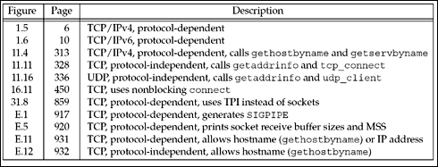
Different versions of the daytime client developed in the text

Slide 29
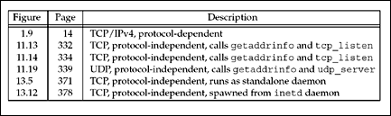
Different versions of the daytime server developed in the text

Slide 30
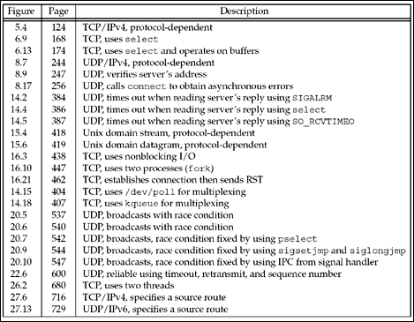
Different versions of the echo client developed in the t

Slide 31
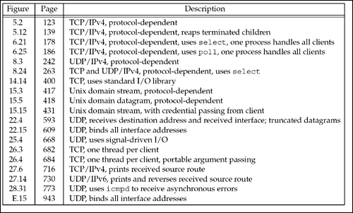
Different versions of the echo server developed in the text

Slide 32
1.7 OSI Model
A common way to describe the layers in a network is to use the International Organization for Standardization (ISO) open systems interconnection (OSI) model for computer communications. This is a seven-layer model, which we show in Figure 1.14, along with the approximate mapping to the Internet protocol suite.

Slide 33
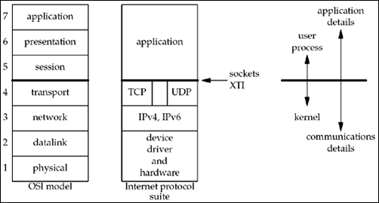
Layers in OSI model and Internet protocol suite

Slide 34
1.8 BSD Networking History
The sockets API originated with the 4.2BSD system, released in 1983. Figure 1.15 shows the development of the various BSD releases, noting the major TCP/IP developments. A few changes to the sockets API also took place in 1990 with the 4.3BSD Reno release, when the OSI protocols went into the BSD kernel.

Slide 35
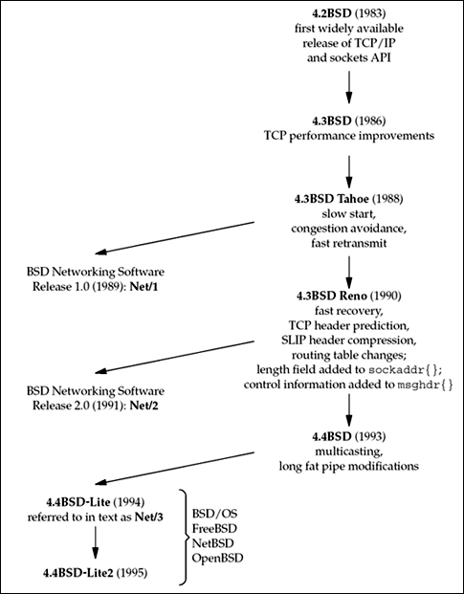

Slide 36
1.9 Test Networks and Hosts
Discovering Network Topology
netstat
ifconfig
ping

Slide 37
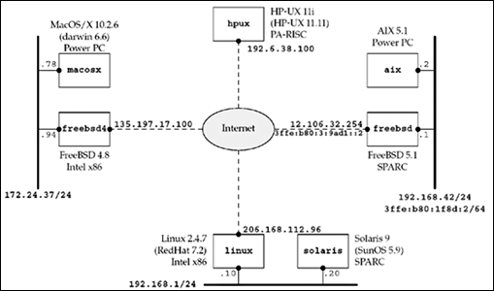
Networks and hosts used for most examples in the text

Slide 38
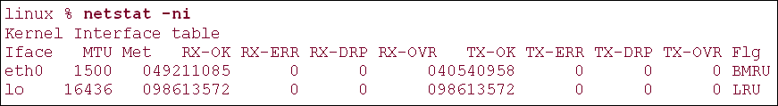
netstat -i provides information on the interfaces. We also specify the -n flag to print numeric addresses, instead of trying to find names for the networks.

Slide 39
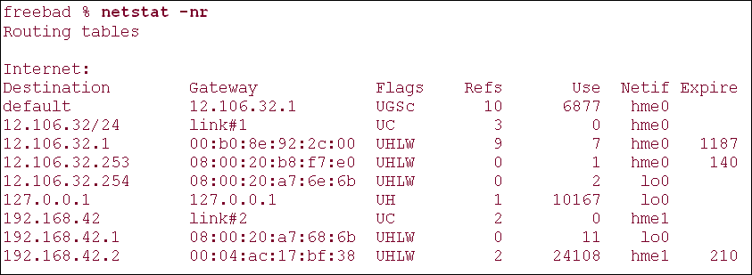
netstat -r shows the routing table, which is another way to determine the interfaces. We normally specify the -n flag to print numeric addresses.

Slide 40
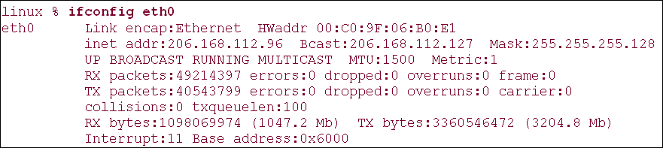
execute ifconfig to obtain the details for each interface

Slide 41
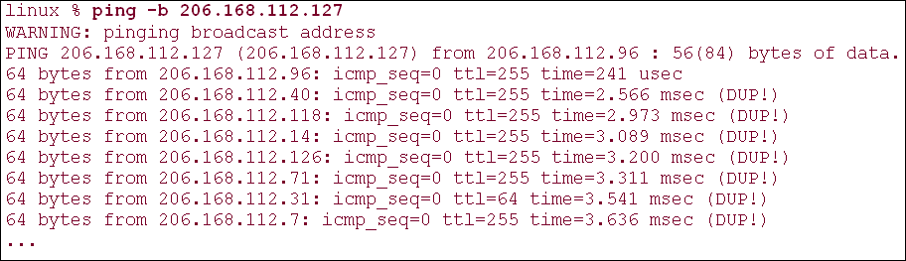
One way to find the IP address of many hosts on the local network is to ping the broadcast address

Slide 42
1.10 Unix Standards
the most interesting Unix standardization activity was being done by The Austin Common Standards Revision Group (CSRG). Their efforts have produced roughly 4,000 pages of specifications covering over 1,700 programming interfaces

Slide 43
1.11 64-Bit Architectures
the trend began toward 64-bit architectures and 64-bit software. One reason is for larger addressing within a process (i.e., 64-bit pointers)
which can address large amounts of memory (more than 2³² bytes).

Slide 44
1.12 Summary
Figure 1.5 and Figure 1.9 shows a complete version of the client and server. They introduce many of the terms and concepts that are expanded on throughout the rest of the book.
write protocol-independent code
wrapper functions

Slide 45
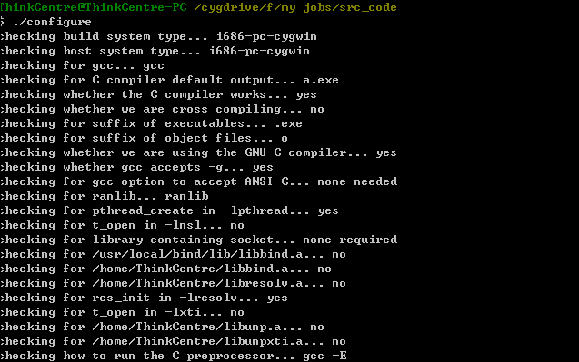
实验配置

Slide 46
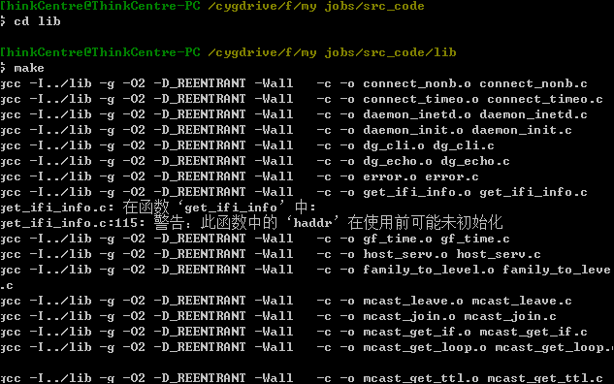
实验配置

Slide 47

实验配置

Slide 48

实验配置

Slide 50
实验配置
家庭作业：实验环境配置及实验报告

