Slide 1
Chapter 2. The Transport Layer: TCP, UDP, and SCTP

Slide 2
1 Motivation
provides an overview of the protocols in the TCP/IP suite
provide enough detail from a network programming perspective to understand how to use the protocols and provide references to more detailed descriptions of their actual design, implementation, and history
We need to understand the services provided by these transport protocols to the application, so that we know what is handled by the protocol and what we must handle in the application.
There are features of TCP that, when understood, make it easier for us to write robust clients and servers. Also, when we understand these features, it becomes easier to debug our clients and servers using commonly provided tools such as netstat

Slide 3
1 TCP, UDP, SCTP
UDP is a simple, unreliable datagram protocol, while TCP is a sophisticated, reliable byte-stream protocol. SCTP is similar to TCP as a reliable transport protocol
SCTP is a newer protocol, originally designed for transport of telephony signaling across the Internet.
These transport protocols use the network-layer protocol IP, either IPv4 or IPv6. While it is possible to use IPv4 or IPv6 directly, bypassing the transport layer, this technique, often called raw sockets, is used much less frequently

Slide 4
1 Topics in this section
TCP's three-way handshake
TCP's connection termination sequence
TCP's TIME_WAIT state
SCTP's four-way handshake
SCTP's connection termination
SCTP, TCP, and UDP buffering by the socket layer

Slide 5
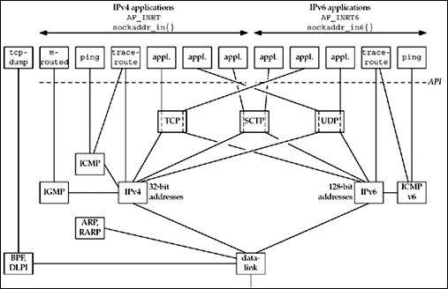
Overview of TCP/IP protocols

Slide 6
2 Protocol suite "TCP/IP"
IPv4 (Internet Protocol version 4). IPv4, which we often denote as just IP, has been the workhorse protocol of the IP suite since the early 1980s. It uses 32-bit addresses. IPv4 provides packet delivery service for TCP, UDP, SCTP, ICMP, and IGMP
IPv6 (Internet Protocol version 6). IPv6 was designed in the mid-1990s as a replacement for IPv4. The major change is a larger address comprising 128 bits, to deal with the explosive growth of the Internet in the 1990s. IPv6 provides packet delivery service for TCP, UDP, SCTP, and ICMPv6.We often use the word "IP" as an adjective, as in IP layer and IP address, when the distinction between IPv4 and IPv6 is not needed.

Slide 7
2 Protocol suite "TCP/IP"
TCP (Transmission Control Protocol). TCP is a connection-oriented protocol that provides a reliable, full-duplex byte stream to its users. TCP sockets are an example of stream sockets. TCP takes care of details such as acknowledgments, timeouts, retransmissions, and the like. Most Internet application programs use TCP. Notice that TCP can use either IPv4 or IPv6.
UDP (User Datagram Protocol). UDP is a connectionless protocol, and UDP sockets are an example of datagram sockets. There is no guarantee that UDP datagrams ever reach their intended destination. As with TCP, UDP can use either IPv4 or IPv6.

Slide 8
2 Protocol suite "TCP/IP"
SCTP (Stream Control Transmission Protocol). SCTP is a connection-oriented protocol that provides a reliable full-duplex association. The word "association" is used when referring to a connection in SCTP because SCTP is multihomed, involving a set of IP addresses and a single port for each side of an association. SCTP provides a message service, which maintains record boundaries. As with TCP and UDP, SCTP can use either IPv4 or IPv6, but it can also use both IPv4 and IPv6 simultaneously on the same association.

Slide 9
2 Protocol suite "TCP/IP"
ICMP (Internet Control Message Protocol). ICMP handles error and control information between routers and hosts. These messages are normally generated by and processed by the TCP/IP networking software itself, not user processes, although we show the ping and traceroute programs, which use ICMP. We sometimes refer to this protocol as ICMPv4 to distinguish it from ICMPv6.

Slide 10
2 Protocol suite "TCP/IP"
IGMP (Internet Group Management Protocol). IGMP is used with multicasting (Chapter 21), which is optional with IPv4.
ARP (Address Resolution Protocol). ARP maps an IPv4 address into a hardware address (such as an Ethernet address). ARP is normally used on broadcast networks such as Ethernet, token ring, and FDDI, and is not needed on point-to-point networks.

Slide 11
2 Protocol suite "TCP/IP"
RARP Reverse Address Resolution Protocol. RARP maps a hardware address into an IPv4 address. It is sometimes used when a diskless node is booting.
ICMPv6 Internet Control Message Protocol version 6. ICMPv6 combines the functionality of ICMPv4, IGMP, and ARP.

Slide 12
2 Protocol suite "TCP/IP"
BPF (BSD packet filter). This interface provides access to the datalink layer. It is normally found on Berkeley-derived kernels.
DLPI (Datalink provider interface). This interface also provides access to the datalink layer. It is normally provided with SVR4.

Slide 13
3 User Datagram Protocol (UDP)
a simple transport-layer protocol
The application writes a message to a UDP socket, which is then encapsulated in a UDP datagram, which is then further encapsulated as an IP datagram, which is then sent to its destination. There is no guarantee that a UDP datagram will ever reach its final destination, that order will be preserved across the network, or that datagrams arrive only once.

Slide 14
3 User Datagram Protocol (UDP)
lack of reliability
If we want to be certain that a datagram reaches its destination, we can build lots of features into our application: acknowledgments from the other end, timeouts, retransmissions, and the like.
Each UDP datagram has a length. TCP is a byte-stream protocol, without any record boundaries at all, which differs from UDP.

Slide 15
3 User Datagram Protocol (UDP)
UDP provides a connectionless service, as there need not be any long-term relationship between a UDP client and server.
For example, a UDP client can create a socket and send a datagram to a given server and then immediately send another datagram on the same socket to a different server.
Similarly, a UDP server can receive several datagrams on a single UDP socket, each from a different client.

Slide 16
4 Transmission Control Protocol (TCP)

Slide 17
4 Transmission Control Protocol (TCP)
The service provided by TCP to an application is different from the service provided by UDP.
TCP provides connections between clients and servers. A TCP client establishes a connection with a given server, exchanges data with that server across the connection, and then terminates the connection.

Slide 18
4 Transmission Control Protocol (TCP)
TCP also provides reliability.
When TCP sends data to the other end, it requires an acknowledgment in return.
If an acknowledgment is not received, TCP automatically retransmits the data and waits a longer amount of time.
After some number of retransmissions, TCP will give up, with the total amount of time spent trying to send data typically between 4 and 10 minutes (depending on the implementation).

Slide 19
4 Transmission Control Protocol (TCP)
TCP contains algorithms to estimate the round-trip time (RTT) between a client and server dynamically so that it knows how long to wait for an acknowledgment.
For example, the RTT on a LAN can be milliseconds while across a WAN, it can be seconds. Furthermore, TCP continuously estimates the RTT of a given connection, because the RTT is affected by variations in the network traffic.

Slide 20
4 Transmission Control Protocol (TCP)
TCP also sequences the data by associating a sequence number with every byte that it sends.
For example, assume an application writes 2,048 bytes to a TCP socket, causing TCP to send two segments, the first containing the data with sequence numbers 1–1,024 and the second containing the data with sequence numbers 1,025–2,048. (A segment is the unit of data that TCP passes to IP.)
If the segments arrive out of order, the receiving TCP will reorder the two segments based on their sequence numbers before passing the data to the receiving application.
If TCP receives duplicate data from its peer (say the peer thought a segment was lost and retransmitted it, when it wasn't really lost, the network was just overloaded), it can detect that the data has been duplicated (from the sequence numbers), and discard the duplicate data.

Slide 21
4 Transmission Control Protocol (TCP)
There is no reliability provided by UDP.
UDP itself does not provide anything like acknowledgments, sequence numbers, RTT estimation, timeouts, or retransmissions.
If a UDP datagram is duplicated in the network, two copies can be delivered to the receiving host
Also, if a UDP client sends two datagrams to the same destination, they can be reordered by the network and arrive out of order. UDP applications must handle all these cases

Slide 22
4 Transmission Control Protocol (TCP)
TCP provides flow control.
TCP always tells its peer exactly how many bytes of data it is willing to accept from the peer at any one time. This is called the advertised window. At any time, the window is the amount of room currently available in the receive buffer, guaranteeing that the sender cannot overflow the receive buffer.
The window changes dynamically over time: As data is received from the sender, the window size decreases, but as the receiving application reads data from the buffer, the window size increases. It is possible for the window to reach 0: when TCP's receive buffer for a socket is full and it must wait for the application to read data from the buffer before it can take any more data from the peer.

Slide 23
4 Transmission Control Protocol (TCP)
UDP provides no flow control. It is easy for a fast UDP sender to transmit datagrams at a rate that the UDP receiver cannot keep up with.

Slide 24
4 Transmission Control Protocol (TCP)
Finally, a TCP connection is full-duplex. This means that an application can send and receive data in both directions on a given connection at any time. This means that TCP must keep track of state information such as sequence numbers and window sizes for each direction of data flow: sending and receiving. After a full-duplex connection is established, it can be turned into a simplex connection if desired

Slide 25
5 Stream Control Transmission Protocol (SCTP)
SCTP provides services similar to those offered by UDP and TCP.
SCTP provides associations between clients and servers. SCTP also provides applications with reliability, sequencing, flow control, and full-duplex data transfer, like TCP.
The word "association" is used in SCTP instead of "connection" to avoid the connotation that a connection involves communication between only two IP addresses. An association refers to a communication between two systems, which may involve more than two addresses due to multihoming.

Slide 26
5 Stream Control Transmission Protocol (SCTP)
Unlike TCP, SCTP is message-oriented. It provides sequenced delivery of individual records. Like UDP, the length of a record written by the sender is passed to the receiving application.

Slide 27
5 Stream Control Transmission Protocol (SCTP)
SCTP can provide multiple streams between connection endpoints, each with its own reliable sequenced delivery of messages. A lost message in one of these streams does not block delivery of messages in any of the other streams. This approach is in contrast to TCP, where a loss at any point in the single stream of bytes blocks delivery of all future data on the connection until the loss is repaired.

Slide 28
5 Stream Control Transmission Protocol (SCTP)
SCTP also provides a multihoming feature, which allows a single SCTP endpoint to support multiple IP addresses.
This feature can provide increased robustness against network failure. An endpoint can have multiple redundant network connections, where each of these networks has a different connection to the Internet infrastructure.
SCTP can work around a failure of one network or path across the Internet by switching to another address already associated with the SCTP association.

Slide 29
5 Stream Control Transmission Protocol (SCTP)
Similar robustness can be obtained from TCP with help from routing protocols. For example, BGP connections within a domain (iBGP) often use addresses that are assigned to a virtual interface within the router as the endpoints of the TCP connection. The domain's routing protocol ensures that if there is a route between two routers, it can be used, which would not be possible if the addresses used belonged to an interface that went down, for example. SCTP's multihoming feature allows hosts to multihome, not just routers, and allows this multihoming to occur across different service providers, which the routing-based TCP method cannot allow.

Slide 30
6 TCP Connection Establishment and Termination
The server must be prepared to accept an incoming connection. This is normally done by calling socket, bind, and listen and is called a passive open.
The client issues an active open by calling connect. This causes the client TCP to send a "synchronize" (SYN) segment, which tells the server the client's initial sequence number for the data that the client will send on the connection. Normally, there is no data sent with the SYN; it just contains an IP header, a TCP header, and possible TCP options (which we will talk about shortly).
The server must acknowledge (ACK) the client's SYN and the server must also send its own SYN containing the initial sequence number for the data that the server will send on the connection. The server sends its SYN and the ACK of the client's SYN in a single segment.
The client must acknowledge the server's SYN.
The minimum number of packets required for this exchange is three; hence, this is called TCP's three-way handshake. We show the three segments in Figure 2.2.

Slide 31
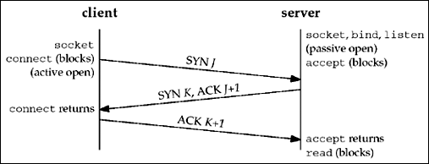
TCP three-way handshake

Slide 32
6 TCP Connection Establishment and Termination
An everyday analogy for establishing a TCP connection is the telephone system.
The socket function is the equivalent of having a telephone to use.
bind is telling other people your telephone number so that they can call you. listen is turning on the ringer so that you will hear when an incoming call arrives.
connect requires that we know the other person's phone number and dial it. accept is when the person being called answers the phone. Having the client's identity returned by accept (where the identify is the client's IP address and port number) is similar to having the caller ID feature show the caller's phone number.
One difference, however, is that accept returns the client's identity only after the connection has been established, whereas the caller ID feature shows the caller's phone number before we choose whether to answer the phone or not.
If the DNS is used (Chapter 11), it provides a service analogous to a telephone book. getaddrinfo is similar to looking up a person's phone number in the phone book. getnameinfo would be the equivalent of having a phone book sorted by telephone numbers that we could search, instead of a book sorted by name.

Slide 33
6 TCP Connection Establishment and Termination
TCP Options
Each SYN can contain TCP options. Commonly used options include the following:
MSS option. With this option, the TCP sending the SYN announces its maximum segment size, the maximum amount of data that it is willing to accept in each TCP segment, on this connection. The sending TCP uses the receiver's MSS value as the maximum size of a segment that it sends. We will see how to fetch and set this TCP option with the TCP_MAXSEG socket option (Section 7.9).

Slide 34
6 TCP Connection Establishment and Termination
Window scale option. The maximum window that either TCP can advertise to the other TCP is 65,535, because the corresponding field in the TCP header occupies 16 bits. But, high-speed connections, common in today's Internet or long delay paths (satellite links) require a larger window to obtain the maximum throughput possible. This newer option specifies that the advertised window in the TCP header must be scaled (left-shifted) by 0–14 bits, providing a maximum window of almost one gigabyte (65,535 x 214). Both end-systems must support this option for the window scale to be used on a connection.

Slide 35
6 TCP Connection Establishment and Termination
Timestamp option. This option is needed for high-speed connections to prevent possible data corruption caused by old, delayed, or duplicated segments. Since it is a newer option, it is negotiated similarly to the window scale option. As network programmers there is nothing we need to worry about with this option.
These common options are supported by most implementations. The latter two are sometimes called the "RFC 1323 options," as that RFC [Jacobson, Braden, and Borman 1992] specifies the options. They are also called the "long fat pipe options," since a network with either a high bandwidth or a long delay is called a long fat pipe.

Slide 36
6 TCP Connection Establishment and Termination
TCP Connection Termination
While it takes three segments to establish a connection, it takes four to terminate a connection.
1 One application calls close first, and we say that this end performs the active close. This end's TCP sends a FIN segment, which means it is finished sending data.
2 The other end that receives the FIN performs the passive close. The received FIN is acknowledged by TCP. The receipt of the FIN is also passed to the application as an end-of-file (after any data that may have already been queued for the application to receive), since the receipt of the FIN means the application will not receive any additional data on the connection.
3 Sometime later, the application that received the end-of-file will close its socket. This causes its TCP to send a FIN.
4 The TCP on the system that receives this final FIN (the end that did the active close) acknowledges the FIN.

Slide 37
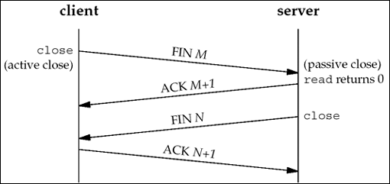
Packets exchanged when a TCP connection is closed

Slide 38
6 TCP Connection Termination
Since a FIN and an ACK are required in each direction, four segments are normally required.
We use the qualifier "normally" because in some scenarios, the FIN in Step 1 is sent with data. Also, the segments in Steps 2 and 3 are both from the end performing the passive close and could be combined into one segment.
We show these packets in Figure 2.3.
A FIN occupies one byte of sequence number space just like a SYN. Therefore, the ACK of each FIN is the sequence number of the FIN plus one.

Slide 39
6 TCP Connection Termination
Between Steps 2 and 3 it is possible for data to flow from the end doing the passive close to the end doing the active close. This is called a half-close and we will talk about this in detail with the shutdown function in Section 6.6.
The sending of each FIN occurs when a socket is closed. We indicated that the application calls close for this to happen, but realize that when a Unix process terminates, either voluntarily (calling exit or having the main function return) or involuntarily (receiving a signal that terminates the process), all open descriptors are closed, which will also cause a FIN to be sent on any TCP connection that is still open.
Although we show the client in Figure 2.3 performing the active close, either end—the client or the server—can perform the active close. Often the client performs the active close, but with some protocols (notably HTTP/1.0), the server performs the active close.

Slide 40
6 TCP State Transition Diagram
The operation of TCP with regard to connection establishment and connection termination can be specified with a state transition diagram. We show this in Figure 2.4.

Slide 41
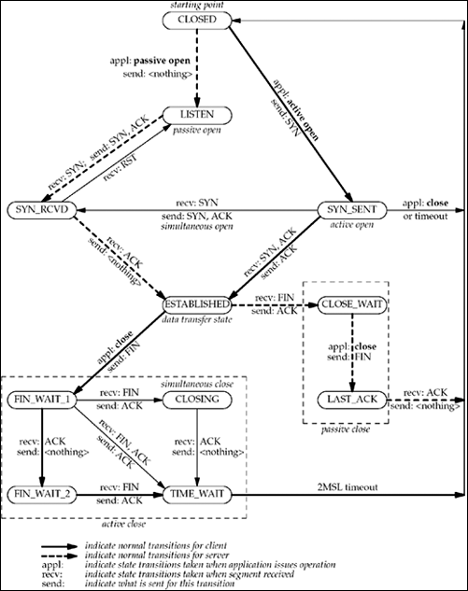

Slide 42
6 TCP State Transition Diagram
There are 11 different states defined for a connection and the rules of TCP dictate the transitions from one state to another, based on the current state and the segment received in that state.
For example, if an application performs an active open in the CLOSED state, TCP sends a SYN and the new state is SYN_SENT. If TCP next receives a SYN with an ACK, it sends an ACK and the new state is ESTABLISHED. This final state is where most data transfer occurs.

Slide 43
6 TCP State Transition Diagram
The two arrows leading from the ESTABLISHED state deal with the termination of a connection. If an application calls close before receiving a FIN (an active close), the transition is to the FIN_WAIT_1 state. But if an application receives a FIN while in the ESTABLISHED state (a passive close), the transition is to the CLOSE_WAIT state.

Slide 44
6 TCP State Transition Diagram
We denote the normal client transitions with a darker solid line and the normal server transitions with a darker dashed line. We also note that there are two transitions that we have not talked about: a simultaneous open (when both ends send SYNs at about the same time and the SYNs cross in the network) and a simultaneous close (when both ends send FINs at the same time). Chapter 18 of TCPv1 contains examples and a discussion of both scenarios, which are possible but rare.

Slide 45
Watching the Packets
Figure 2.5 shows the actual packet exchange that takes place for a complete TCP connection: the connection establishment, data transfer, and connection termination. We also show the TCP states through which each endpoint passes.

Slide 46
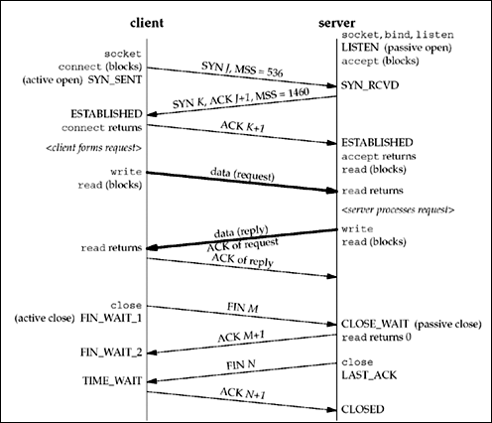

Slide 47
Watching the Packets
The client in this example announces an MSS of 536 (indicating that it implements only the minimum reassembly buffer size) and the server announces an MSS of 1,460 (typical for IPv4 on an Ethernet). It is okay for the MSS to be different in each direction (see Exercise 2.5).

Slide 48
Watching the Packets
Once a connection is established, the client forms a request and sends it to the server. We assume this request fits into a single TCP segment (i.e., less than 1,460 bytes given the server's announced MSS). The server processes the request and sends a reply, and we assume that the reply fits in a single segment (less than 536 in this example).
We show both data segments as bolder arrows. Notice that the acknowledgment of the client's request is sent with the server's reply. This is called piggybacking and will normally happen when the time it takes the server to process the request and generate the reply is less than around 200 ms. If the server takes longer, say one second, we would see the acknowledgment followed later by the reply.

Slide 49
Watching the Packets
We then show the four segments that terminate the connection. Notice that the end that performs the active close (the client in this scenario) enters the TIME_WAIT state. We will discuss this in the next section.

Slide 50
Watching the Packets
It is important to notice in Figure 2.5 that if the entire purpose of this connection was to send a one-segment request and receive a one-segment reply, there would be eight segments of overhead involved when using TCP. If UDP was used instead, only two packets would be exchanged: the request and the reply. But switching from TCP to UDP removes all the reliability that TCP provides to the application, pushing lots of these details from the transport layer (TCP) to the UDP application.
Another important feature provided by TCP is congestion control, which must then be handled by the UDP application. Nevertheless, it is important to understand that many applications are built using UDP because the application exchanges small amounts of data and UDP avoids the overhead of TCP connection establishment and connection termination.

Slide 51
2.7 TIME_WAIT State
Undoubtedly, one of the most misunderstood aspects of TCP with regard to network programming is its TIME_WAIT state. We can see in Figure 2.4 that the end that performs the active close goes through this state. The duration that this endpoint remains in this state is twice the maximum segment lifetime (MSL), sometimes called 2MSL.

Slide 52
2.7 TIME_WAIT State
Every implementation of TCP must choose a value for the MSL. The recommended value in RFC 1122 [Braden 1989] is 2 minutes, although Berkeley-derived implementations have traditionally used a value of 30 seconds instead. This means the duration of the TIME_WAIT state is between 1 and 4 minutes. The MSL is the maximum amount of time that any given IP datagram can live in a network. We know this time is bounded because every datagram contains an 8-bit hop limit with a maximum value of 255. Although this is a hop limit and not a true time limit, the assumption is made that a packet with the maximum hop limit of 255 cannot exist in a network for more than MSL seconds.

Slide 53
2.7 TIME_WAIT State
The way in which a packet gets "lost" in a network is usually the result of routing anomalies. A router crashes or a link between two routers goes down and it takes the routing protocols seconds or minutes to stabilize and find an alternate path. During that time period, routing loops can occur (router A sends packets to router B, and B sends them back to A) and packets can get caught in these loops. In the meantime, assuming the lost packet is a TCP segment, the sending TCP times out and retransmits the packet, and the retransmitted packet gets to the final destination by some alternate path. But sometime later (up to MSL seconds after the lost packet started on its journey), the routing loop is corrected and the packet that was lost in the loop is sent to the final destination. This original packet is called a lost duplicate or a wandering duplicate. TCP must handle these duplicates.

Slide 54
2.7 TIME_WAIT State
There are two reasons for the TIME_WAIT state:
To implement TCP's full-duplex connection termination reliably
To allow old duplicate segments to expire in the network

Slide 55
2.7 TIME_WAIT State
The first reason can be explained by looking at Figure 2.5 and assuming that the final ACK is lost. The server will resend its final FIN, so the client must maintain state information, allowing it to resend the final ACK. If it did not maintain this information, it would respond with an RST (a different type of TCP segment), which would be interpreted by the server as an error. If TCP is performing all the work necessary to terminate both directions of data flow cleanly for a connection (its full-duplex close), then it must correctly handle the loss of any of these four segments. This example also shows why the end that performs the active close is the end that remains in the TIME_WAIT state: because that end is the one that might have to retransmit the final ACK.

Slide 56
2.7 TIME_WAIT State
To understand the second reason for the TIME_WAIT state, assume we have a TCP connection between 12.106.32.254 port 1500 and 206.168.112.219 port 21. This connection is closed and then sometime later, we establish another connection between the same IP addresses and ports: 12.106.32.254 port 1500 and 206.168.112.219 port 21. This latter connection is called an incarnation of the previous connection since the IP addresses and ports are the same.
TCP must prevent old duplicates from a connection from reappearing at some later time and being misinterpreted as belonging to a new incarnation of the same connection.
To do this, TCP will not initiate a new incarnation of a connection that is currently in the TIME_WAIT state. Since the duration of the TIME_WAIT state is twice the MSL, this allows MSL seconds for a packet in one direction to be lost, and another MSL seconds for the reply to be lost.
By enforcing this rule, we are guaranteed that when we successfully establish a TCP connection, all old duplicates from previous incarnations of the connection have expired in the network.

Slide 57
2.7 TIME_WAIT State
There is an exception to this rule. Berkeley-derived implementations will initiate a new incarnation of a connection that is currently in the TIME_WAIT state if the arriving SYN has a sequence number that is "greater than" the ending sequence number from the previous incarnation. Pages 958–959 of TCPv2 talk about this in more detail. This requires the server to perform the active close, since the TIME_WAIT state must exist on the end that receives the next SYN. This capability is used by the rsh command. RFC 1185 [Jacobson, Braden, and Zhang 1990] talks about some pitfalls in doing this.

Slide 58
2.8 SCTP Association Establishment and Termination
Four-Way Handshake
The following scenario, similar to TCP, occurs when an SCTP association is established:
1 The server must be prepared to accept an incoming association. This preparation is normally done by calling socket, bind, and listen and is called a passive open.
2 The client issues an active open by calling connect or by sending a message, which implicitly opens the association. This causes the client SCTP to send an INIT message (which stands for "initialization") to tell the server the client's list of IP addresses, initial sequence number, initiation tag to identify all packets in this association, number of outbound streams the client is requesting, and number of inbound streams the client can support.
3 The server acknowledges the client's INIT message with an INIT-ACK message, which contains the server's list of IP addresses, initial sequence number, initiation tag, number of outbound streams the server is requesting, number of inbound streams the server can support, and a state cookie. The state cookie contains all of the state that the server needs to ensure that the association is valid, and is digitally signed to ensure its validity.
4 The client echos the server's state cookie with a COOKIE-ECHO message. This message may also contain user data bundled within the same packet.
5 The server acknowledges that the cookie was correct and that the association was established with a COOKIE-ACK message. This message may also contain user data bundled within the same packet.
The minimum number of packets required for this exchange is four; hence, this process is called SCTP's four-way handshake. We show a picture of the four segments in Figure 2.6.

Slide 59
2.8 SCTP Association Establishment and Termination
The SCTP four-way handshake is similar in many ways to TCP's three-way handshake, except for the cookie generation, which is an integral part.
The INIT carries with it (along with its many parameters) a verification tag, Ta, and an initial sequence number, J.
The tag Ta must be present in every packet sent by the peer for the life of the association.
The initial sequence number J is used as the starting sequence number for DATA messages termed DATA chunks.
The peer also chooses a verification tag, Tz, which must be present in each of its packets for the life of the association.
Along with the verification tag and initial sequence number, K, the receiver of the INIT also sends a cookie, C. The cookie contains all the state needed to set up the SCTP association, so that the server's SCTP stack does not need to keep information about the associating client.

Slide 60
2.8 SCTP Association Establishment and Termination
At the conclusion of the four-way handshake, each side chooses a primary destination address. The primary destination address is used as the default destination to which data will be sent in the absence of network failure.
The four-way handshake is used in SCTP to avoid a form of denial-of-service attack we will discuss in Section 4.5.
SCTP's four-way handshake using Cookies formalizes a method of protection against this attack. Many TCP implementations use a similar method; the big difference is that in TCP, the cookie state must be encoded into the initial sequence number, which is only 32 bits. SCTP provides an arbitrary-length field, and requires cryptographic security to prevent attacks.

Slide 61
2.8 SCTP Association Establishment and Termination
Association Termination
Unlike TCP, SCTP does not permit a "half-closed" association. When one end shuts down an association, the other end must stop sending new data. The receiver of the shutdown request sends the data that was queued, if any, and then completes the shutdown. We show this exchange in Figure 2.7.
SCTP does not have a TIME_WAIT state like TCP, due to its use of verification tags. All chunks are tagged with the tag exchanged in the INIT chunks; a chunk from an old connection will arrive with an incorrect tag. Therefore, in lieu of keeping an entire connection in TIME_WAIT, SCTP instead places verification tag values in TIME_WAIT.

Slide 62
2.8 SCTP Association Establishment and Termination
SCTP State Transition Diagram
The operation of SCTP with regard to association establishment and termination can be specified with a state transition diagram. We show this in Figure 2.8.

Slide 63
2.8 SCTP Association Establishment and Termination
As in Figure 2.4, the transitions from one state to another in the state machine are dictated by the rules of SCTP, based on the current state and the chunk received in that state.
For example, if an application performs an active open in the CLOSED state, SCTP sends an INIT and the new state is COOKIE-WAIT. If SCTP next receives an INIT ACK, it sends a COOKIE ECHO and the new state is COOKIE-ECHOED. If SCTP then receives a COOKIE ACK, it moves to the ESTABLISHED state. This final state is where most data transfer occurs, although DATA chunks can be piggybacked on COOKIE ECHO and COOKIE ACK chunks.

Slide 64
2.8 SCTP Association Establishment and Termination
The two arrows leading from the ESTABLISHED state deal with the termination of an association. If an application calls close before receiving a SHUTDOWN (an active close), the transition is to the SHUTDOWN-PENDING state. However, if an application receives a SHUTDOWN while in the ESTABLISHED state (a passive close), the transition is to the SHUTDOWN-RECEIVED state.

Slide 65
2.8 SCTP Association Establishment and Termination
Watching the Packets
Figure 2.9 shows the actual packet exchange that takes place for a sample SCTP association: the association establishment, data transfer, and association termination. We also show the SCTP states through which each endpoint passes.

Slide 66
2.8 SCTP Association Establishment and Termination
In this example, the client piggybacks its first data chunk on the COOKIE ECHO, and the server replies with data on the COOKIE ACK. In general, the COOKIE ECHO will often have one or more DATA chunks bundled with it when the application is using the one-to-many interface style
The unit of information within an SCTP packet is a "chunk." A "chunk" is self-descriptive and contains a chunk type, chunk flags, and a chunk length. This approach facilitates the bundling of chunks simply by combining multiple chunks into an SCTP outbound packet

Slide 67
SCTP Options
SCTP uses parameters and chunks to facilitate optional features. New features are defined by adding either of these two items, and allowing normal SCTP processing rules to report unknown parameters and unknown chunks. The upper two bits of both the parameter space and the chunk space dictate what an SCTP receiver should do with an unknown parameter or chunk

Slide 68
SCTP Options
Currently, two extensions for SCTP are under development:
The dynamic address extension, which allows cooperating SCTP endpoints to dynamically add and remove IP addresses from an existing association.
The partial reliability extension, which allows cooperating SCTP endpoints, under application direction, to limit the retransmission of data. When a message becomes too old to send (according to the application's direction), the message will be skipped and thus no longer sent to the peer. This means that not all data is assured of arrival at the other end of the association.

Slide 69
2.9 Port Numbers
At any given time, multiple processes can be using any given transport: UDP, SCTP, or TCP.
All three transport layers use 16-bit integer port numbers to differentiate between these processes.

Slide 70
2.9 Port Numbers
When a client wants to contact a server, the client must identify the server with which it wants to communicate.
TCP, UDP, and SCTP define a group of well-known ports to identify well-known services.
For example, every TCP/IP implementation that supports FTP assigns the well-known port of 21 (decimal) to the FTP server.
Trivial File Transfer Protocol (TFTP) servers are assigned the UDP port of 69.

Slide 71
2.9 Port Numbers
Clients, on the other hand, normally use ephemeral ports, that is, short-lived ports. These port numbers are normally assigned automatically by the transport protocol to the client.
Clients normally do not care about the value of the ephemeral port; the client just needs to be certain that the ephemeral port is unique on the client host. The transport protocol code guarantees this uniqueness.

Slide 72
2.9 Port Numbers
The Internet Assigned Numbers Authority (IANA) maintains a list of port number assignments. The port numbers are divided into three ranges:
The well-known ports: 0 through 1023. These port numbers are controlled and assigned by the IANA. When possible, the same port is assigned to a given service for TCP, UDP, and SCTP. For example, port 80 is assigned for a Web server, for both TCP and UDP, even though all implementations currently use only TCP.
The registered ports: 1024 through 49151. These are not controlled by the IANA, but the IANA registers and lists the uses of these ports as a convenience to the community.
The dynamic or private ports, 49152 through 65535. The IANA says nothing about these ports. These are what we call ephemeral ports

Slide 73
2.9 Port Numbers
Socket Pair
The socket pair for a TCP connection is the four-tuple that defines the two endpoints of the connection: the local IP address, local port, foreign IP address, and foreign port.
A socket pair uniquely identifies every TCP connection on a network. For SCTP, an association is identified by a set of local IP addresses, a local port, a set of foreign IP addresses, and a foreign port. In its simplest form, where neither endpoint is multihomed, this results in the same four-tuple socket pair used with TCP.
However, when either of the endpoints of an association are multihomed, then multiple four-tuple sets (with different IP addresses but the same port numbers) may identify the same association.

Slide 74
2.9 Port Numbers
The two values that identify each endpoint, an IP address and a port number, are often called a socket.
We can extend the concept of a socket pair to UDP, even though UDP is connectionless. When we describe the socket functions (bind, connect, getpeername, etc.), we will note which functions specify which values in the socket pair. For example, bind lets the application specify the local IP address and local port for TCP, UDP, and SCTP sockets.

Slide 75
2.10 TCP Port Numbers and Concurrent Servers
With a concurrent server, where the main server loop spawns a child to handle each new connection, what happens if the child continues to use the well-known port number while servicing a long request?
Let's examine a typical sequence. First, the server is started on the host freebsd, which is multihomed with IP addresses 12.106.32.254 and 192.168.42.1, and the server does a passive open using its well-known port number (21, for this example). It is now waiting for a client request, which we show in Figure 2.11.

Slide 76
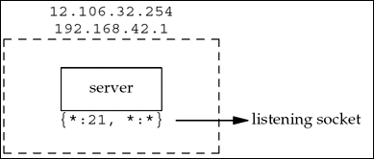
TCP server with a passive open on port 21

Slide 77
2.10 TCP Port Numbers and Concurrent Servers
We use the notation {*:21, *:*} to indicate the server's socket pair. The server is waiting for a connection request on any local interface (the first asterisk) on port 21. The foreign IP address and foreign port are not specified and we denote them as *:*. We also call this a listening socket.

Slide 78
2.10 TCP Port Numbers and Concurrent Servers
We use a colon to separate the IP address from the port number because that is what HTTP uses and is commonly seen elsewhere. The netstat program uses a period to separate the IP address and port, but this is sometimes confusing because decimal points are used in both domain names (freebsd.unpbook.com.21) and in IPv4 dotted-decimal notation (12.106.32.254.21).

Slide 79
2.10 TCP Port Numbers and Concurrent Servers
When we specify the local IP address as an asterisk, it is called the wildcard character. If the host on which the server is running is multihomed (as in this example), the server can specify that it wants only to accept incoming connections that arrive destined to one specific local interface. This is a one-or-any choice for the server. The server cannot specify a list of multiple addresses. The wildcard local address is the "any" choice. In Figure 1.9, the wildcard address was specified by setting the IP address in the socket address structure to INADDR_ANY before calling bind.

Slide 80
2.10 TCP Port Numbers and Concurrent Servers
At some later time, a client starts on the host with IP address 206.168.112.219 and executes an active open to the server's IP address of 12.106.32.254. We assume the ephemeral port chosen by the client TCP is 1500 for this example. This is shown in Figure 2.12. Beneath the client we show its socket pair.
When the server receives and accepts the client's connection, it forks a copy of itself, letting the child handle the client, as we show in Figure 2.13. (We will describe the fork function in Section 4.7.)

Slide 81
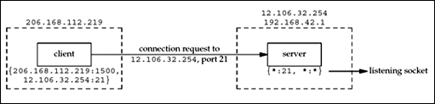
Connection request from client to server

Slide 82
2.10 TCP Port Numbers and Concurrent Servers
At this point, we must distinguish between the listening socket and the connected socket on the server host. Notice that the connected socket uses the same local port (21) as the listening socket. Also notice that on the multihomed server, the local address is filled in for the connected socket (12.106.32.254) once the connection is established.

Slide 83
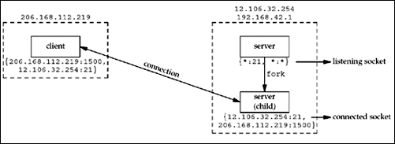
Concurrent server has child handle client

Slide 84
2.10 TCP Port Numbers and Concurrent Servers
The next step assumes that another client process on the client host requests a connection with the same server. The TCP code on the client host assigns the new client socket an unused ephemeral port number, say 1501. This gives us the scenario shown in Figure 2.14. On the server, the two connections are distinct: the socket pair for the first connection differs from the socket pair for the second connection because the client's TCP chooses an unused port for the second connection (1501).

Slide 85
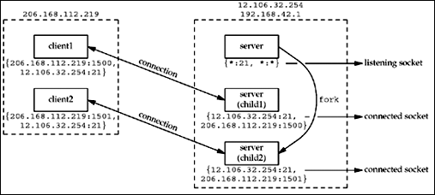
Second client connection with same server

Slide 86
2.10 TCP Port Numbers and Concurrent Servers
Notice from this example that TCP cannot demultiplex incoming segments by looking at just the destination port number. TCP must look at all four elements in the socket pair to determine which endpoint receives an arriving segment. In Figure 2.14, we have three sockets with the same local port (21). If a segment arrives from 206.168.112.219 port 1500 destined for 12.106.32.254 port 21, it is delivered to the first child. If a segment arrives from 206.168.112.219 port 1501 destined for 12.106.32.254 port 21, it is delivered to the second child. All other TCP segments destined for port 21 are delivered to the original server with the listening socket.

Slide 87
2.11 Buffer Sizes and Limitations
Certain limits affect the size of IP datagrams. We first describe these limits and then tie them all together with regard to how they affect the data an application can transmit.
The maximum size of an IPv4 datagram is 65,535 bytes, including the IPv4 header. This is because of the 16-bit total length field in Figure A.1.

Slide 88
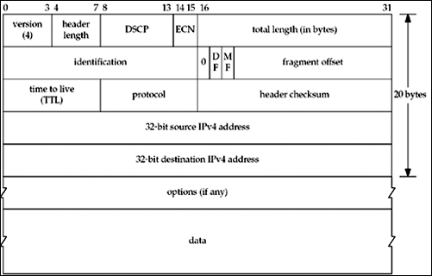
Format of the IPv4 header

Slide 89
2.11 Buffer Sizes and Limitations
The maximum size of an IPv6 datagram is 65,575 bytes, including the 40-byte IPv6 header. This is because of the 16-bit payload length field in Figure A.2. Notice that the IPv6 payload length field does not include the size of the IPv6 header, while the IPv4 total length field does include the header size.
IPv6 has a jumbo payload option, which extends the payload length field to 32 bits, but this option is supported only on datalinks with a maximum transmission unit (MTU) that exceeds 65,535. (This is intended for host-to-host interconnects, such as HIPPI, which often have no inherent MTU.)

Slide 90
2.11 Buffer Sizes and Limitations
Many networks have an MTU which can be dictated by the hardware. For example, the Ethernet MTU is 1,500 bytes. Other datalinks, such as point-to-point links using the Point-to-Point Protocol (PPP), have a configurable MTU. Older SLIP links often used an MTU of 1,006 or 296 bytes.
The minimum link MTU for IPv4 is 68 bytes. This permits a maximum-sized IPv4 header (20 bytes of fixed header, 30 bytes of options) and minimum-sized fragment (the fragment offset is in units of 8 bytes). The minimum link MTU for IPv6 is 1,280 bytes. IPv6 can run over links with a smaller MTU, but requires link-specific fragmentation and reassembly to make the link appear to have an MTU of at least 1,280 bytes (RFC 2460 [Deering and Hinden 1998]).

Slide 91
2.11 Buffer Sizes and Limitations
The smallest MTU in the path between two hosts is called the path MTU. Today, the Ethernet MTU of 1,500 bytes is often the path MTU. The path MTU need not be the same in both directions between any two hosts because routing in the Internet is often asymmetric [Paxson 1996]. That is, the route from A to B can differ from the route from B to A.
When an IP datagram is to be sent out an interface, if the size of the datagram exceeds the link MTU, fragmentation is performed by both IPv4 and IPv6. The fragments are not normally reassembled until they reach the final destination. IPv4 hosts perform fragmentation on datagrams that they generate and IPv4 routers perform fragmentation on datagrams that they forward. But with IPv6, only hosts perform fragmentation on datagrams that they generate; IPv6 routers do not fragment datagrams that they are forwarding.

Slide 92
2.11 Buffer Sizes and Limitations
If the "don't fragment" (DF) bit is set in the IPv4 header (Figure A.1), it specifies that this datagram must not be fragmented, either by the sending host or by any router. A router that receives an IPv4 datagram with the DF bit set whose size exceeds the outgoing link's MTU generates an ICMPv4 "destination unreachable, fragmentation needed but DF bit set" error message (Figure A.15).
IPv4 and IPv6 define a minimum reassembly buffer size, the minimum datagram size that we are guaranteed any implementation must support. For IPv4, this is 576 bytes. IPv6 raises this to 1,500 bytes. With IPv4, for example, we have no idea whether a given destination can accept a 577-byte datagram or not. Therefore, many IPv4 applications that use UDP (e.g., DNS, RIP, TFTP, BOOTP, SNMP) prevent applications from generating IP datagrams that exceed this size.

Slide 93
2.11 Buffer Sizes and Limitations
TCP has a maximum segment size (MSS) that announces to the peer TCP the maximum amount of TCP data that the peer can send per segment. We saw the MSS option on the SYN segments in Figure 2.5. The goal of the MSS is to tell the peer the actual value of the reassembly buffer size and to try to avoid fragmentation. The MSS is often set to the interface MTU minus the fixed sizes of the IP and TCP headers. On an Ethernet using IPv4, this would be 1,460, and on an Ethernet using IPv6, this would be 1,440. (The TCP header is 20 bytes for both, but the IPv4 header is 20 bytes and the IPv6 header is 40 bytes.)
SCTP keeps a fragmentation point based on the smallest path MTU found to all the peer's addresses. This smallest MTU size is used to split large user messages into smaller pieces that can be sent in one IP datagram. The SCTP_MAXSEG socket option can influence this value, allowing the user to request a smaller fragmentation point.

Slide 94
2.11 Buffer Sizes and Limitations
TCP Output
Every TCP socket has a send buffer and we can change the size of this buffer with the SO_SNDBUF socket option (Section 7.5). When an application calls write, the kernel copies all the data from the application buffer into the socket send buffer. If there is insufficient room in the socket buffer for all the application's data (either the application buffer is larger than the socket send buffer, or there is already data in the socket send buffer), the process is put to sleep. This assumes the normal default of a blocking socket. (We will talk about nonblocking sockets in Chapter 16.) The kernel will not return from the write until the final byte in the application buffer has been copied into the socket send buffer. Therefore, the successful return from a write to a TCP socket only tells us that we can reuse our application buffer. It does not tell us that either the peer TCP has received the data or that the peer application has received the data.

Slide 95
2.11 Buffer Sizes and Limitations
TCP takes the data in the socket send buffer and sends it to the peer TCP based on all the rules of TCP data transmission (Chapter 19 and 20 of TCPv1). The peer TCP must acknowledge the data, and as the ACKs arrive from the peer, only then can our TCP discard the acknowledged data from the socket send buffer. TCP must keep a copy of our data until it is acknowledged by the peer.

Slide 96
2.11 Buffer Sizes and Limitations
TCP sends the data to IP in MSS-sized or smaller chunks, prepending its TCP header to each segment, where the MSS is the value announced by the peer, or 536 if the peer did not send an MSS option. IP prepends its header, searches the routing table for the destination IP address (the matching routing table entry specifies the outgoing interface), and passes the datagram to the appropriate datalink. IP might perform fragmentation before passing the datagram to the datalink, but as we said earlier, one goal of the MSS option is to try to avoid fragmentation and newer implementations also use path MTU discovery. Each datalink has an output queue, and if this queue is full, the packet is discarded and an error is returned up the protocol stack: from the datalink to IP and then from IP to TCP. TCP will note this error and try sending the segment later. The application is not told of this transient condition.

Slide 97
2.11 Buffer Sizes and Limitations
UDP Output
This time, we show the socket send buffer as a dashed box because it doesn't really exist. A UDP socket has a send buffer size (which we can change with the SO_SNDBUF socket option, Section 7.5), but this is simply an upper limit on the maximum-sized UDP datagram that can be written to the socket. If an application writes a datagram larger than the socket send buffer size, EMSGSIZE is returned. Since UDP is unreliable, it does not need to keep a copy of the application's data and does not need an actual send buffer. (The application data is normally copied into a kernel buffer of some form as it passes down the protocol stack, but this copy is discarded by the datalink layer after the data is transmitted.)

Slide 98
2.11 Buffer Sizes and Limitations
UDP simply prepends its 8-byte header and passes the datagram to IP. IPv4 or IPv6 prepends its header, determines the outgoing interface by performing the routing function, and then either adds the datagram to the datalink output queue (if it fits within the MTU) or fragments the datagram and adds each fragment to the datalink output queue. If a UDP application sends large datagrams (say 2,000-byte datagrams), there is a much higher probability of fragmentation than with TCP, because TCP breaks the application data into MSS-sized chunks, something that has no counterpart in UDP

Slide 99
2.11 Buffer Sizes and Limitations
The successful return from a write to a UDP socket tells us that either the datagram or all fragments of the datagram have been added to the datalink output queue. If there is no room on the queue for the datagram or one of its fragments, ENOBUFS is often returned to the application.
Unfortunately, some implementations do not return this error, giving the application no indication that the datagram was discarded without even being transmitted.

Slide 100
SCTP Output
SCTP, since it is a reliable protocol like TCP, has a send buffer. As with TCP, an application can change the size of this buffer with the SO_SNDBUF socket option (Section 7.5).
When the application calls write, the kernel copies all the data from the application buffer into the socket send buffer. If there is insufficient room in the socket buffer for all of the application's data (either the application buffer is larger than the socket send buffer, or there is already data in the socket send buffer), the process is put to sleep. This sleeping assumes the normal default of a blocking socket. (We will talk about nonblocking sockets in Chapter 16.) The kernel will not return from the write until the final byte in the application buffer has been copied into the socket send buffer.
Therefore, the successful return from a write to an SCTP socket only tells the sender that it can reuse the application buffer. It does not tell us that either the peer SCTP has received the data, or that the peer application has received the data.

Slide 101
SCTP Output
SCTP takes the data in the socket send buffer and sends it to the peer SCTP based on all the rules of SCTP data transmission (for details of data transfer, see Chapter 5 of [Stewart and Xie 2001]).
The sending SCTP must await a SACK in which the cumulative acknowledgment point passes the sent data before that data can be removed from the socket buffer.

Slide 102
2.12 Standard Internet Services
Figure 2.18 lists several standard services that are provided by most implementations of TCP/IP. Notice that all are provided using both TCP and UDP and the port number is the same for both protocols.

Slide 103
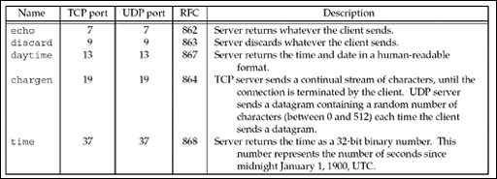
Standard TCP/IP services provided by most implementations

Slide 104
2.12 Standard Internet Services
Often these services are provided by the inetd daemon on Unix hosts (Section 13.5). These standard services provide an easy testing facility using the standard Telnet client. For example, the following tests both the daytime and echo servers:

Slide 105
2.12 Standard Internet Services
aix % telnet freebsd daytime
Trying 12.106.32.254...output by Telnet client
Connected to freebsd.unpbook.com. output by Telnet client
Escape character is '^]'. output by Telnet client
Mon Jul 28 11:56:22 2003 output by daytime server
Connection closed by foreign host. output by Telnet client (server closes connection)

Slide 106
2.12 Standard Internet Services
aix % telnet freebsd echo
Trying 12.106.32.254...output by Telnet client
Connected to freebsd.unpbook.com. output by Telnet client
Escape character is '^]'. output by Telnet client
hello, world we type this
hello, world and it is echoed back by the server
^] we type control and right bracket to talk to Telnet client
telnet> quit and tell client we are done
Connection closed. client closes the connection this time

Slide 107
2.12 Standard Internet Services
In these two examples, we type the name of the host and the name of the service (daytime and echo). These service names are mapped into the port numbers shown in Figure 2.18 by the /etc/services file, as we will describe in Section 11.5.
Notice that when we connect to the daytime server, the server performs the active close, while with the echo server, the client performs the active close. Recall from Figure 2.4 that the end performing the active close is the end that goes through the TIME_WAIT state.
These "simple services" are often disabled by default on modern systems due to denial-of-service and other resource utilization attacks against them.

Slide 108
2.13 Protocol Usage by Common Internet Applications
Figure 2.19 summarizes the protocol usage of various common Internet applications.
The first two applications, ping and traceroute, are diagnostic applications that use ICMP. traceroute builds its own UDP packets to send and reads ICMP replies.

Slide 109
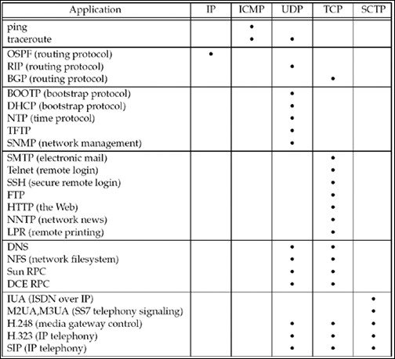
Protocol usage of various common Internet applications

Slide 110
2.13 Protocol Usage by Common Internet Applications
The three popular routing protocols demonstrate the variety of transport protocols used by routing protocols. OSPF uses IP directly, employing a raw socket, while RIP uses UDP and BGP uses TCP.
The next five are UDP-based applications, followed by seven TCP applications and four that use both UDP and TCP. The final five are IP telephony applications that use SCTP exclusively or optionally UDP, TCP, or SCTP.

Slide 111
2.14 Summary
UDP is a simple, unreliable, connectionless protocol
while TCP is a complex, reliable, connection-oriented protocol
SCTP combines some of the features of both protocols, providing additional features beyond those found in TCP.
While most applications on the Internet use TCP (the Web, Telnet, FTP, and email), there is a need for all three transport layers.
In Section 22.4, we will discuss the reasons to choose UDP instead of TCP. In Section 23.12, we will discuss the reasons to choose SCTP instead of TCP.

Slide 112
2.14 Summary
TCP establishes connections using a three-way handshake and terminates connections using a four-packet exchange.
When a TCP connection is established, it goes from the CLOSED state to the ESTABLISHED state, and when it is terminated, it goes back to the CLOSED state.
There are 11 states in which a TCP connection can be, and a state transition diagram gives the rules on how to go between the states.
Understanding this diagram is essential to diagnosing problems using the netstat command and understanding what happens when an application calls functions such as connect, accept, and close.

Slide 113
2.14 Summary
TCP's TIME_WAIT state is a continual source of confusion with network programmers.
This state exists to implement TCP's full-duplex connection termination (i.e., to handle the case of the final ACK being lost), and to allow old duplicate segments to expire in the network.

Slide 114
2.14 Summary
SCTP establishes an association by using a four-way handshake and terminates connections using a three-packet exchange.
When an SCTP association is established, it goes from the CLOSED state to the ESTABLISHED state, and when it is terminated, it goes back to the CLOSED state.
There are eight states in which an SCTP association can be, and a state transition diagram gives the rules on how to go between the states. SCTP does not need the TIME_WAIT state as TCP does due to its use of verification tags.

