Slide 1
Chapter 4. Elementary TCP Sockets

Slide 2
4.1 Introduction
Describes the elementary socket functions required to write a complete TCP client and server.
First describe all the elementary socket functions that we will be using and then develop the client and server in the next chapter.
We will work with this client and server throughout the text, enhancing it many times

Slide 3
4.1 Introduction
Describe concurrent servers, a common Unix technique for providing concurrency when numerous clients are connected to the same server at the same time.
Each client connection causes the server to fork a new process just for that client. In this chapter, we consider only the one-process-per-client model using fork, but we will consider a different one-thread-per-client model when we describe threads in Chapter 26.

Slide 4
4.1 Introduction
First, the server is started, then sometime later, a client is started that connects to the server. We assume that the client sends a request to the server, the server processes the request, and the server sends a reply back to the client.
This continues until the client closes its end of the connection, which sends an end-of-file notification to the server. The server then closes its end of the connection and either terminates or waits for a new client connection.

Slide 5
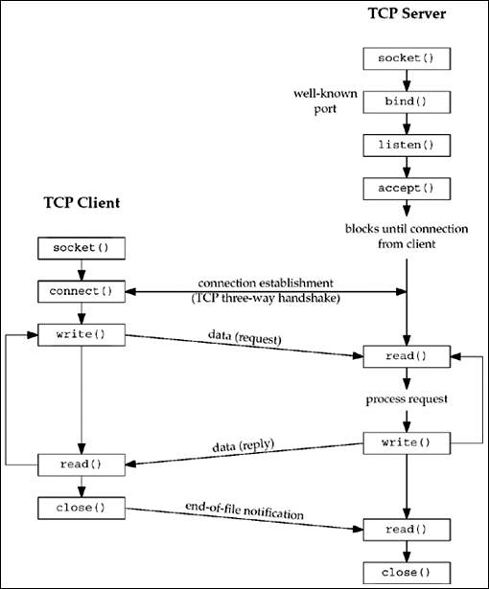
Socket functions for elementary TCP client/server

Slide 6
4.2 socket Function
To perform network I/O, the first thing a process must do is call the socket function, specifying the type of communication protocol desired (TCP using IPv4, UDP using IPv6, Unix domain stream protocol, etc.).

Slide 7
4.2 socket Function
#include <sys/socket.h>
int socket (int family, int type, int protocol);
Returns: non-negative descriptor if OK, -1 on err

Slide 8
4.2 socket Function
family specifies the protocol family and is one of the constants shown in Figure 4.2. This argument is often referred to as domain instead of family
Figure 4.2
Family | Description
AF_INET AF_INET6 AF_LOCAL AF_ROUTE AF_KEY | IPv4 protocols IPv6 protocols Unix domain protocols Routing socket Key socket

Slide 9
4.2 socket Function
The socket type is one of the constants shown in Figure 4.3.
Figure 4.3
Type | Description
sock_stream sock_dgram sock_seqpacket sock_raw | Stream socket Datagram socket Sequenced packet socket Raw socket

Slide 10
4.2 socket Function
The protocol argument to the socket function should be set to the specific protocol type found in Figure 4.4, or 0 to select the system's default for the given combination of family and type
Figure 4.4
Protocol | Description
ipproto_TCP ipproto_UDP ipproto_SCTP | TCP UDP SCTP

Slide 11
4.2 socket Function
Not all combinations of socket family and type are valid. Figure 4.5 shows the valid combinations, along with the actual protocols that are valid for each pair. The boxes marked "Yes" are valid but do not have handy acronyms. The blank boxes are not supported.

Slide 12
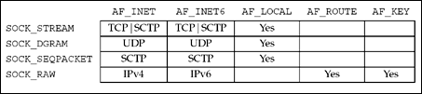
Figure 4.5. Combinations of family and type for the socket function.

Slide 13
4.2 socket Function
On success, the socket function returns a small non-negative integer value, similar to a file descriptor. We call this a socket descriptor, or a sockfd.
To obtain this socket descriptor, all we have specified is a protocol family (IPv4, IPv6, or Unix) and the socket type (stream, datagram, or raw).

Slide 14
4.2 socket Function
The "AF_" prefix stands for "address family" and the "PF_" prefix stands for "protocol family." Historically, the intent was that a single protocol family might support multiple address families and that the PF_ value was used to create the socket and the AF_ value was used in socket address structures.
But in actuality, a protocol family supporting multiple address families has never been supported and the <sys/socket.h> header defines the PF_ value for a given protocol to be equal to the AF_ value for that protocol.
While there is no guarantee that this equality between the two will always be true, should anyone change this for existing protocols, lots of existing code would break. To conform to existing coding practice, we use only the AF_ constants in this text, although you may encounter the PF_ value, mainly in calls to socket.

Slide 15
4.3 connect Function
The connect function is used by a TCP client to establish a connection with a TCP server
#include <sys/socket.h>
int connect(int sockfd, const struct sockaddr *servaddr, socklen_t addrlen);
Returns: 0 if OK, -1 on error

Slide 16
4.3 connect Function
sockfd is a socket descriptor returned by the socket function.
The second and third arguments are a pointer to a socket address structure and its size, as described in Section 3.3.
The socket address structure must contain the IP address and port number of the server. We saw an example of this function in Figure 1.5.

Slide 17
4.3 connect Function
The client does not have to call bind (which we will describe in the next section) before calling connect: the kernel will choose both an ephemeral port and the source IP address if necessary

Slide 18
4.3 connect Function
In the case of a TCP socket, the connect function initiates TCP's three-way handshake (Section 2.6).
The function returns only when the connection is established or an error occurs.
There are several different error returns possible

Slide 19
4.3 connect Function
If the client TCP receives no response to its SYN segment, ETIMEDOUT is returned.
4.4BSD, for example, sends one SYN when connect is called, another 6 seconds later, and another 24 seconds later (p. 828 of TCPv2). If no response is received after a total of 75 seconds, the error is returned

Slide 20
4.3 connect Function
If the server's response to the client's SYN is a reset (RST), this indicates that no process is waiting for connections on the server host at the port specified (i.e., the server process is probably not running).
This is a hard error and the error ECONNREFUSED is returned to the client as soon as the RST is received

Slide 21
4.3 connect Function
If the client's SYN elicits an ICMP "destination unreachable" from some intermediate router, this is considered a soft error.
The client kernel saves the message but keeps sending SYNs with the same time between each SYN as in the first scenario. If no response is received after some fixed amount of time (75 seconds for 4.4BSD), the saved ICMP error is returned to the process as either EHOSTUNREACH or ENETUNREACH.
It is also possible that the remote system is not reachable by any route in the local system's forwarding table, or that the connect call returns without waiting at all

Slide 22
4.3 connect Function
We first specify the local host (127.0.0.1), which is running the daytime server, and see the output.
solaris % daytimetcpcli 127.0.0.1
Sun Jul 27 22:01:51 2003

Slide 23
4.3 connect Function
To see a different format for the returned reply, we specify a different machine's IP address (in this example, the IP address of the HP-UX machine).
solaris % daytimetcpcli 192.6.38.100
Sun Jul 27 22:04:59 PDT 2003

Slide 24
4.3 connect Function
Next, we specify an IP address that is on the local subnet (192.168.1/24) but the host ID (100) is nonexistent. That is, there is no host on the subnet with a host ID of 100, so when the client host sends out ARP requests (asking for that host to respond with its hardware address), it will never receive an ARP reply.
solaris % daytimetcpcli 192.168.1.100
connect error: Connection timed out
We only get the error after the connect times out (around four minutes with Solaris 9). Notice that our err_sys function prints the human-readable string associated with the ETIMEDOUT error.

Slide 25
4.3 connect Function
Our next example is to specify a host (a local router) that is not running a daytime server.
solaris % daytimetcpcli 192.168.1.5
connect error: Connection refused
The server responds immediately with an RST.

Slide 26
4.3 connect Function
Our final example specifies an IP address that is not reachable on the Internet. If we watch the packets with tcpdump, we see that a router six hops away returns an ICMP host unreachable error.
solaris % daytimetcpcli 192.3.4.5
connect error: No route to host
As with the ETIMEDOUT error, in this example, connect returns the EHOSTUNREACH error only after waiting its specified amount of time.

Slide 27
4.3 connect Function
In terms of the TCP state transition diagram. connect moves from the CLOSED state (the state in which a socket begins when it is created by the socket function) to the SYN_SENT state, and then, on success, to the ESTABLISHED state.
If connect fails, the socket is no longer usable and must be closed. We cannot call connect again on the socket. In Figure 11.10, we will see that when we call connect in a loop, trying each IP address for a given host until one works, each time connect fails, we must close the socket descriptor and call socket again.

Slide 28
4.4 bind Function
The bind function assigns a local protocol address to a socket.
With the Internet protocols, the protocol address is the combination of either a 32-bit IPv4 address or a 128-bit IPv6 address, along with a 16-bit TCP or UDP port number

Slide 29
4.4 bind Function
#include <sys/socket.h>
int bind (int sockfd, const struct sockaddr *myaddr, socklen_t addrlen);
Returns: 0 if OK,-1 on error

Slide 30
4.4 bind Function
The second argument is a pointer to a protocol-specific address, and the third argument is the size of this address structure.
With TCP, calling bind lets us specify a port number, an IP address, both, or neither.

Slide 31
4.4 bind Function
Servers bind their well-known port when they start. We saw this in Figure 1.9. If a TCP client or server does not do this, the kernel chooses an ephemeral port for the socket when either connect or listen is called.
It is normal for a TCP client to let the kernel choose an ephemeral port, unless the application requires a reserved port ,
but it is rare for a TCP server to let the kernel choose an ephemeral port, since servers are known by their well-known port.

Slide 32
4.4 bind Function
A process can bind a specific IP address to its socket. The IP address must belong to an interface on the host.
For a TCP client, this assigns the source IP address that will be used for IP datagrams sent on the socket.
For a TCP server, this restricts the socket to receive incoming client connections destined only to that IP address.

Slide 33
4.4 bind Function
As we said, calling bind lets us specify the IP address, the port, both, or neither.
Figure 4.6 summarizes the values to which we set sin_addr and sin_port, or sin6_addr and sin6_port, depending on the desired result.

Slide 34
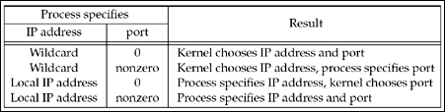
Result when specifying IP address and/or port number to bind

Slide 35
4.4 bind Function
If we specify a port number of 0, the kernel chooses an ephemeral port when bind is called.
But if we specify a wildcard IP address, the kernel does not choose the local IP address until either the socket is connected (TCP) or a datagram is sent on the socket (UDP).

Slide 36
4.4 bind Function
With IPv4, the wildcard address is specified by the constant INADDR_ANY, whose value is normally 0. This tells the kernel to choose the IP address. We saw the use of this in Figure 1.9 with the assignment
struct sockaddr_in servaddr; servaddr.sin_addr.s_addr = htonl (INADDR_ANY); /* wildcard */

Slide 37
4.4 bind Function
struct sockaddr_in6 serv;
serv.sin6_addr = in6addr_any; /* wildcard */
The system allocates and initializes the in6addr_any variable to the constant IN6ADDR_ANY_INIT. The <netinet/in.h> header contains the extern declaration for in6addr_any.

Slide 38
4.4 bind Function
If we tell the kernel to choose an ephemeral port number for our socket, notice that bind does not return the chosen value.
Indeed, it cannot return this value since the second argument to bind has the const qualifier. To obtain the value of the ephemeral port assigned by the kernel, we must call getsockname to return the protocol address.

Slide 39
4.4 bind Function
A common example of a process binding a non-wildcard IP address to a socket is a host that provides Web servers to multiple organizations
First, each organization has its own domain name, such as www.organization.com.
Next, each organization's domain name maps into a different IP address, but typically on the same subnet. For example, if the subnet is 198.69.10, the first organization's IP address could be 198.69.10.128, the next 198.69.10.129, and so on. All these IP addresses are then aliased onto a single network interface (using the alias option of the ifconfig command on 4.4BSD, for example) so that the IP layer will accept incoming datagrams destined for any of the aliased addresses.
Finally, one copy of the HTTP server is started for each organization and each copy binds only the IP address for that organization.

Slide 40
4.4 bind Function
An alternative technique is to run a single server that binds the wildcard address. When a connection arrives, the server calls getsockname to obtain the destination IP address from the client, which in our discussion above could be 198.69.10.128, 198.69.10.129, and so on.
The server then handles the client request based on the IP address to which the connection was issued.

Slide 41
4.4 bind Function
One advantage in binding a non-wildcard IP address is that the demultiplexing of a given destination IP address to a given server process is then done by the kernel.

Slide 42
4.4 bind Function
We must be careful to distinguish between the interface on which a packet arrives versus the destination IP address of that packet.
In Section 8.8, we will talk about the weak end system model and the strong end system model.
Most implementations employ the former, meaning it is okay for a packet to arrive with a destination IP address that identifies an interface other than the interface on which the packet arrives. (This assumes a multihomed host.)
Binding a non-wildcard IP address restricts the datagrams that will be delivered to the socket based only on the destination IP address. It says nothing about the arriving interface, unless the host employs the strong end system model.

Slide 43
4.5 listen Function
The listen function is called only by a TCP server and it performs two actions:
When a socket is created by the socket function, it is assumed to be an active socket, that is, a client socket that will issue a connect.
The listen function converts an unconnected socket into a passive socket, indicating that the kernel should accept incoming connection requests directed to this socket.
In terms of the TCP state transition diagram (Figure 2.4), the call to listen moves the socket from the CLOSED state to the LISTEN state.

Slide 44
4.5 listen Function
The second argument to this function specifies the maximum number of connections the kernel should queue for this socket.
#include <sys/socket.h>
#int listen (int sockfd, int backlog);
Returns: 0 if OK, -1 on error
This function is normally called after both the socket and bind functions and must be called before calling the accept function.

Slide 45
4.5 listen Function
To understand the backlog argument, we must realize that for a given listening socket, the kernel maintains two queues:
An incomplete connection queue, which contains an entry for each SYN that has arrived from a client for which the server is awaiting completion of the TCP three-way handshake. These sockets are in the SYN_RCVD state (Figure 2.4).
A completed connection queue, which contains an entry for each client with whom the TCP three-way handshake has completed. These sockets are in the ESTABLISHED state (Figure 2.4).

Slide 46
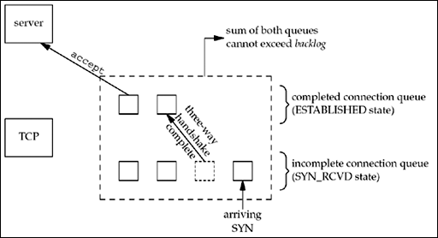
The two queues maintained by TCP for a listening socket

Slide 47
4.5 listen Function
When a SYN arrives from a client, TCP creates a new entry on the incomplete queue and then responds with the second segment of the three-way handshake: the server's SYN with an ACK of the client's SYN (Section 2.6). This entry will remain on the incomplete queue until the third segment of the three-way handshake arrives (the client's ACK of the server's SYN), or until the entry times out. (Berkeley-derived implementations have a timeout of 75 seconds for these incomplete entries.)
If the three-way handshake completes normally, the entry moves from the incomplete queue to the end of the completed queue.
When the process calls accept, which we will describe in the next section, the first entry on the completed queue is returned to the process, or if the queue is empty, the process is put to sleep until an entry is placed onto the completed queue

Slide 48
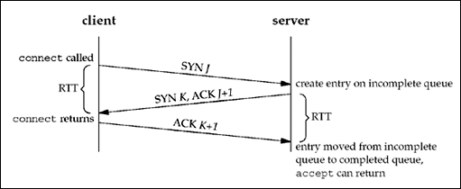
TCP three-way handshake and the two queues for a listening socket

Slide 49
4.5 listen Function
Wrapper function for listen that allows an environment variable to specify backlog
137 void
138 Listen (int fd, int backlog)
139 {
140 char *ptr;
141 /* can override 2nd argument with environment variable */
142 if ( (ptr = getenv("LISTENQ")) != NULL)
143 backlog = atoi (ptr);
144 if (listen (fd, backlog) < 0)
145 err_sys ("listen error");
146 }

Slide 50
4.6 accept Function
accept is called by a TCP server to return the next completed connection from the front of the completed connection queue. If the completed connection queue is empty, the process is put to sleep (assuming the default of a blocking socket).

Slide 51
4.6 accept Function
#include <sys/socket.h>
int accept (int sockfd, struct sockaddr *cliaddr, socklen_t *addrlen);
Returns: non-negative descriptor if OK, -1 on error

Slide 52
4.6 accept Function
The cliaddr and addrlen arguments are used to return the protocol address of the connected peer process (the client). addrlen is a value-result argument (Section 3.3):
Before the call, we set the integer value referenced by *addrlen to the size of the socket address structure pointed to by cliaddr;
on return, this integer value contains the actual number of bytes stored by the kernel in the socket address structure

Slide 53
4.6 accept Function
If accept is successful, its return value is a brand-new descriptor automatically created by the kernel. This new descriptor refers to the TCP connection with the client.
When discussing accept, we call the first argument to accept the listening socket (the descriptor created by socket and then used as the first argument to both bind and listen), and we call the return value from accept the connected socket. It is important to differentiate between these two sockets.
A given server normally creates only one listening socket, which then exists for the lifetime of the server.
The kernel creates one connected socket for each client connection that is accepted (i.e., for which the TCP three-way handshake completes).
When the server is finished serving a given client, the connected socket is closed.

Slide 54
4.6 accept Function
This function returns up to three values: an integer return code that is either a new socket descriptor or an error indication, the protocol address of the client process (through the cliaddr pointer), and the size of this address (through the addrlen pointer).
If we are not interested in having the protocol address of the client returned, we set both cliaddr and addrlen to null pointers.

Slide 55
4.6 accept Function
Figure 1.9 shows these points.
The connected socket is closed each time through the loop, but the listening socket remains open for the life of the server.
We also see that the second and third arguments to accept are null pointers, since we were not interested in the identity of the client.

Slide 56
4.6 accept Function
Value-Result Arguments
We will now show how to handle the value-result argument to accept by modifying the code from Figure 1.9 to print the IP address and port of the client. We show this in Figure 4.11.

Slide 57
4.6 accept Function
Daytime server that prints client IP address and port
1 #include "unp.h" 2
2 #include <time.h>
3 int
4 main(int argc, char **argv)
5 {
6 int listenfd, connfd;
7 socklen_t len;
8 struct sockaddr_in servaddr, cliaddr;
9 char buff[MAXLINE];
10 time_t ticks;
11 listenfd = Socket(AF_INET, SOCK_STREAM, 0);

Slide 58
4.6 accept Function
12 bzero(&servaddr, sizeof(servaddr));
13 servaddr.sin_family = AF_INET;
14 servaddr.sin_addr.s_addr = htonl(INADDR_ANY);
15 servaddr.sin_port = htons(13); /* daytime server */
16 Bind(listenfd, (SA *) &servaddr, sizeof(servaddr));
17 Listen(listenfd, LISTENQ);
18 for ( ; ; ) {
19 len = sizeof(cliaddr);
20 connfd = Accept(listenfd, (SA *) &cliaddr, &len);
21 printf("connection from %s, port %d\n",
22 Inet_ntop(AF_INET, &cliaddr.sin_addr, buff, sizeof(buff)),
23 ntohs(cliaddr.sin_port));
24 ticks = time(NULL);
25 snprintf(buff, sizeof(buff), "%.24s\r\n", ctime(&ticks));
26 Write(connfd, buff, strlen(buff));
27 Close(connfd);
28 }
29 }

Slide 59
4.6 accept Function
New declarations
7–8 We define two new variables: len, which will be a value-result variable, and cliaddr, which will contain the client's protocol address.

Slide 60
4.6 accept Function
Accept connection and print client's address
19–23 We initialize len to the size of the socket address structure and pass a pointer to the cliaddr structure and a pointer to len as the second and third arguments to accept.
We call inet_ntop (Section 3.7) to convert the 32-bit IP address in the socket address structure to a dotted-decimal ASCII string and call ntohs (Section 3.4) to convert the 16-bit port number from network byte order to host byte order.

Slide 61
4.6 accept Function
If we run our new server and then run our client on the same host, connecting to our server twice in a row, we have the following output from the client:
solaris % daytimetcpcli 127.0.0.1 Thu Sep 11 12:44:00 2003
solaris % daytimetcpcli 192.168.1.20 Thu Sep 11 12:44:09 2003

Slide 62
4.6 accept Function
We first specify the server's IP address as the loopback address (127.0.0.1) and then as its own IP address (192.168.1.20). Here is the corresponding server output:
solaris # daytimetcpsrv1
connection from 127.0.0.1, port 43388
connection from 192.168.1.20, port 43389

Slide 63
4.6 accept Function
Notice what happens with the client's IP address. Since our daytime client (Figure 1.5) does not call bind, we said in Section 4.4 that the kernel chooses the source IP address based on the outgoing interface that is used.
In the first case, the kernel sets the source IP address to the loopback address; in the second case, it sets the address to the IP address of the Ethernet interface.
We can also see in this example that the ephemeral port chosen by the Solaris kernel is 43388, and then 43389 (recall Figure 2.10).

Slide 64
4.6 accept Function
As a final point, our shell prompt for the server script changes to the pound sign (#), the commonly used prompt for the superuser. Our server must run with superuser privileges to bind the reserved port of 13. If we do not have superuser privileges, the call to bind will fail:
solaris % daytimetcpsrv1
bind error: Permission denied

Slide 65
4.7 fork and exec Functions
Before describing how to write a concurrent server in the next section, we must describe the Unix fork function.
This function (including the variants of it provided by some systems) is the only way in Unix to create a new process.
#include <unistd.h>
pid_t fork(void);
Returns: 0 in child, process ID of child in parent, -1 on error

Slide 66
4.7 fork and exec Functions
If you have never seen this function before, the hard part in understanding fork is that it is called once but it returns twice.
It returns once in the calling process (called the parent) with a return value that is the process ID of the newly created process (the child).
It also returns once in the child, with a return value of 0.
Hence, the return value tells the process whether it is the parent or the child.

Slide 67
4.7 fork and exec Functions
The reason fork returns 0 in the child, instead of the parent's process ID, is because a child has only one parent and it can always obtain the parent's process ID by calling getppid.
A parent, on the other hand, can have any number of children, and there is no way to obtain the process IDs of its children. If a parent wants to keep track of the process IDs of all its children, it must record the return values from fork.

Slide 68
4.7 fork and exec Functions
All descriptors open in the parent before the call to fork are shared with the child after fork returns.
We will see this feature used by network servers: The parent calls accept and then calls fork. The connected socket is then shared between the parent and child.
Normally, the child then reads and writes the connected socket and the parent closes the connected socket

Slide 69
4.7 fork and exec Functions
There are two typical uses of fork:
A process makes a copy of itself so that one copy can handle one operation while the other copy does another task. This is typical for network servers. We will see many examples of this later in the text.
A process wants to execute another program. Since the only way to create a new process is by calling fork, the process first calls fork to make a copy of itself, and then one of the copies (typically the child process) calls exec (described next) to replace itself with the new program. This is typical for programs such as shells.

Slide 70
4.7 fork and exec Functions
The only way in which an executable program file on disk can be executed by Unix is for an existing process to call one of the six exec functions. (We will often refer generically to "the exec function" when it does not matter which of the six is called.)
exec replaces the current process image with the new program file, and this new program normally starts at the main function. The process ID does not change. We refer to the process that calls exec as the calling process and the newly executed program as the new program

Slide 71
4.7 fork and exec Functions
The differences in the six exec functions are:
(a) whether the program file to execute is specified by a filename or a pathname;
(b) whether the arguments to the new program are listed one by one or referenced through an array of pointers; and
(c) whether the environment of the calling process is passed to the new program or whether a new environment is specified.

Slide 72
4.7 fork and exec Functions
#include <unistd.h>
int execl (const char *pathname, const char *arg0, ... /* (char *) 0 */ );
int execv (const char *pathname, char *const argv[]);
int execle (const char *pathname, const char *arg0, .../* (char *) 0, char *const envp[] */ );
int execve (const char *pathname, char *const argv[], char *const envp[]);
int execlp (const char *filename, const char *arg0, ... /* (char *) 0 */ );
int execvp (const char *filename, char *const argv[]);
All six return: -1 on error, no return on suc

Slide 73
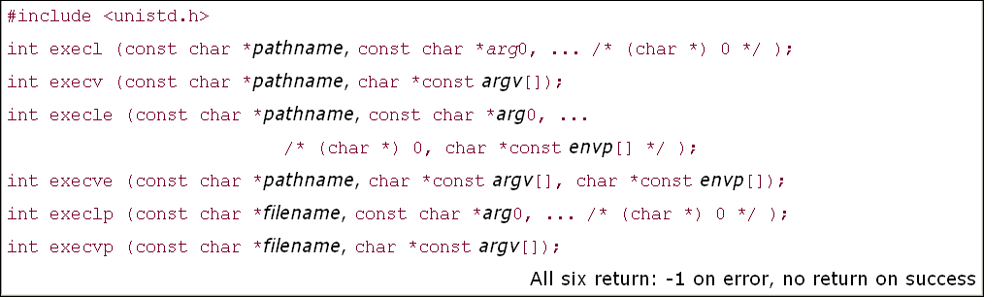

Slide 74
4.7 fork and exec Functions
These functions return to the caller only if an error occurs. Otherwise, control passes to the start of the new program, normally the main function.
The relationship among these six functions is shown in Figure 4.12. Normally, only execve is a system call within the kernel and the other five are library functions that call execve.

Slide 75
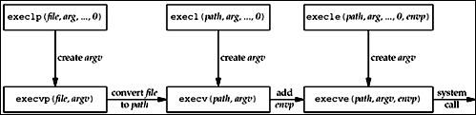
Relationship among the six exec functions

Slide 76
4.7 fork and exec Functions
Note the following differences among these six functions:
The three functions in the top row specify each argument string as a separate argument to the exec function, with a null pointer terminating the variable number of arguments. The three functions in the second row have an argv array, containing pointers to the argument strings. This argv array must contain a null pointer to specify its end, since a count is not specified.

Slide 77
4.7 fork and exec Functions
The two functions in the left column specify a filename argument. This is converted into a pathname using the current PATH environment variable.
If the filename argument to execlp or execvp contains a slash (/) anywhere in the string, the PATH variable is not used.
The four functions in the right two columns specify a fully qualified pathname argument.

Slide 78
4.7 fork and exec Functions
The four functions in the left two columns do not specify an explicit environment pointer.
Instead, the current value of the external variable environ is used for building an environment list that is passed to the new program.
The two functions in the right column specify an explicit environment list. The envp array of pointers must be terminated by a null pointer.

Slide 79
4.7 fork and exec Functions
Descriptors open in the process before calling exec normally remain open across the exec. We use the qualifier "normally" because this can be disabled using fcntl to set the FD_CLOEXEC descriptor flag. The inetd server uses this feature, as we will describe in Section 13.5.

Slide 80
4.8 Concurrent Servers
The server in Figure 4.11 is an iterative server. For something as simple as a daytime server, this is fine.
But when a client request can take longer to service, we do not want to tie up a single server with one client; we want to handle multiple clients at the same time.
The simplest way to write a concurrent server under Unix is to fork a child process to handle each client. Figure 4.13 shows the outline for a typical concurrent server.

Slide 81
Figure 4.13 Outline for typical concurrent server
pid_t pid;
int listenfd, connfd;
listenfd = Socket( ... ); /* fill in sockaddr_in{} with server's well-known port */
Bind(listenfd, ... );
Listen(listenfd, LISTENQ);
for ( ; ; ) { connfd = Accept (listenfd, ... ); /* probably blocks */
if( (pid = Fork()) == 0)
{ Close(listenfd); /* child closes listening socket */
doit(connfd); /* process the request */
Close(connfd); /* done with this client */
exit(0); /* child terminates */ }
Close(connfd); /* parent closes connected socket */ }

Slide 82
4.8 Concurrent Servers
When a connection is established, accept returns, the server calls fork, and the child process services the client (on connfd, the connected socket) and the parent process waits for another connection (on listenfd, the listening socket).
The parent closes the connected socket since the child handles the new client.

Slide 83
4.8 Concurrent Servers
In Figure 4.13, we assume that the function doit does whatever is required to service the client.
When this function returns, we explicitly close the connected socket in the child. This is not required since the next statement calls exit, and part of process termination is to close all open descriptors by the kernel.
Whether to include this explicit call to close or not is a matter of personal programming taste.

Slide 84
4.8 Concurrent Servers
We said in Section 2.6 that calling close on a TCP socket causes a FIN to be sent, followed by the normal TCP connection termination sequence. Why doesn't the close of connfd in Figure 4.13 by the parent terminate its connection with the client?
To understand what's happening, we must understand that every file or socket has a reference count. The reference count is maintained in the file table entry (pp. 57–60 of APUE). This is a count of the number of descriptors that are currently open that refer to this file or socket. In Figure 4.13, after socket returns, the file table entry associated with listenfd has a reference count of 1. After accept returns, the file table entry associated with connfd has a reference count of 1.
But, after fork returns, both descriptors are shared (i.e., duplicated) between the parent and child, so the file table entries associated with both sockets now have a reference count of 2. Therefore, when the parent closes connfd, it just decrements the reference count from 2 to 1 and that is all.
The actual cleanup and de-allocation of the socket does not happen until the reference count reaches 0. This will occur at some time later when the child closes connfd.

Slide 85
4.8 Concurrent Servers
We can also visualize the sockets and connection that occur in Figure 4.13 as follows. First, Figure 4.14 shows the status of the client and server while the server is blocked in the call to accept and the connection request arrives from the client.
Immediately after accept returns, we have the scenario shown in Figure 4.15. The connection is accepted by the kernel and a new socket, connfd, is created. This is a connected socket and data can now be read and written across the connection.

Slide 86
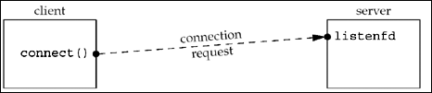
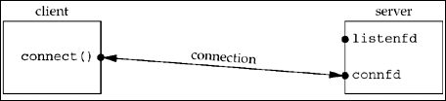
Figure 4.14
Figure 4.15

Slide 87
4.8 Concurrent Servers
The next step in the concurrent server is to call fork. Figure 4.16 shows the status after fork returns
Notice that both descriptors, listenfd and connfd, are shared (duplicated) between the parent and child.
The next step is for the parent to close the connected socket and the child to close the listening socket. This is shown in Figure 4.17.

Slide 88
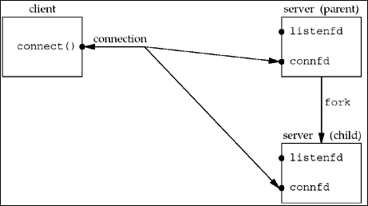
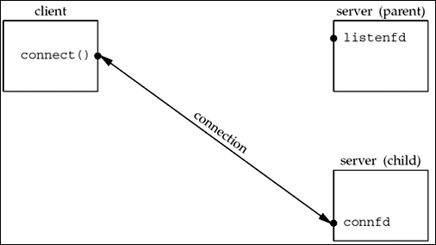
Figure 4.16. Status of client/server after fork returns
Figure 4.17. Status of client/server after parent and child close appropriate sockets

Slide 89
4.8 Concurrent Servers
This is the desired final state of the sockets. The child is handling the connection with the client and the parent can call accept again on the listening socket, to handle the next client connection.

Slide 90
4.9 close Function
The normal Unix close function is also used to close a socket and terminate a TCP connection
#include <unistd.h>
int close (int sockfd);
Returns: 0 if OK, -1 on error

Slide 91
4.9 close Function
The default action of close with a TCP socket is to mark the socket as closed and return to the process immediately.
The socket descriptor is no longer usable by the process: It cannot be used as an argument to read or write.
But, TCP will try to send any data that is already queued to be sent to the other end, and after this occurs, the normal TCP connection termination sequence takes place (Section 2.6).

Slide 92
4.9 close Function
In Section 7.5, we will describe the SO_LINGER socket option, which lets us change this default action with a TCP socket.
In that section, we will also describe what a TCP application must do to be guaranteed that the peer application has received any outstanding data.

Slide 93
4.9 close Function
Descriptor Reference Counts
At the end of Section 4.8, we mentioned that when the parent process in our concurrent server closes the connected socket, this just decrements the reference count for the descriptor.
Since the reference count was still greater than 0, this call to close did not initiate TCP's four-packet connection termination sequence. This is the behavior we want with our concurrent server with the connected socket that is shared between the parent and child.

Slide 94
4.9 close Function
If we really want to send a FIN on a TCP connection, the shutdown function can be used (Section 6.6) instead of close. We will describe the motivation for this in Section 6.5.

Slide 95
4.9 close Function
We must also be aware of what happens in our concurrent server if the parent does not call close for each connected socket returned by accept.
First, the parent will eventually run out of descriptors, as there is usually a limit to the number of descriptors that any process can have open at any time.
But more importantly, none of the client connections will be terminated. When the child closes the connected socket, its reference count will go from 2 to 1 and it will remain at 1 since the parent never closes the connected socket.
This will prevent TCP's connection termination sequence from occurring, and the connection will remain open.

Slide 96
4.10 getsockname and getpeername Functions
These two functions return either the local protocol address associated with a socket (getsockname) or the foreign protocol address associated with a socket (getpeername).
#include <sys/socket.h>
int getsockname(int sockfd, struct sockaddr *localaddr, socklen_t *addrlen);
int getpeername(int sockfd, struct sockaddr *peeraddr, socklen_t *addrlen);
Both return: 0 if OK, -1 on error

Slide 97
4.10 getsockname and getpeername Functions
Notice that the final argument for both functions is a value-result argument. That is, both functions fill in the socket address structure pointed to by localaddr or peeraddr.
We mentioned in our discussion of bind that the term "name" is misleading. These two functions return the protocol address associated with one of the two ends of a network connection, which for IPV4 and IPV6 is the combination of an IP address and port number. These functions have nothing to do with domain names (Chapter 11).

Slide 98
4.10 getsockname and getpeername Functions
These two functions are required for the following reasons:
After connect successfully returns in a TCP client that does not call bind, getsockname returns the local IP address and local port number assigned to the connection by the kernel.
After calling bind with a port number of 0 (telling the kernel to choose the local port number), getsockname returns the local port number that was assigned.
getsockname can be called to obtain the address family of a socket, as we show in Figure 4.19.

Slide 99
4.10 getsockname and getpeername Functions
In a TCP server that binds the wildcard IP address (Figure 1.9), once a connection is established with a client (accept returns successfully), the server can call getsockname to obtain the local IP address assigned to the connection.
The socket descriptor argument in this call must be that of the connected socket, and not the listening socket.

Slide 100
4.10 getsockname and getpeername Functions
When a server is execed by the process that calls accept, the only way the server can obtain the identity of the client is to call getpeername.
This is what happens whenever inetd (Section 13.5) forks and execs a TCP server. Figure 4.18 shows this scenario. inetd calls accept (top left box) and two values are returned: the connected socket descriptor, connfd, is the return value of the function, and the small box we label "peer's address" (an Internet socket address structure) contains the IP address and port number of the client.
fork is called and a child of inetd is created. Since the child starts with a copy of the parent's memory image, the socket address structure is available to the child, as is the connected socket descriptor (since the descriptors are shared between the parent and child).
But when the child execs the real server (say the Telnet server that we show), the memory image of the child is replaced with the new program file for the Telnet server (i.e., the socket address structure containing the peer's address is lost), and the connected socket descriptor remains open across the exec.
One of the first function calls performed by the Telnet server is getpeername to obtain the IP address and port number of the client.

Slide 101
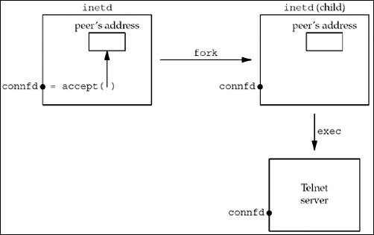
Figure 4.18. Example of inetd spawning a server

Slide 102
4.10 getsockname and getpeername Functions
Obviously the Telnet server in this final example must know the value of connfd when it starts. There are two common ways to do this.
First, the process calling exec can format the descriptor number as a character string and pass it as a command-line argument to the newly execed program. Alternately, a convention can be established that a certain descriptor is always set to the connected socket before calling exec.
The latter is what inetd does, always setting descriptors 0, 1, and 2 to be the connected socket.

Slide 103
Obtaining the Address Family of a Socket
The sockfd_to_family function shown in Figure 4.19 returns the address family of a socket.
Figure 4.19 Return the address family of a socket.
lib/sockfd_to_family.c
1 #include "unp.h"
2 int
3 sockfd_to_family(int sockfd)
4 {
5 struct sockaddr_storage ss;
6 socklen_t len;
7 len = sizeof(ss);
8 if (getsockname(sockfd, (SA *) &ss, &len) < 0)
9 return (-1);
10 return (ss.ss_family);
11 }

Slide 104
Obtaining the Address Family of a Socket
Allocate room for largest socket address structure
5 Since we do not know what type of socket address structure to allocate, we use a sockaddr_storage value, since it can hold any socket address structure supported by the system.
Call getsockname
7–10 We call getsockname and return the address family.
Since the POSIX specification allows a call to getsockname on an unbound socket, this function should work for any open socket descriptor.

Slide 105
4.11 Summary
All clients and servers begin with a call to socket, returning a socket descriptor. Clients then call connect, while servers call bind, listen, and accept.
Sockets are normally closed with the standard close function, although we will see another way to do this with the shutdown function (Section 6.6), and we will also examine the effect of the SO_LINGER socket option (Section 7.5).

Slide 106
4.11 Summary
Most TCP servers are concurrent, with the server calling fork for every client connection that it handles.
We will see that most UDP servers are iterative. While these two models have been used successfully for many years, in Chapter 30 we will look at other server design options that use threads and processes.

