Slide 1
Chapter 7. Socket Options

Slide 2
7.1 Introduction
There are various ways to get and set the options that affect a socket:
The getsockopt and setsockopt functions
The fcntl function
The ioctl function

Slide 3
7.1 Introduction
This chapter starts by covering the setsockopt and getsockopt functions, followed by an example that prints the default value of all the options, and then a detailed description of all the socket options. We divide the detailed descriptions into the following categories: generic, IPv4, IPv6, TCP, and SCTP. This detailed coverage can be skipped during a first reading of this chapter, and the individual sections referred to when needed. A few options are discussed in detail in a later chapter, such as the IPv4 and IPv6 multicasting options, which we will describe with multicasting in Section 21.6.
We also describe the fcntl function, because it is the POSIX way to set a socket for nonblocking I/O, signal-driven I/O, and to set the owner of a socket. We save the ioctl function for Chapter 17.

Slide 4
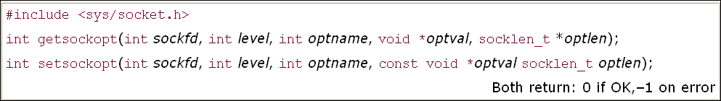
7.2 getsockopt and setsockopt Functions

Slide 5
7.2 getsockopt and setsockopt Functions
sockfd must refer to an open socket descriptor. level specifies the code in the system that interprets the option: the general socket code or some protocol-specific code (e.g., IPv4, IPv6, TCP, or SCTP).
optval is a pointer to a variable from which the new value of the option is fetched by setsockopt, or into which the current value of the option is stored by getsockopt. The size of this variable is specified by the final argument, as a value for setsockopt and as a value-result for getsockopt.

Slide 6
7.2 getsockopt and setsockopt Functions
Figures 7.1 and 7.2 summarize the options that can be queried by getsockopt or set by setsockopt. The "Datatype" column shows the datatype of what the optval pointer must point to for each option. We use the notation of two braces to indicate a structure, as in linger{} to mean a struct linger

Slide 7
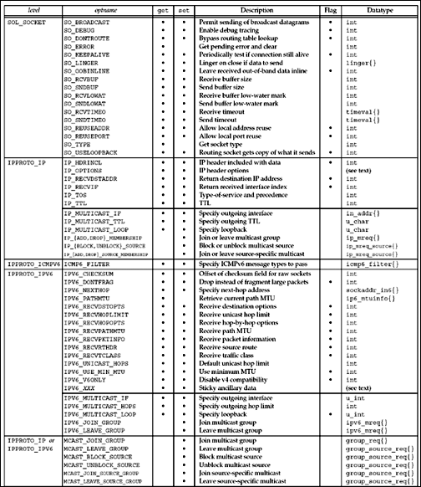
Figure 7.1. Summary of socket and IP-layer socket options for getsockopt and setsockopt

Slide 8
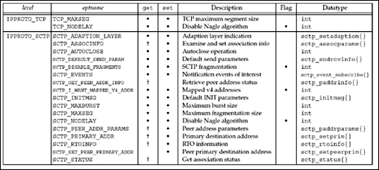
Figure 7.2. Summary of transport-layer socket options

Slide 9
7.2 getsockopt and setsockopt Functions
There are two basic types of options: binary options that enable or disable a certain feature (flags), and options that fetch and return specific values that we can either set or examine (values). The column labeled "Flag" specifies if the option is a flag option.
When calling getsockopt for these flag options, *optval is an integer. The value returned in *optval is zero if the option is disabled, or nonzero if the option is enabled. Similarly, setsockopt requires a nonzero *optval to turn the option on, and a zero value to turn the option off.
If the "Flag" column does not contain a "•," then the option is used to pass a value of the specified datatype between the user process and the system.

Slide 10
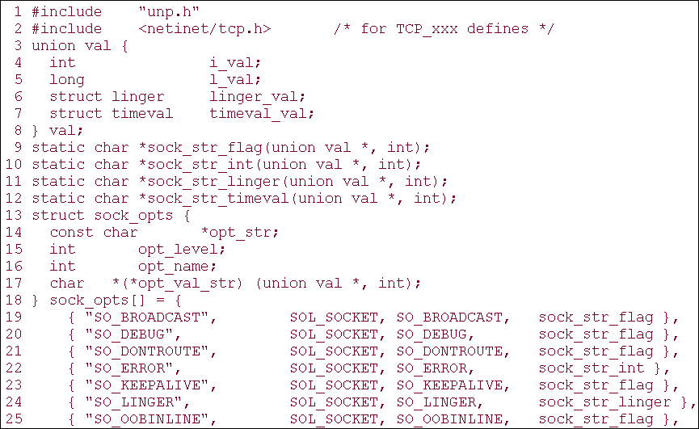
7.3 Checking if an Option Is Supported and Obtaining the Default
Figure 7.3 Declarations for our program to check the socket options

Slide 11
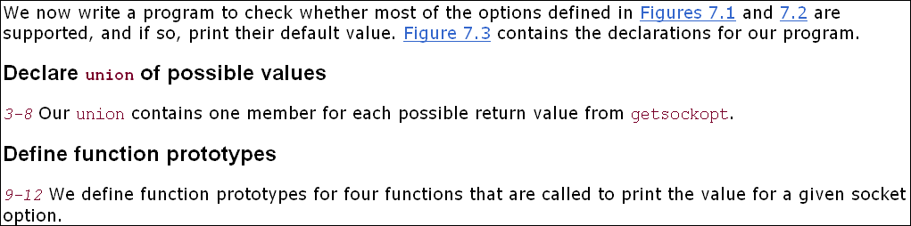
7.3 Checking if an Option Is Supported and Obtaining the Default

Slide 12
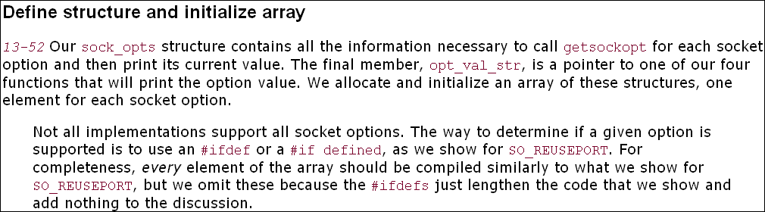
7.3 Checking if an Option Is Supported and Obtaining the Default

Slide 13
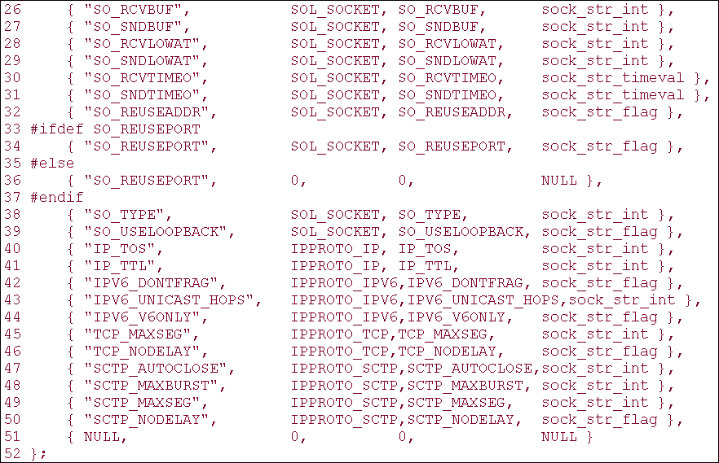
7.3 Checking if an Option Is Supported and Obtaining the Default
Figure 7.3 Declarations for our program to check the socket options

Slide 14
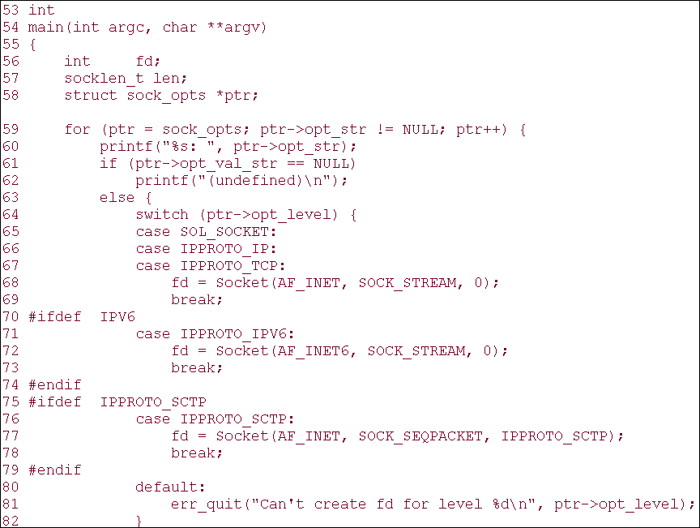
7.3 Checking if an Option Is Supported and Obtaining the Default
Figure 7.4 main function to check all socket options.

Slide 15
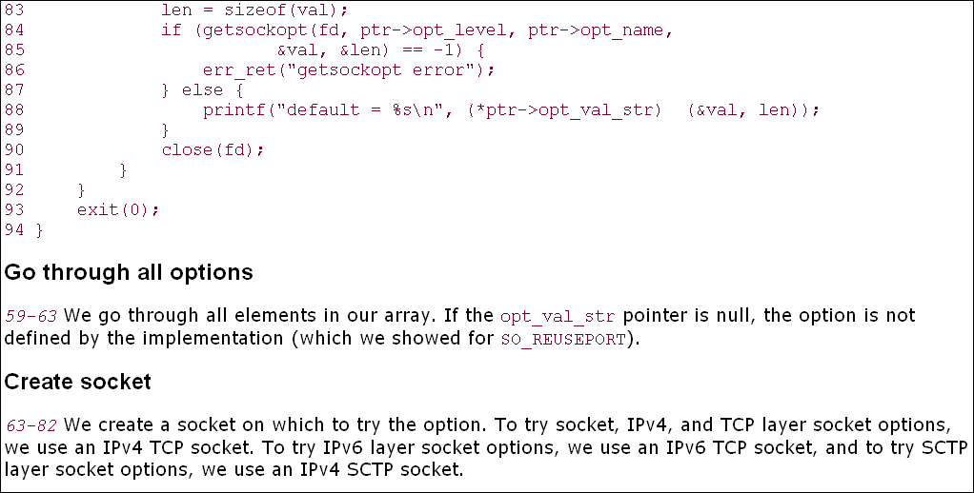
7.3 Checking if an Option Is Supported and Obtaining the Default
Figure 7.4 main function to check all socket options.

Slide 16
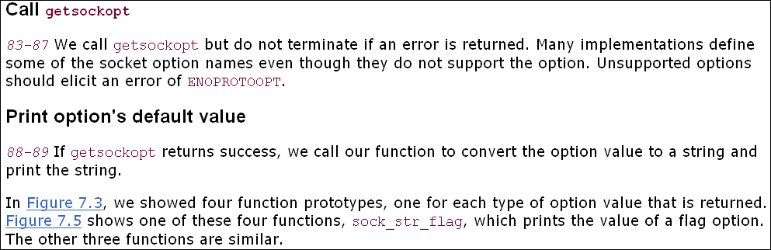
7.3 Checking if an Option Is Supported and Obtaining the Default

Slide 17
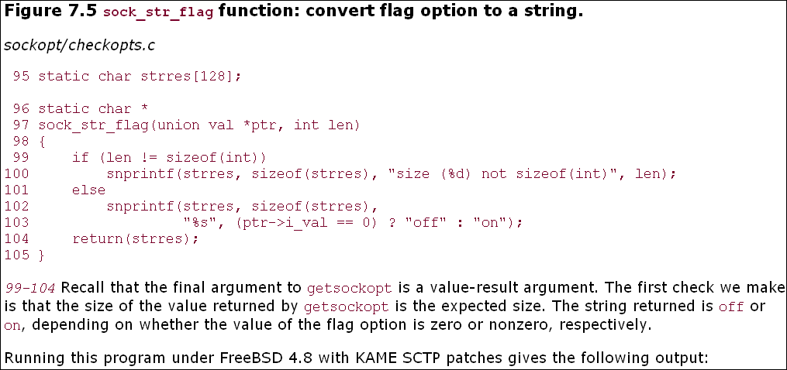
7.3 Checking if an Option Is Supported and Obtaining the Default

Slide 18
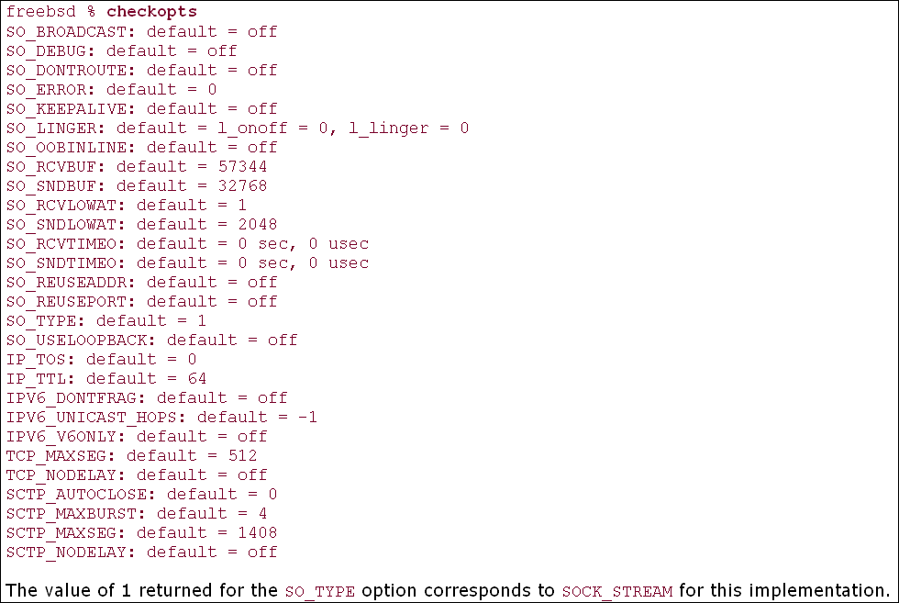
7.3 Checking if an Option Is Supported and Obtaining the Default

Slide 19
7.4 Socket States
Some socket options have timing considerations about when to set or fetch the option versus the state of the socket. We mention these with the affected options.
The following socket options are inherited by a connected TCP socket from the listening socket (pp. 462–463 of TCPv2): SO_DEBUG, SO_DONTROUTE, SO_KEEPALIVE, SO_LINGER, SO_OOBINLINE, SO_RCVBUF, SO_RCVLOWAT, SO_SNDBUF, SO_SNDLOWAT, TCP_MAXSEG, and TCP_NODELAY. This is important with TCP because the connected socket is not returned to a server by accept until the three-way handshake is completed by the TCP layer. To ensure that one of these socket options is set for the connected socket when the three-way handshake completes, we must set that option for the listening socket.

Slide 20
7.5 Generic Socket Options
We start with a discussion of the generic socket options. These options are protocol-independent (that is, they are handled by the protocol-independent code within the kernel, not by one particular protocol module such as IPv4),
but some of the options apply to only certain types of sockets. For example, even though the SO_BROADCAST socket option is called "generic," it applies only to datagram sockets.

Slide 21
7.5 Generic Socket Options
SO_BROADCAST Socket Option
This option enables or disables the ability of the process to send broadcast messages. Broadcasting is supported for only datagram sockets and only on networks that support the concept of a broadcast message (e.g., Ethernet, token ring, etc.). You cannot broadcast on a point-to-point link or any connection-based transport protocol such as SCTP or TCP. We will talk more about broadcasting in Chapter 20.
Since an application must set this socket option before sending a broadcast datagram, it prevents a process from sending a broadcast when the application was never designed to broadcast. For example, a UDP application might take the destination IP address as a command-line argument, but the application never intended for a user to type in a broadcast address. Rather than forcing the application to try to determine if a given address is a broadcast address or not, the test is in the kernel: If the destination address is a broadcast address and this socket option is not set, EACCES is returned (p. 233 of TCPv2).

Slide 22
7.5 Generic Socket Options
SO_DEBUG Socket Option
This option is supported only by TCP. When enabled for a TCP socket, the kernel keeps track of detailed information about all the packets sent or received by TCP for the socket. These are kept in a circular buffer within the kernel that can be examined with the trpt program. Pages 916–920 of TCPv2 provide additional details and an example that uses this option.

Slide 23
7.5 Generic Socket Options
SO_DONTROUTE Socket Option
This option specifies that outgoing packets are to bypass the normal routing mechanisms of the underlying protocol. For example, with IPv4, the packet is directed to the appropriate local interface, as specified by the network and subnet portions of the destination address. If the local interface cannot be determined from the destination address (e.g., the destination is not on the other end of a point-to-point link, or is not on a shared network), ENETUNREACH is returned.
The equivalent of this option can also be applied to individual datagrams using the MSG_DONTROUTE flag with the send, sendto, or sendmsg functions.
This option is often used by routing daemons (e.g., routed and gated) to bypass the routing table and force a packet to be sent out a particular interface.

Slide 24
7.5 Generic Socket Options
SO_ERROR Socket Option
When an error occurs on a socket, the protocol module in a Berkeley-derived kernel sets a variable named so_error for that socket to one of the standard Unix Exxx values. This is called the pending error for the socket. The process can be immediately notified of the error in one of two ways:
If the process is blocked in a call to select on the socket (Section 6.3), for either readability or writability, select returns with either or both conditions set.
If the process is using signal-driven I/O (Chapter 25), the SIGIO signal is generated for either the process or the process group.
The process can then obtain the value of so_error by fetching the SO_ERROR socket option. The integer value returned by getsockopt is the pending error for the socket. The value of so_error is then reset to 0 by the kernel (p. 547 of TCPv2).

Slide 25
7.5 Generic Socket Options
If so_error is nonzero when the process calls read and there is no data to return, read returns–1 with errno set to the value of so_error (p. 516 of TCPv2). The value of so_error is then reset to 0. If there is data queued for the socket, that data is returned by read instead of the error condition. If so_error is nonzero when the process calls write, –1 is returned with errno set to the value of so_error (p. 495 of TCPv2) and so_error is reset to 0.
There is a bug in the code shown on p. 495 of TCPv2 in that so_error is not reset to 0. This has been fixed in most modern releases. Anytime the pending error for a socket is returned, it must be reset to 0.
This is the first socket option that we have encountered that can be fetched but cannot be set.

Slide 26
7.5 Generic Socket Options
SO_KEEPALIVE Socket Option
When the keep-alive option is set for a TCP socket and no data has been exchanged across the socket in either direction for two hours, TCP automatically sends a keep-alive probe to the peer. This probe is a TCP segment to which the peer must respond. One of three scenarios results:
The peer responds with the expected ACK. The application is not notified (since everything is okay). TCP will send another probe following another two hours of inactivity.
The peer responds with an RST, which tells the local TCP that the peer host has crashed and rebooted. The socket's pending error is set to ECONNRESET and the socket is closed.
There is no response from the peer to the keep-alive probe. Berkeley-derived TCPs send 8 additional probes, 75 seconds apart, trying to elicit a response. TCP will give up if there is no response within 11 minutes and 15 seconds after sending the first probe.

Slide 27
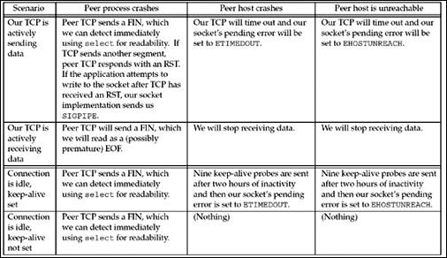
Figure 7.6. Ways to detect various TCP conditions.

Slide 28
7.5 Generic Socket Options
SO_LINGER Socket Option
This option specifies how the close function operates for a connection-oriented protocol (e.g., for TCP and SCTP, but not for UDP). By default, close returns immediately, but if there is any data still remaining in the socket send buffer, the system will try to deliver the data to the peer.
The SO_LINGER socket option lets us change this default. This option requires the following structure to be passed between the user process and the kernel. It is defined by including
<sys/socket.h>.
struct linger
{
int l_onoff; /* 0=off, nonzero=on */
int l_linger; /* linger time, POSIX specifies units as seconds */
};

Slide 29
7.5 Generic Socket Options
SO_OOBINLINE Socket Option
When this option is set, out-of-band data will be placed in the normal input queue (i.e., inline). When this occurs, the MSG_OOB flag to the receive functions cannot be used to read the out-of-band data. We will discuss out-of-band data in more detail in Chapter 24.
SO_RCVBUF and SO_SNDBUF Socket Options
Every socket has a send buffer and a receive buffer. We described the operation of the send buffers with TCP, UDP, and SCTP in Figures 2.15, 2.16, and 2.17.

Slide 30
7.5 Generic Socket Options
SO_RCVLOWAT and SO_SNDLOWAT Socket Options
Every socket also has a receive low-water mark and a send low-water mark. These are used by the select function, as we described in Section 6.3. These two socket options, SO_RCVLOWAT and SO_SNDLOWAT, let us change these two low-water marks.
The receive low-water mark is the amount of data that must be in the socket receive buffer for select to return "readable." It defaults to 1 for TCP, UDP, and SCTP sockets. The send low-water mark is the amount of available space that must exist in the socket send buffer for select to return "writable." This low-water mark normally defaults to 2,048 for TCP sockets. With UDP, the low-water mark is used, as we described in Section 6.3, but since the number of bytes of available space in the send buffer for a UDP socket never changes (since UDP does not keep a copy of the datagrams sent by the application), as long as the UDP socket send buffer size is greater than the socket's low-water mark, the UDP socket is always writable. Recall from Figure 2.16 that UDP does not have a send buffer; it has only a send buffer size.

Slide 31
7.5 Generic Socket Options
SO_RCVTIMEO and SO_SNDTIMEO Socket Options
These two socket options allow us to place a timeout on socket receives and sends. Notice that the argument to the two sockopt functions is a pointer to a timeval structure, the same one used with select (Section 6.3). This lets us specify the timeouts in seconds and microseconds. We disable a timeout by setting its value to 0 seconds and 0 microseconds. Both timeouts are disabled by default.
The receive timeout affects the five input functions: read, readv, recdv, recvfrom, and recvmsg. The send timeout affects the five output functions: write, writev, send, sendto, and sendmsg. We will talk more about socket timeouts in Section 14.2.

Slide 32
7.5 Generic Socket Options
SO_REUSEADDR and SO_REUSEPORT Socket Options
SO_REUSEADDR allows a listening server to start and bind its well-known port, even if previously established connections exist that use this port as their local port. This condition is typically encountered as follows:
  A listening server is started.
  A connection request arrives and a child process is spawned to handle that client.
  The listening server terminates, but the child continues to service the client on the existing connection.
  The listening server is restarted.

Slide 33
7.5 Generic Socket Options
SO_TYPE Socket Option
This option returns the socket type. The integer value returned is a value such as SOCK_STREAM or SOCK_DGRAM. This option is typically used by a process that inherits a socket when it is started.
SO_USELOOPBACK Socket Option
This option applies only to sockets in the routing domain (AF_ROUTE). This option defaults to ON for these sockets (the only one of the SO_xxx socket options that defaults to ON instead of OFF). When this option is enabled, the socket receives a copy of everything sent on the socket.
Another way to disable these loopback copies is to call shutdown with a second argument of SHUT_RD.

Slide 34
7.6 IPv4 Socket Options
These socket options are processed by IPv4 and have a level of IPPROTO_IP.
IP_HDRINCL Socket Option If this option is set for a raw IP socket (Chapter 28), we must build our own IP header for all the datagrams we send on the raw socket. Normally, the kernel builds the IP header for datagrams sent on a raw socket, but there are some applications (notably traceroute) that build their own IP header to override values that IP would place into certain header fields.
When this option is set, we build a complete IP header, with the following exceptions:
IP always calculates and stores the IP header checksum.
If we set the IP identification field to 0, the kernel will set the field.
If the source IP address is INADDR_ANY, IP sets it to the primary IP address of the outgoing interface.
Setting IP options is implementation-dependent. Some implementations take any IP options that were set using the IP_OPTIONS socket option and append these to the header that we build, while others require our header to also contain any desired IP options.
Some fields must be in host byte order, and some in network byte order. This is implementation-dependent, which makes writing raw packets with IP_HDRINCL not as portable as we'd like.
We show an example of this option in Section 29.7. Pages 1056–1057 of TCPv2 provide additional details on this socket option.

Slide 35
7.6 IPv4 Socket Options
IP_OPTIONS Socket Option
Setting this option allows us to set IP options in the IPv4 header. This requires intimate knowledge of the format of the IP options in the IP header. We will discuss this option with regard to IPv4 source routes in Section 27.3.
IP_RECVDSTADDR Socket Option
This socket option causes the destination IP address of a received UDP datagram to be returned as ancillary data by recvmsg. We will show an example of this option in Section 22.2.
IP_RECVIF Socket Option
This socket option causes the index of the interface on which a UDP datagram is received to be returned as ancillary data by recvmsg. We will show an example of this option in Section 22.2.

Slide 36
7.6 IPv4 Socket Options
IP_TOS Socket Option
This option lets us set the type-of-service (TOS) field (which contains the DSCP and ECN fields, Figure A.1) in the IP header for a TCP, UDP, or SCTP socket. If we call getsockopt for this option, the current value that would be placed into the DSCP and ECN fields in the IP header (which defaults to 0) is returned. There is no way to fetch the value from a received IP datagram.

Slide 37
7.6 IPv4 Socket Options
IP_TTL Socket Option
With this option, we can set and fetch the default TTL (Figure A.1) that the system will use for unicast packets sent on a given socket. (The multicast TTL is set using the IP_MULTICAST_TTL socket option, described in Section 21.6.) 4.4BSD, for example, uses the default of 64 for both TCP and UDP sockets (specified in the IANA's "IP Option Numbers" registry [IANA]) and 255 for raw sockets. As with the TOS field, calling getsockopt returns the default value of the field that the system will use in outgoing datagrams—there is no way to obtain the value from a received datagram. We will set this socket option with our traceroute program in Figure 28.19.

Slide 38
7.7 ICMPv6 Socket Option
This socket option is processed by ICMPv6 and has a level of IPPROTO_ICMPV6.
ICMP6_FILTER Socket Option
This option lets us fetch and set an icmp6_filter structure that specifies which of the 256 possible ICMPv6 message types will be passed to the process on a raw socket. We will discuss this option in Section 28.4.

Slide 39
7.8 IPv6 Socket Options
These socket options are processed by IPv6 and have a level of IPPROTO_IPV6. We defer discussion of the multicasting socket options until Section 21.6. We note that many of these options make use of ancillary data with the recvmsg function, and we will describe this in Section 14.6. All the IPv6 socket options are defined in RFC 3493 [Gilligan et al. 2003] and RFC 3542 [Stevens et al. 2003].
IPV6_CHECKSUM Socket Option
This socket option specifies the byte offset into the user data where the checksum field is located. If this value is non-negative, the kernel will: (i) compute and store a checksum for all outgoing packets, and (ii) verify the received checksum on input, discarding packets with an invalid checksum. This option affects all IPv6 raw sockets, except ICMPv6 raw sockets. (The kernel always calculates and stores the checksum for ICMPv6 raw sockets.) If a value of -1 is specified (the default), the kernel will not calculate and store the checksum for outgoing packets on this raw socket and will not verify the checksum for received packets.

Slide 40
7.8 IPv6 Socket Options
IPV6_DONTFRAG Socket Option
Setting this option disables the automatic insertion of a fragment header for UDP and raw sockets. When this option is set, output packets larger than the MTU of the outgoing interface will be dropped. No error needs to be returned from the system call that sends the packet, since the packet might exceed the path MTU en-route. Instead, the application should enable the IPV6_RECVPATHMTU option (Section 22.9) to learn about path MTU changes.
IPV6_NEXTHOP Socket Option
This option specifies the next-hop address for a datagram as a socket address structure, and is a privileged operation. We will say more about this feature in Section 22.8.
IPV6_PATHMTU Socket Option
This option cannot be set, only retrieved. When this option is retrieved, the current MTU as determined by path-MTU discovery is returned (see Section 22.9).

Slide 41
7.8 IPv6 Socket Options
IPV6_RECVDSTOPTS Socket Option
Setting this option specifies that any received IPv6 destination options are to be returned as ancillary data by recvmsg. This option defaults to OFF. We will describe the functions that are used to build and process these options in Section 27.5.
IPV6_RECVHOPLIMIT Socket Option
Setting this option specifies that the received hop limit field is to be returned as ancillary data by recvmsg. This option defaults to OFF. We will describe this option in Section 22.8.
There is no way with IPv4 to obtain the received TTL field.
IPV6_RECVHOPOPTS Socket Option
Setting this option specifies that any received IPv6 hop-by-hop options are to be returned as ancillary data by recvmsg. This option defaults to OFF. We will describe the functions that are used to build and process these options in Section 27.5.
IPV6_RECVPATHMTU Socket Option
Setting this option specifies that the path MTU of a path is to be returned as ancillary data by recvmsg (without any accompanying data) when it changes. We will describe this option in Section 22.9.

Slide 42
7.8 IPv6 Socket Options
IPV6_RECVPKTINFO Socket Option
Setting this option specifies that the following two pieces of information about a received IPv6 datagram are to be returned as ancillary data by recvmsg: the destination IPv6 address and the arriving interface index. We will describe this option in Section 22.8.
IPV6_RECVRTHDR Socket Option
Setting this option specifies that a received IPv6 routing header is to be returned as ancillary data by recvmsg. This option defaults to OFF. We will describe the functions that are used to build and process an IPv6 routing header in Section 27.6.
IPV6_RECVTCLASS Socket Option
Setting this option specifies that the received traffic class (containing the DSCP and ECN fields) is to be returned as ancillary data by recvmsg. This option defaults to OFF. We will describe this option in Section 22.8.
IPV6_UNICAST_HOPS Socket Option
This IPv6 option is similar to the IPv4 IP_TTL socket option. Setting the socket option specifies the default hop limit for outgoing datagrams sent on the socket, while fetching the socket option returns the value for the hop limit that the kernel will use for the socket. The actual hop limit field from a received IPv6 datagram is obtained by using the IPV6_RECVHOPLIMIT socket option. We will set this socket option with our traceroute program in Figure 28.19.

Slide 43
7.8 IPv6 Socket Options
IPV6_USE_MIN_MTU Socket Option
Setting this option to 1 specifies that path MTU discovery is not to be performed and that packets are sent using the minimum IPv6 MTU to avoid fragmentation. Setting it to 0 causes path MTU discovery to occur for all destinations. Setting it to–1 specifies that path MTU discovery is performed for unicast destinations but the minimum MTU is used when sending to multicast destinations. This option defaults to –1. We will describe this option in Section 22.9.
IPV6_V6ONLY Socket Option
Setting this option on an AF_INET6 socket restricts it to IPv6 communication only. This option defaults to OFF, although some systems have an option to turn it ON by default. We will describe IPv4 and IPv6 communication using AF_INET6 sockets in Sections 12.2 and 12.3.
IPV6_XXX Socket Options
Most of the IPv6 options for header modification assume a UDP socket with information being passed between the kernel and the application using ancillary data with recvmsg and sendmsg. A TCP socket fetches and stores these values using getsockopt and setsockopt instead. The socket option is the same as the type of the ancillary data, and the buffer contains the same information as would be present in the ancillary data. We will describe this in Section 27.7.

Slide 44
7.9 TCP Socket Options
There are two socket options for TCP. We specify the level as IPPROTO_TCP.
TCP_MAXSEG Socket Option
This socket option allows us to fetch or set the MSS for a TCP connection. The value returned is the maximum amount of data that our TCP will send to the other end; often, it is the MSS announced by the other end with its SYN, unless our TCP chooses to use a smaller value than the peer's announced MSS. If this value is fetched before the socket is connected, the value returned is the default value that will be used if an MSS option is not received from the other end. Also be aware that a value smaller than the returned value can actually be used for the connection if the timestamp option, for example, is in use, because this option occupies 12 bytes of TCP options in each segment.

Slide 45
7.9 TCP Socket Options
TCP_NODELAY Socket Option
If set, this option disables TCP's Nagle algorithm (Section 19.4 of TCPv1 and pp. 858–859 of TCPv2). By default, this algorithm is enabled.
The purpose of the Nagle algorithm is to reduce the number of small packets on a WAN. The algorithm states that if a given connection has outstanding data (i.e., data that our TCP has sent, and for which it is currently awaiting an acknowledgment), then no small packets will be sent on the connection in response to a user write operation until the existing data is acknowledged. The definition of a "small" packet is any packet smaller than the MSS. TCP will always send a full-sized packet if possible; the purpose of the Nagle algorithm is to prevent a connection from having multiple small packets outstanding at any time.

Slide 46
7.10 SCTP Socket Options
The relatively large number of socket options for SCTP (17 at present writing) reflects the finer grain of control SCTP provides to the application developer. We specify the level as IPPROTO_SCTP.
Several options used to get information about SCTP require that data be passed into the kernel (e.g., association ID and/or peer address). While some implementations of getsockopt support passing data both into and out of the kernel, not all do. The SCTP API defines a sctp_opt_info function (Section 9.11) that hides this difference. On systems on which getsockopt does support this, it is simply a wrapper around getsockopt. Otherwise, it performs the required action, perhaps using a custom ioctl or a new system call. We recommend always using sctp_opt_info when retrieving these options for maximum portability. These options are marked with a dagger ( ) in Figure 7.2 and include SCTP_ASSOCINFO, SCTP_GET_PEER_ADDR_INFO, SCTP_PEER_ADDR_PARAMS, SCTP_PRIMARY_ADDR, SCTP_RTOINFO, and SCTP_STATUS.

Slide 47
7.10 SCTP Socket Options
SCTP_ADAPTION_LAYER Socket Option
During association initialization, either endpoint may specify an adaption layer indication. This indication is a 32-bit unsigned integer that can be used by the two applications to coordinate any local application adaption layer. This option allows the caller to fetch or set the adaption layer indication that this endpoint will provide to peers.
When fetching this value, the caller will only retrieve the value the local socket will provide to all future peers. To retrieve the peer's adaption layer indication, an application must subscribe to adaption layer events.
SCTP_ASSOCINFO Socket Option
The SCTP_ASSOCINFO socket option can be used for three purposes: (i) to retrieve information about an existing association, (ii) to change the parameters of an existing association, and/or (iii) to set defaults for future associations. When retrieving information about an existing association, the sctp_opt_info function should be used instead of getsockopt. This option takes as input the sctp_assocparams structure.

Slide 48
7.10 SCTP Socket Options
SCTP_AUTOCLOSE Socket Option
This option allows us to fetch or set the autoclose time for an SCTP endpoint. The autoclose time is the number of seconds an SCTP association will remain open when idle. Idle is defined by the SCTP stack as neither endpoint sending or receiving user data. The default is for the autoclose function to be disabled.
The autoclose option is intended to be used in the one-to-many-style SCTP interface (Chapter 9). When this option is set, the integer passed to the option is the number of seconds before an idle connection should be closed; a value of 0 disables autoclose. Only future associations created by this endpoint will be affected by this option; existing associations retain their current setting.
Autoclose can be used by a server to force the closing of idle associations without the server needing to maintain additional state. A server using this feature needs to carefully assess the longest idle time expected on all its associations. Setting the autoclose value smaller than needed results in the premature closing of associations.

Slide 49
7.10 SCTP Socket Options
SCTP_DEFAULT_SEND_PARAM Socket Option
SCTP has many optional send parameters that are often passed as ancillary data or used with the sctp_sendmsg function call (which is often implemented as a library call that passes ancillary data for the user). An application that wishes to send a large number of messages, all with the same parameters, can use this option to set up the default parameters and thus avoid using ancillary data or the sctp_sendmsg call. This option takes as input the sctp_sndrcvinfo structure.

Slide 50
7.10 SCTP Socket Options
SCTP_DEFAULT_SEND_PARAM Socket Option
SCTP has many optional send parameters that are often passed as ancillary data or used with the sctp_sendmsg function call (which is often implemented as a library call that passes ancillary data for the user). An application that wishes to send a large number of messages, all with the same parameters, can use this option to set up the default parameters and thus avoid using ancillary data or the sctp_sendmsg call. This option takes as input the sctp_sndrcvinfo structure.

Slide 51
7.10 SCTP Socket Options
SCTP_EVENTS Socket Option
This socket option allows a caller to fetch, enable, or disable various SCTP notifications. An SCTP notification is a message that the SCTP stack will send to the application. The message is read as normal data, with the msg_flags field of the recvmsg function being set to MSG_NOTIFICATION. An application that is not prepared to use either recvmsg or sctp_recvmsg should not enable events. Eight different types of events can be subscribed to by using this option and passing an sctp_event_subscribe structure. Any value of 0 represents a non-subscription and a value of 1 represents a subscription.

Slide 52
7.10 SCTP Socket Options
SCTP_GET_PEER_ADDR_INFO Socket Option
This option retrieves information about a peer address, including the congestion window, smoothed RTT and MTU. This option may only be used to retrieve information about a specific peer address. The caller provides a sctp_paddrinfo structure with the spinfo_address field filled in with the peer address of interest, and should use sctp_opt_info instead of getsockopt for maximum portability.

Slide 53
7.10 SCTP Socket Options
SCTP_I_WANT_MAPPED_V4_ADDR Socket Option
This flag can be used to enable or disable IPv4-mapped addresses on an AF_INET6-type socket. Note that when enabled (which is the default behavior), all IPv4 addresses will be mapped to a IPv6 address before sending to the application. If this option is disabled, the SCTP socket will not map IPv4 addresses and will instead pass them as a sockaddr_in structure.
SCTP_INITMSG Socket Option
This option can be used to get or set the default initial parameters used on an SCTP socket when sending out the INIT message. The option uses the sctp_initmsg structure

Slide 54
7.10 SCTP Socket Options
SCTP_MAXBURST Socket Option
This socket option allows the application to fetch or set the maximum burst size used when sending packets. When an SCTP implementation sends data to a peer, no more than SCTP_MAXBURST packets are sent at once to avoid flooding the network with packets. An implementation may apply this limit by either: (i) reducing its congestion window to the current flight size plus the maximum burst size times the path MTU, or (ii) using this value as a separate micro-control, sending at most maximum burst packets at any single send opportunity.

Slide 55
7.10 SCTP Socket Options
SCTP_MAXSEG Socket Option
This socket option allows the application to fetch or set the maximum fragment size used during SCTP fragmentation. This option is similar to the TCP option TCP_MAXSEG described in Section 7.9.
When an SCTP sender receives a message from an application that is larger than this value, the SCTP sender will break the message into multiple pieces for transport to the peer endpoint. The size that the SCTP sender normally uses is the smallest MTU of all addresses associated with the peer. This option overrides this value downward to the value specified. Note that the SCTP stack may fragment a message at a smaller boundary than requested by this option. This smaller fragmentation will occur when one of the paths to the peer endpoint has a smaller MTU than the value requested in the SCTP_MAXSEG option.
This value is an endpoint-wide setting and may affect more than one association in the one-to-many interface style.

Slide 56
7.10 SCTP Socket Options
SCTP_NODELAY Socket Option
If set, this option disables SCTP's Nagle algorithm. This option is OFF by default (i.e., the Nagle algorithm is ON by default). SCTP's Nagle algorithm works identically to TCP's except that it is trying to coalesce multiple DATA chunks as opposed to simply coalescing bytes on a stream. For a further discussion of the Nagle algorithm, see TCP_MAXSEG.
SCTP_PEER_ADDR_PARAMS Socket Option
This socket option allows an application to fetch or set various parameters on an association. The caller provides the sctp_paddrparams structure, filling in the association identification. The sctp_paddrparams structure has the following format:
struct sctp_paddrparams { sctp_assoc_t spp_assoc_id; struct sockaddr_storage spp_address; u_int32_t spp_hbinterval; u_int16_t spp_pathmaxrxt; };

Slide 57
7.10 SCTP Socket Options
SCTP_PRIMARY_ADDR Socket Option
This socket option fetches or sets the address that the local endpoint is using as primary. The primary address is used, by default, as the destination address for all messages sent to a peer. To set this value, the caller fills in the association identification and the peer's address that should be used as the primary address. The caller passes this information in a sctp_setprim structure, which is defined as:
struct sctp_setprim { sctp_assoc_t ssp_assoc_id; struct sockaddr_storage ssp_addr; };

Slide 58
7.10 SCTP Socket Options
SCTP_RTOINFO Socket Option
This socket option can be used to fetch or set various RTO information on a specific association or the default values used by this endpoint. When fetching, the caller should use sctp_opt_info instead of getsockopt for maximum portability. The caller provides a sctp_rtoinfo structure of the following form:
struct sctp_rtoinfo { sctp_assoc srto_assoc_id; uint32_t srto_initial; uint32_t srto_max; uint32_t srto_min; };

Slide 59
7.10 SCTP Socket Options
SCTP_SET_PEER_PRIMARY_ADDR Socket Option
Setting this option causes a message to be sent that requests that the peer set the specified local address as its primary address. The caller provides an sctp_setpeerprim structure and must fill in both the association identification and a local address to request the peer mark as its primary. The address provided must be one of the local endpoint's bound addresses. The sctp_setpeerprim structure is defined as follows:
struct sctp_setpeerprim { sctp_assoc_t sspp_assoc_id; struct sockaddr_storage sspp_addr; };

Slide 60
7.10 SCTP Socket Options
SCTP_STATUS Socket Option
This socket option will retrieve the current state of an SCTP association. The caller should use sctp_opt_info instead of getaddrinfo for maximum portability. The caller provides an sctp_status structure, filling in the association identification field, sstat_assoc_id. The structure will be returned filled in with the information pertaining to the requested association. The sctp_status structure has the following format:
struct sctp_status { sctp_assoc_t sstat_assoc_id; int32_t sstat_state; u_int32_t sstat_rwnd; u_int16_t sstat_unackdata; u_int16_t sstat_penddata; u_int16_t sstat_instrms; u_int16_t sstat_outstrms; u_int32_t sstat_fragmentation_point; struct sctp_paddrinfo sstat_primary; };

Slide 61
7.11 fcntl Function
fcntl stands for "file control" and this function performs various descriptor control operations. Before describing the function and how it affects a socket, we need to look at the bigger picture. Figure 7.20 summarizes the different operations performed by fcntl, ioctl, and routing sockets.

Slide 62
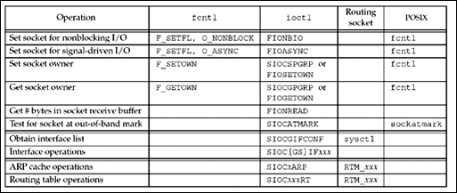
7.11 fcntl Function
Figure 7.20. Summary of fcntl, ioctl, and routing socket operations.

Slide 63
7.11 fcntl Function
The first six operations can be applied to sockets by any process; the second two (interface operations) are less common, but are still general-purpose; and the last two (ARP and routing table) are issued by administrative programs such as ifconfig and route. We will talk more about the various ioctl operations in Chapter 17 and routing sockets in Chapter 18.
There are multiple ways to perform the first four operations, but we note in the final column that POSIX specifies that fcntl is the preferred way. We also note that POSIX provides the sockatmark function (Section 24.3) as the preferred way to test for the out-of-band mark. The remaining operations, with a blank final column, have not been standardized by POSIX.
We also note that the first two operations, setting a socket for nonblocking I/O and for signal-driven I/O, have been set historically using the FNDELAY and FASYNC commands with fcntl. POSIX defines the O_XXX constants.

Slide 64
7.11 fcntl Function
The fcntl function provides the following features related to network programming:
Nonblocking I/O— We can set the O_NONBLOCK file status flag using the F_SETFL command to set a socket as nonblocking. We will describe nonblocking I/O in Chapter 16.
Signal-driven I/O— We can set the O_ASYNC file status flag using the F_SETFL command, which causes the SIGIO signal to be generated when the status of a socket changes. We will discuss this in Chapter 25.
The F_SETOWN command lets us set the socket owner (the process ID or process group ID) to receive the SIGIO and SIGURG signals. The former signal is generated when signal-driven I/O is enabled for a socket (Chapter 25) and the latter signal is generated when new out-of-band data arrives for a socket
(Chapter 24). The F_GETOWN command returns the current owner of the socket.
The term "socket owner" is defined by POSIX. Historically, Berkeley-derived implementations have called this "the process group ID of the socket" because the variable that stores this ID is the so_pgid member of the socket structure (p. 438 of TCPv2).

Slide 65
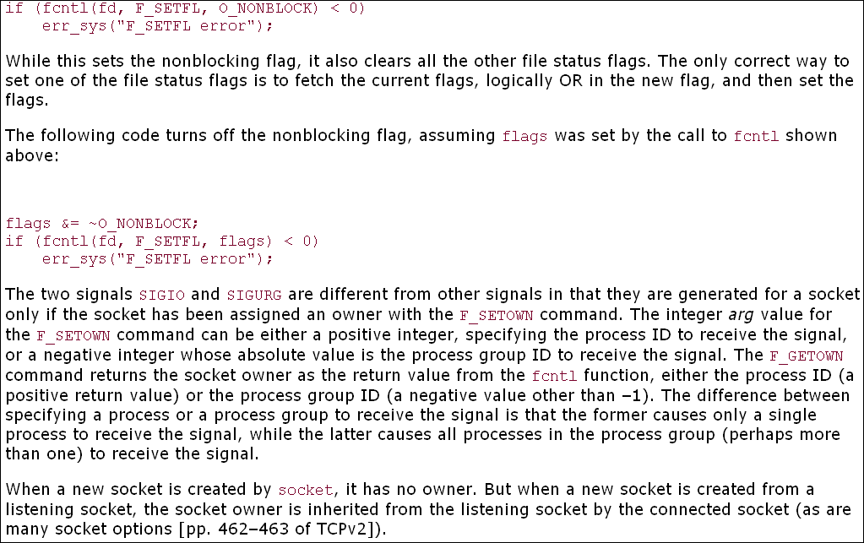
7.11 fcntl Function

Slide 66
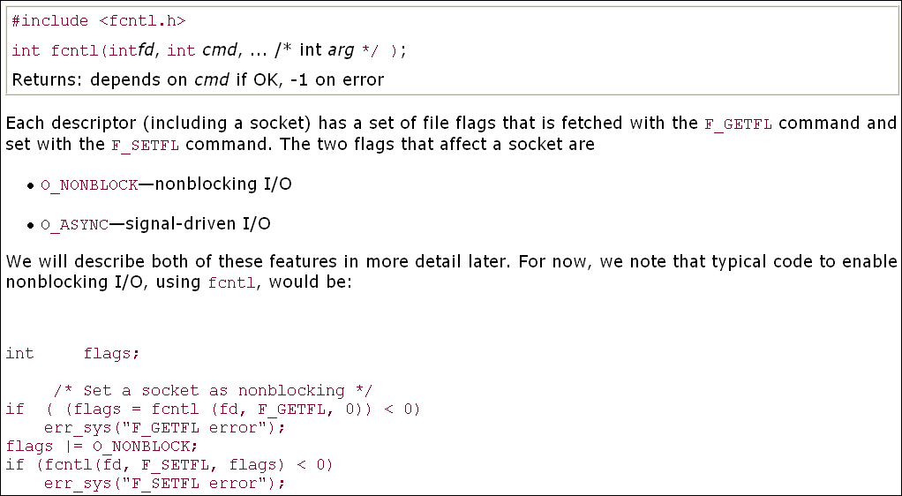
7.11 fcntl Function

Slide 67
7.12 Summary
Socket options run the gamut from the very general (SO_ERROR) to the very specific (IP header options).
The most commonly used options that we might encounter are SO_KEEPALIVE, SO_RCVBUF, SO_SNDBUF, and SO_REUSEADDR. The latter should always be set for a TCP server before it calls bind (Figure 11.12).
The SO_BROADCAST option and the 10 multicast socket options are only for applications that broadcast or multicast, respectively.

Slide 68
7.12 Summary
The SO_KEEPALIVE socket option is set by many TCP servers and automatically terminates a half-open connection. The nice feature of this option is that it is handled by the TCP layer, without requiring an application-level inactivity timer; its downside is that it cannot tell the difference between a crashed client host and a temporary loss of connectivity to the client.
SCTP provides 17 socket options that are used by the application to control the transport. SCTP_NODELAY and SCTP_MAXSEG are similar to TCP_NODELAY and TCP_MAXSEG and perform equivalent functions.
The other 15 options give the application finer control of the SCTP stack; we will discuss the use of many of these socket options in Chapter 23.

Slide 69
7.12 Summary
The SO_LINGER socket option gives us more control over when close returns and also lets us force an RST to be sent instead of TCP's four-packet connection termination sequence. We must be careful sending RSTs, because this avoids TCP's TIME_WAIT state.
Much of the time, this socket option does not provide the information that we need, in which case, an application-level ACK is required.

Slide 70
7.12 Summary
Every TCP and SCTP socket has a send buffer and a receive buffer, and every UDP socket has a receive buffer. The SO_SNDBUF and SO_RCVBUF socket options let us change the sizes of these buffers.
The most common use of these options is for bulk data transfer across long fat pipes: TCP connections with either a high bandwidth or a long delay, often using the RFC 1323 extensions. UDP sockets, on the other hand, might want to increase the size of the receive buffer to allow the kernel to queue more datagrams if the application is busy.

