Slide 1
Chapter 8. Elementary UDP Sockets

Slide 2
8.1 Introduction
There are some fundamental differences between applications written using TCP versus those that use UDP. These are because of the differences in the two transport layers: UDP is a connectionless, unreliable, datagram protocol, quite unlike the connection-oriented, reliable byte stream provided by TCP. Nevertheless, there are instances when it makes sense to use UDP instead of TCP, and we will go over this design choice in Section 22.4. Some popular applications are built using UDP: DNS, NFS, and SNMP, for example.

Slide 3
8.1 Introduction
Figure 8.1 shows the function calls for a typical UDP client/server. The client does not establish a connection with the server. Instead, the client just sends a datagram to the server using the sendto function (described in the next section), which requires the address of the destination (the server) as a parameter.
Similarly, the server does not accept a connection from a client. Instead, the server just calls the recvfrom function, which waits until data arrives from some client. recvfrom returns the protocol address of the client, along with the datagram, so the server can send a response to the correct client.

Slide 4
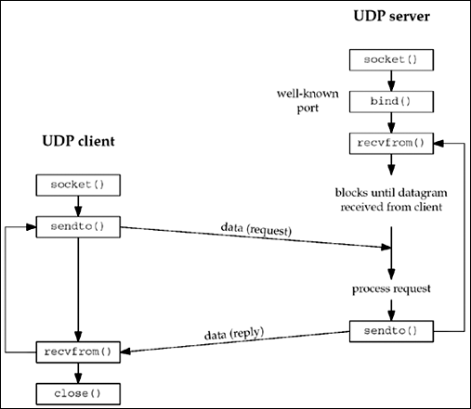
8.1 Introduction
Figure 8.1. Socket functions for UDP client/server

Slide 5
8.1 Introduction
Figure 8.1 shows a timeline of the typical scenario that takes place for a UDP client/server exchange. We can compare this to the typical TCP exchange that was shown in Figure 4.1.
In this chapter, we will describe the new functions that we use with UDP sockets, recvfrom and sendto, and redo our echo client/server to use UDP. We will also describe the use of the connect function with a UDP socket, and the concept of asynchronous errors.

Slide 6
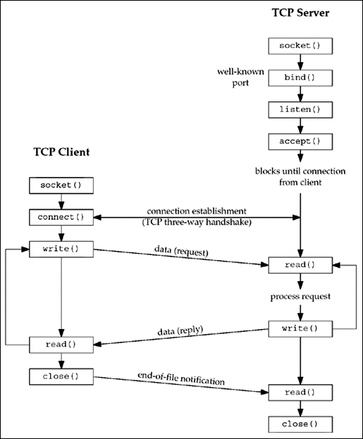
8.1 Introduction
Figure 4.1. Socket functions for elementary TCP client/server

Slide 7
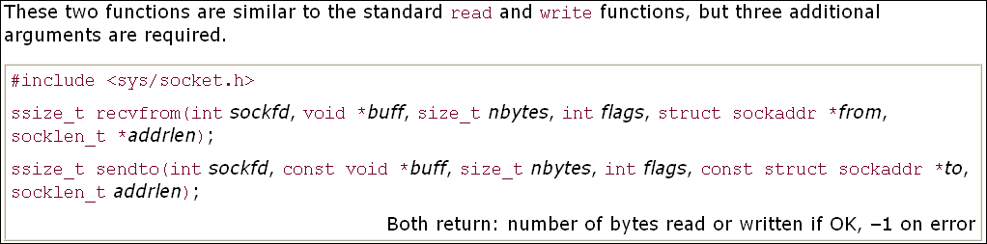
8.2 recvfrom and sendto Functions

Slide 8
8.2 recvfrom and sendto Functions
The first three arguments, sockfd, buff, and nbytes, are identical to the first three arguments for read and write: descriptor, pointer to buffer to read into or write from, and number of bytes to read or write.
We will describe the flags argument in Chapter 14 when we discuss the recv, send, recvmsg, and sendmsg functions, since we do not need them with our simple UDP client/server example in this chapter. For now, we will always set the flags to 0.

Slide 9
8.2 recvfrom and sendto Functions
The to argument for sendto is a socket address structure containing the protocol address (e.g., IP address and port number) of where the data is to be sent. The size of this socket address structure is specified by addrlen. The recvfrom function fills in the socket address structure pointed to by from with the protocol address of who sent the datagram. The number of bytes stored in this socket address structure is also returned to the caller in the integer pointed to by addrlen. Note that the final argument to sendto is an integer value, while the final argument to recvfrom is a pointer to an integer value (a value-result argument).
The final two arguments to recvfrom are similar to the final two arguments to accept: The contents of the socket address structure upon return tell us who sent the datagram (in the case of UDP) or who initiated the connection (in the case of TCP). The final two arguments to sendto are similar to the final two arguments to connect: We fill in the socket address structure with the protocol address of where to send the datagram (in the case of UDP) or with whom to establish a connection (in the case of TCP).

Slide 10
8.2 recvfrom and sendto Functions
Both functions return the length of the data that was read or written as the value of the function. In the typical use of recvfrom, with a datagram protocol, the return value is the amount of user data in the datagram received.
Writing a datagram of length 0 is acceptable. In the case of UDP, this results in an IP datagram containing an IP header (normally 20 bytes for IPv4 and 40 bytes for IPv6), an 8-byte UDP header, and no data. This also means that a return value of 0 from recvfrom is acceptable for a datagram protocol: It does not mean that the peer has closed the connection, as does a return value of 0 from read on a TCP socket. Since UDP is connectionless, there is no such thing as closing a UDP connection.

Slide 11
8.2 recvfrom and sendto Functions
If the from argument to recvfrom is a null pointer, then the corresponding length argument (addrlen) must also be a null pointer, and this indicates that we are not interested in knowing the protocol address of who sent us data.
Both recvfrom and sendto can be used with TCP, although there is normally no reason to do so.

Slide 12
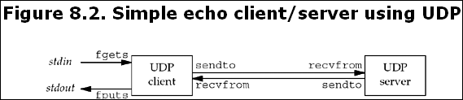
8.3 UDP Echo Server: main Function
We will now redo our simple echo client/server from Chapter 5 using UDP.
Our UDP client and server programs follow the function call flow that we diagrammed in Figure 8.1.
Figure 8.2 depicts the functions that are used. Figure 8.3 shows the server main function.

Slide 13
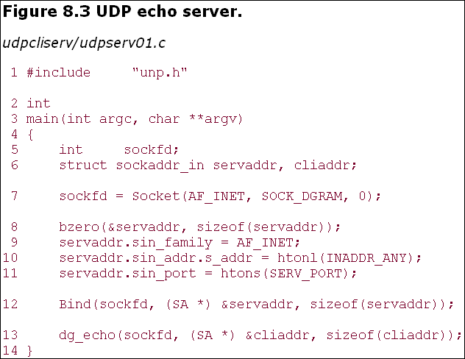
8.3 UDP Echo Server: main Function

Slide 14
8.3 UDP Echo Server: main Function
Create UDP socket, bind server's well-known port
7–12 We create a UDP socket by specifying the second argument to socket as SOCK_DGRAM (a datagram socket in the IPv4 protocol). As with the TCP server example, the IPv4 address for the bind is specified as INADDR_ANY and the server's well-known port is the constant SERV_PORT from the unp.h header.
13 The function dg_echo is called to perform server processing.

Slide 15
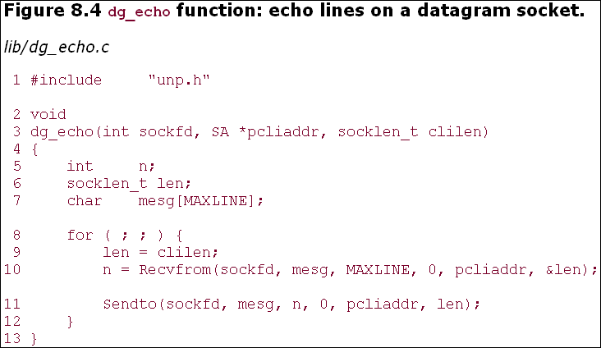
8.4 UDP Echo Server: dg_echo Function

Slide 16
8.4 UDP Echo Server: dg_echo Function
Read datagram, echo back to sender
8–12 This function is a simple loop that reads the next datagram arriving at the server's port using recvfrom and sends it back using sendto.
Despite the simplicity of this function, there are numerous details to consider. First, this function never terminates. Since UDP is a connectionless protocol, there is nothing like an EOF as we have with TCP.
Next, this function provides an iterative server, not a concurrent server as we had with TCP. There is no call to fork, so a single server process handles any and all clients. In general, most TCP servers are concurrent and most UDP servers are iterative.

Slide 17
8.4 UDP Echo Server: dg_echo Function
There is implied queuing taking place in the UDP layer for this socket. Indeed, each UDP socket has a receive buffer and each datagram that arrives for this socket is placed in that socket receive buffer. When the process calls recvfrom, the next datagram from the buffer is returned to the process in a first-in, first-out (FIFO) order. This way, if multiple datagrams arrive for the socket before the process can read what's already queued for the socket, the arriving datagrams are just added to the socket receive buffer. But, this buffer has a limited size. We discussed this size and how to increase it with the SO_RCVBUF socket option in Section 7.5.
Figure 8.5 summarizes our TCP client/server from Chapter 5 when two clients establish connections with the server.

Slide 18
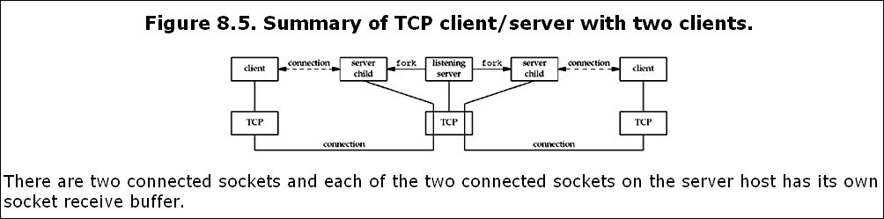
8.4 UDP Echo Server: dg_echo Function

Slide 19
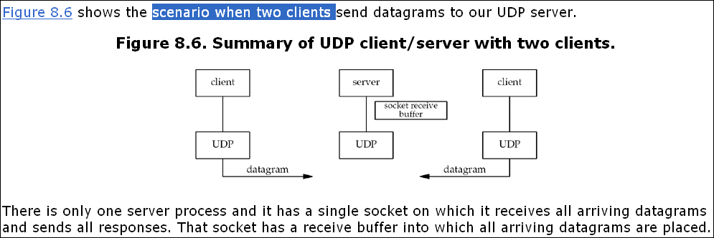
8.4 UDP Echo Server: dg_echo Function

Slide 20
8.4 UDP Echo Server: dg_echo Function
The main function in Figure 8.3 is protocol-dependent (it creates a socket of protocol AF_INET and allocates and initializes an IPv4 socket address structure), but the dg_echo function is protocol-independent. The reason dg_echo is protocol-independent is because the caller (the main function in our case) must allocate a socket address structure of the correct size, and a pointer to this structure, along with its size, are passed as arguments to dg_echo.
The function dg_echo never looks inside this protocol-dependent structure: It simply passes a pointer to the structure to recvfrom and sendto. recvfrom fills this structure with the IP address and port number of the client, and since the same pointer (pcliaddr) is then passed to sendto as the destination address, this is how the datagram is echoed back to the client that sent the datagram.

Slide 21
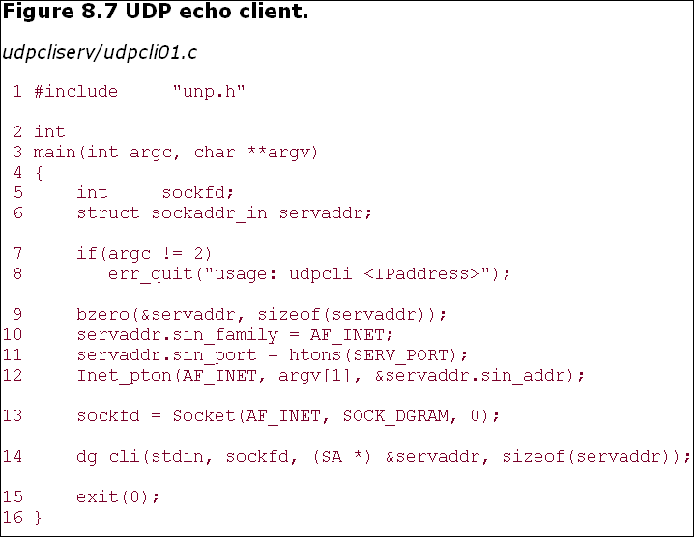
8.5 UDP Echo Client: main Function

Slide 22
8.5 UDP Echo Client: main Function
Fill in socket address structure with server's address
9–12 An IPv4 socket address structure is filled in with the IP address and port number of the server. This structure will be passed to dg_cli, specifying where to send datagrams.
13–14 A UDP socket is created and the function dg_cli is called.

Slide 23
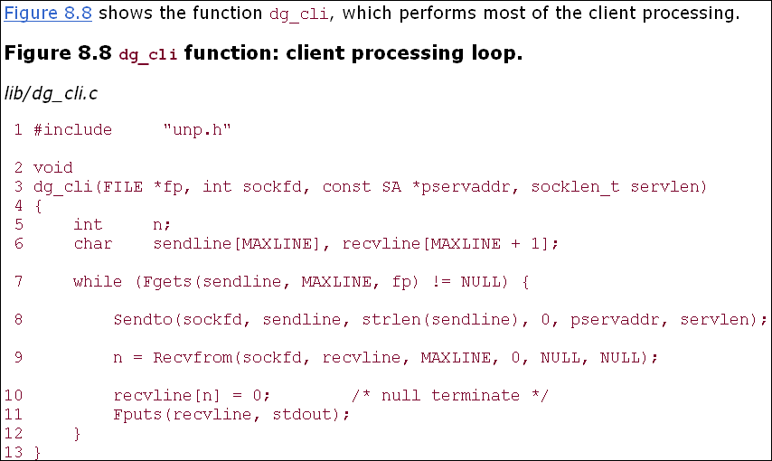
8.6 UDP Echo Client: dg_cli Function

Slide 24
8.6 UDP Echo Client: dg_cli Function
7–12 There are four steps in the client processing loop: read a line from standard input using fgets, send the line to the server using sendto, read back the server's echo using recvfrom, and print the echoed line to standard output using fputs.
Our client has not asked the kernel to assign an ephemeral port to its socket. (With a TCP client, we said the call to connect is where this takes place.) With a UDP socket, the first time the process calls sendto, if the socket has not yet had a local port bound to it, that is when an ephemeral port is chosen by the kernel for the socket. As with TCP, the client can call bind explicitly, but this is rarely done.

Slide 25
8.6 UDP Echo Client: dg_cli Function
Notice that the call to recvfrom specifies a null pointer as the fifth and sixth arguments. This tells the kernel that we are not interested in knowing who sent the reply. There is a risk that any process, on either the same host or some other host, can send a datagram to the client's IP address and port, and that datagram will be read by the client, who will think it is the server's reply. We will address this in Section 8.8.
As with the server function dg_echo, the client function dg_cli is protocol-independent, but the client main function is protocol-dependent. The main function allocates and initializes a socket address structure of some protocol type and then passes a pointer to this structure, along with its size, to dg_cli.

Slide 26
8.7 Lost Datagrams
Our UDP client/server example is not reliable. If a client datagram is lost (say it is discarded by some router between the client and server), the client will block forever in its call to recvfrom in the function dg_cli, waiting for a server reply that will never arrive.
Similarly, if the client datagram arrives at the server but the server's reply is lost, the client will again block forever in its call to recvfrom. A typical way to prevent this is to place a timeout on the client's call to recvfrom. We will discuss this in Section 14.2.

Slide 27
8.7 Lost Datagrams
Just placing a timeout on the recvfrom is not the entire solution. For example, if we do time out, we cannot tell whether our datagram never made it to the server, or if the server's reply never made it back. If the client's request was something like "transfer a certain amount of money from account A to account B" (instead of our simple echo server), it would make a big difference as to whether the request was lost or the reply was lost. We will talk more about adding reliability to a UDP client/server in Section 22.5.

Slide 28
8.8 Verifying Received Response
At the end of Section 8.6, we mentioned that any process that knows the client's ephemeral port number could send datagrams to our client, and these would be intermixed with the normal server replies. What we can do is change the call to recvfrom in Figure 8.8 to return the IP address and port of who sent the reply and ignore any received datagrams that are not from the server to whom we sent the datagram. There are a few pitfalls with this, however, as we will see.
First, we change the client main function (Figure 8.7) to use the standard echo server (Figure 2.18). We just replace the assignment
servaddr.sin_port = htons(SERV_PORT); with
servaddr.sin_port = htons(7); We do this so we can use any host running the standard echo server with our client.
We then recode the dg_cli function to allocate another socket address structure to hold the structure returned by recvfrom. We show this in Figure 8.9.

Slide 29
8.8 Verifying Received Response
Allocate another socket address structure
9 We allocate another socket address structure by calling malloc. Notice that the dg_cli function is still protocol-independent; because we do not care what type of socket address structure we are dealing with, we use only its size in the call to malloc.
Compare returned address
12–18 In the call to recvfrom, we tell the kernel to return the address of the sender of the datagram. We first compare the length returned by recvfrom in the value-result argument and then compare the socket address structures themselves using memcmp.
Section 3.2 says that even if the socket address structure contains a length field, we need never set it or examine it. However, memcmp compares every byte of data in the two socket address structures, and the length field is set in the socket address structure that the kernel returns; so in this case we must set it when constructing the sockaddr. If we don't, the memcmp will compare a 0 (since we didn't set it) with a 16 (assuming sockaddr_in) and will not match.

Slide 30
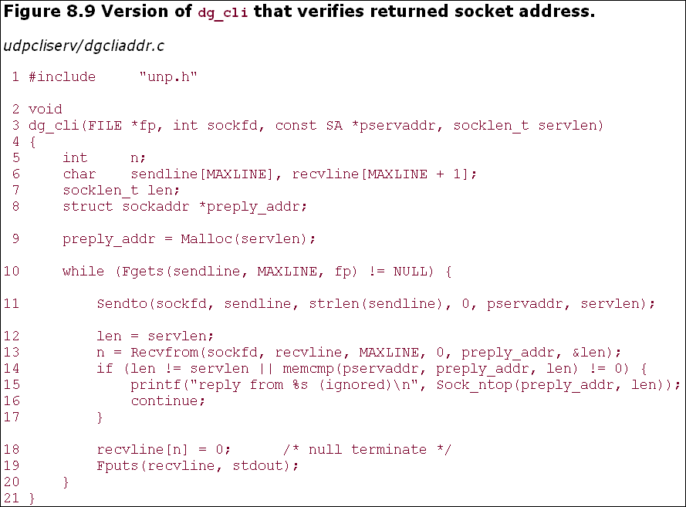
8.8 Verifying Received Response

Slide 31
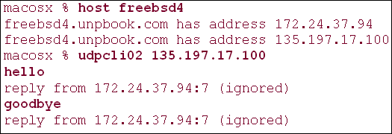
8.8 Verifying Received Response
This new version of our client works fine if the server is on a host with just a single IP address. But this program can fail if the server is multihomed. We run this program to our host freebsd4, which has two interfaces and two IP addresses.

Slide 32
8.8 Verifying Received Response
We specified the IP address that does not share the same subnet as the client.
This is normally allowed. Most IP implementations accept an arriving IP datagram that is destined for any of the host's IP addresses, regardless of the interface on which the datagram arrives (pp. 217–219 of TCPv2). RFC 1122 [Braden 1989] calls this the weak end system model. If a system implemented what this RFC calls the strong end system model, it would accept an arriving datagram only if that datagram arrived on the interface to which it was addressed.
The IP address returned by recvfrom (the source IP address of the UDP datagram) is not the IP address to which we sent the datagram. When the server sends its reply, the destination IP address is 172.24.37.78. The routing function within the kernel on freebsd4 chooses 172.24.37.94 as the outgoing interface. Since the server has not bound an IP address to its socket (the server has bound the wildcard address to its socket, which is something we can verify by running netstat on freebsd), the kernel chooses the source address for the IP datagram. It is chosen to be the primary IP address of the outgoing interface (pp. 232–233 of TCPv2). Also, since it is the primary IP address of the interface, if we send our datagram to a nonprimary IP address of the interface (i.e., an alias), this will also cause our test in Figure 8.9 to fail.

Slide 33
8.8 Verifying Received Response
One solution is for the client to verify the responding host's domain name instead of its IP address by looking up the server's name in the DNS (Chapter 11), given the IP address returned by recvfrom. Another solution is for the UDP server to create one socket for every IP address that is configured on the host, bind that IP address to the socket, use select across all these sockets (waiting for any one to become readable), and then reply from the socket that is readable. Since the socket used for the reply was bound to the IP address that was the destination address of the client's request (or the datagram would not have been delivered to the socket), this guaranteed that the source address of the reply was the same as the destination address of the request. We will show an example of this in Section 22.6.
On a multihomed Solaris system, the source IP address for the server's reply is the destination IP address of the client's request. The scenario described in this section is for Berkeley-derived implementations that choose the source IP address based on the outgoing interface.

Slide 34
8.9 Server Not Running
The next scenario to examine is starting the client without starting the server. If we do so and type in a single line to the client, nothing happens. The client blocks forever in its call to recvfrom, waiting for a server reply that will never appear. But, this is an example where we need to understand more about the underlying protocols to understand what is happening to our networking application.
First we start tcpdump on the host macosx, and then we start the client on the same host, specifying the host freebsd4 as the server host. We then type a single line, but the line is not echoed.
macosx % udpcli01 172.24.37.94 hello, worldwe type this line but nothing is echoed back

Slide 35
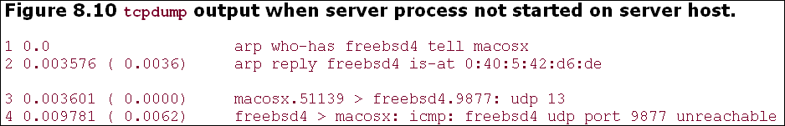
8.9 Server Not Running
First we notice that an ARP request and reply are needed before the client host can send the UDP datagram to the server host. (We left this exchange in the output to reiterate the potential for an ARP request-reply before an IP datagram can be sent to another host or router on the local network.)
In line 3, we see the client datagram sent but the server host responds in line 4 with an ICMP "port unreachable." (The length of 13 accounts for the 12 characters and the newline.) This ICMP error, however, is not returned to the client process, for reasons that we will describe shortly. Instead, the client blocks forever in the call to recvfrom in Figure 8.8. We also note that ICMPv6 has a "port unreachable" error, similar to ICMPv4 (Figures A.15 and A.16), so the results described here are similar for IPv6.

Slide 36
8.9 Server Not Running
We call this ICMP error an asynchronous error. The error was caused by sendto, but sendto returned successfully. Recall from Section 2.11 that a successful return from a UDP output operation only means there was room for the resulting IP datagram on the interface output queue. The ICMP error is not returned until later (4 ms later in Figure 8.10), which is why it is called asynchronous.
The basic rule is that an asynchronous error is not returned for a UDP socket unless the socket has been connected. We will describe how to call connect for a UDP socket in Section 8.11. Why this design decision was made when sockets were first implemented is rarely understood. (The implementation implications are discussed on pp. 748–749 of TCPv2.)

Slide 37
8.9 Server Not Running
Consider a UDP client that sends three datagrams in a row to three different servers (i.e., three different IP addresses) on a single UDP socket. The client then enters a loop that calls recvfrom to read the replies. Two of the datagrams are correctly delivered (that is, the server was running on two of the three hosts) but the third host was not running the server. This third host responds with an ICMP port unreachable. This ICMP error message contains the IP header and UDP header of the datagram that caused the error. (ICMPv4 and ICMPv6 error messages always contain the IP header and all of the UDP header or part of the TCP header to allow the receiver of the ICMP error to determine which socket caused the error. We will show this in Figures 28.21 and 28.22.)
The client that sent the three datagrams needs to know the destination of the datagram that caused the error to distinguish which of the three datagrams caused the error. But how can the kernel return this information to the process? The only piece of information that recvfrom can return is an errno value; recvfrom has no way of returning the destination IP address and destination UDP port number of the datagram in error. The decision was made, therefore, to return these asynchronous errors to the process only if the process connected the UDP socket to exactly one peer.

Slide 38
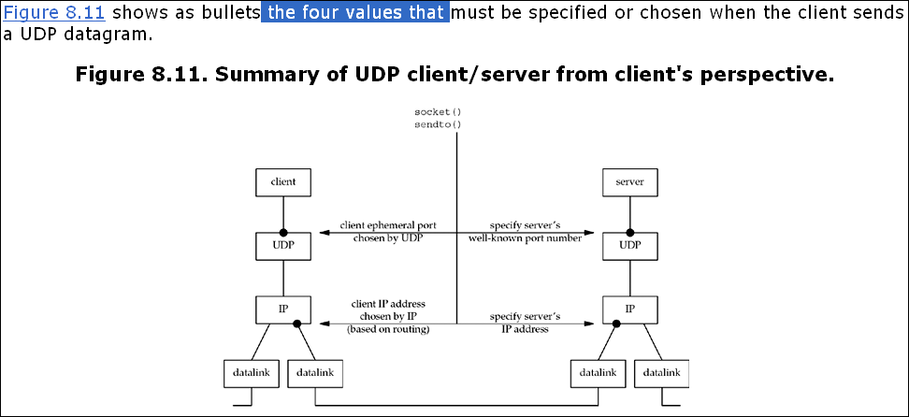
8.10 Summary of UDP Example

Slide 39
8.10 Summary of UDP Example
The client must specify the server's IP address and port number for the call to sendto. Normally, the client's IP address and port are chosen automatically by the kernel, although we mentioned that the client can call bind if it so chooses. If these two values for the client are chosen by the kernel, we also mentioned that the client's ephemeral port is chosen once, on the first sendto, and then it never changes. The client's IP address, however, can change for every UDP datagram that the client sends, assuming the client does not bind a specific IP address to the socket. The reason is shown in Figure 8.11: If the client host is multihomed, the client could alternate between two destinations, one going out the datalink on the left, and the other going out the datalink on the right. In this worst-case scenario, the client's IP address, as chosen by the kernel based on the outgoing datalink, would change for every datagram.

Slide 40
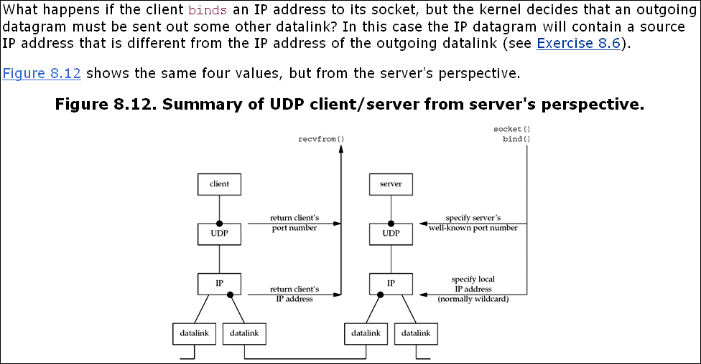
8.10 Summary of UDP Example

Slide 41
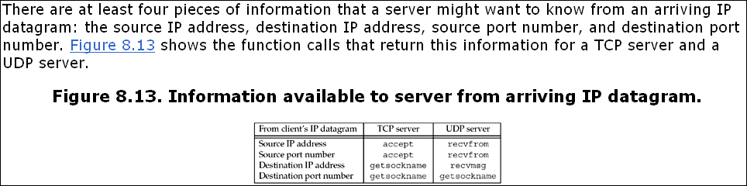
8.10 Summary of UDP Example

Slide 42
8.10 Summary of UDP Example
A TCP server always has easy access to all four pieces of information for a connected socket, and these four values remain constant for the lifetime of a connection. With a UDP socket, however, the destination IP address can only be obtained by setting the IP_RECVDSTADDR socket option for IPv4 or the IPV6_PKTINFO socket option for IPv6 and then calling recvmsg instead of recvfrom.
Since UDP is connectionless, the destination IP address can change for each datagram that is sent to the server. A UDP server can also receive datagrams destined for one of the host's broadcast addresses or for a multicast address, as we will discuss in Chapters 20 and 21. We will show how to determine the destination address of a UDP datagram in Section 22.2, after we cover the recvmsg function.

Slide 43
8.11 connect Function with UDP
We mentioned at the end of Section 8.9 that an asynchronous error is not returned on a UDP socket unless the socket has been connected. Indeed, we are able to call connect (Section 4.3) for a UDP socket. But this does not result in anything like a TCP connection: There is no three-way handshake. Instead, the kernel just checks for any immediate errors (e.g., an obviously unreachable destination), records the IP address and port number of the peer (from the socket address structure passed to connect), and returns immediately to the calling process.
Overloading the connect function with this capability for UDP sockets is confusing. If the convention that sockname is the local protocol address and peername is the foreign protocol address is used, then a better name would have been setpeername. Similarly, a better name for the bind function would be setsockname.
With this capability, we must now distinguish between
An unconnected UDP socket, the default when we create a UDP socket
A connected UDP socket, the result of calling connect on a UDP socket

Slide 44
8.11 connect Function with UDP
With a connected UDP socket, three things change, compared to the default unconnected UDP socket:
We can no longer specify the destination IP address and port for an output operation. That is, we do not use sendto, but write or send instead. Anything written to a connected UDP socket is automatically sent to the protocol address (e.g., IP address and port) specified by connect.
Similar to TCP, we can call sendto for a connected UDP socket, but we cannot specify a destination address. The fifth argument to sendto (the pointer to the socket address structure) must be a null pointer, and the sixth argument (the size of the socket address structure) should be 0. The POSIX specification states that when the fifth argument is a null pointer, the sixth argument is ignored.
We do not need to use recvfrom to learn the sender of a datagram, but read, recv, or recvmsg instead. The only datagrams returned by the kernel for an input operation on a connected UDP socket are those arriving from the protocol address specified in connect. Datagrams destined to the connected UDP socket's local protocol address (e.g., IP address and port) but arriving from a protocol address other than the one to which the socket was connected are not passed to the connected socket. This limits a connected UDP socket to exchanging datagrams with one and only one peer.
Technically, a connected UDP socket exchanges datagrams with only one IP address, because it is possible to connect to a multicast or broadcast address.
Asynchronous errors are returned to the process for connected UDP sockets.
The corollary, as we previously described, is that unconnected UDP sockets do not receive asynchronous errors.

Slide 45
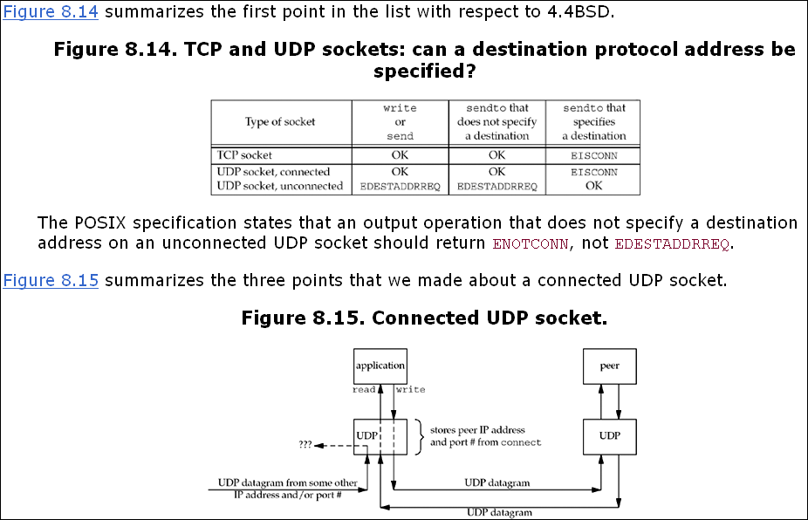
8.11 connect Function with UDP

Slide 46
8.11 connect Function with UDP
Datagrams arriving from any other IP address or port (which we show as "???" in Figure 8.15) are not passed to the connected socket because either the source IP address or source UDP port does not match the protocol address to which the socket is connected. These datagrams could be delivered to some other UDP socket on the host. If there is no other matching socket for the arriving datagram, UDP will discard it and generate an ICMP "port unreachable" error.
In summary, we can say that a UDP client or server can call connect only if that process uses the UDP socket to communicate with exactly one peer. Normally, it is a UDP client that calls connect, but there are applications in which the UDP server communicates with a single client for a long duration (e.g., TFTP); in this case, both the client and server can call connect.

Slide 47
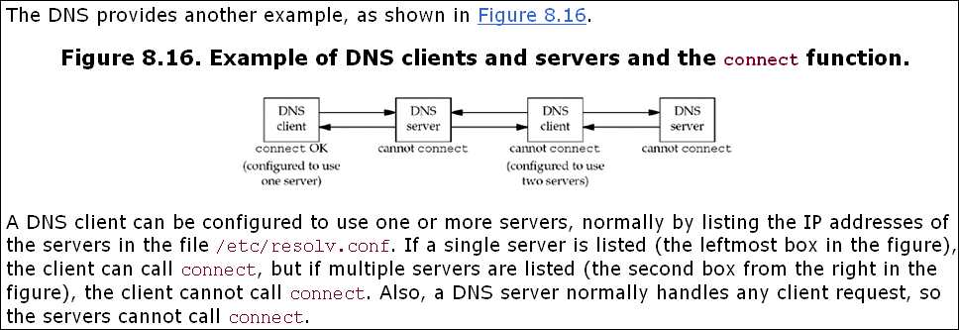
8.11 connect Function with UDP

Slide 48
8.11 connect Function with UDP
Calling connect Multiple Times for a UDP Socket
A process with a connected UDP socket can call connect again for that socket for one of two reasons:
To specify a new IP address and port
To unconnect the socket
The first case, specifying a new peer for a connected UDP socket, differs from the use of connect with a TCP socket: connect can be called only one time for a TCP socket.
To unconnect a UDP socket, we call connect but set the family member of the socket address structure (sin_family for IPv4 or sin6_family for IPv6) to AF_UNSPEC. This might return an error of EAFNOSUPPORT (p. 736 of TCPv2), but that is acceptable. It is the process of calling connect on an already connected UDP socket that causes the socket to become unconnected (pp. 787–788 of TCPv2).

Slide 49
8.11 connect Function with UDP
The Unix variants seem to differ on exactly how to unconnect a socket, and you may encounter approaches that work on some systems and not others. For example, calling connect with NULL for the address works only on some systems (and on some, it only works if the third argument, the length, is nonzero). The POSIX specification and BSD man pages are not much help here, only mentioning that a null address should be used and not mentioning the error return (even on success) at all. The most portable solution is to zero out an address structure, set the family to AF_UNSPEC as mentioned above, and pass it to connect.
Another area of disagreement is around the local binding of a socket during the unconnect process. AIX keeps both the chosen local IP address and the port, even from an implicit bind. FreeBSD and Linux set the local IP address back to all zeros, even if you previously called bind, but leave the port number intact. Solaris sets the local IP address back to all zeros if it was assigned by an implicit bind; but if the program called bind explicitly, then the IP address remains unchanged.

Slide 50
8.11 connect Function with UDP
Performance
When an application calls sendto on an unconnected UDP socket, Berkeley-derived kernels temporarily connect the socket, send the datagram, and then unconnect the socket (pp. 762–763 of TCPv2). Calling sendto for two datagrams on an unconnected UDP socket then involves the following six steps by the kernel:
Connect the socket
Output the first datagram
Unconnect the socket
Connect the socket
Output the second datagram
Unconnect the socket
Another consideration is the number of searches of the routing table. The first temporary connect searches the routing table for the destination IP address and saves (caches) that information. The second temporary connect notices that the destination address equals the destination of the cached routing table information (we are assuming two sendtos to the same destination) and we do not need to search the routing table again (pp. 737–738 of TCPv2).

Slide 51
8.11 connect Function with UDP
When the application knows it will be sending multiple datagrams to the same peer, it is more efficient to connect the socket explicitly. Calling connect and then calling write two times involves the following steps by the kernel:
Connect the socket
Output first datagram
Output second datagram
In this case, the kernel copies only the socket address structure containing the destination IP address and port one time, versus two times when sendto is called twice. [Partridge and Pink 1993] note that the temporary connecting of an unconnected UDP socket accounts for nearly one-third of the cost of each UDP transmission.

Slide 52
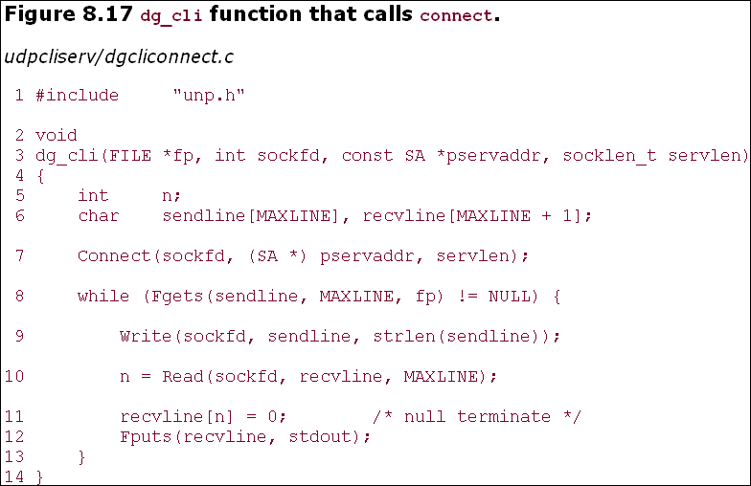
8.12 dg_cli Function (Revisited)

Slide 53
8.12 dg_cli Function (Revisited)
The changes are the new call to connect and replacing the calls to sendto and recvfrom with calls to write and read. This function is still protocol-independent since it doesn't look inside the socket address structure that is passed to connect. Our client main function, Figure 8.7, remains the same.
If we run this program on the host macosx, specifying the IP address of the host freebsd4 (which is not running our server on port 9877), we have the following output:
macosx % udpcli04 172.24.37.94 hello, world read error: Connection refused

Slide 54
8.12 dg_cli Function (Revisited)
The first point we notice is that we do not receive the error when we start the client process. The error occurs only after we send the first datagram to the server. It is sending this datagram that elicits the ICMP error from the server host. But when a TCP client calls connect, specifying a server host that is not running the server process, connect returns the error because the call to connect causes the TCP three-way handshake to happen, and the first packet of that handshake elicits an RST from the server TCP (Section 4.3).
Figure 8.18 shows the tcpdump output.
Figure 8.18 tcpdump output when running Figure 8.17.
macosx % tcpdump 1 0.0 macosx.51139 > freebsd4.9877: udp 13 2 0.006180 ( 0.0062) freebsd4 > macosx: icmp: freebsd4 udp port 9877 unreachable We also see in Figure A.15 that this ICMP error is mapped by the kernel into the error ECONNREFUSED, which corresponds to the message string output by our err_sys function: "Connection refused."

Slide 55
8.12 dg_cli Function (Revisited)
Unfortunately, not all kernels return ICMP messages to a connected UDP socket, as we have shown in this section. Normally, Berkeley-derived kernels return the error, while System V kernels do not. For example, if we run the same client on a Solaris 2.4 host and connect to a host that is not running our server, we can watch with tcpdump and verify that the ICMP "port unreachable" error is returned by the server host, but the client's call to read never returns. This bug was fixed in Solaris 2.5. UnixWare does not return the error, while AIX, Digital Unix, HP-UX, and Linux all return the error.

Slide 56
8.13 Lack of Flow Control with UDP
We now examine the effect of UDP not having any flow control. First, we modify our dg_cli function to send a fixed number of datagrams. It no longer reads from standard input. Figure 8.19 shows the new version. This function writes 2,000 1,400-byte UDP datagrams to the server.
We next modify the server to receive datagrams and count the number received. This server no longer echoes datagrams back to the client. Figure 8.20 shows the new dg_echo function. When we terminate the server with our terminal interrupt key (SIGINT), it prints the number of received datagrams and terminates.

Slide 57
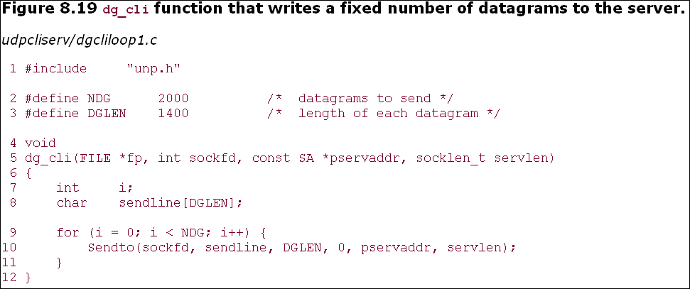
8.13 Lack of Flow Control with UDP

Slide 58
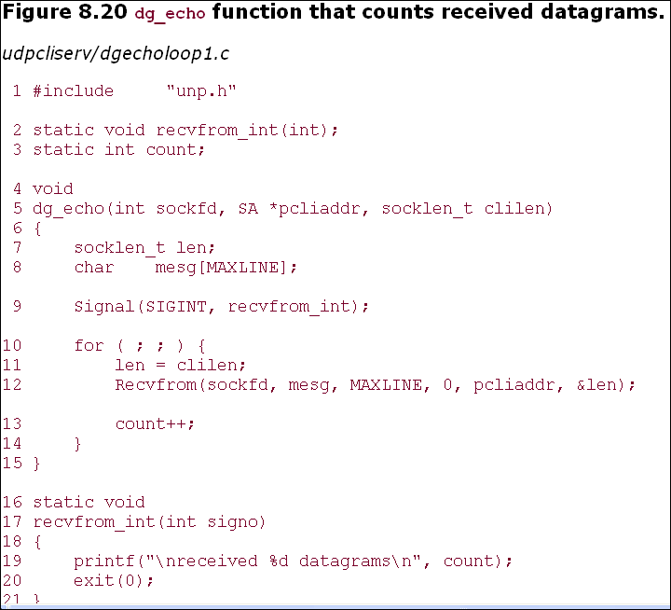
8.13 Lack of Flow Control with UDP

Slide 59
8.13 Lack of Flow Control with UDP
We now run the server on the host freebsd, a slow SPARCStation. We run the client on the RS/6000 system aix, connected directly with 100Mbps Ethernet. Additionally, we run netstat -s on the server, both before and after, as the statistics that are output tell us how many datagrams were lost. Figure 8.21 shows the output on the server.
The client sent 2,000 datagrams, but the server application received only 30 of these, for a 98% loss rate. There is no indication whatsoever to the server application or to the client application that these datagrams were lost. As we have said, UDP has no flow control and it is unreliable. It is trivial, as we have shown, for a UDP sender to overrun the receiver.

Slide 60
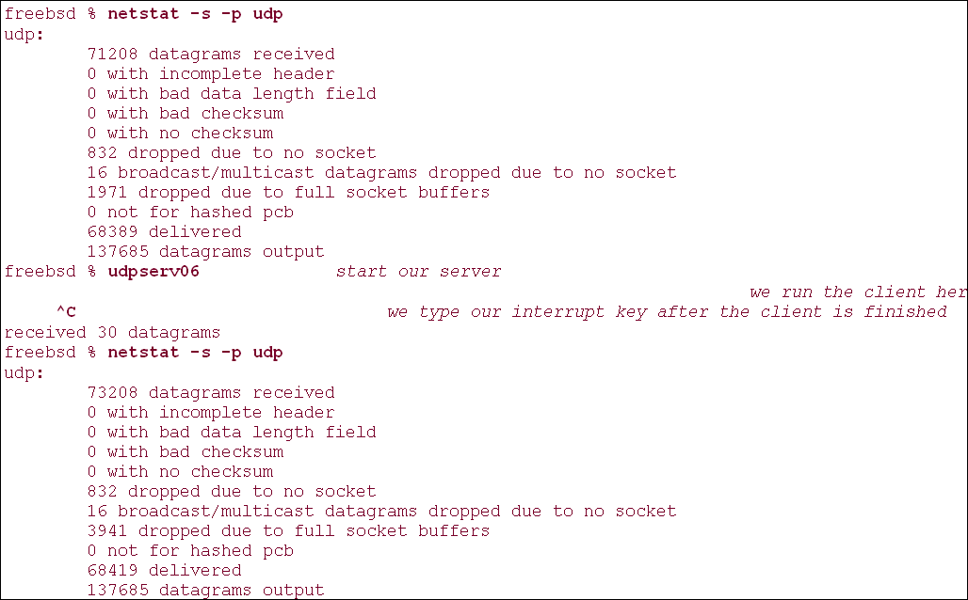
Figure 8.21 Output on server host.

Slide 61
8.13 Lack of Flow Control with UDP
If we look at the netstat output, the total number of datagrams received by the server host (not the server application) is 2,000 (73,208 - 71,208). The counter "dropped due to full socket buffers" indicates how many datagrams were received by UDP but were discarded because the receiving socket's receive queue was full (p. 775 of TCPv2). This value is 1,970 (3,491 - 1,971), which when added to the counter output by the application (30), equals the 2,000 datagrams received by the host. Unfortunately, the netstat counter of the number dropped due to a full socket buffer is systemwide. There is no way to determine which applications (e.g., which UDP ports) are affected.
The number of datagrams received by the server in this example is not predictable. It depends on many factors, such as the network load, the processing load on the client host, and the processing load on the server host.

Slide 62
8.13 Lack of Flow Control with UDP
If we run the same client and server, but this time with the client on the slow Sun and the server on the faster RS/6000, no datagrams are lost.
aix % udpserv06 ^?we type our interrupt key after the client is finishedreceived 2000 datagrams

Slide 63
8.13 Lack of Flow Control with UDP
UDP Socket Receive Buffer
The number of UDP datagrams that are queued by UDP for a given socket is limited by the size of that socket's receive buffer. We can change this with the SO_RCVBUF socket option, as we described in Section 7.5. The default size of the UDP socket receive buffer under FreeBSD is 42,080 bytes, which allows room for only 30 of our 1,400-byte datagrams. If we increase the size of the socket receive buffer, we expect the server to receive additional datagrams. Figure 8.22 shows a modification to the dg_echo function from Figure 8.20 that sets the socket receive buffer to 240 KB.

Slide 64
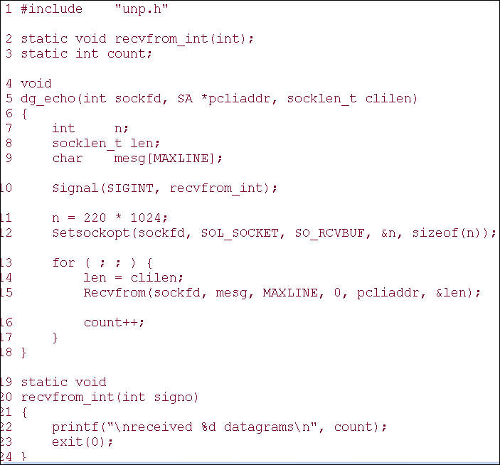
8.13 Lack of Flow Control with UDP

Slide 65
8.13 Lack of Flow Control with UDP
If we run this server on the Sun and the client on the RS/6000, the count of received datagrams is now 103. While this is slightly better than the earlier example with the default socket receive buffer, it is no panacea.
Why do we set the receive socket buffer size to 220 x 1,024 in Figure 8.22? The maximum size of a socket receive buffer in FreeBSD 5.1 defaults to 262,144 bytes (256 x 1,024), but due to the buffer allocation policy (described in Chapter 2 of TCPv2), the actual limit is 233,016 bytes. Many earlier systems based on 4.3BSD restricted the size of a socket buffer to around 52,000 bytes.

Slide 66
8.14 Determining Outgoing Interface with UDP
A connected UDP socket can also be used to determine the outgoing interface that will be used to a particular destination. This is because of a side effect of the connect function when applied to a UDP socket: The kernel chooses the local IP address (assuming the process has not already called bind to explicitly assign this). This local IP address is chosen by searching the routing table for the destination IP address, and then using the primary IP address for the resulting interface.
Figure 8.23 shows a simple UDP program that connects to a specified IP address and then calls getsockname, printing the local IP address and port.

Slide 67
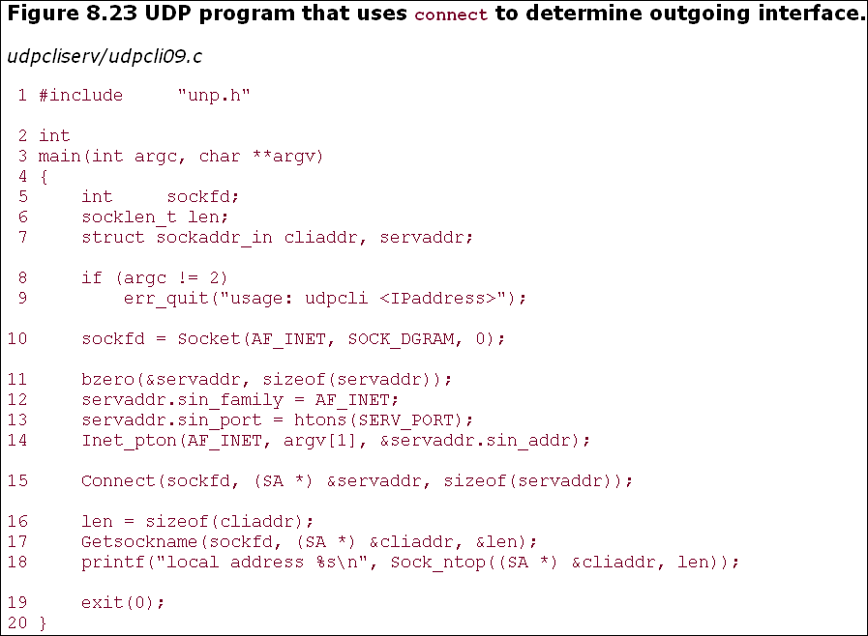
8.14 Determining Outgoing Interface with UDP

Slide 68
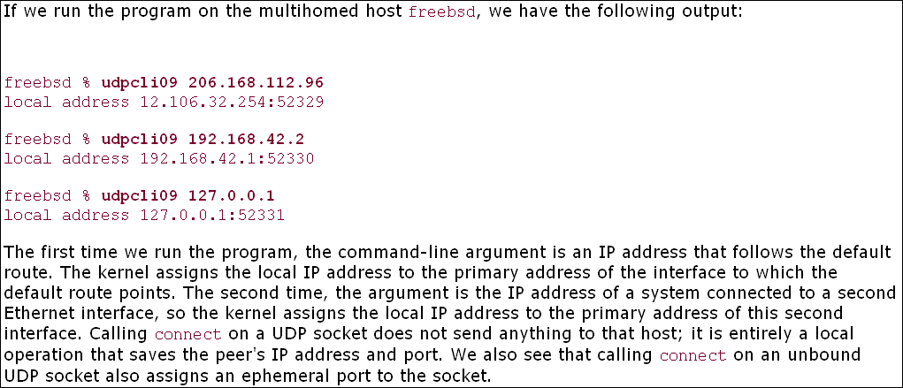
8.14 Determining Outgoing Interface with UDP

Slide 69
8.15 TCP and UDP Echo Server Using select
We now combine our concurrent TCP echo server from Chapter 5 with our iterative UDP echo server from this chapter into a single server that uses select to multiplex a TCP and UDP socket. Figure 8.24 is the first half of this server.
Create listening TCP socket
14–22 A listening TCP socket is created that is bound to the server's well-known port. We set the SO_REUSEADDR socket option in case connections exist on this port.
Create UDP socket
23–29 A UDP socket is also created and bound to the same port. Even though the same port is used for TCP and UDP sockets, there is no need to set the SO_REUSEADDR socket option before this call to bind, because TCP ports are independent of UDP ports.
Figure 8.25 shows the second half of our server.
Establish signal handler for SIGCHLD
30 A signal handler is established for SIGCHLD because TCP connections will be handled by a child process. We showed this signal handler in Figure 5.11.
Prepare for select
31–32 We initialize a descriptor set for select and calculate the maximum of the two descriptors for which we will wait.

Slide 70
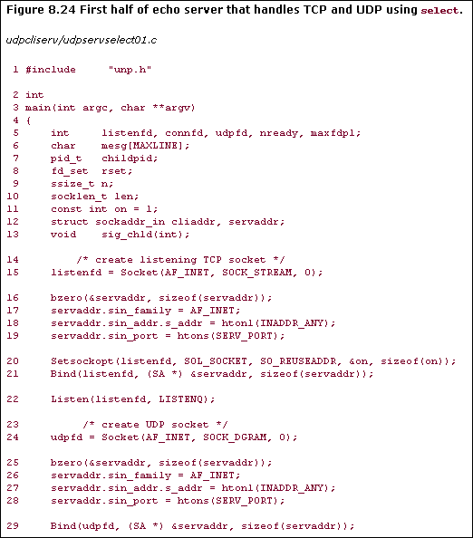
8.15 TCP and UDP Echo Server Using select

Slide 71
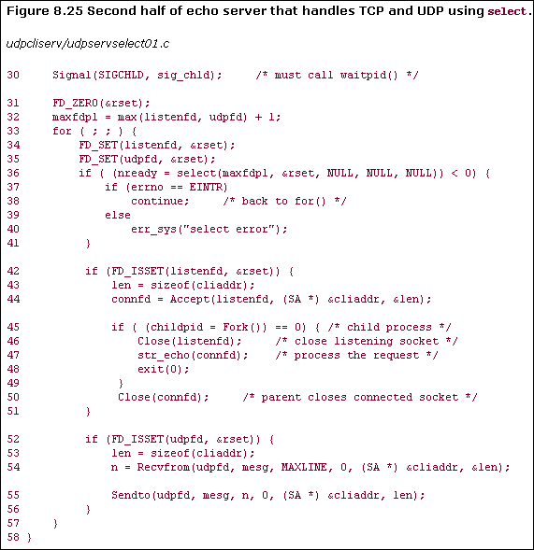

Slide 72
8.15 TCP and UDP Echo Server Using select
Call select
34–41 We call select, waiting only for readability on the listening TCP socket or readability on the UDP socket. Since our sig_chld handler can interrupt our call to select, we handle an error of EINTR.
Handle new client connection
42–51 We accept a new client connection when the listening TCP socket is readable, fork a child, and call our str_echo function in the child. This is the same sequence of steps we used in Chapter 5.
Handle arrival of datagram
52–57 If the UDP socket is readable, a datagram has arrived. We read it with recvfrom and send it back to the client with sendto.

Slide 73
8.16 Summary
Converting our echo client/server to use UDP instead of TCP was simple. But lots of features provided by TCP are missing: detecting lost packets and retransmitting, verifying responses as being from the correct peer, and the like. We will return to this topic in Section 22.5 and see what it takes to add some reliability to a UDP application.
UDP sockets can generate asynchronous errors, that is, errors that are reported some time after a packet is sent. TCP sockets always report these errors to the application, but with UDP, the socket must be connected to receive these errors.

Slide 74
8.16 Summary
UDP has no flow control, and this is easy to demonstrate. Normally, this is not a problem, because many UDP applications are built using a request-reply model, and not for transferring bulk data.
There are still more points to consider when writing UDP applications, but we will save these until Chapter 22, after covering the interface functions, broadcasting, and multicasting

