Slide 1
20
Biodiversity change %
0
-20
>1
>1.5
>2
>3
Global warming (°C)
Notes:
Edit by Wang Longhao
Email: hhuwlh@163.com

Slide 2
Saskatchewan
-7%
-3%
5%
21%
40%
20%
0%
-20%
-40%
CMIP5
CMIP6
HELIX
ISIMIP

Slide 3
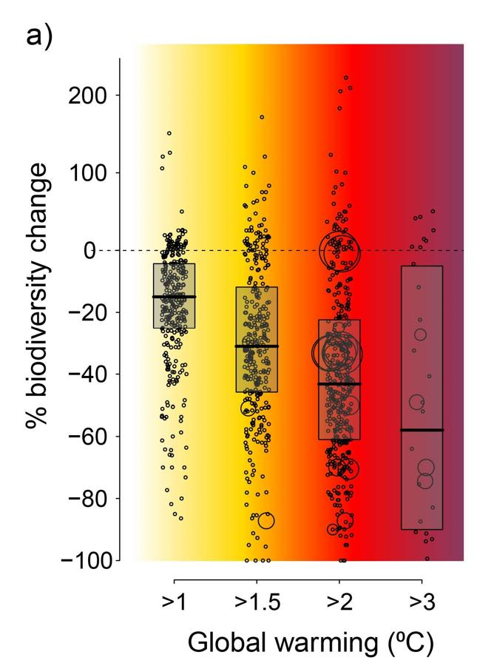
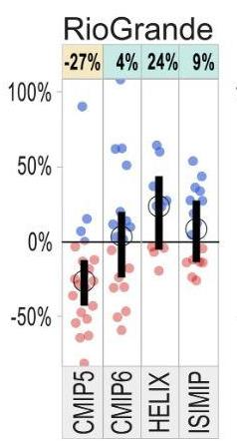
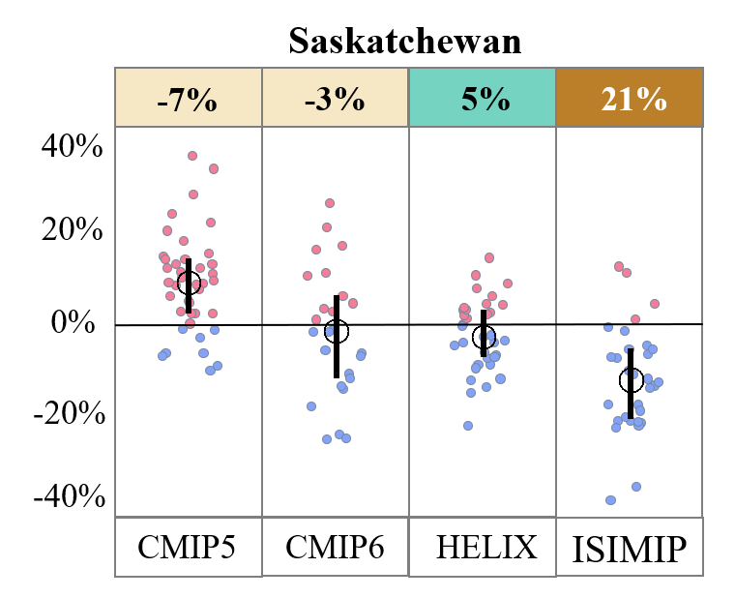
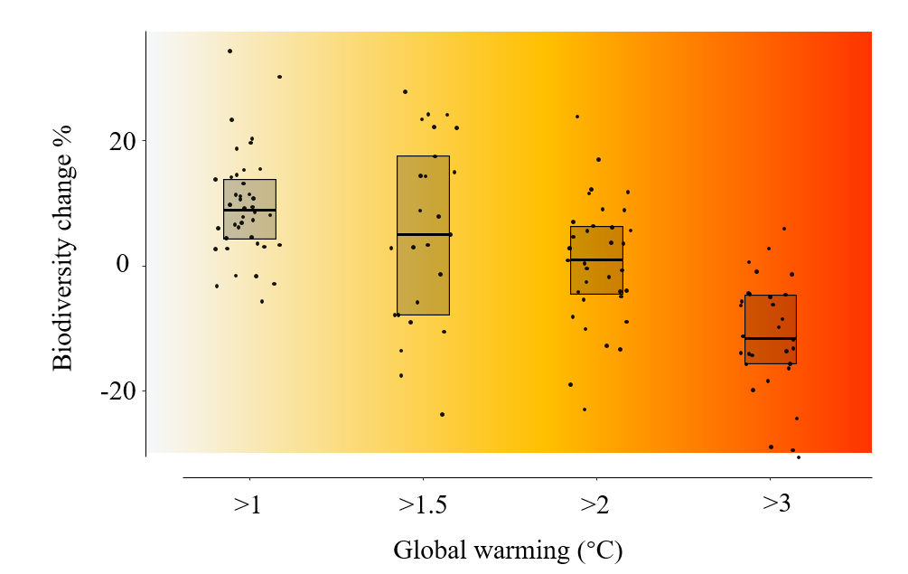
R + ppt 复现
IPCC原图

