Slide 1
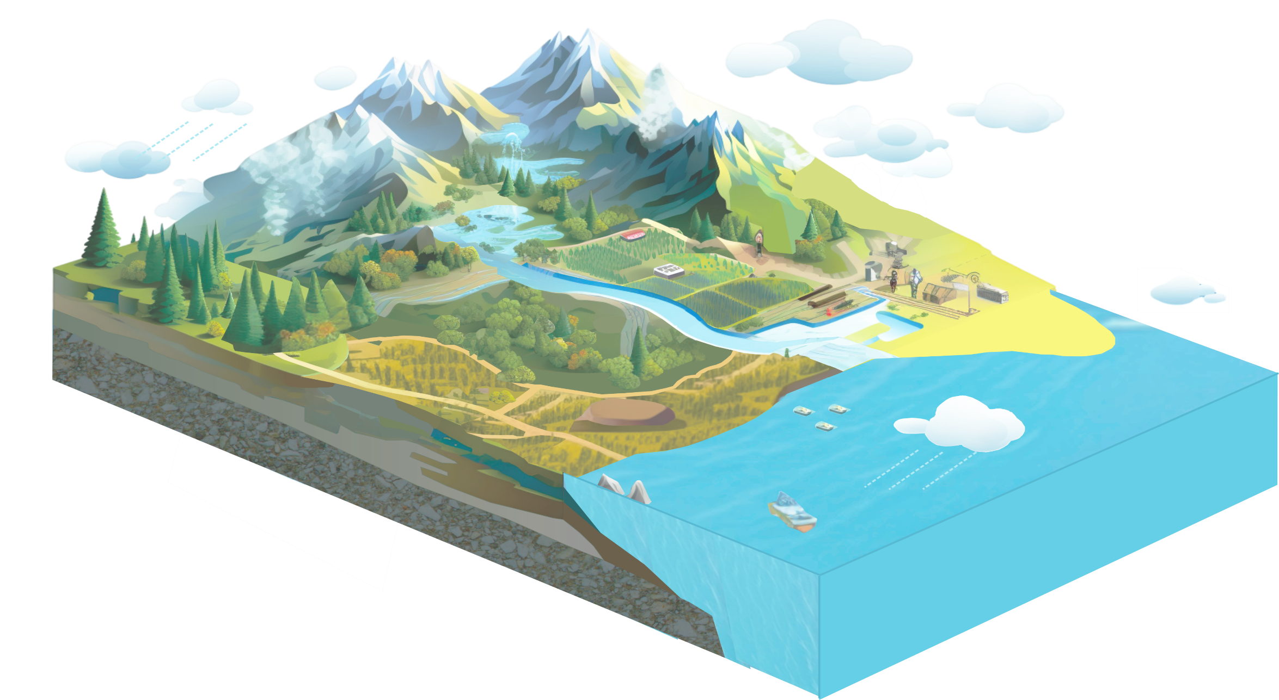
Land precipitation
112.4 ± 4.2 / 117.8 ± 5.3
Historial period / Future
Unit: 10³ km³ year⁻¹
Surface flow
13.2 ± 3.6
Subsurface flow
25.9 ± 5.1
Land evapotranspiration
73.4 ± 6.2 / 76.7 ± 6.6
Forest
29.6 ± 1.9%
Wetland
1.7 ± 0.3%
Others
3.9 ± 0.3%
Cropland
12.3 ± 0.9%
Shrubland
31.7 ± 1.2%
Water
1.7 ± 0.6%
Total river flow
39.1 ± 5.4 / 42.1 ± 5.7
Ocean precipitation
395.5 ± 20.6 / 404.7 ± 21.7
Grassland
19.0 ± 1.0%
Ocean evaporation
434.6 ± 21.3 / 445.5 ± 22.9
Figure 2 | Partitioning global water cycle components based on the emergent constraint approach. a. Historical period (1980-2014). b. Future under SSP2-4.5 (2051-2100). Note that in panel b, the water balance approaches zero (though not precisely equal to zero) since each component is estimated independently.

