Slide 1
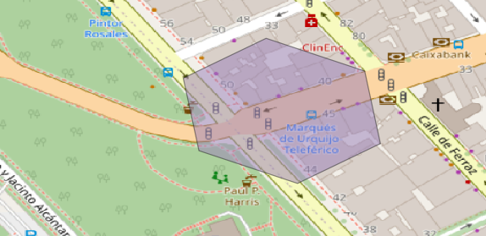
Bikeability Index
Proportion of Natural Area
Length of Biking Infrastructure
Density of Potential Destinations
Separated from Cars
Density of Bike Parking Spots

Slide 2
Classification of the Indicator Length of Biking Infrastructure
Average 67. Percentile from Model Regions: 1429 Meters
Interval Length: 1429 / 10 = 142.9
Unclassified
Classified
x ≥ 1286.1 Meters (1429 – 142.9)
10
1286.1 < x ≥ 1143.2 Meters
9
1143.2 < x ≥ 1000.3 Meters
8
1000.3 < x ≥ 857.4 Meters
7
857.4 < x ≥ 714.5 Meters
6
714.5 < x ≥ 571.6 Meters
5
571.6 < x ≥ 428.7 Meters
4
428.7 < x ≥ 285.8 Meters
3
285.8 < x ≥ 142.9 Meters
2
142.9 < x ≥ 0 Meters
1

