Slide 1
Docker
Presenter :- Prakriti Jain

Slide 2
Docker Containers are NOT Virtual Machines
Easy Connection to make
Fundamentally different architecture
Fundamentally different Benefits
High Efficiency
Notes:
Sometime the code doesn’t work on other system due to the differences in computer environments so what could be solution to this?
We can create virtual machine but I think docker is better solution
After docker everything works just fine

Slide 3
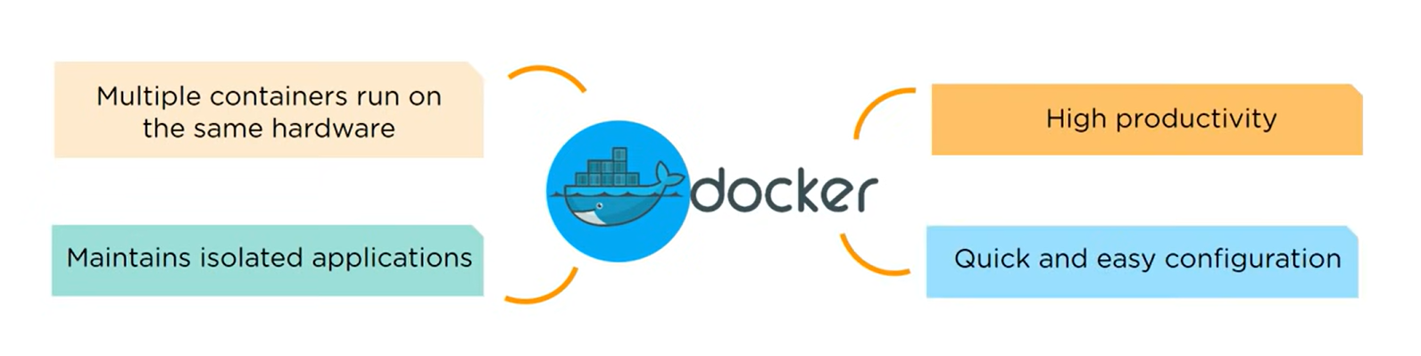

What Is Docker?
Docker is a platform which is used to automate the deployment of application in lightweight containers so that applications can work efficiently in different environments
Docker is a platform which is used to automate the deployment of application in lightweight containers so that applications can work efficiently in different environments
What are Containers?
What are Containers?
A container is a lightweight, portable package that includes an application and all its dependencies, providing a consistent and isolated environment for running software.
A container is a lightweight, portable package that includes an application and all its dependencies, providing a consistent and isolated environment for running software.

Slide 4
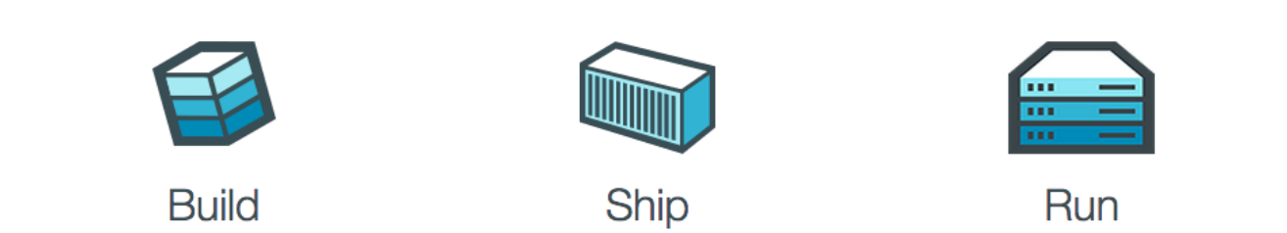
Build ship and run anywhere
Build an app using Docker container with any language and any toolchain
Ship the Dokerized app and dependencies any where to QA, teammates, or cloud without breaking anything
Scales to 1000s of nodes, move between data centres and cloud, update with zero downtime and more
Notes:
The advantage of Docker platform is to ship, test, and deploy code quicker so that we can reduce the time between writing code and execute it in production. And the main important thing about Docker is that its open source, i.e., anyone can use it and can contribute to Docker to make it easier and more features in it which aren’t available in it

Slide 5
Docker Architecture
Notes:
Generally, docker follows a client-server architecture
The client communicates with the daemon, which generally takes up the task of building,running, and shipping the docker containers.
The client and daemon communicate using REST API calls. These calls act as an interface between the client and daemon
A command-line interface, Docker CLI runs docker commands. Some basic docker commands with examples are listed in the git with there syntax.
Registry stores the docker images

Slide 6
Conclusion
Three main features of Docker products are the most distinguishing:
Quick deployment in a variety of environments
Greatly facilitated testing
Possibility of using Docker as a development environment

