Slide 1

Spring Boot
An introduction
Marianna Corona

Slide 2
What
“Spring is an open-source application framework that provides infrastructure support for developing Java applications.
Spring Boot is basically an extension of the Spring framework which eliminates the boilerplate configurations and provides Java developers with a platform to get started with an auto configurable production-grade Spring application.“
Definitions from: https://blogs.sap.com/2023/10/01/build-and-launch-a-simple-spring-boot-appweb-service-on-sap-btp/
Spring Boot Marianna Corona
Notes:
2

Slide 3
Framework?
Spring Boot Marianna Corona
Notes:
3

Slide 4
Framework
Spring Boot Marianna Corona
Notes:
4

Slide 5
Why
Part of the big Spring Ecosystem
Fast
Embed Server (Starting App =starting server)
Good documented
Spring Boot Marianna Corona
Notes:
5

Slide 6
Three ways to use
Installing Springboot
Choosing New spring starter project in the IDLE
Opening Spring initializr (like yesterday)
Spring Boot Marianna Corona
Notes:
Choose New spring starter project in Eclipse – not enough time to try it
6

Slide 7
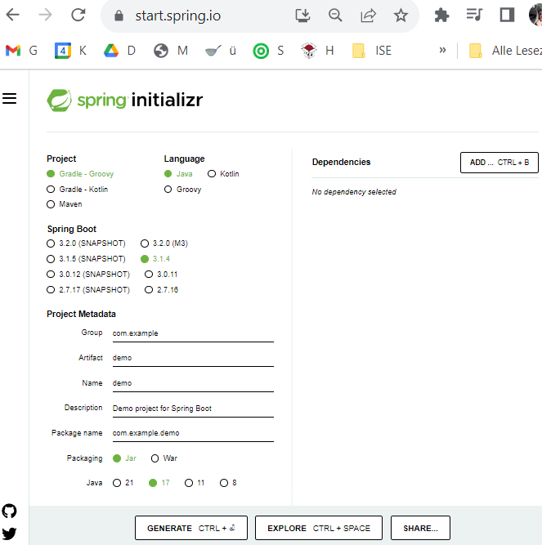
Spring Web
Spring data (JPA)
Spring Boot Marianna Corona
Notes:
web = server tombcat. We have the application, that contains the server!)
Spring data (JPA)
Generate
7

Slide 8
Thank you.
Questions?
Spring Boot Marianna Corona
Notes:
Choose New spring starter project in Eclipse – not enough time to try it
8

