Slide 1
GIS FOR CODE AND CUSTOMISATION M.TECH GEOMATICS SHAILY GANDHI SABYASACHI PURKAYASTHA PT201117

Slide 2
AUTOMATIC TRAINING SAMPLE GENERATOR FOR DEEP LEARNING AND DEEP FEATURE EXTRACTION

Slide 3
Introduction
Supervised machine learning tasks always requires a large amount of labelled datasets for training the classifiers to be able to predict on unseen data. Creating labelled datasets is very expensive and a time taking process.
One such task involves extracting the built area and distributing the census population amongst the extracted areas that fall within residential zone and further model the pedestrian volume and vehicular trip lengths using road network datasets in association with the built area.

Slide 4
Scope
The script takes user input in the form of coordinate pairs, zoom level, no. of images to be stitched, and resizing dimensions for feeding into Keras along with file and folder path requests.
The script generates training samples for built area from the given user inputs.

Slide 5
Evaluation
10 different urban locations were used for testing the accuracy of the generated sample using the customized threshold.
The custom threshold is determined by the mean RGB values of the pixel.
It is meaningful to understand that bright features such as buildings have values of RGB closer to 255,255,255 and values of vegetation, water body are closer to 0,0,0.
The maximum confusion for algorithm happens due to other manmade features such as concrete roads.
An average accuracy of 82% was recorded with a high threshold.
Larger training samples with a few inaccuracies is preferred over smaller training samples without much sample variation for deep learning tasks.

Slide 6
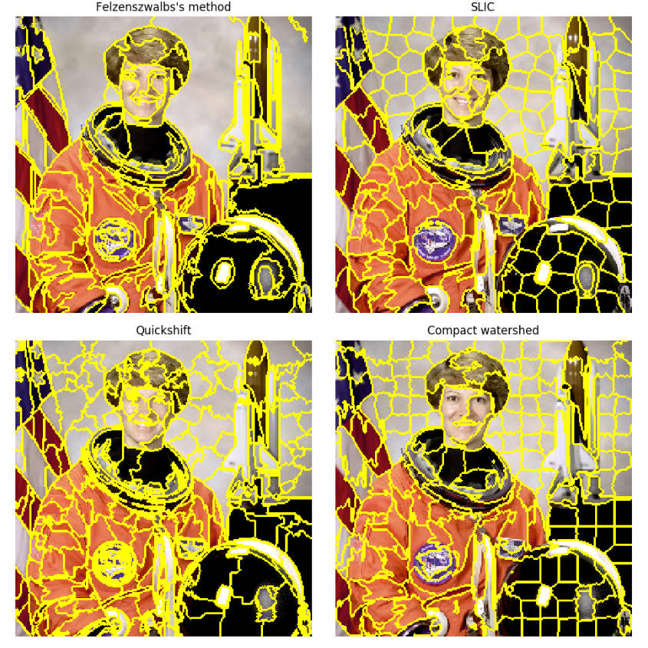
Why SLIC ?
Source: Skimage documentation

Slide 7
Stacks & Libraries
Python 3.6.4
OpenCV
Scikit-image
Numpy Arrays
Tkinter
Pandas
PILLOW

Slide 8
User input
latitu-de
longit-ude
Zoom level
No. of imag-es to stitch
Resize sampl-e dimen-sion
SLIC range (min, max)
Tkinter.filedialog
Logical flow
USER INPUT
Create google tile coordinates
Generate image frame
Hit google API and paste retrieved images
High resolution image generated
Function resize all individual segments to desired training feed dimensions
Access the created segments and save as individual image using bboxes
Create segments using SLIC
Output Samples for Deep Features Extraction

