Slide 1

DART PMEARL System Accelerating SDGs through Smart Humanitarian Action By Win-Win Strategies
Transforming decision making, actions, accountability, service delivery & outcome tracking with adaptive digital tools
Innovative approaches driving sustainable development goals progress

Slide 2

Dynamic Auto Real Time Monitoring Evaluation Accountability Reporting and Learning (DART PMEARL) System
What is it?
DART PMEARL is a next-generation humanitarian platform designed to ensure accurate, unduplicated beneficiary data, enabling better planning, anticipatory action, and resource allocation.
It combines outcome mapping with real-time feedback from communities, field teams, and third-party monitors. Through interactive dashboards, it delivers trustworthy, high-quality information for decision making, accountability, and continuous learning.
Transformative Digital Platform
DART PMEARL is designed to enhance impact, accountability, and learning in humanitarian efforts.
Revolutionizing Aid Delivery
The system improves how aid is delivered and monitored with smart, data-driven approaches.
Supporting Sustainable Development
DART PMEARL accelerates Sustainable Development Goals through effective monitoring and learning.

Slide 3

The Global Challenge (The problem)
Fragmented Data Systems
Disjointed data systems create inefficiencies, making humanitarian efforts less transparent and harder to manage effectively.
Risk of Fraud and Duplication
Fraudulent activities and duplication of efforts undermine accountability and waste valuable resources in aid programs.
Reactive Decision-Making
Slow and reactive decisions limit the ability to respond to urgent humanitarian needs effectively and timely.
Impact on Sustainable Development
These challenges delay progress on goals like Zero Hunger, Good Health, and Reduced Inequalities globally.

Slide 4

Our Game-Changing Solution
Digital Beneficiary Registration
The platform facilitates efficient and accurate digital registration of beneficiaries for humanitarian programmes.
Real-Time Service Verification
Real-time registration/verification ensures transparency and accountability in service delivery to beneficiaries.
Outcome Mapping Integration
Integrated Outcome Mapping tracks behavioral changes to measure programme impact effectively.
AI-Driven Adaptive Management
AI insights support adaptive management for smarter, faster, and fairer aid delivery.

Slide 5

How DART PMEARL Accelerates SDGs (SDG alignment)
Targeting Poverty and Hunger
DART PMEARL ensures precise targeting to effectively reduce poverty and hunger, advancing SDG 1 and 2 goals.
Health Intervention Verification
Biometric verification improves the delivery and monitoring of health interventions, supporting SDG 3.
Promoting Equity and Inclusion
Transparent and inclusive data practices foster equity and inclusion, aligning with SDGs 5 and 10.
Strengthening Institutions and Partnerships
Enhances accountability and collaborative learning to support SDGs 16 and 17 through strong institutions and partnerships. (Outcome mapping)

Slide 6

Core Features
Secure Beneficiary Tracking
QR code and biometric registration enable secure and efficient tracking of beneficiaries in humanitarian programs.
Real-Time Service Verification
Mobile-based verification ensures services are accounted for in real time, enhancing program transparency and accountability.
Outcome mapping
Tracking changes/milestones as they occur and comparing them to the schedule of changes, then deciding what could be lagging behind, for extra attention.
Dynamic Reporting Dashboards
Cloud dashboards provide dynamic, accessible reporting for monitoring program progress and outcomes.
Predictive AI Analytics
AI analytics offer predictive insights supporting proactive decision-making in humanitarian program management.

Slide 7
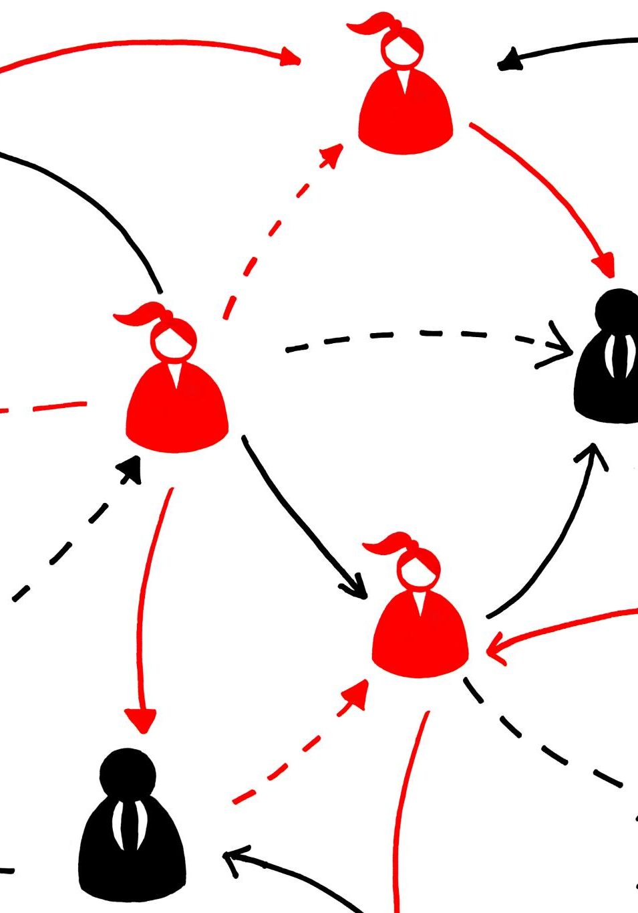
Outcome Mapping – Our Differentiator
Focus on Real Change
Outcome Mapping emphasizes actual behavioral changes instead of just measuring inputs and outputs.
Integrated Monitoring Approach
Combines field data, beneficiary feedback, and third-party monitoring for comprehensive tracking.
Early Issue Detection
Supports early identification of problems and enables timely course correction to avoid failures.
Culture of Continuous Learning
Fosters ongoing learning and adaptation to keep humanitarian interventions effective and relevant.

Slide 8

Implementation Roadmap
Phase I MVP Development
Phase I develops the MVP with registration, QR code generation, and basic outcome tracking modules.
Phase II Advanced Features
Phase II adds biometric verification, stakeholder surveys, and learning loops to enhance functionality.
Ongoing Monitoring
Monitoring occurs quarterly by Humanitarian organizations and bi-annually by the stakeholders and partners for quality improvement.

Slide 9

Technology for Scale & Sustainability (Infrastructure)
Robust Technology Stack
DART PMEARL utilizes ReactJS for responsive interfaces and Django for backend operations ensuring scalability.
Database and Accessibility
PostgreSQL manages data while Progressive Web Apps enable seamless offline and online access.
Cloud Hosting and Security
The system supports cloud hosting on major platforms and ensures GDPR compliance with encrypted data and access controls.

Slide 10

Efficiency, Effectiveness & Sustainability – Dual Impact analysis
Operational Efficiency
Fast registration, real-time verification, and mobile-first design drive system efficiency and smooth operations.
System Effectiveness
Tracking real change and enabling data-driven decisions ensure impactful and informed outcomes.
Sustainability & SDG Impact
Modular design, learning loops, and inclusive engagement promote long-term sustainability and SDG progress.
Notes:
--- This slide references information from the following file: https://ifrcorg-my.sharepoint.com/personal/patrick_muthomi_ifrc_org/_layouts/15/Doc.aspx?sourcedoc=%7B1E7CE8DF-4EB6-471E-B10E-2284B95B16DC%7D&file=DART%20PMEARL%20Concept%20Note.docx&action=default&mobileredirect=true DART PMEARL delivers dual impact by enhancing both the system’s operational performance and the broader attainment of SDGs. System efficiency is achieved through fast registration, real-time verification, and mobile-first design. Effectiveness is supported by tracking real change and enabling data-driven decisions. Sustainability is ensured through modular architecture and learning loops. For SDGs, the system reduces duplication, speeds emergency response, and streamlines reporting. It tracks real-world change, promotes inclusive engagement, and builds local capacity for long-term progress.

Slide 11

Call to Action
Partnership Invitation
We invite you to join the DART PMEARL initiative, a humanitarian platform that will deliver accurate, unduplicated beneficiary data, sharpen planning and anticipatory action, and ensure real change, not just reports.
Let’s collaborate to unlock transparency, learning, and excellence in every intervention.
Accelerating SDG Attainment
To accelerate SDG success, we must move beyond rough estimates to sharp insight. DART PMEARL secures reliable beneficiary data for anticipatory planning.
Real-time feedback + outcome mapping = actionable dashboards that tighten accountability and drive impact.
Transforming Humanitarian Operations
Together, lets harness the power of high quality and timely evidence and information to power and transform humanitarian interventions and operations and to transform peoples lives as envisaged by the SDGS.
This is the aspiration, the promise of DART PMEARL

