Slide 1
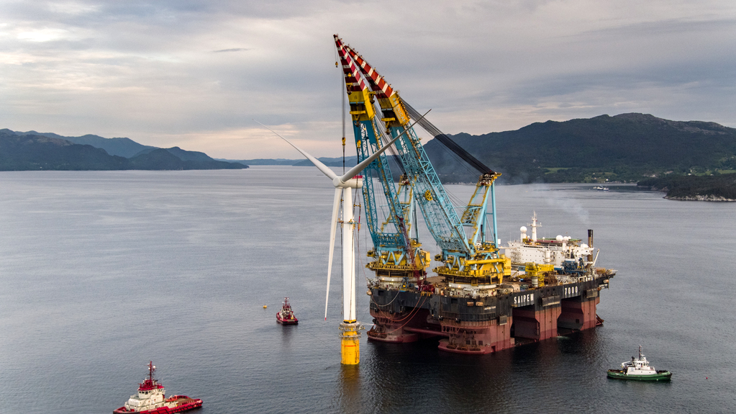

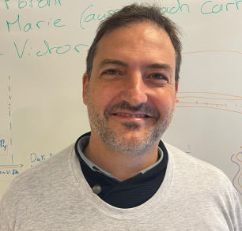
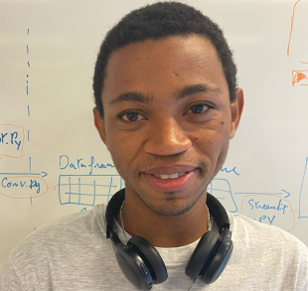


MeteoWind
LAMANI Bouabdellah
GALLARDO Cristobal
TIAZARA
Gaëtan
MERZOUK Gaya
TOURNIER Thibault

Slide 2
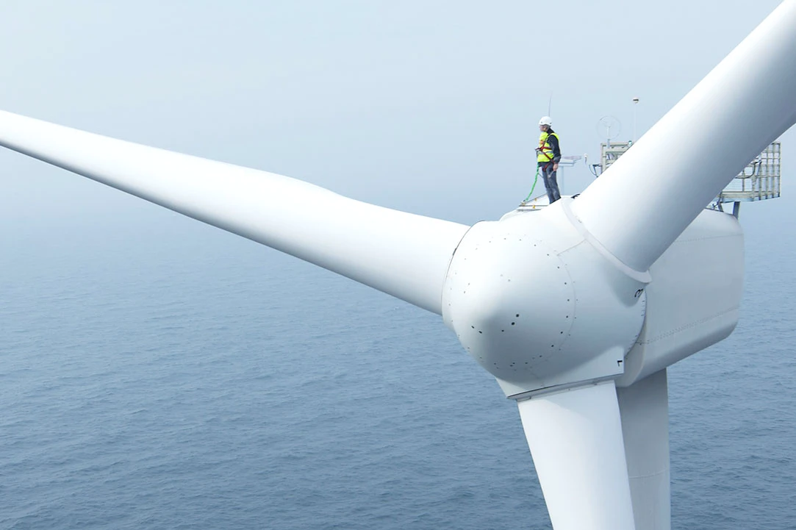
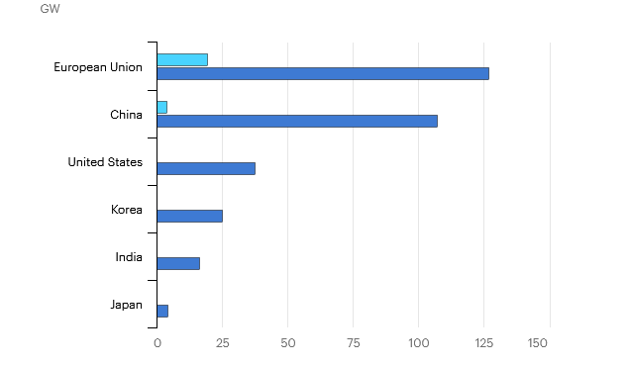
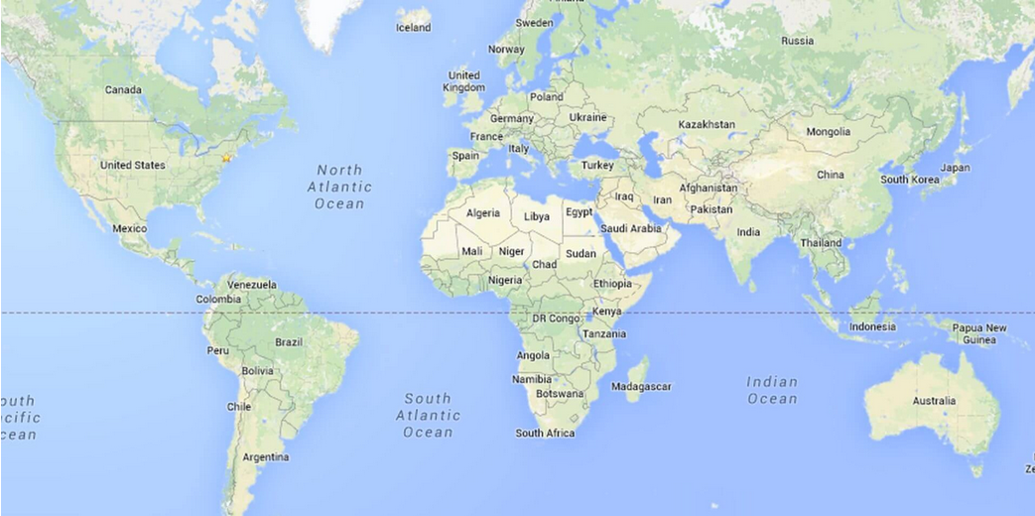

INTRODUCTION
Industry outlook
Offshore wind farm projets are set to increase around the world in coming years according to factors such as:
Wind speed, Distance to shore, Water Depth
Flora, fauna, human activities
Our team aims to develop a tool to help industry leaders to take informed decisions regarding the location of the sites

Slide 3
1
2
3
Where to find wind data and how and in which format we acquire it …
How to convert / process ERA 5 Wind 100m U/V component, into wind speed and direction ? How to organize in a web-adapted input …
How to generate web composant, static-files and process outputs, in a GIS web-application ? How to automate that …
?
?
?

Slide 4

1
Where to find wind data and how and in which format we acquire it …
Request
Convert
Process
WebVisual
?

Slide 5
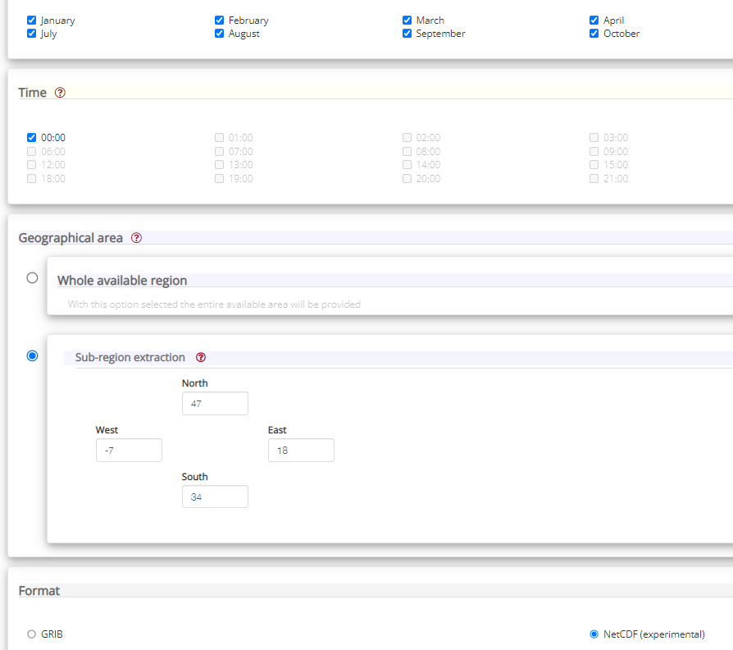

Wind 100m U/V component data acquisition
!
1979 – 2021
(42 Years)
ERA5 monthly averaged data on single levels from 1979 to present

Slide 6


$HOME/.cdsapirc
Wind 100m U/V component data acquisition
url: https://cds.climate.copernicus.eu/api/v2
key: 16840 : xxxxxxxx-xxxx-xxxx-xxxx-xxxxxxxxxxxxxxx
Request
1979 – 2021
(42 Years)
ERA5 monthly averaged data on single levels from 1979 to present
CDS API

Slide 7
2
How to convert / process ERA 5 Wind 100m U/V component, into wind speed and direction ? How to organize in a web-adapted input …
Request
Convert
Process
WebVisual
?

Slide 8
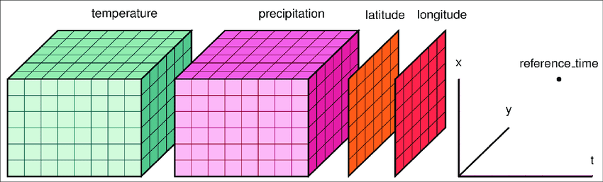
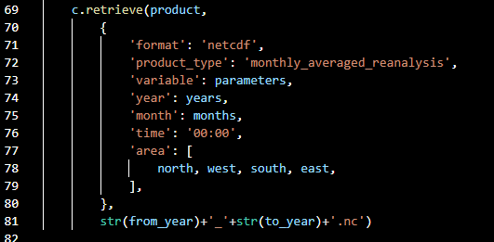
NCF file on server
Bathymetry
Wind speed
CONVERT
Script
Longitude
Latitude
Time
Wind speed
…
Bathymetry
Human activities
Fauna
Presence of infraestructure

Slide 9



3
User’s inputs (X, Y, T … )
How to generate web composant, static-files and process outputs, in a GIS web-application ? How to automate that …
Request
Convert
Process
WebVisual
?
Data-Frame
Functions

Slide 10
Questions ?
LAMANI Bouabdellah
GALLARDO Cristobal
TIAZARA
Gaëtan
MERZOUK Gaya
TOURNIER Thibault

