Slide 1

Is South Carolina Heating Up?
DATA ANALYSIS PROJECT
Three angles on 60 years of NOAA weather data (1966-2025)
[Your Name] | [Course name] | [Date]
1966
2025
Notes:
[0:00-0:45] Good [morning/afternoon] everyone. My name is [Your Name], and my project asks a simple question: is South Carolina heating up?
The colored band at the bottom of this slide is my whole project in one picture. Each stripe is one year, from 1966 on the left to 2025 on the right. Blue years were cooler than normal and red years were warmer. You can see the colors change as you go from left to right.
In the next fifteen minutes I'll show you where I got the data, the three angles I used to analyze it, and what I found, including one result I did not expect.

Slide 2
Why South Carolina?
WHY THIS TOPIC
What has actually changed in South Carolina's weather over the last 60 years: where, when, and how do people feel it?
Floods
1
Charleston floods at high tide, and the state had a "1000-year" flood in October 2015.
Heat
2
Summers are hot and humid. Hot nights affect health and electricity bills.
I used public NOAA data that anyone can download, and tested the changes with statistics instead of just looking at charts.
Farms
3
Agriculture depends on freeze dates and the length of the growing season.
Notes:
[0:45-1:45] Why South Carolina? The assignment pointed us to NOAA's past-weather page for Charleston, and Charleston is a great example of why weather matters.
[Point to the cards] One is flooding. Charleston floods at high tide, and in October 2015 the state had a so-called thousand-year flood. Two is heat. Summers are hot and humid, and hot nights affect people's health and their electricity bills. Three is farming. Agriculture is a big part of the economy, so freeze dates and the growing season really matter.
We usually hear about climate change as one global number, but people feel the weather where they live. So my question was: what has actually changed in South Carolina's weather over the last 60 years, where has it changed most, and how would people notice it? And I wanted to answer it with public data that anyone can check, using real statistics instead of just eyeballing a chart.

Slide 3
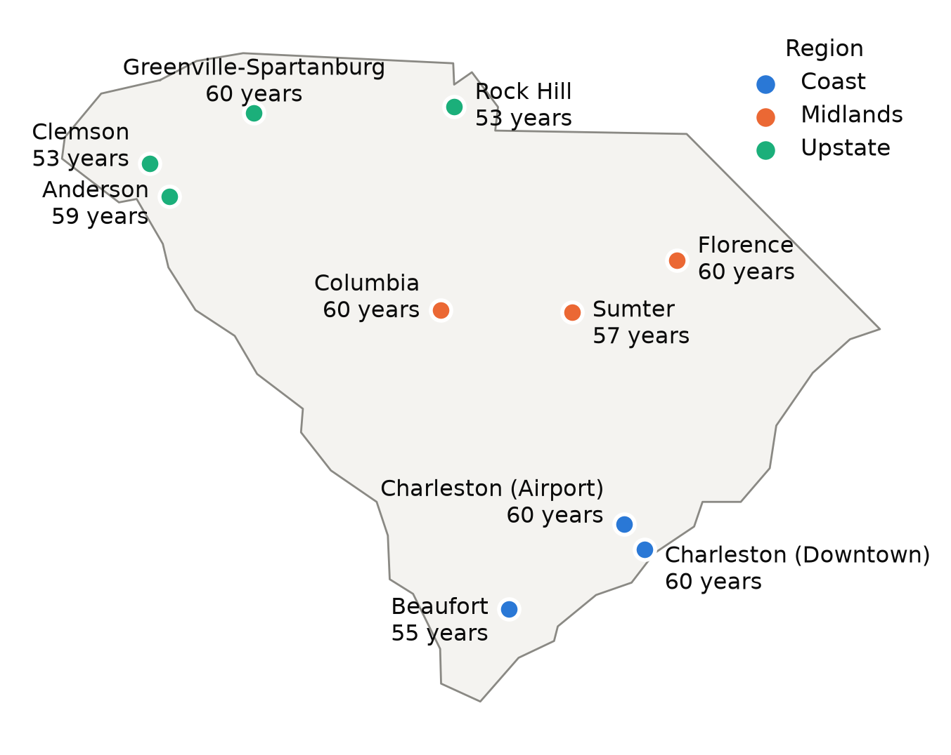
The data: 10 NOAA weather stations, 1966-2025
TASK 1: THE DATA
10
60
217,782
stations in 3 regions
years: 1966-2025
days of highs, lows and rain
Source: NOAA NCEI GHCN-Daily (the data behind NOAA's "Past Weather" page)
Download: one CSV file per station from a public URL, no account needed
Selection: 18 candidates → kept 10 with ≥ 330 days of data in (almost) every year
Variables: daily high (TMAX), daily low (TMIN), rain (PRCP)
Notes:
[1:45-2:45] All my data comes from NOAA's Global Historical Climatology Network Daily dataset. It's the same database that powers the past-weather page in the assignment. Every station has one CSV file you can download straight from a URL, and you don't need an account.
I filtered NOAA's station list down to South Carolina, downloaded 18 candidate stations, and kept the 10 that have a complete record, meaning at least 330 days of data, in almost every year from 1966 to 2025.
[Point to the map] They cover the three regions people in the state talk about: the Coast in blue, the Midlands in orange and the Upstate in green. Charleston has two stations, the airport and downtown, and that turned out to be really useful later.
In total that's 217,782 days of daily highs, lows and rainfall. My download script saves a trimmed copy into the repository, so the project runs even without internet.

Slide 4
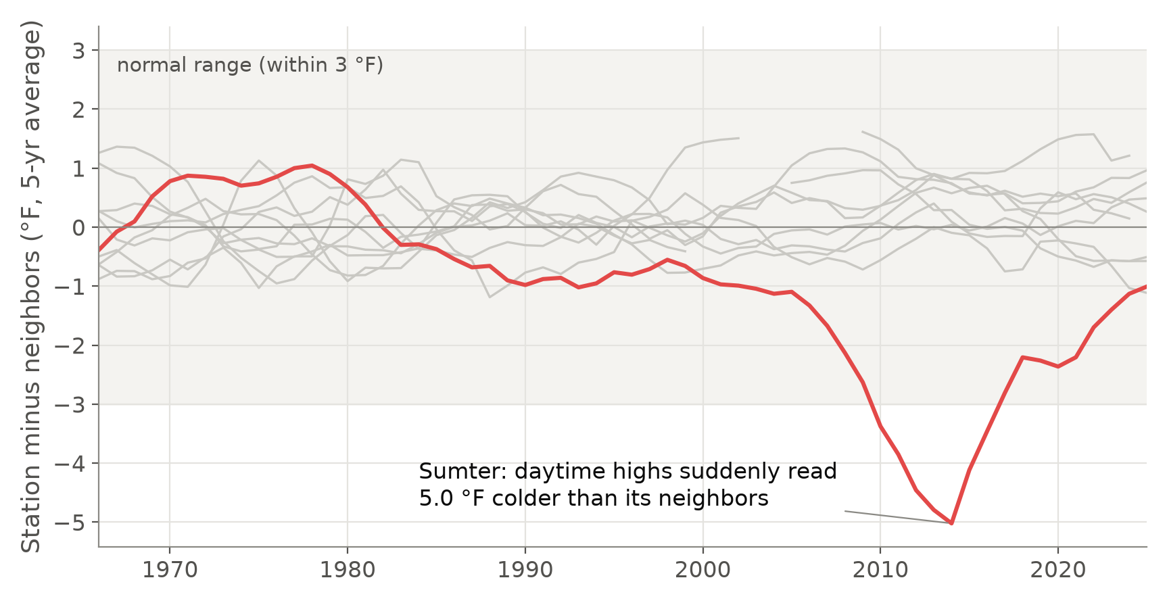
Cleaning and checking the data
TASK 2: CLEANING
−5 °F
Sumter's error compared with nearby stations (2010-2015), so I left it out of statewide averages
Converted to °F and inches
Removed values that failed NOAA's quality flags
Kept only years with ≥ 330 days
Neighbor check: gray lines are normal stations
Notes:
[2:45-4:00] Raw weather data is messy, so before any analysis I cleaned it. [Point to the list] First, NOAA stores temperatures in tenths of a degree Celsius and rain in tenths of a millimeter, so I converted everything to Fahrenheit and inches. Second, every value has a quality flag, and I removed the ones that failed NOAA's checks. Third, I only use years with at least 330 days of data, so a missing summer can't make a year look cool.
Then I added one check of my own. Stations in the same state go up and down together, so I compared each station with the average of the other nine. [Point to the gray lines] Each gray line is a normal station, and they all stay close to zero. [Point to the red line] The red line is Sumter. Around 2010 to 2015 its thermometer suddenly reads up to 5 degrees colder than its neighbors. Columbia, about 40 miles away, shows nothing like it, so this is a broken or moved instrument, not real weather.
So I left Sumter out of all the statewide temperature averages. Without this check, some of my answers would have been wrong.

Slide 5
Three angles
THE THREE ANGLES
1
WHERE
2
WHEN
3
WHAT PEOPLE FEEL
Which city has warmed the most?
Day or night? Which season?
Are extreme days more common?
Tells us if warming is local or statewide, and ranks cities for local planning. (The assignment's example question.)
The yearly average hides how it warms. Night vs. day points to causes like city heat; seasons matter for crops and energy.
People notice thresholds: a 95 °F afternoon, a night that never cools off, a frost, a flood. This also tests rainfall.
the average → its timing → the extremes (all three use the same data, a straight-line trend with a p-value, and 1966-1995 vs. 1996-2025)
Notes:
[4:00-5:30] Now the core of the project: the three angles. A single number like "the average temperature went up" can't tell a city where to act, a doctor when people are at risk, or a farmer when to plant. So each angle answers the question the previous one leaves open.
Angle one is WHERE: which city has warmed the most? That's the example question from the assignment, and it tells us whether warming is a local thing or statewide.
Angle two is WHEN: is it warming more during the day or at night, and in which season? The yearly average hides that, and the answer points to causes, like the extra heat that cities create.
Angle three is WHAT PEOPLE FEEL: extreme days. Nobody feels an average. People feel a 95-degree afternoon, a night that never cools down, a frost or a flood. This angle also lets me test rainfall, which is a second variable.
[Point to the bottom line] So we go from the average, to its timing, to the extremes. All three use the same cleaned data and the same statistics: a straight-line trend with a p-value, plus a simple comparison of 1966-1995 against 1996-2025.

Slide 6
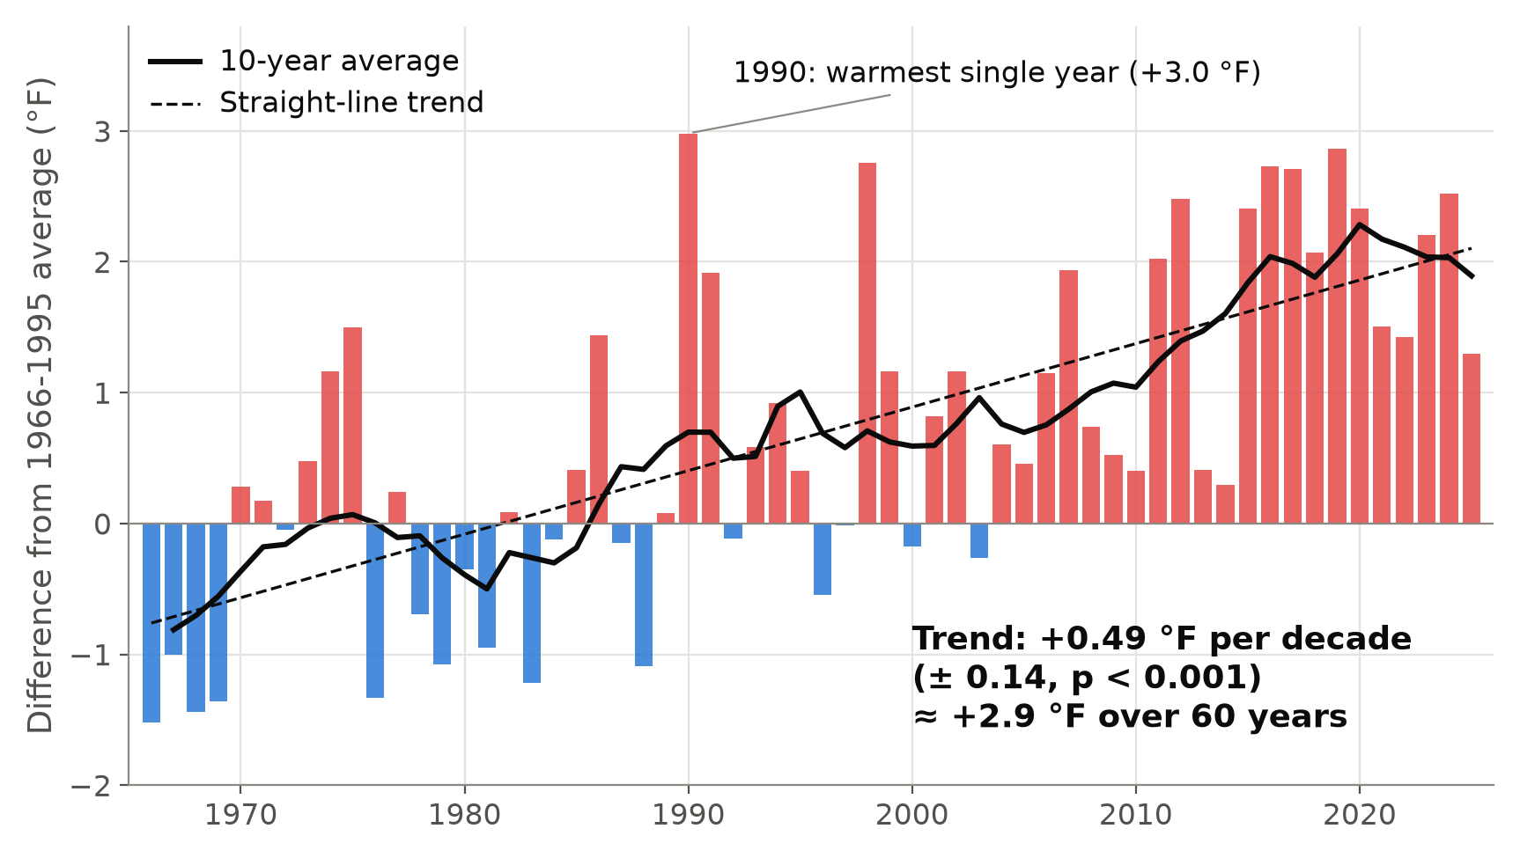
South Carolina has warmed about 3 °F since the 1960s
ANGLE 1: WHERE
+2.9 °F
over 60 years (+0.49 °F per decade, p < 0.001)
Before 1985 most years are blue; since 2010 almost all are red
8 of the 10 warmest years came after 2010
Average of the 9 trusted stations
Notes:
[5:30-6:30] Let's start with the big picture. Each bar is one year compared with the 1966 to 1995 average. Blue is cooler and red is warmer. The black line is a 10-year average.
Before about 1985 most years are blue; since 2010 nearly every year is red. The trend is plus 0.49 degrees Fahrenheit per decade, with a p-value below 0.001, so it's very unlikely to be random noise. Over 60 years that adds up to about 2.9 degrees.
The warmest single year was actually 1990, but 8 of the 10 warmest years came after 2010. So yes, South Carolina is heating up. Now: where?

Slide 7
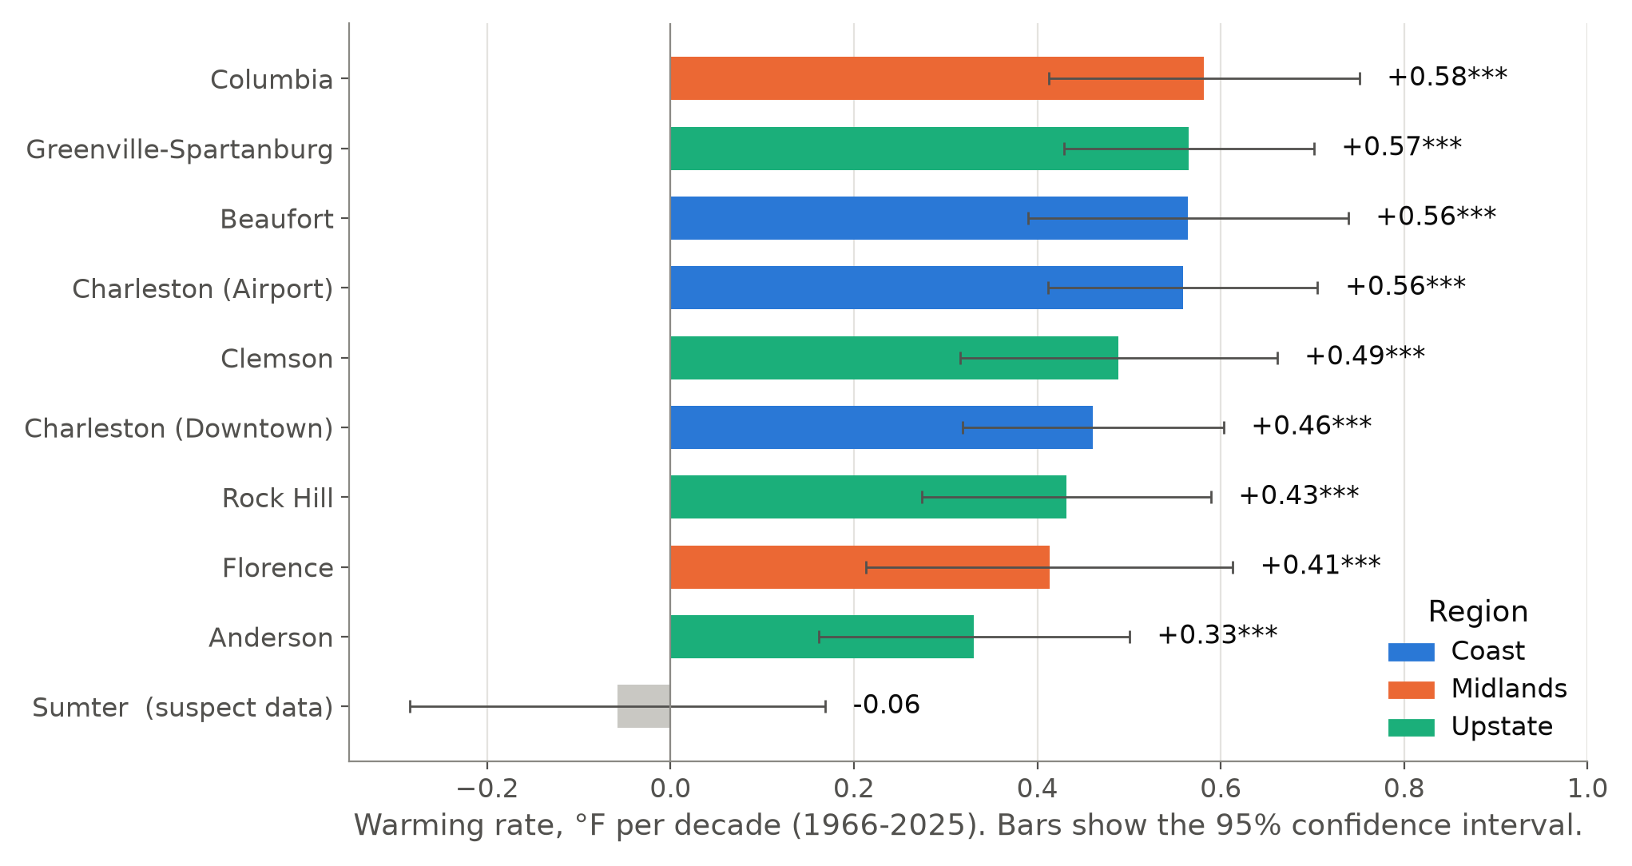
Columbia warmed fastest, but the top four are close
ANGLE 1: WHERE
+0.58
°F per decade in Columbia, about +3.5 °F since 1966
Top 4 are within 0.03 °F/decade and their error bars overlap
All 9 trusted stations warmed (p < 0.001)
Coast 0.53, Midlands 0.50, Upstate 0.45
Notes:
[6:30-7:45] This chart answers Angle one directly. Each bar is a city's warming rate, the color shows its region, and the thin lines are 95 percent confidence intervals.
Columbia has warmed the fastest, at 0.58 degrees per decade, which is about 3.5 degrees since 1966. But look at the error bars: Greenville-Spartanburg, Beaufort and Charleston Airport are within 0.03 of Columbia, and their intervals overlap almost completely. So the honest answer is: Columbia comes first, but the top four are statistically tied.
The more important finding is that every single trusted station warmed, all with p below 0.001, and the three regions are very close: Coast 0.53, Midlands 0.50, Upstate 0.45. Sumter, in gray at the bottom, is the broken station from before.

Slide 8
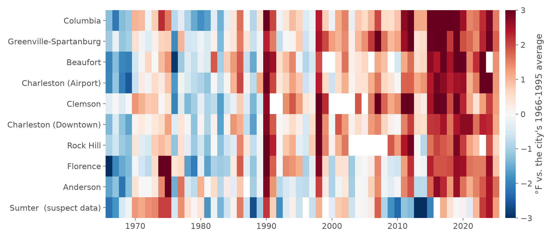
Every station shows the same pattern
ANGLE 1: WHERE
9 / 9
trusted stations have a significant warming trend
Each row = a city, each column = a year
Red = warmer than that city's own 1966-95 normal
Sumter's broken years show as dark blue (2013-14)
Notes:
[7:45-8:30] Here's the same story without any statistics. Each row is a city, each column is a year. Red means warmer than that city's own normal, blue means cooler.
The left side is mostly blue and the right side is mostly red, at every station and at about the same time. That tells us this is a statewide change, not just one city's story.
[Point to the bottom row] You can also spot Sumter's broken thermometer: it's the only row that turns dark blue around 2013.

Slide 9
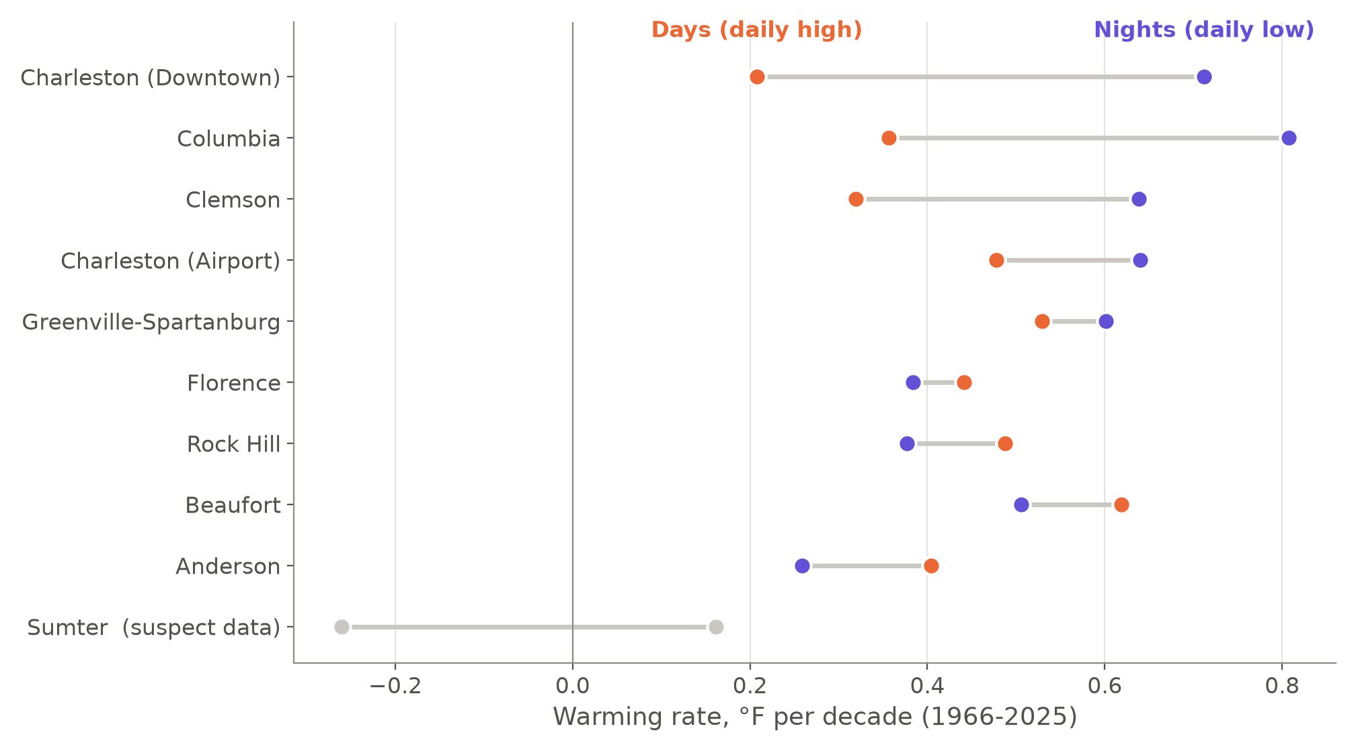
Nights are warming faster than days
ANGLE 2: WHEN
3×
faster warming at night than by day in downtown Charleston
Average: nights +0.55 vs. days +0.43 °F/decade
Biggest gaps: downtown Charleston and Columbia
Urban heat island: concrete stores heat, releases it at night
Notes:
[8:30-9:45] Angle two: when is it warming? Here I split each day into the afternoon high, in orange, and the night-time low, in purple.
On average, nights warm at 0.55 degrees per decade and days at 0.43, so nights are warming faster. But look at the top two rows: downtown Charleston and Columbia. Downtown Charleston's nights warmed more than three times faster than its days. These are the two most built-up locations in my data.
That's the urban heat island effect: concrete, asphalt and buildings soak up heat during the day and release it at night, so cities stay warm after sunset. Smaller places like Anderson and Rock Hill actually warm a little more by day. So part of what city residents feel is extra warming caused by the city itself, on top of the regional trend.

Slide 10
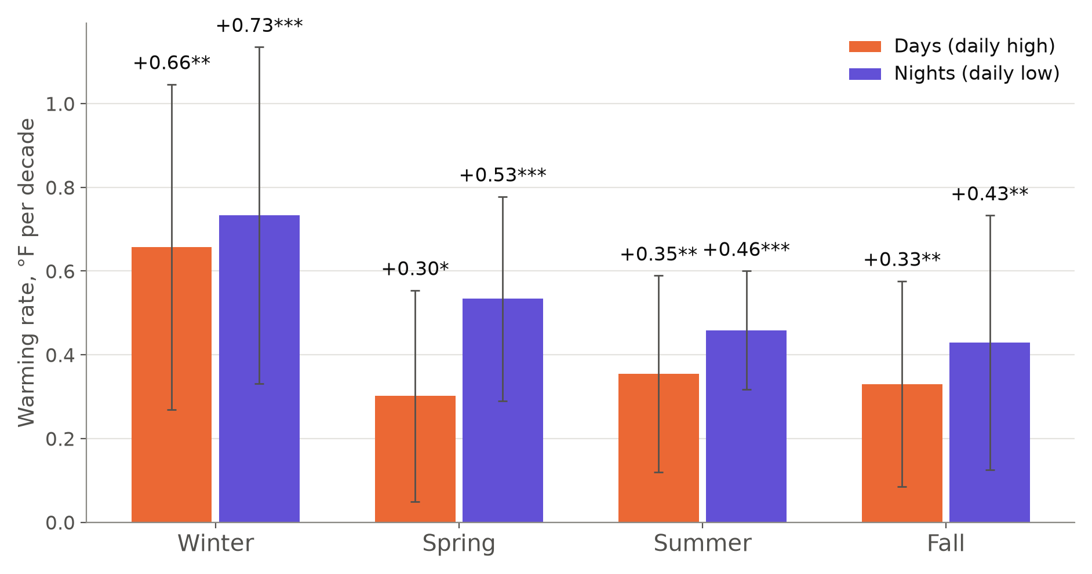
Winter is warming fastest
ANGLE 2: WHEN
1.7×
winter warms 1.7 times faster than the other seasons
Winter: +0.66 (days), +0.73 (nights) °F/decade
Other seasons: nights warm faster than days
Winter varies a lot year to year → wide error bars
Notes:
[9:45-10:35] Next: which season. Winter is warming fastest, at about 0.7 degrees per decade, which is 1.7 times faster than the other three seasons. And in spring, summer and fall, the purple night bars are again taller than the orange day bars.
One caution: winter weather varies a lot from year to year, so the error bars are wide. The winter result is significant, but the exact number 1.7 is less certain.
Put together, Angle two says South Carolina is warming mostly in winter and at night, more than in summer afternoons.

Slide 11
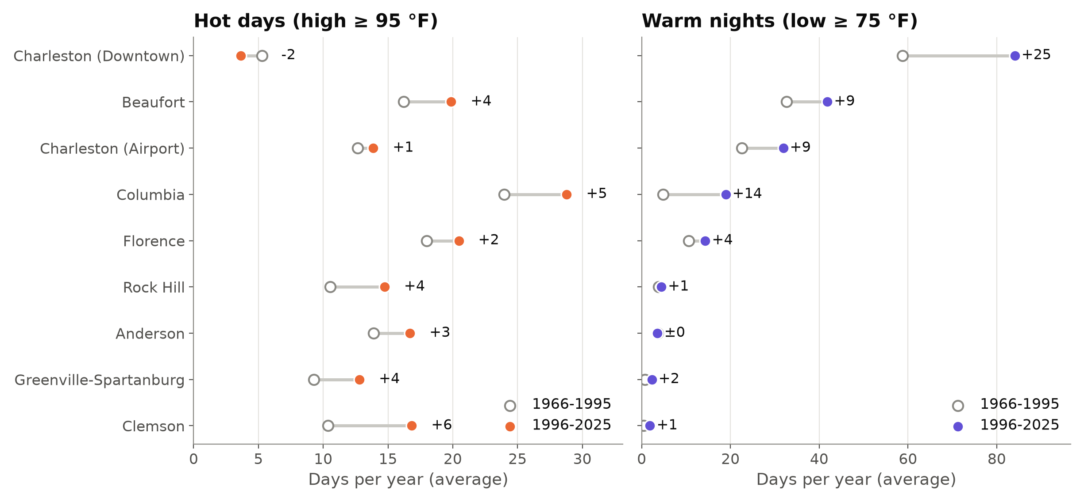
Many more warm nights
ANGLE 3: WHAT PEOPLE FEEL
+47%
more warm nights statewide (15.6 → 22.9 per year)
Downtown Charleston: 59 → 84 warm nights a year
Columbia: 5 → 19 (nearly 4×)
Hot days ≥ 95 °F: +21% (just significant)
Notes:
[10:35-11:45] Angle three: what people actually feel. On the left are hot days, with a high of 95 or more; on the right are warm nights that never drop below 75. The open circle is 1966 to 1995, and the filled circle is 1996 to 2025.
Warm nights changed the most: statewide they're up 47 percent. Downtown Charleston now averages 84 nights a year that never cool below 75, up from 59. That's almost an extra month of nights with no relief, which matters for health and for electricity bills. Columbia went from about 5 to 19.
Hot days rose too, about 21 percent statewide, but that change is only just significant. Downtown Charleston actually has fewer hot afternoons than before. I think the sea breeze keeps the days from getting much hotter, but the nights still don't cool off.

Slide 12
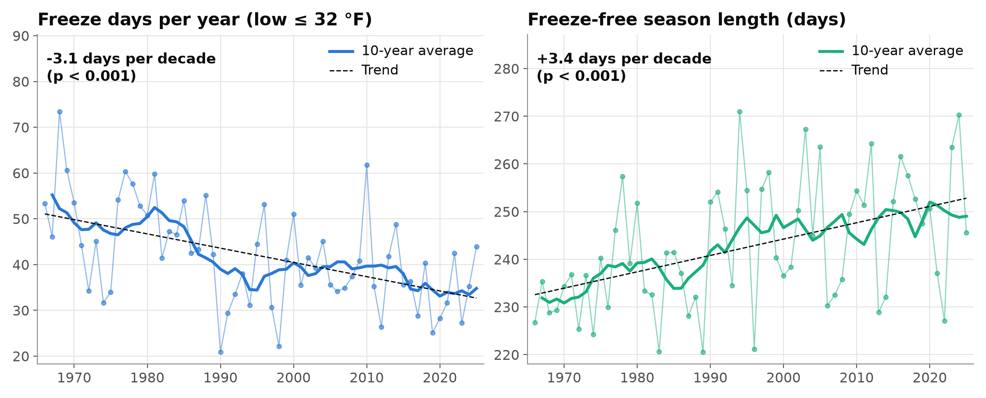
Fewer freezes and a longer growing season
ANGLE 3: WHAT PEOPLE FEEL
+3 weeks
longer freeze-free (growing) season than in the 1960s
Freeze days: 46 → 38 per year (−18%)
−3.1 freeze days per decade (p < 0.001)
Good for some crops, but also for pests and pollen
Notes:
[11:45-12:30] At the cold end, freezing nights are down about 18 percent, roughly 3 fewer per decade. The freeze-free season, which is basically the growing season, is getting longer by about 3.4 days per decade. That's around three weeks longer than in the 1960s.
That's good news for some crops, but it also means a longer season for pests, pollen and mosquitoes.

Slide 13
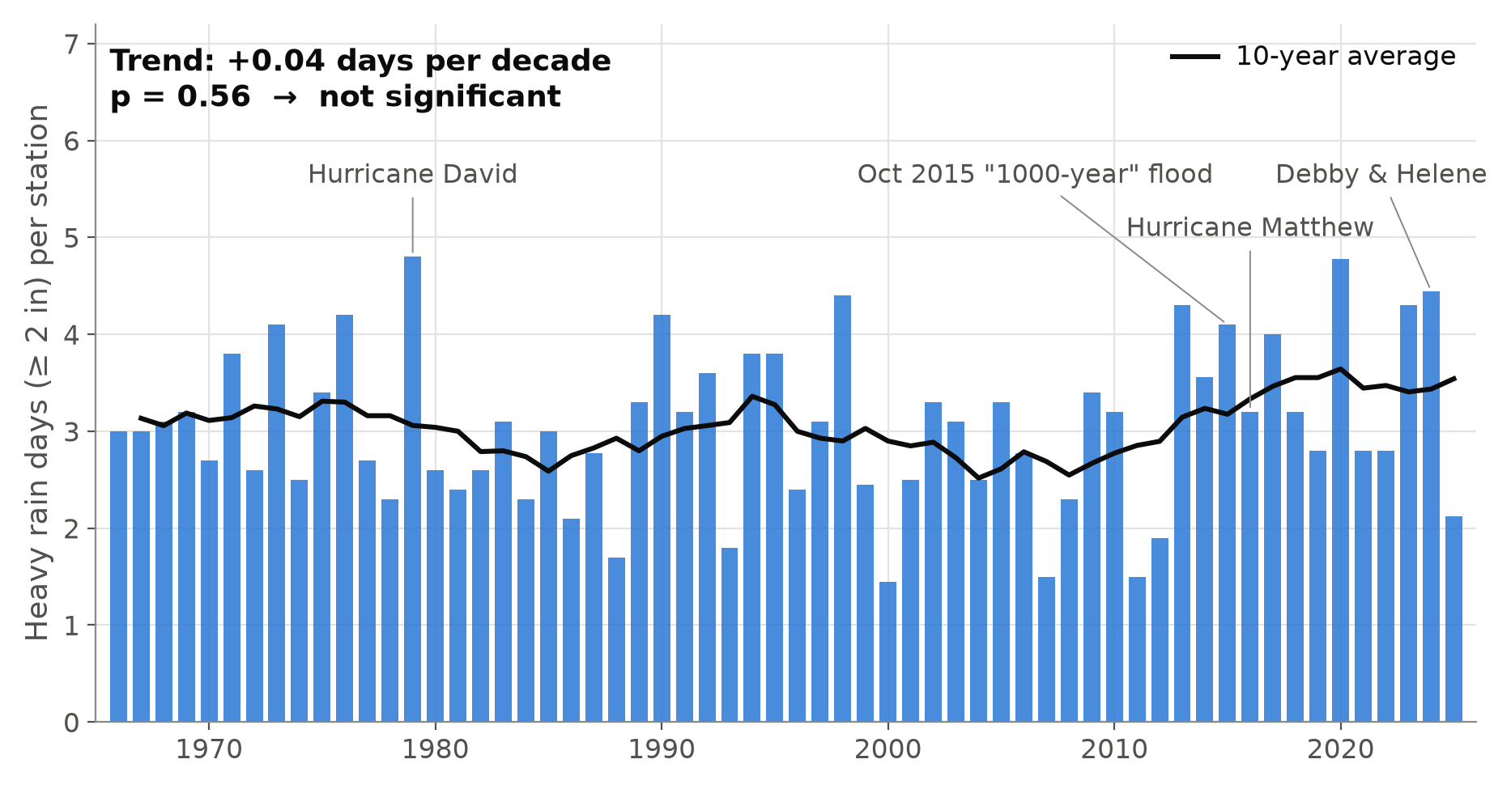
Heavy rain: no clear trend
ANGLE 3: WHAT PEOPLE FEEL
p = 0.56
trend in heavy-rain days (≥ 2 in) is not significant
Spikes are single storms: David, 2015 flood, Matthew, Debby & Helene
Big storm years in every decade
Rising since 2010, worth watching
Notes:
[12:30-13:20] This result was different from what I expected. I thought rain would get more extreme too. This chart shows the number of days with 2 or more inches of rain.
The biggest spikes are single storms: Hurricane David in 1979, the October 2015 flood, Hurricane Matthew in 2016, and Debby and Helene in 2024. Big storm years happen in every decade. The trend is basically zero, with a p-value of 0.56, so it's not significant. The 10-year average has gone up since about 2010, so it's worth watching, but with this data I can't claim heavy rain has increased.
I think that's an important result: not every climate claim is equally supported by local data.

Slide 14
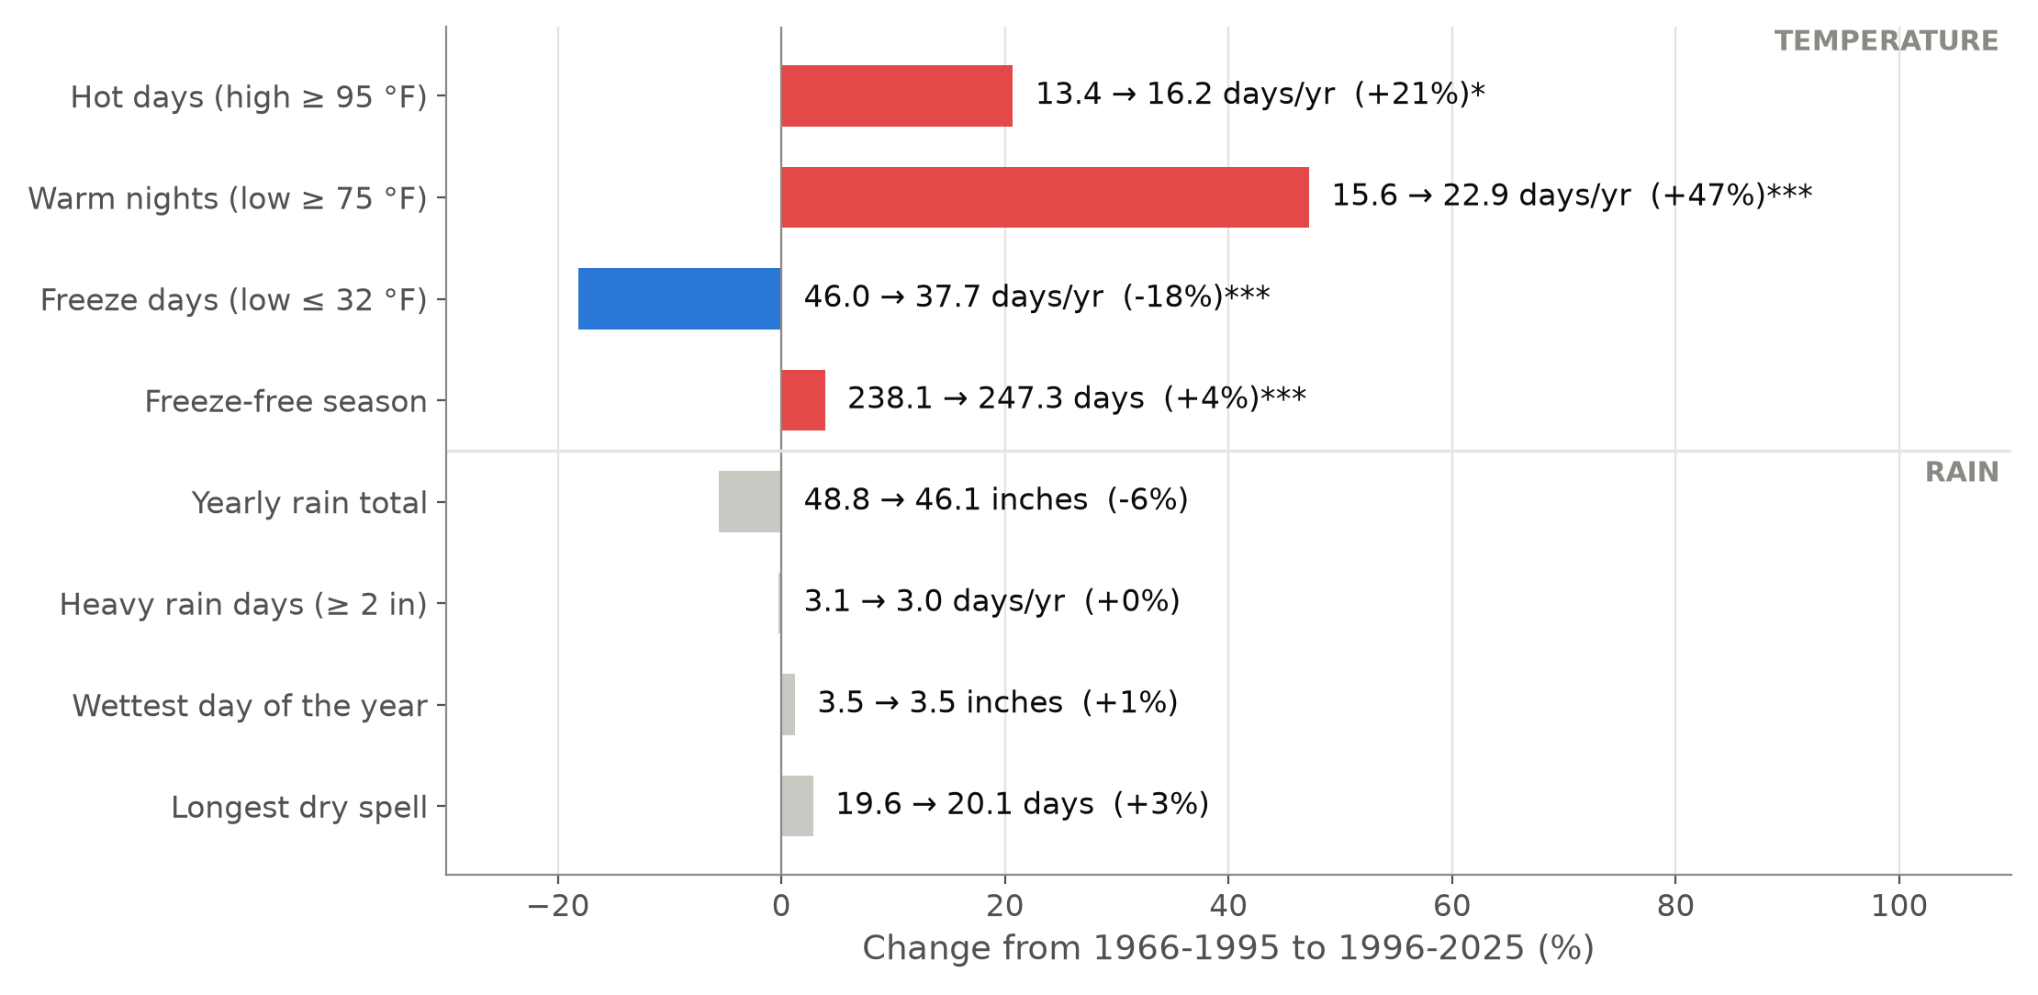
Summary: temperature changed, rain did not
ANGLE 3: WHAT PEOPLE FEEL
4 of 4
temperature measures changed significantly, but 0 of 4 rain measures did
Colored bars have a significant 60-year trend
Gray bars could be natural ups and downs
Rain varies more, so it needs more data
Notes:
[13:20-14:00] Here's everything from Angle three on one chart. Colored bars have a significant 60-year trend; gray bars don't.
Every temperature extreme moved: more hot days, many more warm nights, fewer freezes and a longer growing season. Every rain measure is gray: total rain, heavy-rain days, the wettest day and dry spells show no clear change.

Slide 15
Conclusions
WHERE
+2.9 °F since 1966 at every trusted station. Columbia fastest (+0.58 °F/decade), tied with 3 others.
WHEN
Warming is strongest in winter and at night, and nights warm fastest in cities.
WHAT PEOPLE FEEL
+47% warm nights, −18% freezes, 3-week longer growing season. Heavy rain: no clear trend yet.
Limitations raw station data with a simple neighbor check, cities grew around some stations, a straight line is a simple model, only 10 stations
Lesson check the data first. One broken thermometer in Sumter would have changed the answer.
Notes:
[14:00-14:45] To wrap up.
Where: South Carolina has warmed about 3 degrees since 1966, at every trusted station. Columbia is fastest, but it's statistically tied with three others.
When: the warming is strongest in winter and at night, and the night-time warming is strongest in the cities.
What people feel: many more warm nights, fewer freezes and a growing season about three weeks longer, but no clear change in heavy rain yet.
There are limitations: I used raw station data with a simple quality check, cities have grown around some of the stations, and a straight-line trend is a simple model. But the picture is consistent across all three angles. And one lesson for data science: always check your data first. One broken thermometer in Sumter would have changed the answer.

Slide 16
Thank you! Questions?
Everything is reproducible: python run_all.py rebuilds every chart in about 20 seconds
Code & data: [GitHub repository link]
Report: report/Project_Report.pdf
Data: NOAA NCEI GHCN-Daily (ncei.noaa.gov)
Notes:
[14:45-15:00] Thank you for listening. All the code, the data and the report are in my GitHub repository, and running one command, python run_all.py, rebuilds every chart you saw today.
I'm happy to take any questions.

