Slide 1
DJANGO
By Harsh Thakur

Slide 2
Why django
It helps in dividing our website into smaller apps e.g. main website then blog section of website, etc.
If u use other backend framework php,flask requires db connector to read pull write in db. But Django doesn’t require for sqlite.
If your website has many web links in it and contains many processes then Django is used.
If in future your website requires dsml then python req and Django is based on it

Slide 3
Helps in sending the html, css , js file easily to the browser from the web server
It has its own db connector and offers big modules.
It has its own framework.
It has automatic login system.

Slide 4
MVT ARCHITECTURE
My website can have multiple apps to serve different concerns like blog shop cart, etc. so mvt used here
Matches URL → Calls View → Fetches Data(via model) → Renders Template → Sends Response.
Template:
Django’s Template Engine injects the data into the HTML.
It has placeholders for each requirement, basically it consist of html, css, js and renders the data on the html page.
View send the variables to template for rendering. Thus it handles ui
V – View
Retrieves necessary data from the database (via the Model).
Passes the data to the template for rendering
M - model
-> class made to create table or db info: emp id, emp_name, phone_no -> so we make a class and make it

Slide 5
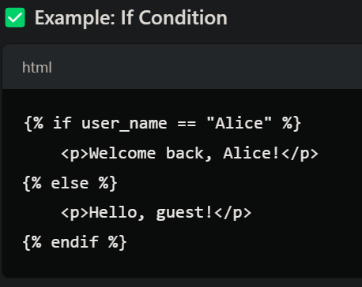
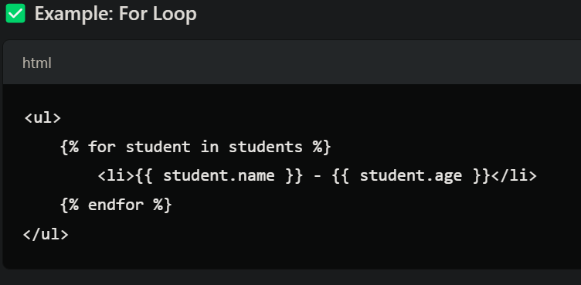
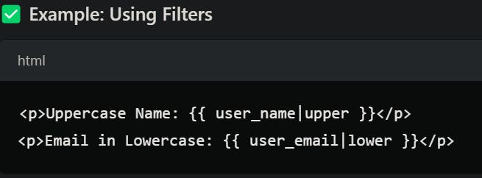
placeholders
Django templates use placeholders to inject dynamic content into HTML.
These placeholders are written using Django Template Language (DTL), which allows us to embed Python-like logic into HTML files.

Slide 6
Get started
Make a folder and Pip install Django
In vs code get the Django extension
Now to start project : python -m django startproject <projectname>
You will get default files of Django shown in next slide
To run server – python manage.py runserver

Slide 7
1️⃣ manage.py
A command-line tool to manage your project.
Used to run the server, migrate databases, create apps, etc.
2️⃣ projectname
This folder contains the core Django project files.
✅ __init__.py
Marks this directory as a Python package.
Needed for Python imports.
✅ settings.py
Main configuration file for the project.
Contains settings for:
Database connection (DATABASES)
Installed apps (INSTALLED_APPS)
Static files (STATIC_URL)
Debug mode (DEBUG)
✅ urls.py
URL routing file for the project.
Defines which view will handle which URL.
✅ asgi.py & wsgi.py
Used for deploying Django applications.
wsgi.py → for traditional WSGI servers (e.g., Gunicorn).
asgi.py → for modern ASGI servers (e.g., Daphne, Uvicorn).

Slide 8
App vs project
1️⃣ Django Project
A Django project is the entire web application.
It is a container for multiple apps.
It contains global settings, configurations, and the main URL routing.
2️⃣ Django App
A Django app is a modular component within a project.
It contains models, views, templates, and URLs for a specific feature.
A project can have multiple apps.

Slide 9
Make an app
Req come to project urls.py and then its sent to app’s urls.py as requested.
python manage.py startapp home -> home app made
We only have project specific settings which have template, db,
Make the url dispatcher from project(hello) to app(home)

Slide 10
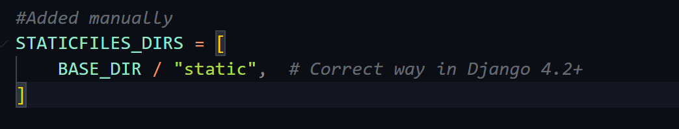
Template and static files
Static files can be accessed by anoyone. Go in settings.py
Create index.html in template and write code from bootstrap and link ur view.py definitions to the related buttons in nav bar.
Add context if u want to send variables while rendering.

Slide 11
bootstrap
Cdn -> content delivery network (all from hosted bootstrap and we getting from there all the frontend)
https://getbootstrap.com/docs/4.4/getting-started/introduction/ -> gives the starter template
https://getbootstrap.com/docs/4.4/components/navbar/ -> gives navi bar
Html css js code here
Contact form- https://getbootstrap.com/docs/4.4/components/forms/

Slide 12
Auto Logging in Django
Manage.py makemi -> checks any change in db schema
Manage.py Migrate – django default tables used for authentication system.
We need to make user for authentication:
Superuser -> can do many thing rsther than normal user
python manage.py createsuperuser -> cmd
/admin in the url or superuser helps in controlling the backend and db.

Slide 13
Unsplash api and bootstrap thumbnails
We need template inheritance as in all our pages we need the same header and footer. Add apart from the template we add content req.( we require blocks for that in django)
After creating common template(i.e. nav bar) for all we go to bootstrap carousel to design each page separately by providing it s body.
Now we can add image using unsplash api(allows any type random of images to pull it). Or just save their image and add it.
Now add we add thumnails from bootstrap

Slide 14
Django Admin
Username-admin
Pwd-admin

Slide 15
CSRF( cross site request furgery)
A hacker can also submit form but from his website not ours.
So to ensure that the form being submit is from our own website we use csrf token
How CSRF attacks work:
A malicious website, email, or other message tricks a user into clicking a link that sends a forged request to a server
The user is already authenticated to the application, so the browser executes the request
The attacker can now impersonate the user and perform actions like transferring money or changing passwords.

Slide 16
Contact page req on db and Model
We have to write logic that if post req come store it in db.
Now Django db has to be made to store these. So we will make a model named contact and import it to view and as soon as request come we save it and put it in the model.
Model defines ur db. So make a model contact in model.py and register it in admin.py before migration
Migration means to store or make a file of all the changes that have been done in the model after registration of the app or model
After registering model in admin.py and app in setting.py we run migration(import contact model in admin.py )

Slide 17
Register and migrations
We register our model and apps bcz Django should know which all apps are active and which all models we have to show in admin panel(db panel)
Every Django app must be added to INSTALLED_APPS in settings.py so that Django can detect it.
Registering models in models.py not required for migrations but allows us to manage them in the Django admin panel.(if u don’t do it wont be there in the Django panel)
Then we do:
Makemigrations – create migration files based on changes made to model.
Migrate – applies migration files to the database, updating the schema.

Slide 18
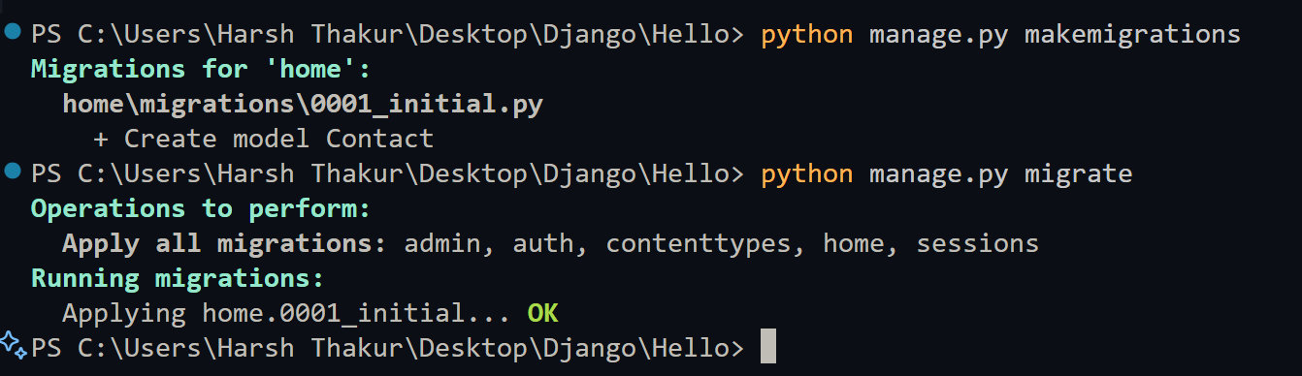
Table on db
Now we write logic on view.py under def contact() to add contact in the db.

Slide 19
Submission confirmation msg
We use django message framework (type ad copy the import command in setting and view.py)
https://docs.djangoproject.com/en/5.1/ref/contrib/messages/
https://getbootstrap.com/docs/4.4/components/alerts/ -> alerts
Get the dismissable alert code
If required field empty show wrror msg
Else show success msg inbuilt in Django framework

Slide 20
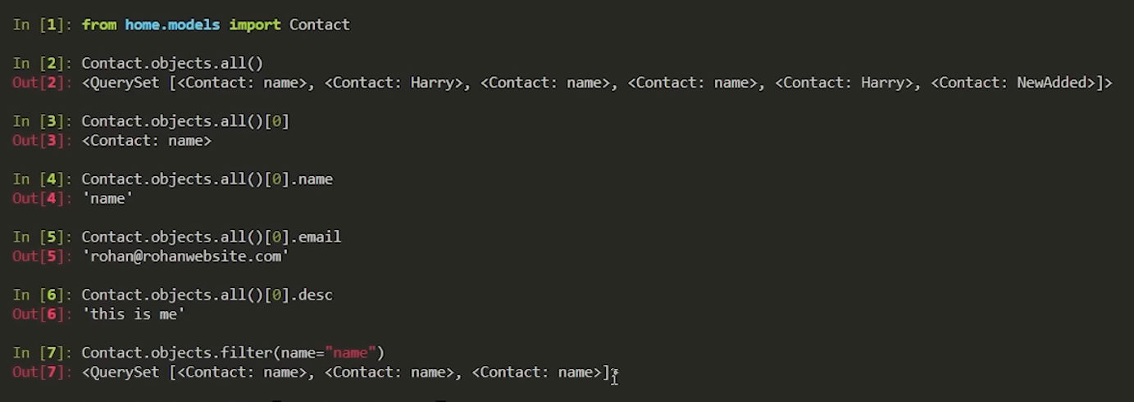
Python shell to see db
Always we wont run server and manage db through admin\
Thus we use python shell
https://docs.djangoproject.com/en/5.1/topics/db/queries/ -refer this

Slide 21
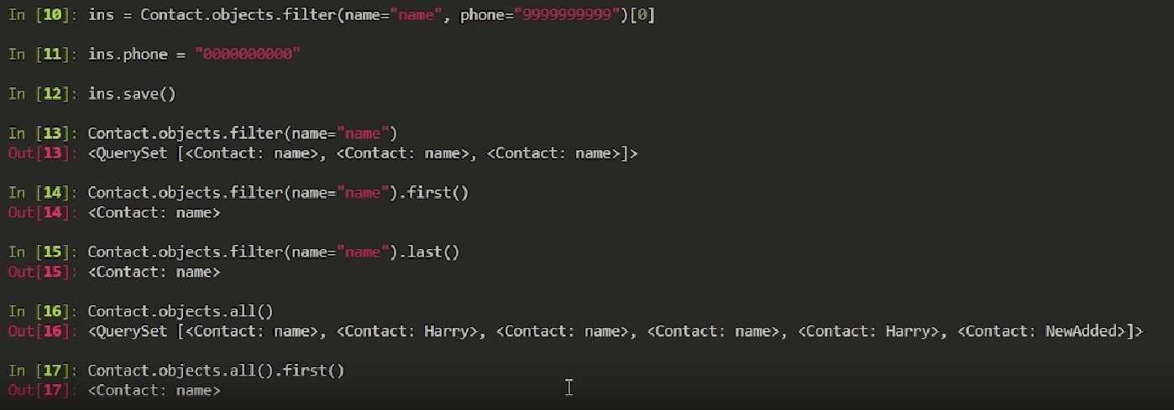
Some more cmds of python shell

Slide 22
reference
https://docs.djangoproject.com/en/5.1/ -> for further info refer this
THANK YOU

