Slide 1
Intention Classification of Social Media Posts During Disasters:A Bangla Language Processing Approach
Course Title: Project & Thesis
Course No. : CSE-400
Presented By
Md.Mohiuddin Hasan
ID: 1904125
Supervised By
Md.Mynul Hasan
Assistant Professor
Dept. of CSE, CUET

Slide 2
Contents
Introduction
Motivation
Objectives
Related Work
Proposed Methodology
Conclusion

Slide 3
Introduction
Natural disaster affect millions, especially in Bangladesh
This research focuses on classifying the intention behind the post during disasters
Intention classes are as follows:
  Advisory
  Donation
  Emergency
  Damage
  Not Relevant

Slide 4
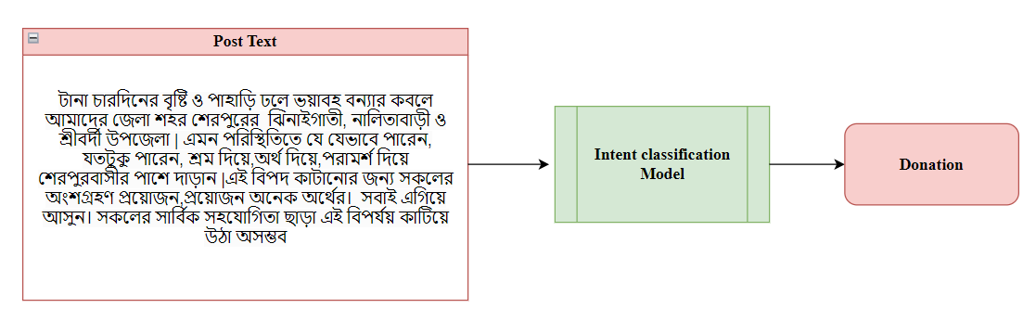
Introduction (Cont.)
Figure 1: An example of intention classification of social media posts during disaster

Slide 5
Motivation
  It would be very helpful if we can accurately classify crisis posts to their intent, for assessing damage, and allocating resources effectively during disasters
  Most research focuses on English-language content, overlooking Bengali & the lack of annotated datasets for Bengali posts analysis
  Creating a framework that will enhance humanitarian support system during disasters

Slide 6
Objectives
To collect and curate a comprehensive dataset of crisis-related social media posts in Bengali
Exploring machine learning, deep learning & transformer based models for classifying the intention
To develop an effective framework for intention classification of social media posts during crises & evaluate efficiency

Slide 7
Related Work
Alam et al. [1] :
developed CrisisDPS, a system focusing on classifying disaster type and humanitarian information type
CNN & LSTM outperformed the classical machine learning models
Limitations:
  In the consolidated dataset there exists duplicate & near duplicate tweets which causes low performance with ML models.
[1]F. Alam, F. Ofli and M. Imran, ‘Crisisdps: Crisis data processing services.,’ in ISCRAM, 2019 (cit. on p. 3).

Slide 8
Related Work
Sajjad et al. [2] :
Consolidated eight datasets for better performance in classifying humanitarian support type
Benchmarked results using CNN, fastText, and transformer models (BERT, RoBERTa).
Limitation:
  Consolidated dataset primarily focuses on English tweets
  Dataset contains duplicate & near duplicate tweets
  [2] F. Alam, H. Sajjad, M. Imran and F. Ofli, ‘Crisisbench: Benchmarking crisis related social media datasets for humanitarian information processing,’ in Proceedings of the International AAAI conference on web and social media, vol. 15, 2021, pp. 923–932 (cit. on pp. 1, 4, 6)

Slide 9
Related Work
Karimiziarani and Moradkhani et al. [3] :
Analyzed over 20 million tweets related to Hurricane Ian
Used machine learning techniques to classify tweets by there intent
Limitations:
  Focused on tweets from a specific period during Hurricane Ian
  Results may not generalize well to other types of disasters
  [3]M. Karimiziarani and H. Moradkhani, ‘Social response and disaster manage ment: Insights from twitter data assimilation on hurricane ian,’ International journal of disaster risk reduction, vol. 95, p. 103865, 2023 (cit. on pp. 2, 3).

Slide 10
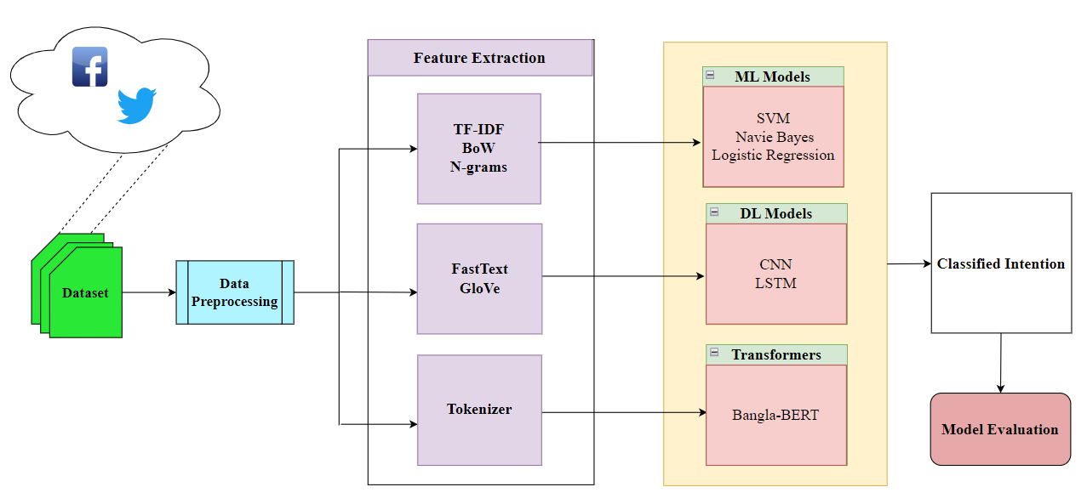
Proposed Methodology
Methodology for crisis post intent classification
Figure 2: Proposed methodology of crisis post intention classification

Slide 11
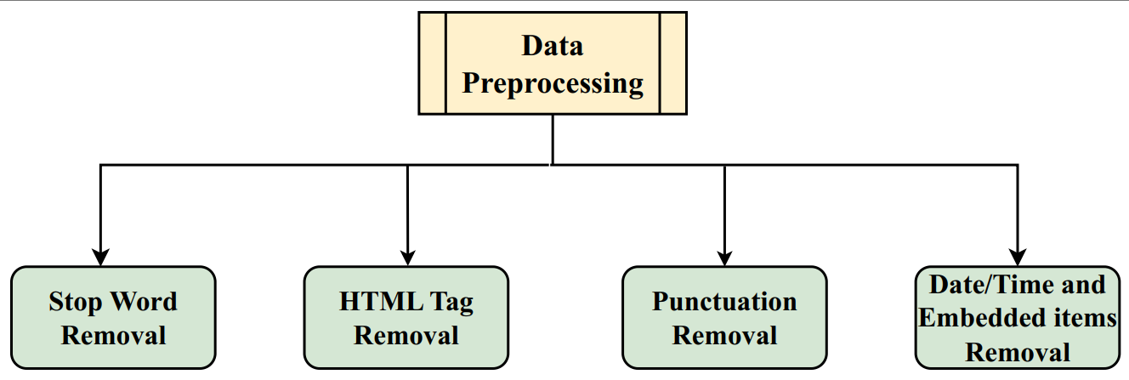
Proposed Methodology (Cont.)
Data Preprocessing:
Figure 3: Processing of data for disaster post intention classification

Slide 12
Proposed Methodology (Cont.)
Data Pre-processing
  Stop word removal: Remove all the stop words like “ইহা”, “অথবা”, “আবার”।
  HTML tag removal: Remove all HTML tags as data is collected from different websites using web scraping which contains some HTML tags.
  Punctuation removal: We need to remove the punctuations from the data like ( |, < ,>,: ,;, (, ), {, }, [, ], &,!, etc)
  Date/time and embedded items removal: There exists many data or time-related words or URLs, inconsistent bold sections, emoticons, etc.

Slide 13
Proposed Methodology (Cont.)
Feature Extraction
  Process of extracting a list of words from the input text and converting them into numerical or quantitative representations.
  TF-IDF
  N-grams
  GloVe
  FastText
  Tokenizer

Slide 14
Proposed Methodology (Cont.)
Model development:
    Machine Learning: Logistic Regression, SVM and Naïve Bias for classification
    Deep Learning: Applying CNN & LSTM for classification of intent
    Transformers: Using Bangla-BERT

Slide 15
Conclusion
This research will create a framework for classifying crisis post to their intent
The Government & humanitarian support organizations can use this system to identify & can make quick response to it
Future works will be more specialized to a single category of emergency and dataset improvement

Slide 16
References
[1]F. Alam, F. Ofli and M. Imran, ‘Crisisdps: Crisis data processing services.,’ in ISCRAM, 2019 (cit. on p. 3).
[2] F. Alam, H. Sajjad, M. Imran and F. Ofli, ‘Crisisbench: Benchmarking crisis related social media datasets for humanitarian information processing,’ in Proceedings of the International AAAI conference on web and social media, vol. 15, 2021, pp. 923–932 (cit. on pp. 1, 4, 6)
[3] M. Karimiziarani and H. Moradkhani, ‘Social response and disaster manage ment: Insights from twitter data assimilation on hurricane ian,’ International journal of disaster risk reduction, vol. 95, p. 103865, 2023 (cit. on pp. 2, 3).

Slide 17
Thank You

