Slide 1

THE DECENTRALIZED CHARITY PORTAL
Team Members:
Suryajit Sudheeran
Rohit C
Sreenath M S
Sudarsanan V P
Project Guide:
Dr. Ramani Bai
Professor and Head, Dept. of CSE

Slide 2
TABLE OF CONTENTS
01
02
03
04
05
06
07
08
09
PROBLEM STATEMENT
OBJECTIVES
LITERATURE REVIEW
APPLICATION FLOW
SYSTEM ARCHITECTURE
TOOLS AND TECHNOLOGIES
PROJECT PLANNING
EXPECTED RESULTS
CONCLUSION

Slide 3
PROBLEM STATEMENT
In a world where charitable contributions play a pivotal role in addressing societal needs, there is a pressing need for a transparent and efficient system that connects donors with a diverse range of charity organizations.
Traditional methods of donation often lack transparency, leaving donors uncertain about the impact of their contributions.
Furthermore, the process of volunteering for charitable causes can be fragmented and lacks a unified platform for coordination.

Slide 4

OBJECTIVES
TRANSPARENCY ENHANCEMENT
Enable donors to have full transparency into the utilization of their contributions by implementing a blockchain-based system that records and displays real-time transactions related to specific fundraising campaigns.
EFFICIENT FUNDRAISING
Facilitate charity organizations, including NGOs and other entities, in hosting decentralized fundraising campaigns. Utilize blockchain technology to streamline the fundraising process, making it secure, transparent, and efficient.
UNIFIED VOLUNTEER ENGAGEMENT
Create a centralized platform for NGOs and various charity organizations to post volunteer opportunities. Provide volunteers with a user-friendly interface to easily discover and engage with causes aligned with their interests.

Slide 5
OBJECTIVES
REAL-TIME TRANSACTION TRACKING
Develop a feature that allows donors to track transactions in real-time, offering a clear view of how their contributions are being utilized by charity organizations. Enhance accountability and build trust between donors and charities.
USER-FRIENDLY INTERFACE
Design an intuitive and accessible user interface for donors, charity organizations, and volunteers. Prioritize a seamless user experience to encourage engagement and participation.
DECENTRALIZED SMART CONTRACTS
Develop and deploy smart contracts on the blockchain to manage fundraising campaigns, volunteer incentives, and other critical processes. Ensure the security and efficiency of smart contracts to maintain the integrity of the platform.

Slide 6
LITERATURE REVIEW
Paper | SmartCon: A Blockchain-Based Framework for Smart Contracts and Transaction Management
Author | Muhammad Muneeb, Zeeshan Raza, Irfan Ul Haq, Omair Shafiq
Published | 2021
Study | Transactions have immutable cryptographic signatures Smart contracts self-execute with agreement terms Using separate blockchains for storing smart contracts and transactions
Conclusion | Secure and transparent blockchain architecture ensuring integrity and accessibility in executing and tracking contracts.
Drawback | Scalability challenge due to separate blockchains for smart contracts and transactions.

Slide 7
LITERATURE REVIEW
Paper | Location Based Service for Presence System Using Haversine Method
Author | Winarno E, Hadikurniawati W, Rosso R N
Published | 2020
Study | Haversine Method in Location-Based Services (LBS) Implementation of the Haversine Method in Presence Systems Optimization and Practical Application
Conclusion | Effective application of the Haversine method in calculating distances for a presence system based on location, outlining the steps involved and emphasizing its suitability for location-based services.
Drawback | Assumes a perfect spherical Earth, which may lead to inaccuracies in distance calculations.

Slide 8
LITERATURE REVIEW
Paper | Recent Advances in Smart Contracts: A Technical Overview and State of the Art
Author | Kemmoe V Y, Stone W, Kim J, Kim D, Son J
Published | 2020
Study | Development and compilation of smart contracts Deployment and storage on blockchain Execution and validation by nodes
Conclusion | Smart contracts operate by being developed, deployed, and executed on a blockchain, providing a secure and automated way to enforce and execute contractual agreements.
Drawback | Challenging to update or correct errors in the code, potentially leading to unintended consequences or vulnerabilities.

Slide 9
LITERATURE REVIEW
Paper | Aid, Charity and Donation Tracking System Using Blockchain
Author | Aashutosh Singh, Rohan Rajak, Harsh Mistry, Prachi Raut
Published | 2020
Study | Transparent transaction process via website Token-based transaction system Government oversight and permission granting
Conclusion | Transparent transaction system, facilitated through a website and incorporating token-based transactions with government oversight, aims to instill trust among donors and enhance accountability in the donation process.
Drawback | Potential privacy concern, as the use of hash values to uniquely identify transactions may compromise the complete anonymity of donors, raising issues related to confidentiality.

Slide 10
LITERATURE REVIEW
Paper | Trust in Blockchain Cryptocurrency Ecosystem
Author | Muhammad Habib ur Rehman, Khaled Salah, Ernesto Damiani, Davor Svetinovic
Published | 2020
Study | Security and decentralization in exchanges User education and communication strategies Risk mitigation and monitoring for traders
Conclusion | The comprehensive approach of implementing decentralized exchanges, enhancing user education and communication, and implementing effective risk mitigation strategies establishes a resilient foundation for addressing security concerns and fostering a sustainable and trustworthy cryptocurrency ecosystem.
Drawback | Potential challenge of penalizing attackers effectively, as it may be difficult to identify and enforce penalties in a decentralized and pseudonymous cryptocurrency environment.

Slide 11
APPLICATION FLOW
The application flow of the decentralized charity platform involves a series of steps that guide users, donors, charity organizations, and volunteers through the process of registration, donation, campaign hosting, and volunteer engagement. Here's a detailed description of the typical application flow:
User Registration:
Donor Registration
Donors access the platform and register for an account.
Provide necessary information, including name, email, and password.
Authenticate the account through email verification or other secure methods.

Slide 12
APPLICATION FLOW
User Registration:
Charity Organization Registration
Charity organizations register on the platform, providing details about their mission, goals, and verification information.
The platform may include a verification process to ensure the legitimacy of charity organizations.
Campaign Hosting:
Charity Organization Creates Campaign
Authenticated charity organizations create fundraising campaigns, specifying a target amount, purpose, and duration.
Campaign details are stored in the database, and a smart contract is deployed on the blockchain to manage the campaign.

Slide 13
APPLICATION FLOW
Campaign Hosting:
Donor Discovers and Contributes:
Donors browse through active campaigns, discovering causes aligned with their interests.
Donors contribute to campaigns by connecting their digital wallets and sending cryptocurrency to the smart contract address.
Smart Contract Handles Contributions:
The smart contract records donor contributions, updating the total funds raised in real-time.
When the target amount is reached, the smart contract triggers actions for fund utilization.

Slide 14
APPLICATION FLOW
Fund Utilization and Transaction Tracking:
Smart Contract Executes:
The smart contract automatically executes actions for fund utilization, which could include transferring funds to the charity organization and recording transactions on the blockchain.
Donors Track Transactions:
Donors can track real-time transactions related to the specific campaign they contributed to.
The platform displays an auditable trail of transactions, enhancing transparency and trust.

Slide 15
APPLICATION FLOW
Volunteer Opportunities:
Charity Organization Calls for Volunteers:
Authenticated charity organizations post volunteer opportunities on the platform, detailing the nature of the work, required skills, and time commitments.
Volunteers Browse and Apply:
Volunteers browse through available opportunities, filtering based on their skills and interests.
Volunteers apply for opportunities, expressing their willingness to contribute time and effort.

Slide 16
APPLICATION FLOW
Real-time Communication:
Platform Notifications:
The platform sends real-time notifications to users, including donors, charity organizations, and volunteers.
Notifications may include updates on campaign progress, volunteer opportunities, and transaction confirmations.

Slide 17
USE CASE DIAGRAM

Slide 18
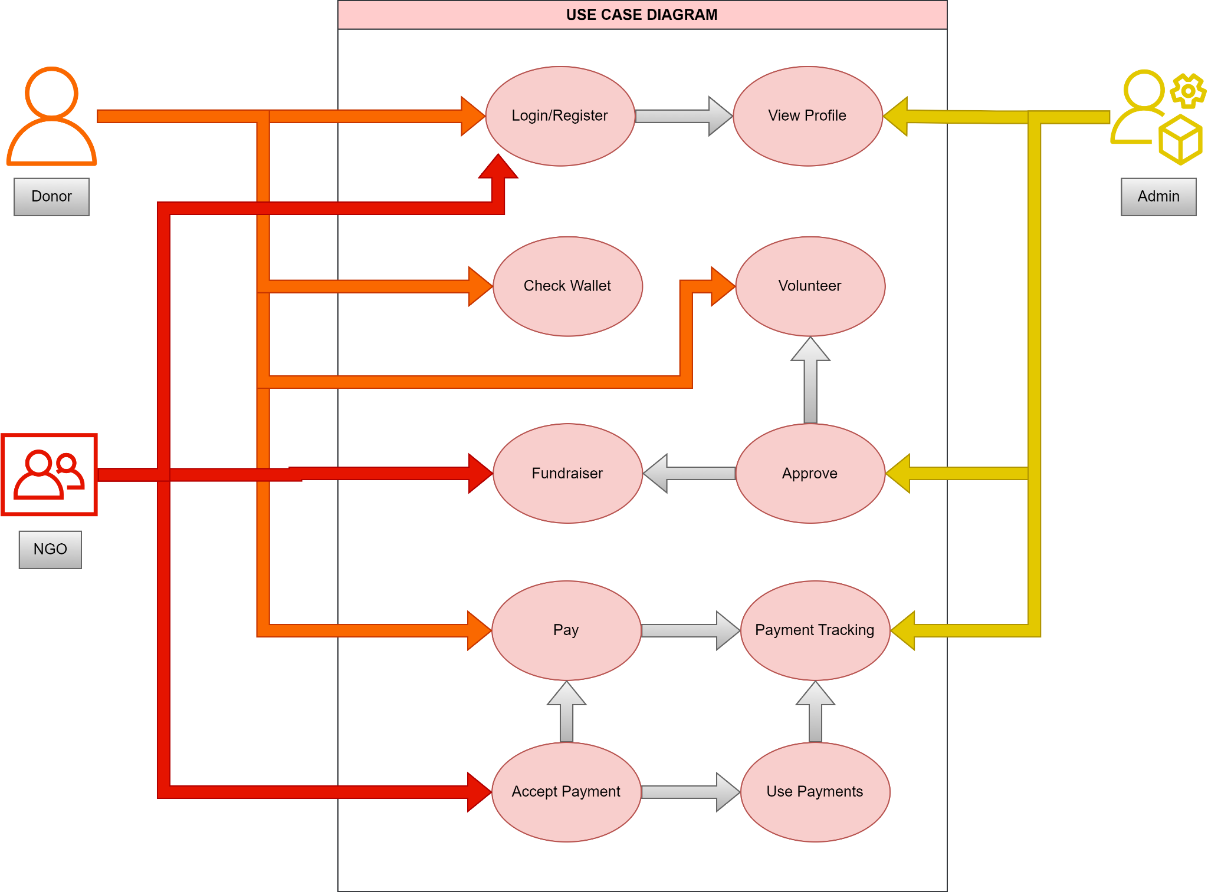

Slide 19
SYSTEM ARCHITECTURE

Slide 20
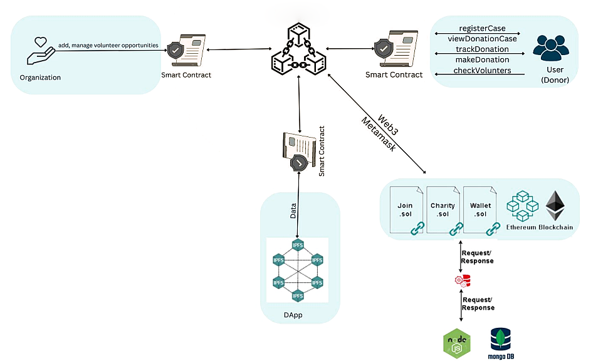

Slide 21
SYSTEM ARCHITECTURE DESIGN
Frontend
The frontend is built using Next.js, which serves as the user interface for donors, charity organizations, and volunteers.
It includes pages for user registration, campaign creation, volunteer opportunities, and transaction tracking.
Implements user authentication and interacts with the backend through API routes.

Slide 22
SYSTEM ARCHITECTURE DESIGN
Backend
Database
Next.js is used for the backend as well, handling API routes for various functionalities.
API routes manage user authentication, campaign creation, volunteer opportunities, and interactions with the blockchain.
Connects to a database (MongoDB or PostgreSQL) to store non-blockchain data, including user information, campaign details, and volunteer registrations.

Slide 23
SYSTEM ARCHITECTURE DESIGN
Blockchain Layer
Ethers.js
Integrates with a blockchain network (Ethereum) for transparent and secure management of smart contracts.
Smart contracts handle fundraising campaigns, donation tracking, volunteer incentives, and record transactions on the blockchain.
Interacts with the blockchain node using Web3.js or Ethers.js to handle transactions, queries, and events on the blockchain.

Slide 24




Tools & Technologies Used
Solidity
Ethers.js
Next.js
MongoDB

Slide 25
RESOURCE ALLOCATION
ROHIT | FRONTEND & BACKEND
SURYAJIT | SMART CONTRACTS & BLOCKCHAIN INTEGRATION
SUDARSANAN | UI/UX & DOCUMENTATION
SREENATH | DATABASE MANAGEMENT

Slide 26
PROJECT PLANNING & SCHEDULING
Oct
Nov
Dec
Mar
Apr
Jun
W1
W2
W3
W4
W1
W2
W3
W4
W1
W2
W3
W4
W1
W2
W3
W4
W1
W2
W3
W4
W1
W2
W3
W4
Planning
Research
Design
Implementation
Follow up

Slide 27
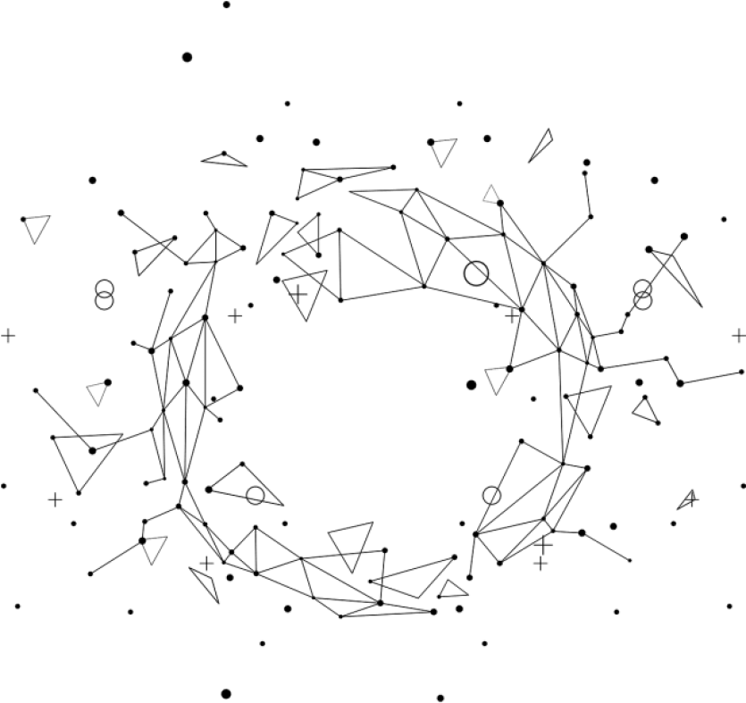
EXPECTED RESULTS
Enhanced donor confidence through transparent fund tracking.
Swift and successful campaign fundraising.
Increased volunteer engagement and streamlined coordination.
Improved donor experience with real-time transaction visibility.
Active volunteer participation due to rewarding incentives.
Fostering a sense of community through user interactions.
Credibility boost through successful charity organization verification.
User confidence with minimal security incidents and legal compliance.
Continuous user registration growth as the platform gains popularity.
Iterative improvements based on user feedback, enhancing satisfaction.
Clear and useful documentation aids user navigation.

Slide 28
CONCLUSION
The decentralized charity platform, driven by Next.js, aims to redefine charitable contributions with transparency, efficiency, and community engagement.
Ongoing monitoring, user feedback, and legal compliance are pivotal for sustained success and positive impact on philanthropy.

Slide 29
THANKS

