Slide 1

THE DECENTRALIZED CHARITY PORTAL
Team Members:
Suryajit Sudheeran
Rohit C
Sreenath M S
Sudarsanan V P
Project Guide:
Dr. Ramani Bai V
Professor and Head, Dept. of CSE

Slide 2
TABLE OF CONTENTS
01
02
03
04
05
06
07
08
09
PROBLEM STATEMENT
OBJECTIVES
LITERATURE REVIEW
APPLICATION FLOW
SYSTEM ARCHITECTURE
TOOLS AND TECHNOLOGIES
PROJECT PLANNING
RESULTS
CONCLUSION

Slide 3
PROBLEM STATEMENT
In a world where charitable contributions play a pivotal role in addressing societal needs, there is a pressing need for a transparent and efficient system that connects donors with a diverse range of charity organizations.
Traditional methods of donation often lack transparency, leaving donors uncertain about the impact of their contributions.
Furthermore, the process of volunteering for charitable causes can be fragmented and lacks a unified platform for coordination.

Slide 4

OBJECTIVES
TRANSPARENCY ENHANCEMENT
Enable donors to have full transparency into the utilization of their contributions by implementing a blockchain-based system that records and displays real-time transactions related to specific fundraising campaigns.
EFFICIENT FUNDRAISING
Facilitate charity organizations, including NGOs and other entities, in hosting decentralized fundraising campaigns. Utilize blockchain technology to streamline the fundraising process, making it secure, transparent, and efficient.
UNIFIED VOLUNTEER ENGAGEMENT
Create a centralized platform for NGOs and various charity organizations to post volunteer opportunities. Provide volunteers with a user-friendly interface to easily discover and engage with causes aligned with their interests.

Slide 5
OBJECTIVES
REAL-TIME TRANSACTION TRACKING
Develop a feature that allows donors to track transactions in real-time, offering a clear view of how their contributions are being utilized by charity organizations. Enhance accountability and build trust between donors and charities.
USER-FRIENDLY INTERFACE
Design an intuitive and accessible user interface for donors, charity organizations, and volunteers. Prioritize a seamless user experience to encourage engagement and participation.
DECENTRALIZED SMART CONTRACTS
Develop and deploy smart contracts on the blockchain to manage fundraising campaigns, volunteer incentives, and other critical processes. Ensure the security and efficiency of smart contracts to maintain the integrity of the platform.

Slide 6
LITERATURE REVIEW
Paper | SmartCon: A Blockchain-Based Framework for Smart Contracts and Transaction Management
Author | Muhammad Muneeb, Zeeshan Raza, Irfan Ul Haq, Omair Shafiq
Published | 2021
Study | Transactions have immutable cryptographic signatures Smart contracts self-execute with agreement terms Using separate blockchains for storing smart contracts and transactions
Conclusion | Secure and transparent blockchain architecture ensuring integrity and accessibility in executing and tracking contracts.
Drawback | Scalability challenge due to separate blockchains for smart contracts and transactions.

Slide 7
LITERATURE REVIEW
Paper | Recent Advances in Smart Contracts: A Technical Overview and State of the Art
Author | Kemmoe V Y, Stone W, Kim J, Kim D, Son J
Published | 2020
Study | Development and compilation of smart contracts Deployment and storage on blockchain Execution and validation by nodes
Conclusion | Smart contracts operate by being developed, deployed, and executed on a blockchain, providing a secure and automated way to enforce and execute contractual agreements.
Drawback | Challenging to update or correct errors in the code, potentially leading to unintended consequences or vulnerabilities.

Slide 8
LITERATURE REVIEW
Paper | Aid, Charity and Donation Tracking System Using Blockchain
Author | Aashutosh Singh, Rohan Rajak, Harsh Mistry, Prachi Raut
Published | 2020
Study | Transparent transaction process via website Token-based transaction system Government oversight and permission granting
Conclusion | Transparent transaction system, facilitated through a website and incorporating token-based transactions with government oversight, aims to instill trust among donors and enhance accountability in the donation process.
Drawback | Potential privacy concern, as the use of hash values to uniquely identify transactions may compromise the complete anonymity of donors, raising issues related to confidentiality.

Slide 9
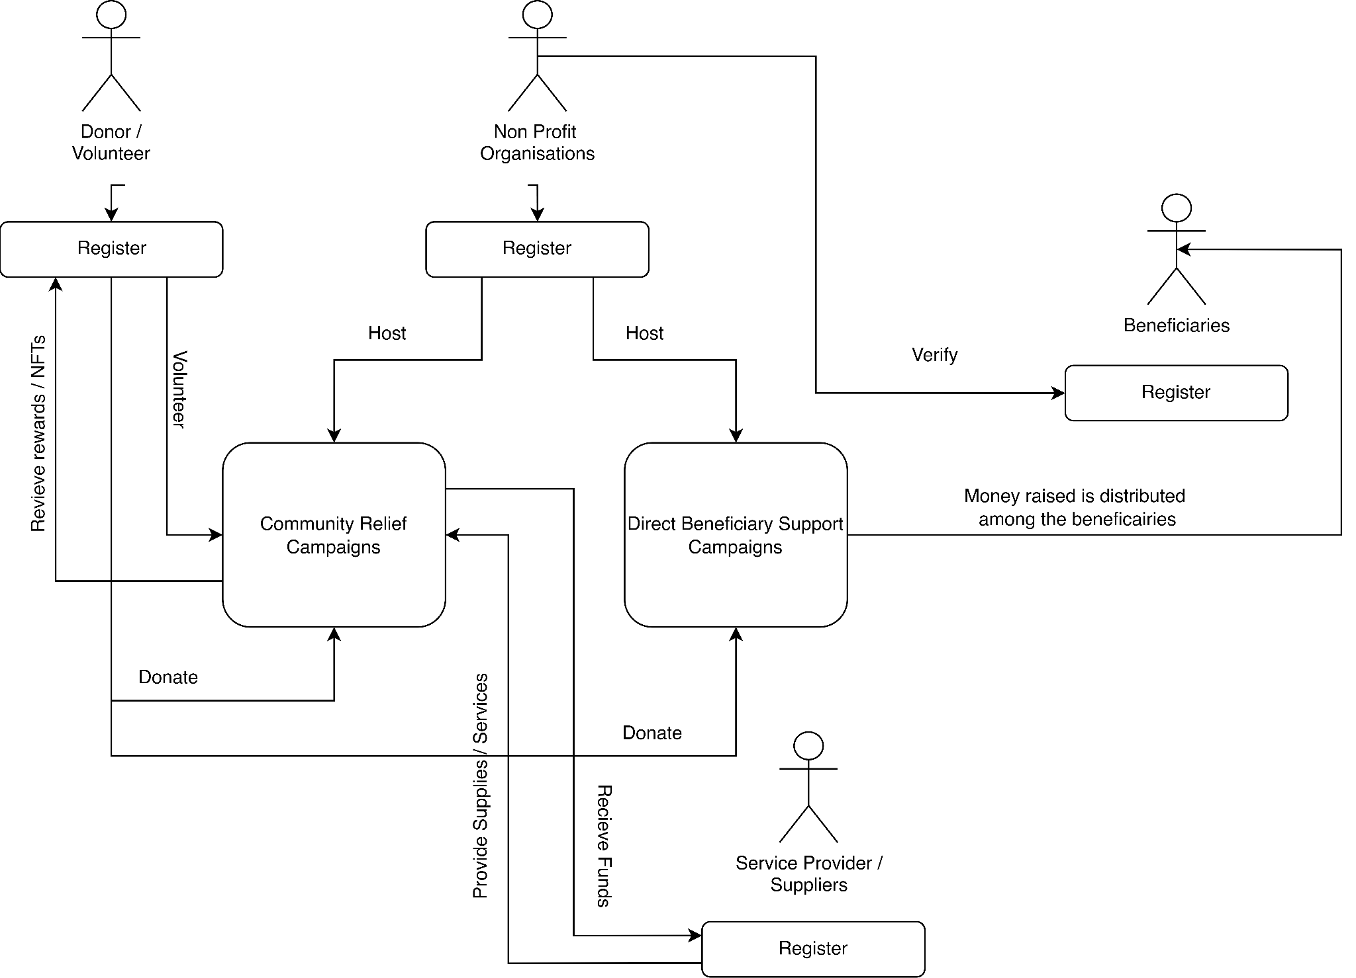
APPLICATION FLOW

Slide 10
APPLICATION FLOW
The application flow of the decentralized charity platform involves a series of steps that guide users, donors, charity organizations, and volunteers through the process of registration, donation, campaign hosting, and volunteer engagement. Here's a detailed description of the typical application flow:
User Registration:
Donor Registration
All users, including donors/volunteers, beneficiaries, NGOs, and service providers, must register on the website. Needy individuals' registrations are subject to verification by sponsoring NGOs.

Slide 11
APPLICATION FLOW
User Registration:
Charity Organization Registration:
Charity organizations register on the platform, providing details about their mission, goals, and verification information.
The platform may include a verification process to ensure the legitimacy of charity organizations.
Campaign Hosting:
Campaign Creation:
NGOs can create two types of campaigns:
Direct Beneficiary Support Campaigns: Funds are directly donated to the web3 wallets of verified needy individuals.

Slide 12
APPLICATION FLOW
Campaign Creation:
Community Relief Campaigns: Funds are used to provide services for the needy through service providers.
Donation Process:
Donors can contribute funds to both types of campaigns.
In Direct Beneficiary Campaigns, donors can track their contributions' progress and verify if funds reached the target individuals.

Slide 13
APPLICATION FLOW
Donation Process:
In Community Relief Campaigns, donors can track if their payments reached the service providers.
Volunteering:
Users can volunteer for Community Relief Campaigns, indicating their willingness
to participate in events or activities.

Slide 14
APPLICATION FLOW
Volunteering
NGOs approve volunteer applications and post volunteer opportunities on the
platform.
Transparency Measures
Donors can view the funds raised and spent at any time during a campaign, ensuring transparency and building user trust.
Needy individuals can see the number of contributions and the donors who contributed to their well-being, enhancing transparency and accountability.

Slide 15
APPLICATION FLOW
Real-time Communication:
Platform Notifications:
The platform sends real-time notifications to users, including donors, charity organizations, and volunteers.
Notifications may include updates on campaign progress, volunteer opportunities, and transaction confirmations.

Slide 16
APPLICATION FLOW
Additional Feature for Direct Beneficiary Support Campaigns:
Beneficiary Payout Conversion:
For Direct Beneficiary Support Campaigns, beneficiaries have the option to convert the raised cryptocurrency into their native local currency. This conversion process facilitates seamless access to funds for beneficiaries who may not have the means to manage cryptocurrencies. Upon conversion, the funds are directly deposited into the beneficiaries' bank accounts, ensuring ease of use and financial accessibility.

Slide 17
SYSTEM ARCHITECTURE

Slide 18
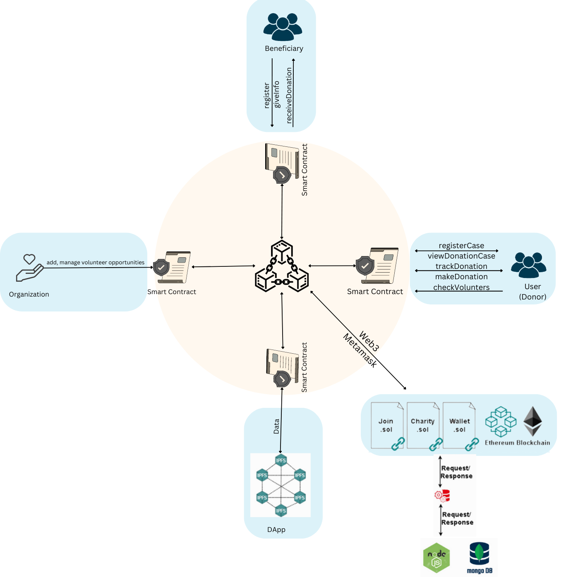

Slide 19
SYSTEM ARCHITECTURE DESIGN
Frontend
The frontend is built using Next.js, which serves as the user interface for donors, charity organizations, and volunteers.
It includes pages for user registration, campaign creation, volunteer opportunities, and transaction tracking.
Implements user authentication and interacts with the backend through API routes.

Slide 20
SYSTEM ARCHITECTURE DESIGN
Backend
Database
Next.js is used for the backend as well, handling API routes for various functionalities.
API routes manage user authentication, campaign creation, volunteer opportunities, and interactions with the blockchain.
Connects to a database (MongoDB or PostgreSQL) to store non-blockchain data, including user information, campaign details, and volunteer registrations.

Slide 21
SYSTEM ARCHITECTURE DESIGN
Blockchain Layer
Ethers.js
Integrates with a blockchain network (Ethereum) for transparent and secure management of smart contracts.
Smart contracts handle fundraising campaigns, donation tracking, volunteer incentives, and record transactions on the blockchain.
Interacts with the blockchain node using Web3.js or Ethers.js to handle transactions, queries, and events on the blockchain.

Slide 22
SYSTEM ARCHITECTURE DESIGN
Metamask Wallet
NFT
MetaMask serves as a digital wallet that enables users to securely store, send, and receive Ethereum (ETH) and other ERC-20 tokens.
Once installed, it seamlessly integrates into the browser's interface, providing easy access to Ethereum-based decentralized applications (dApps) and blockchain functionalities.
It is a type of digital asset that represents ownership or proof of authenticity of a unique item or piece of content using blockchain technology.
Volunteers on our platform are offered certificates in the form of nft’s.

Slide 23




Tools & Technologies Used
Solidity
Ethers.js
Next.js
PostgreSQL

Slide 24
RESOURCE ALLOCATION
ROHIT | FRONTEND & BACKEND
SURYAJIT | SMART CONTRACTS & BLOCKCHAIN INTEGRATION
SUDARSANAN | UI/UX & DOCUMENTATION
SREENATH | DATABASE MANAGEMENT

Slide 25
PROJECT PLANNING & SCHEDULING
Oct
Nov
Dec
Mar
Apr
Jun
W1
W2
W3
W4
W1
W2
W3
W4
W1
W2
W3
W4
W1
W2
W3
W4
W1
W2
W3
W4
W1
W2
W3
W4
Planning
Research
Design
Implementation
Follow up

Slide 26
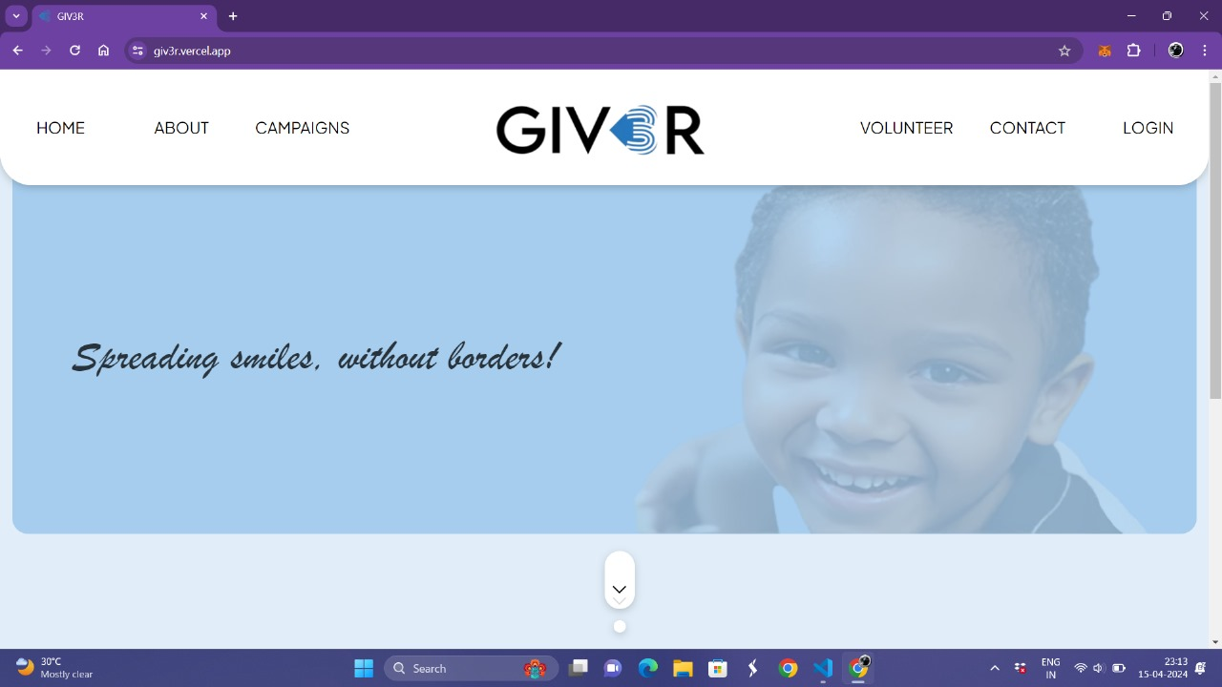
RESULT
This is the home page of the Decentralized Charity Portal.

Slide 27
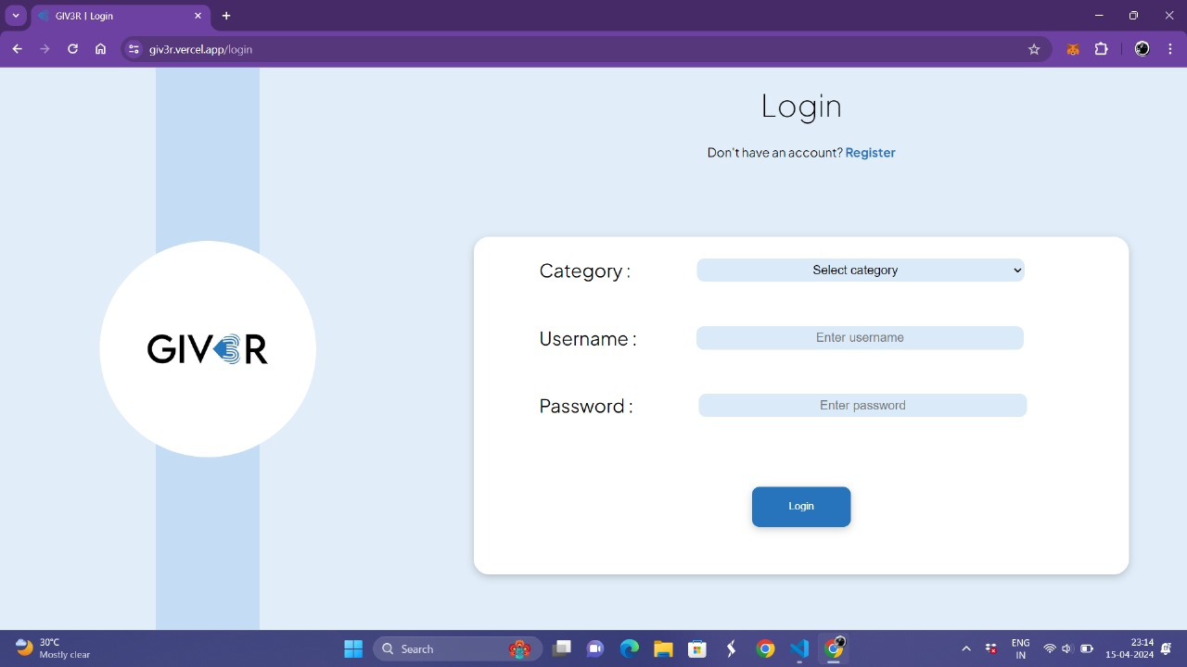
RESULT
This is the login page.

Slide 28
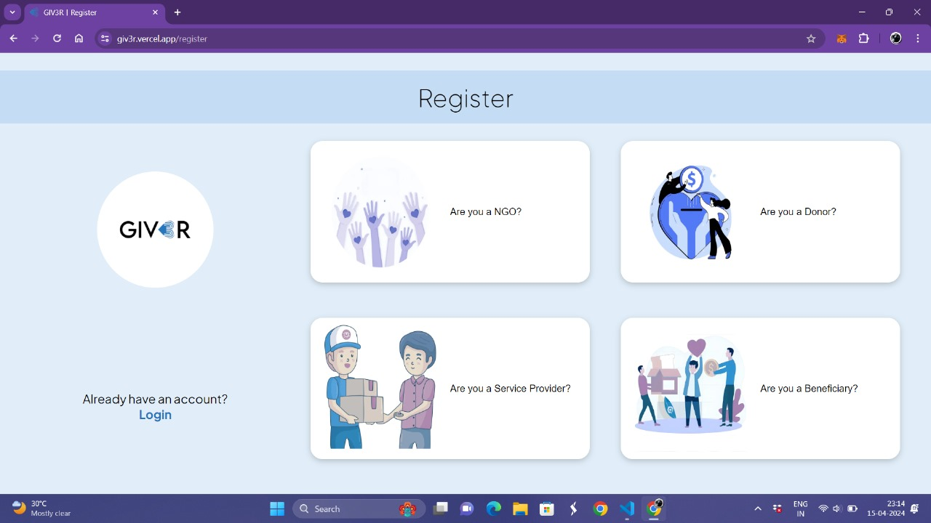
RESULT
This is the registration page where users can sign up as an NGO, donor, service provider, or beneficiary.

Slide 29
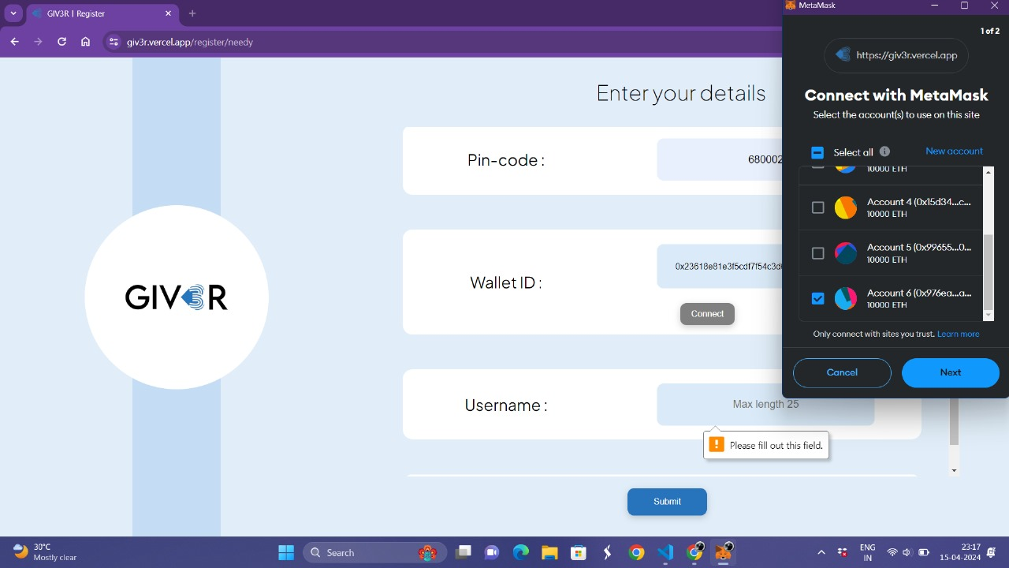
RESULT
You can connect your wallet using the wallet ID, and we support the MetaMask wallet.

Slide 30
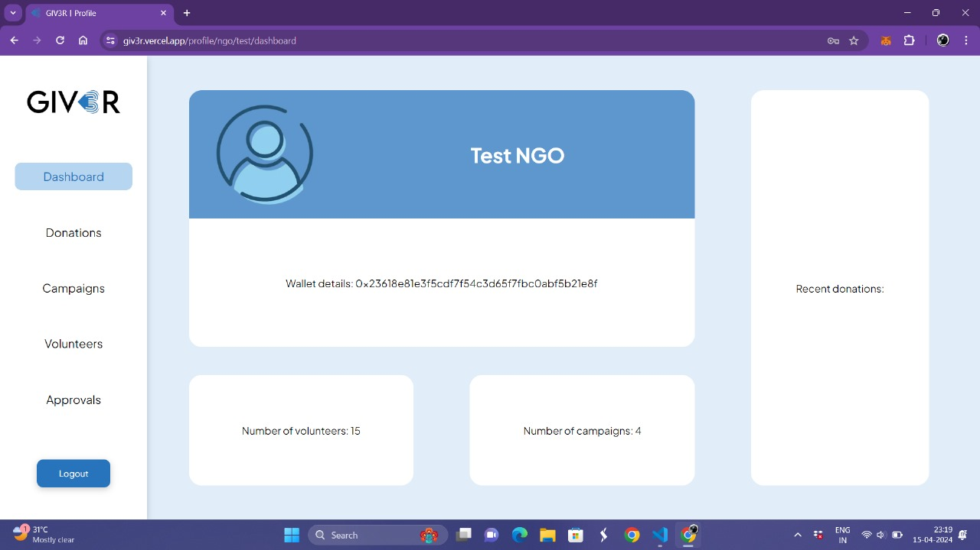
RESULT
This is the ngo dashboard.

Slide 31
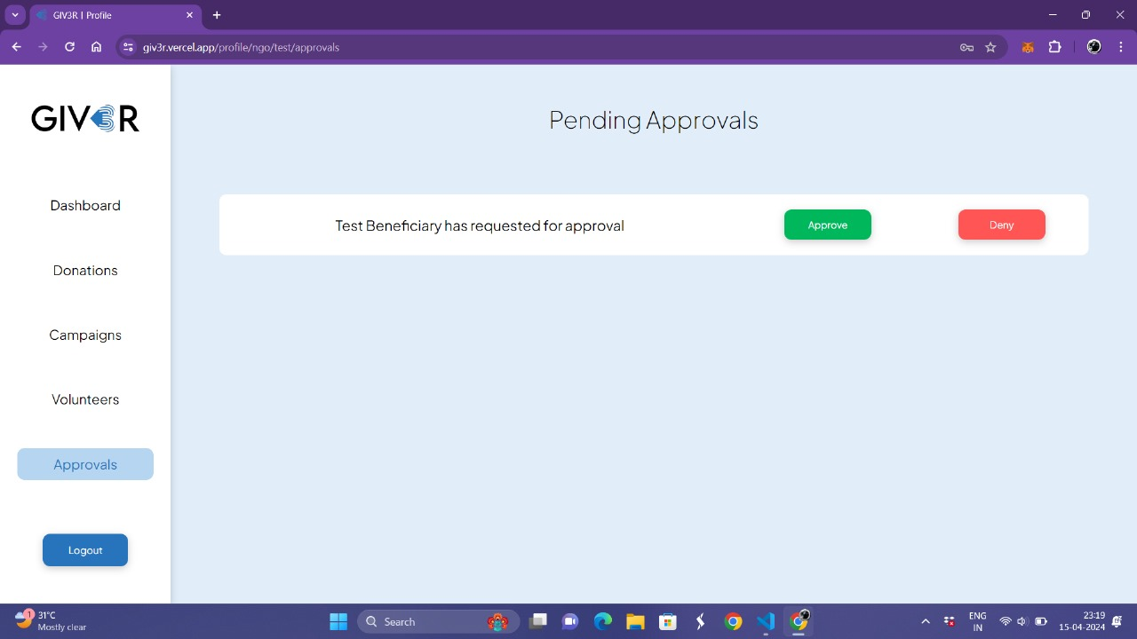
RESULT
The pending beneficiary request is approved by the NGOs.

Slide 32
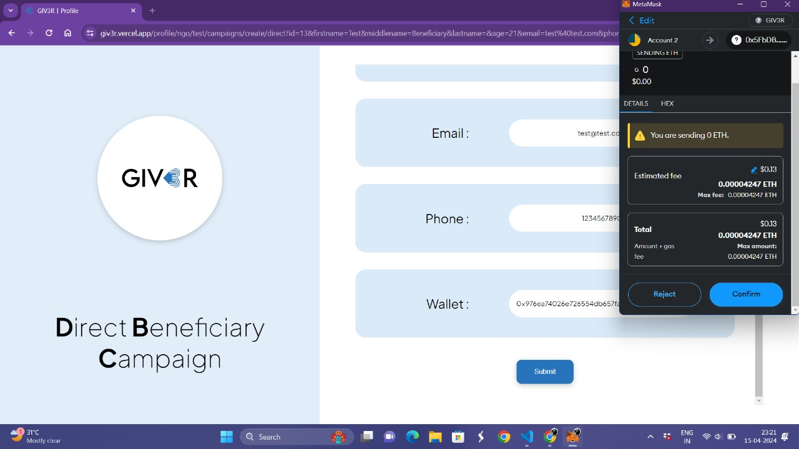
RESULT
This is the campaign creation page where you can create a campaign by providing the necessary details.

Slide 33
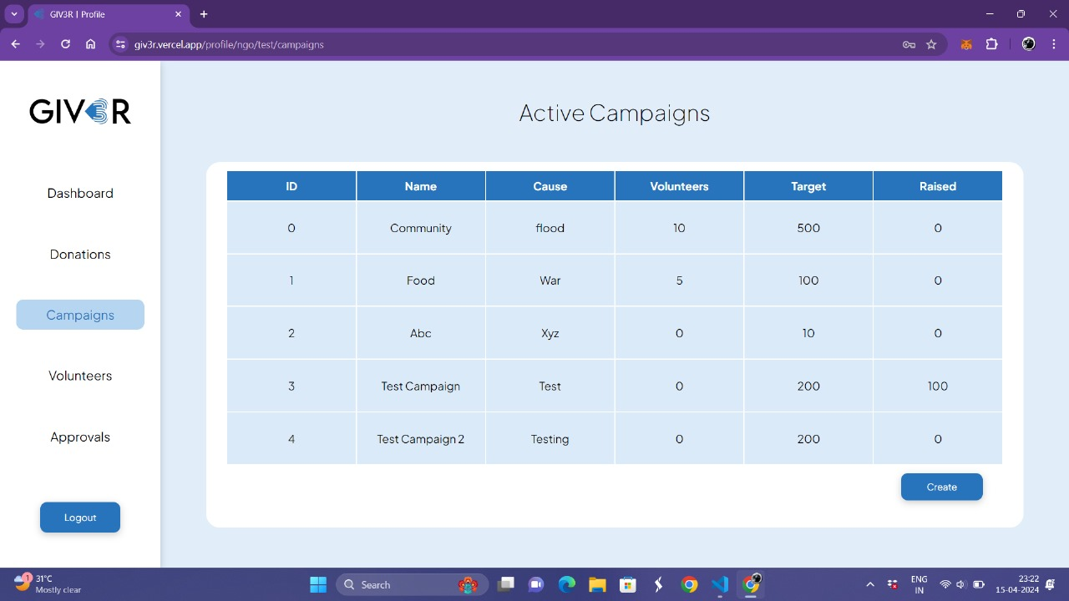
RESULT
All active campaigns can be viewed by the NGOs.

Slide 34
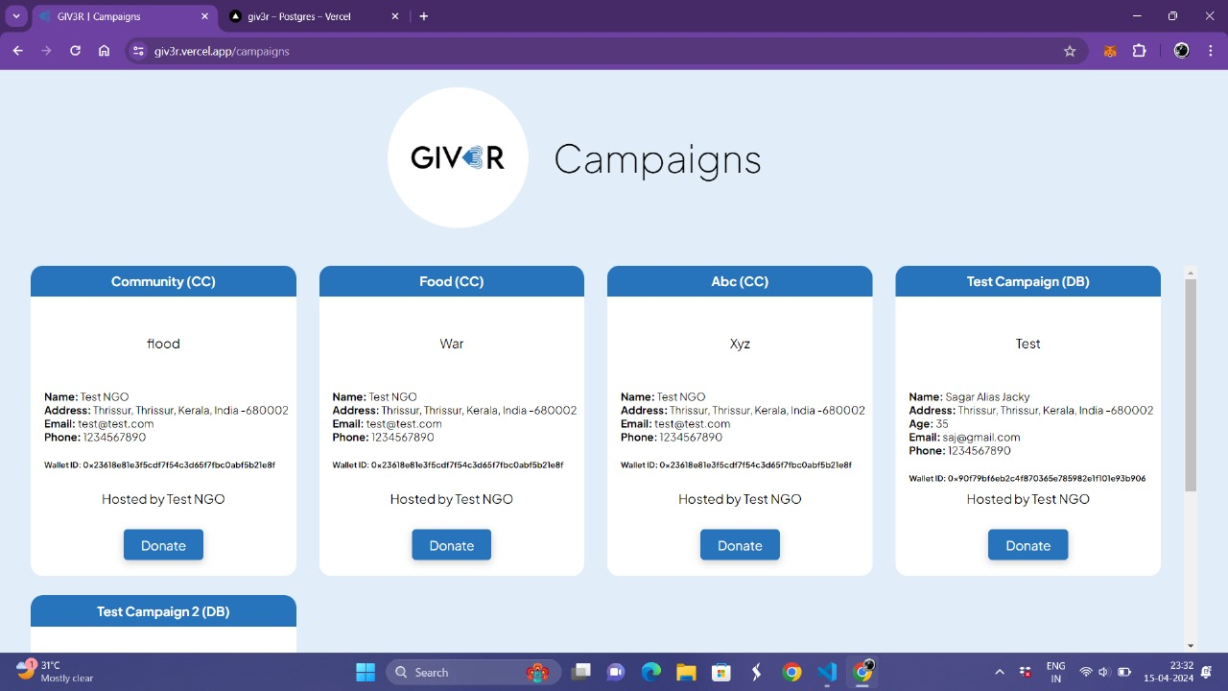
RESULT
Page where all campaigns can be viewed.

Slide 35
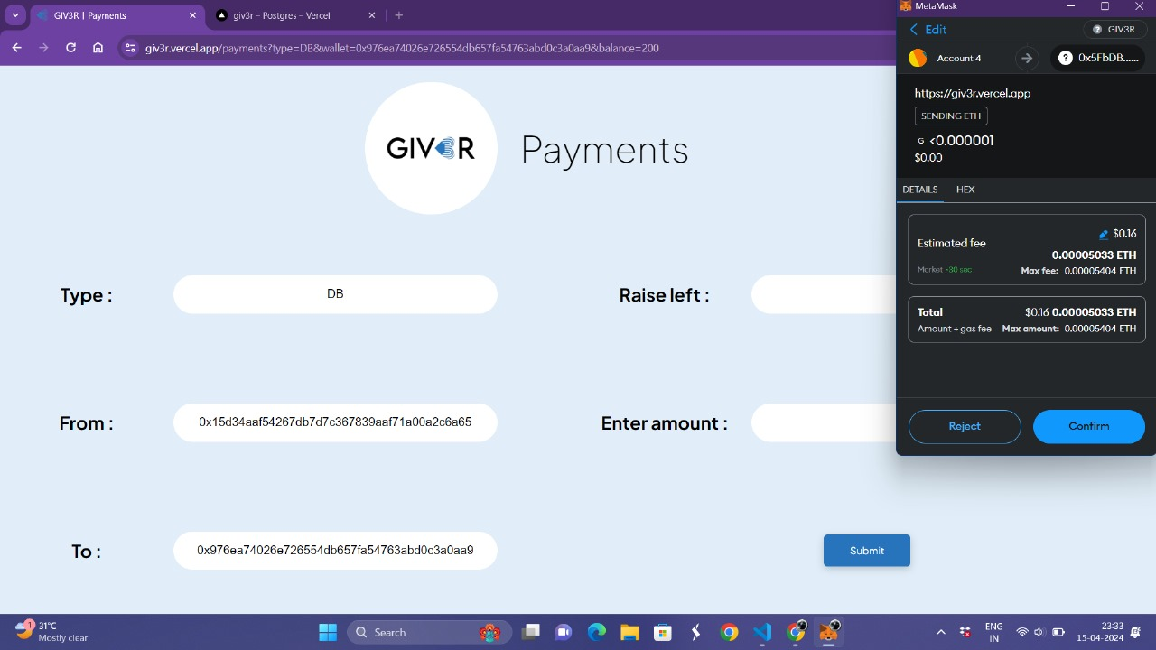
RESULT
Payments can be made by entering the corresponding wallet address and the amount to be donated. Payments are processed using the MetaMask wallet.

Slide 36

RESULT
This is the donor dashboard.

Slide 37
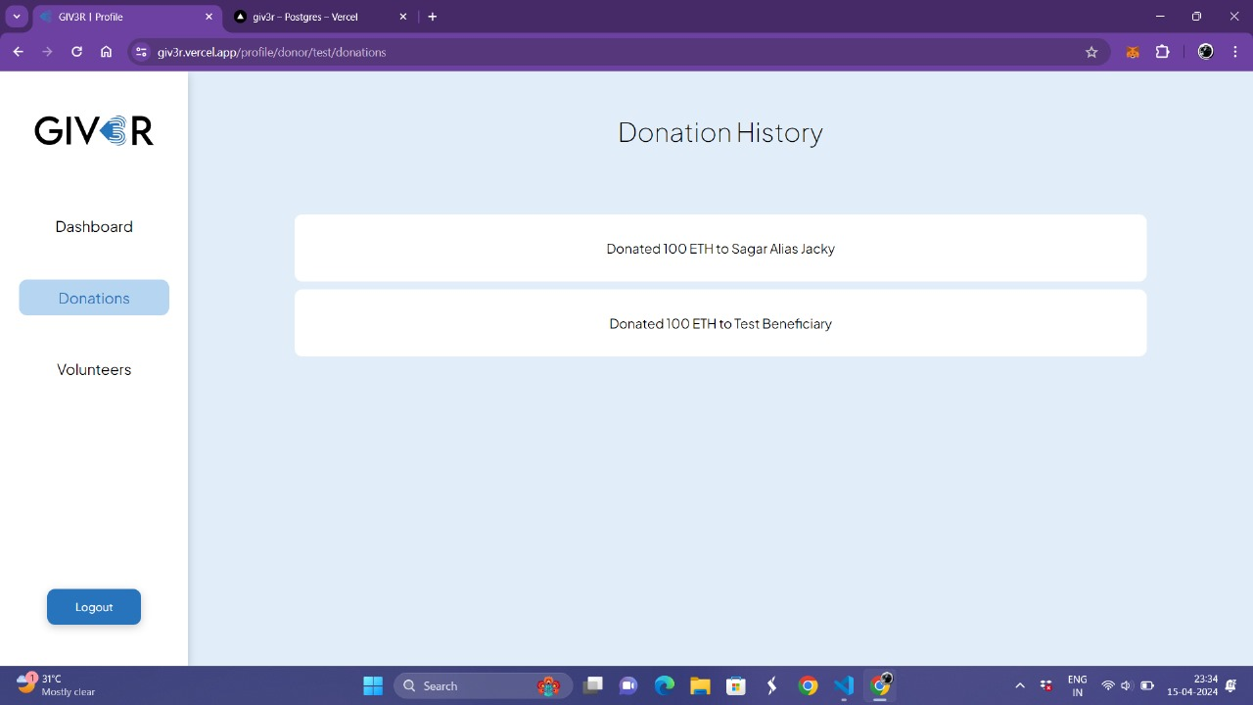
RESULT
Each payment made can be tracked using blockchain technology.

Slide 38
CONCLUSION
The decentralized charity platform, driven by Next.js, aims to redefine charitable contributions with transparency, efficiency, and community engagement.
Ongoing monitoring, user feedback, and legal compliance are pivotal for sustained success and positive impact on philanthropy.

Slide 39
THANKS

