Slide 1
GIV3R
Decentralized Charity Portal:
Empowering Transparent Philanthropy through Blockchain Technology
Rohit C (VAS20CS094), Suryajit IS (VAS20CS117), Sreenath M S (VAS20CS110), Sudarsanan VP(VAS20CS114)
Guided By
Dr. Ramani Bai V Professor and Head, Dept. of CSE
Department of Computer Science and Engineering
VIDYA ACADEMY OF SCIENCE AND TECHNOLOGY,THRISSUR
May 13, 2024

Slide 2











Contents
Traditional System Problem Statement Objectives Litreature Review Application Flow
1
2
3
4
5
System Architecture
Tools and Technologies
Results
Conclusion
Future Scope
References

Slide 3
Traditional System
In a world where charitable contributions play a pivotal role in addressing societal needs,there is a pressing need for a transparent and efficient system that connects donors with a diverse range of charity organizations.
Traditional methods of donation often lack transparency, leaving donors uncertain about the impact of their contributions.

Slide 4
Problem Statement
Traditional methods of supporting charitable causes, like donating money through banks or financial institutions, can be slow, inefficient, and opaque. This lack of transparency and effectiveness creates a trust deficit among donors and discourages support for charitable causes. Moreover, charitable organizations struggle to find and manage volunteers, as well as access necessary resources for their vital work.

Slide 5
Objectives
Transparency Enhancement : Enable donors to have full transparency into the utilization of their contributions by implementing a blockchain-based system that records and displays real-time transactions related to specific fundraising campaigns.
Efficient Fundraising : Facilitate charity organizations, including NGOs and other entities, in hosting decentralized fundraising campaigns. Utilize blockchain technology to streamline the fundraising process, making it secure, transparent, and efficient.
Unified Volunteer Engagement : Create a centralized platform for NGOs and various charity organizations to post volunteer opportunities. Provide volunteers with a user-friendly interface to easily discover and engage with causes aligned with their interests.

Slide 6
Objectives
Real Time Transaction Tracking : Develop a feature that allows donors to track transactions in real-time, offering a clear view of how their contributions are being utilized by charity organizations.
Enhance accountability and build trust between donors and charities.
User Friendly Interface : Design an intuitive and accessible user interface for donors, charity organizations, and volunteers. Prioritize a seamless user experience to encourage engagement and participation.
Decentralized Smart Contracts : Develop and deploy smart contracts on the blockchain to manage fundraising campaigns, volunteer incentives, and other critical processes. Ensure the security and efficiency of smart contracts to maintain the integrity of the platform.

Slide 7
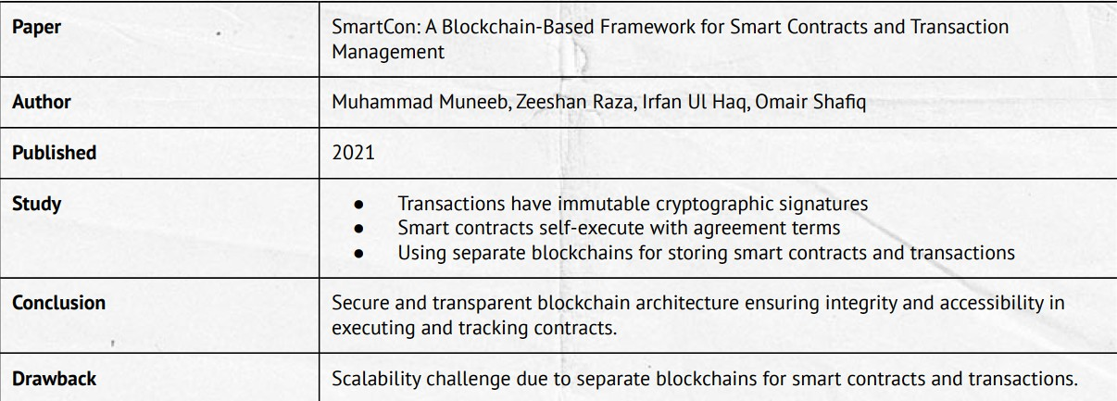
Litreature Review
Figure: Dual Blockchain for Smarter Contract Security and Transparency

Slide 8
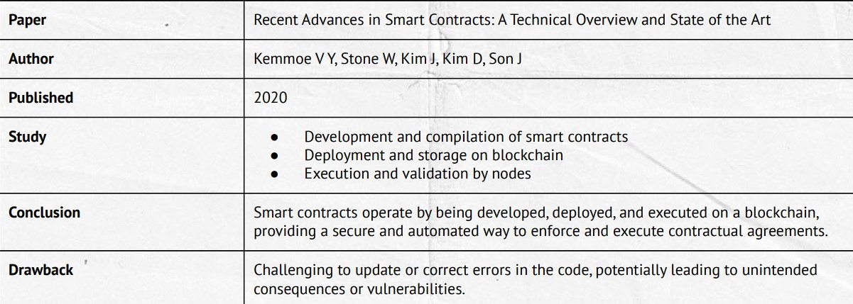
Litreature Review
Figure: Ensuring Secure Automation with Blockchain Technology

Slide 9
Application Flow
Figure: Application Flow of the System

Slide 10
Application Flow
The application flow of the decentralized charity platform involves a series of steps that guide users, donors, charity organizations, and volunteers through the process of registration, donation, campaign hosting, and volunteer engagement. Here’s a detailed description of the typical application flow:

Slide 11
Application Flow
Registrations
All users, including donors, volunteers, beneficiaries, NGOs, and service providers, must register on the website. Needy individuals’ registrations are verified by sponsoring NGOs.
Charity organizations register on the platform, providing details about their mission, goals, and verification information. The platform may include a verification process to ensure the legitimacy of charity organizations.
User Registration
Charity Organization Registration

Slide 12
Application Flow
Campaign Hosting
NGOs can create two types of campaigns:
Direct Beneficiary Support Campaigns: Funds are directly donated to the web3 wallets of verified needy individuals.
Community Relief Campaigns: Funds are used to provide services for the needy through service providers.
Campaign Creation

Slide 13
Application Flow
Donation Process
Donors can contribute funds and track their contributions’ progress and verify if funds reached the target individuals.
Donors can track if their payments reached the service providers.
Direct Beneficiary Campaigns
Community Relief Campaigns

Slide 14
Application Flow
Volunteering
Users can volunteer for Community Relief Campaigns, indicating their willingness to participate in events or activities. NGOs approve volunteer applications and post volunteer opportunities on the platform.
Transparency Measures
Donors can view the funds raised and spent at any time during a campaign, ensuring transparency and building user trust. Needy individuals can see the number of contributions and the donors who contributed to their well-being, enhancing transparency and accountability.
Volunteering for Community Relief Campaigns
Transparency in Campaigns

Slide 15
Application Flow
Real-time Communication
The platform sends real-time notifications to users, including updates on campaign progress, volunteer opportunities, and transaction confirmations.
Additional Feature for Direct Beneficiary Support Campaigns
For Direct Beneficiary Support Campaigns, beneficiaries have the option to convert the raised cryptocurrency into their native local currency. This conversion process facilitates seamless access to funds for beneficiaries who may not have the means to manage cryptocurrencies. Upon conversion, the funds are directly deposited into the beneficiaries’ bank accounts, ensuring ease of use and financial accessibility.
Platform Notifications
Beneficiary Payout Conversion

Slide 16
System Architecture
Figure: Overview of System Architecture
16 / 37

Slide 17
System Architecture
Frontend
The frontend is built using Next.js, which serves as the user interface for donors, charity organizations, and volunteers.
It includes pages for user registration, campaign creation, volunteer opportunities, and transaction tracking.
Implements user authentication and interacts with the backend through API routes.
Backend
Next.js is used for the backend as well, handling API routes for various functionalities.
API routes manage user authentication, campaign creation, volunteer opportunities, and interactions with the blockchain.

Slide 18
System Architecture
Database
Connects to a database (MongoDB or PostgreSQL) to store
non-blockchain data, including user information, campaign details, and volunteer registrations.
Blockchain Layer
Integrates with a blockchain network (Ethereum) for transparent and secure management of smart contracts.
Smart contracts handle fundraising campaigns, donation tracking, volunteer incentives, and record transactions on the blockchain.
Ethers.js
Interacts with the blockchain node using Web3.js or Ethers.js to handle transactions, queries, and events on the blockchain.

Slide 19
System Architecture
Metamask Wallet
MetaMask serves as a digital wallet that enables users to securely store, send, and receive Ethereum (ETH) and other ERC-20 tokens.
Once installed, it seamlessly integrates into the browser’s interface, providing easy access to Ethereum-based decentralized applications (dApps) and blockchain functionalities.
NFT
It is a type of digital asset that represents ownership or proof of authenticity of a unique item or piece of content using blockchain technology.
Volunteers on our platform are offered certificates in the form of NFTs.

Slide 20
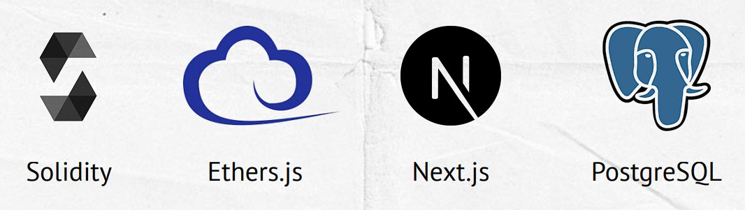
Tools and Technologies
Figure: Tools and Technologies used

Slide 21
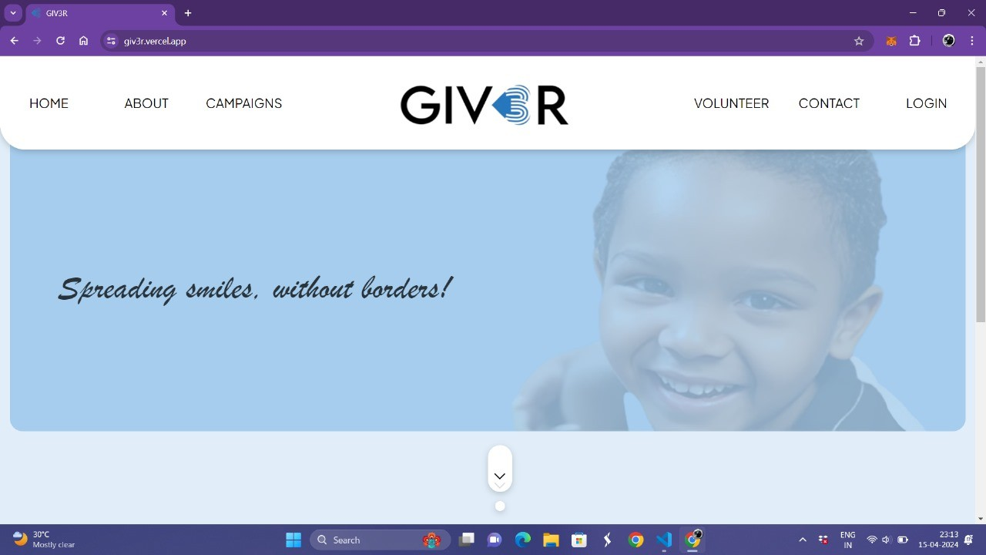
Results
Figure: This is the home page of the Decentralized Charity Portal.

Slide 22
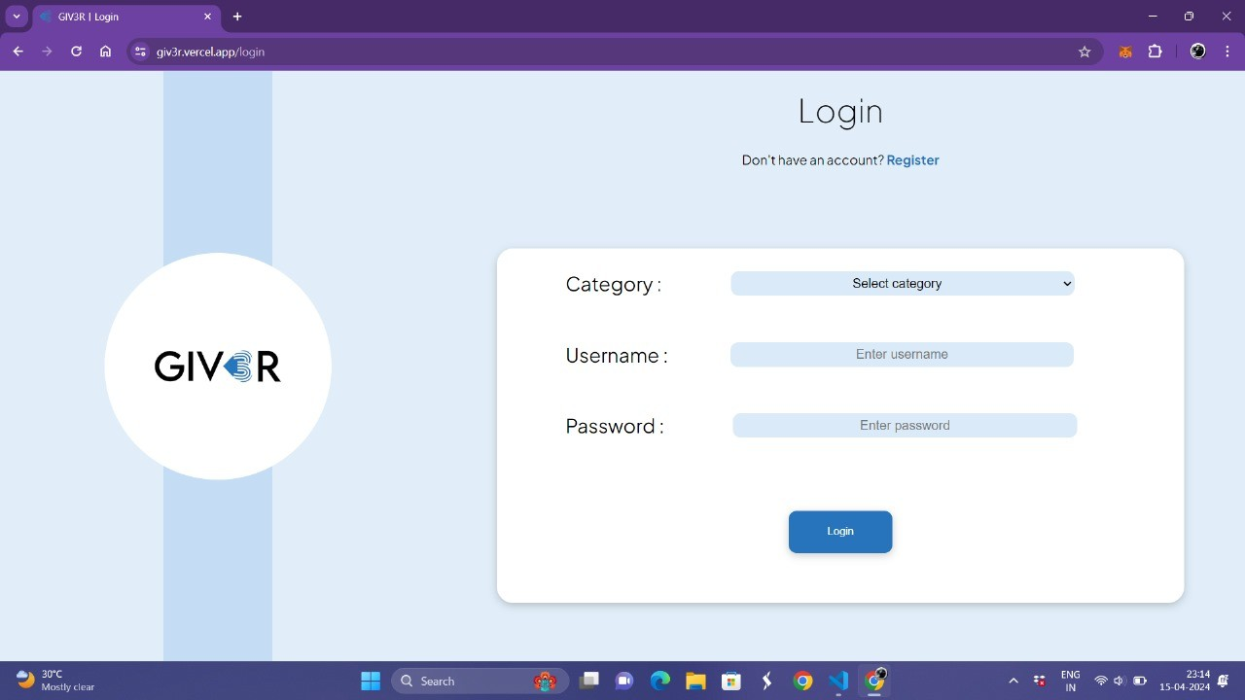
Result
Figure: This is the login page.

Slide 23
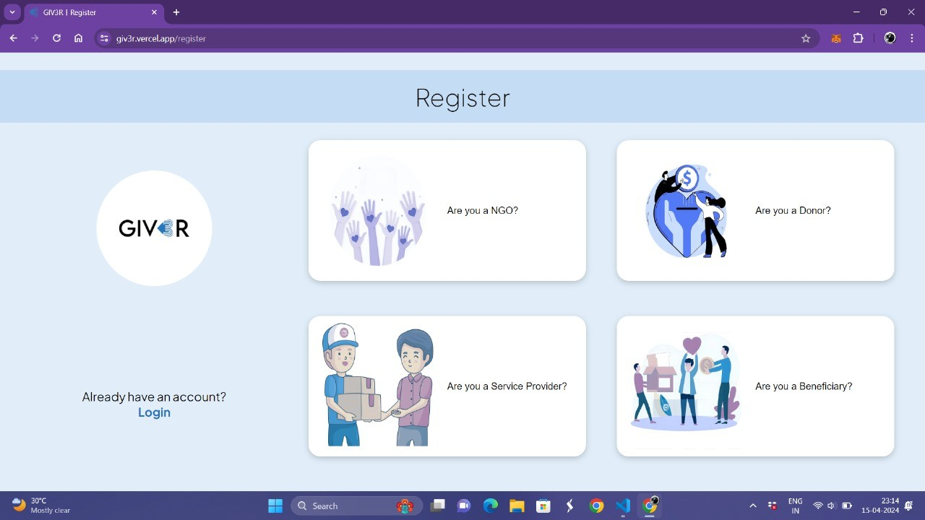
Result
Figure: This is the registration page where users can sign up as an NGO, donor, service provider, or beneficiary.

Slide 24
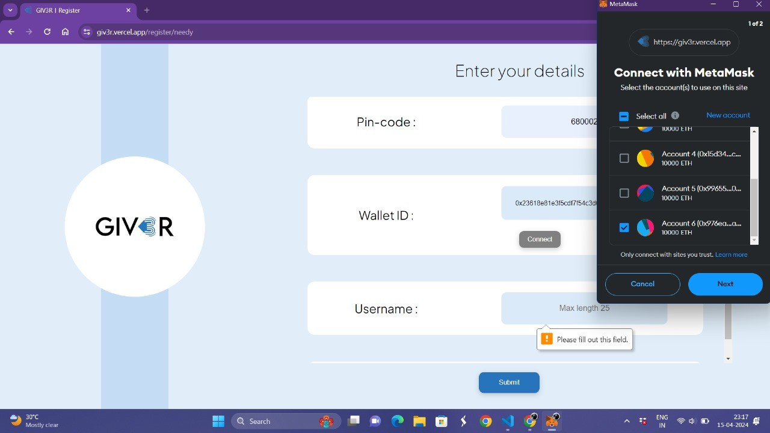
Result
Figure: You can connect your wallet using the wallet ID, and we support the
MetaMask wallet.

Slide 25
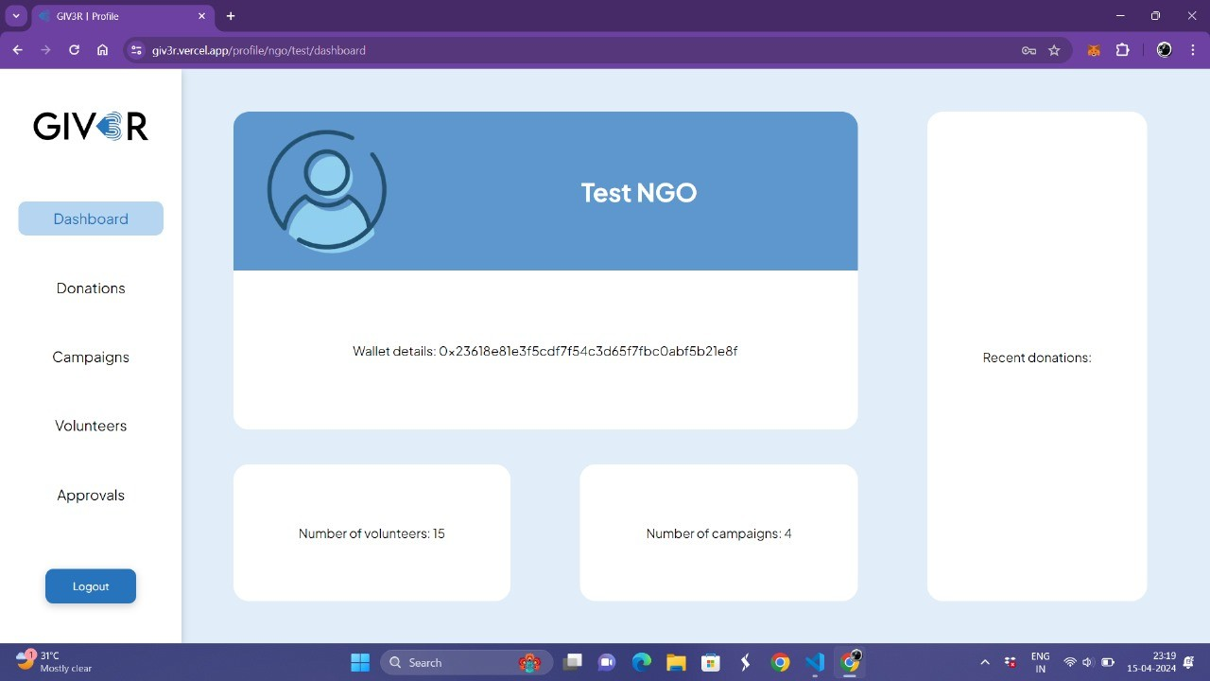
Result
Figure: This is the ngo dashboard.

Slide 26

Result
Figure: This is the donor dashboard.
26 / 37

Slide 27
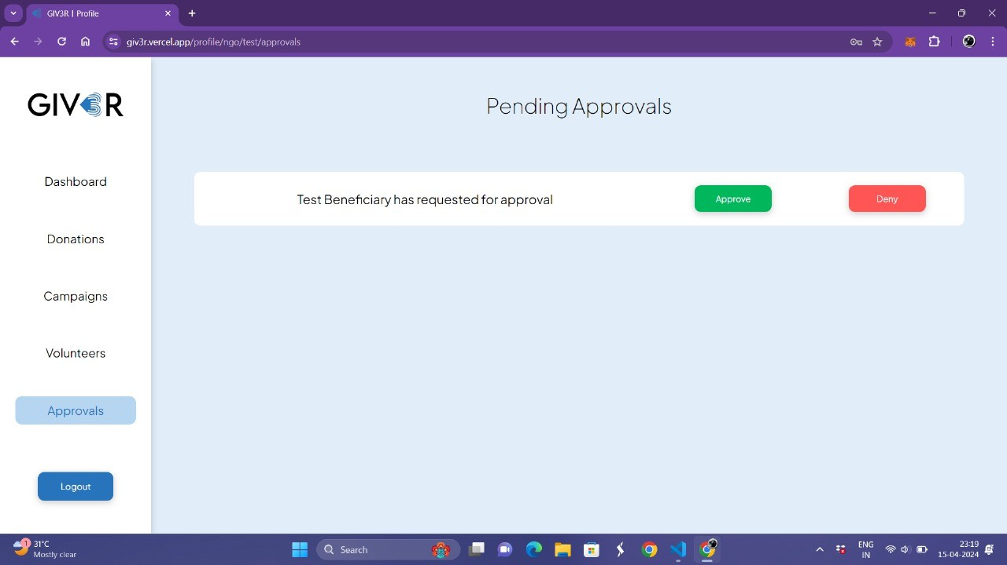
Result
Figure: The pending beneficiary request is approved by the NGOs.

Slide 28
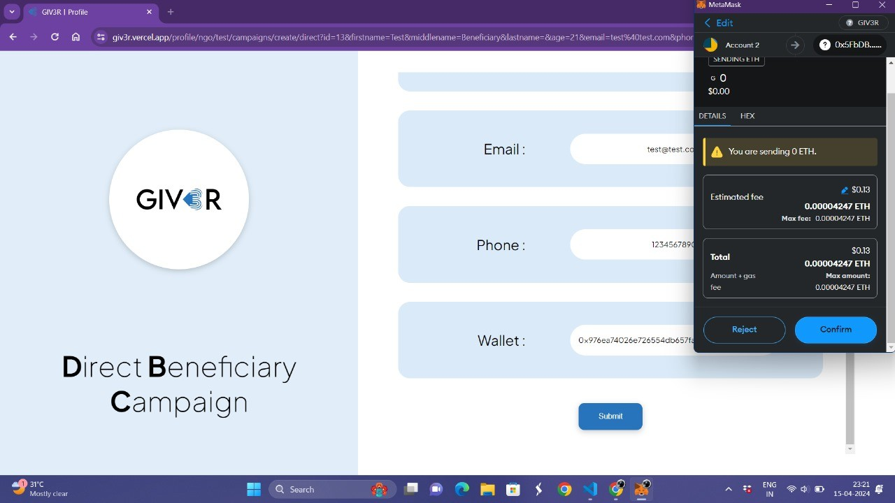
Result
Figure: This is the campaign creation page where you can create a campaign by providing the necessary details.

Slide 29
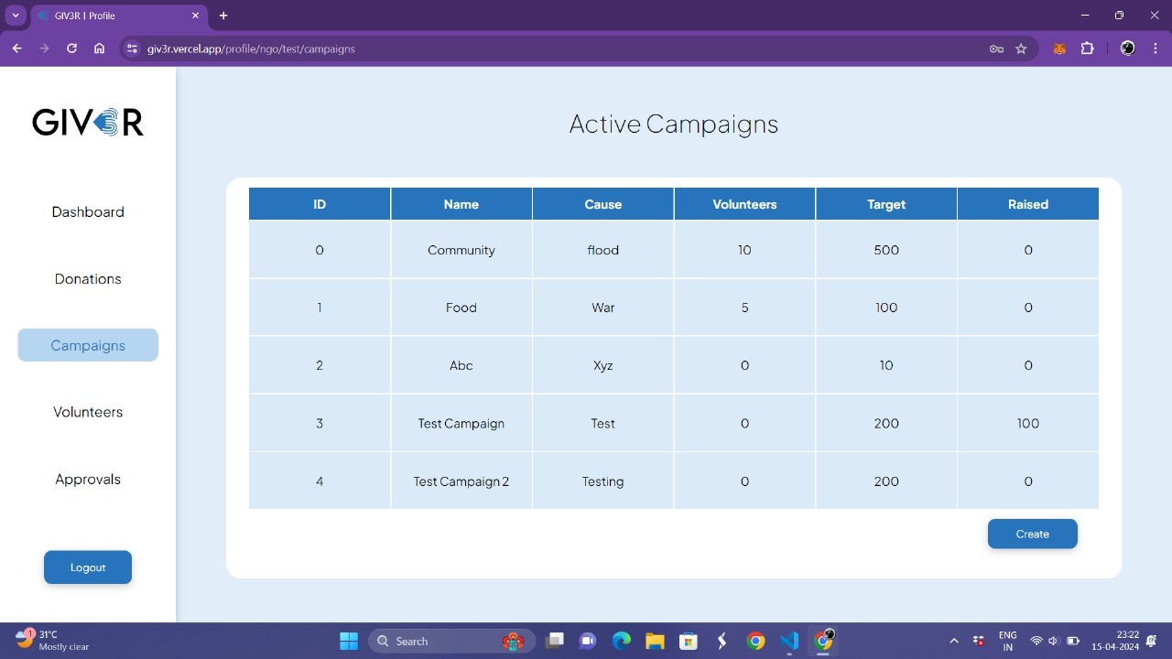
Result
Figure: All active campaigns can be viewed by the NGOs.

Slide 30
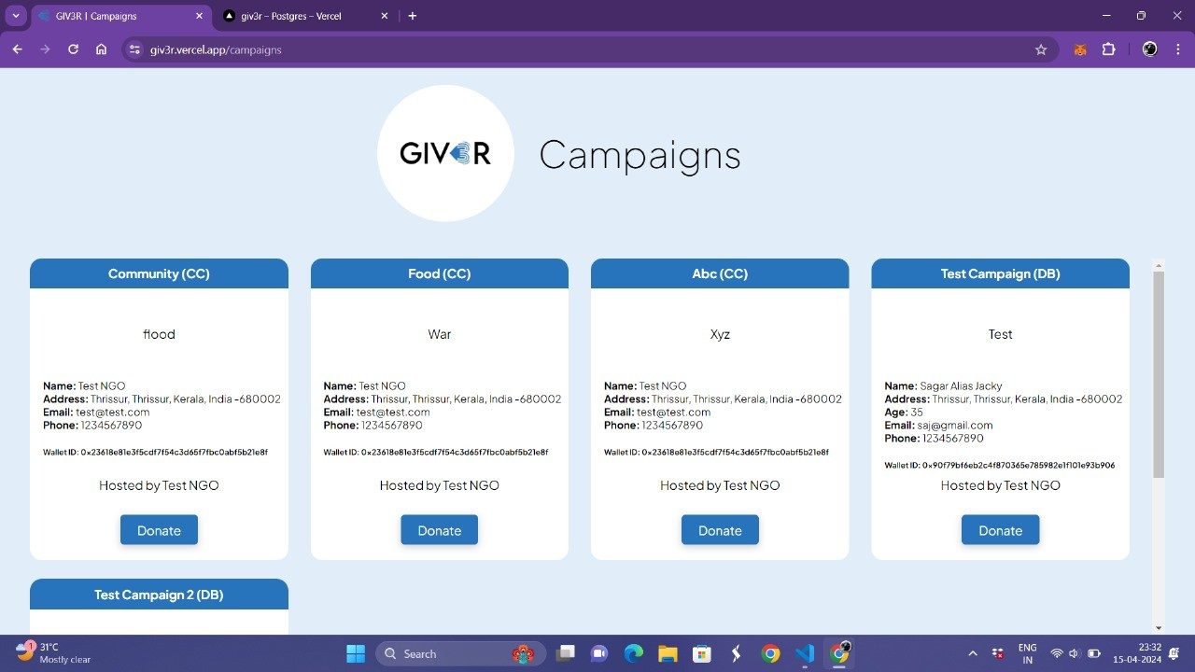
Result
Figure: Page where all campaigns can be viewed.

Slide 31
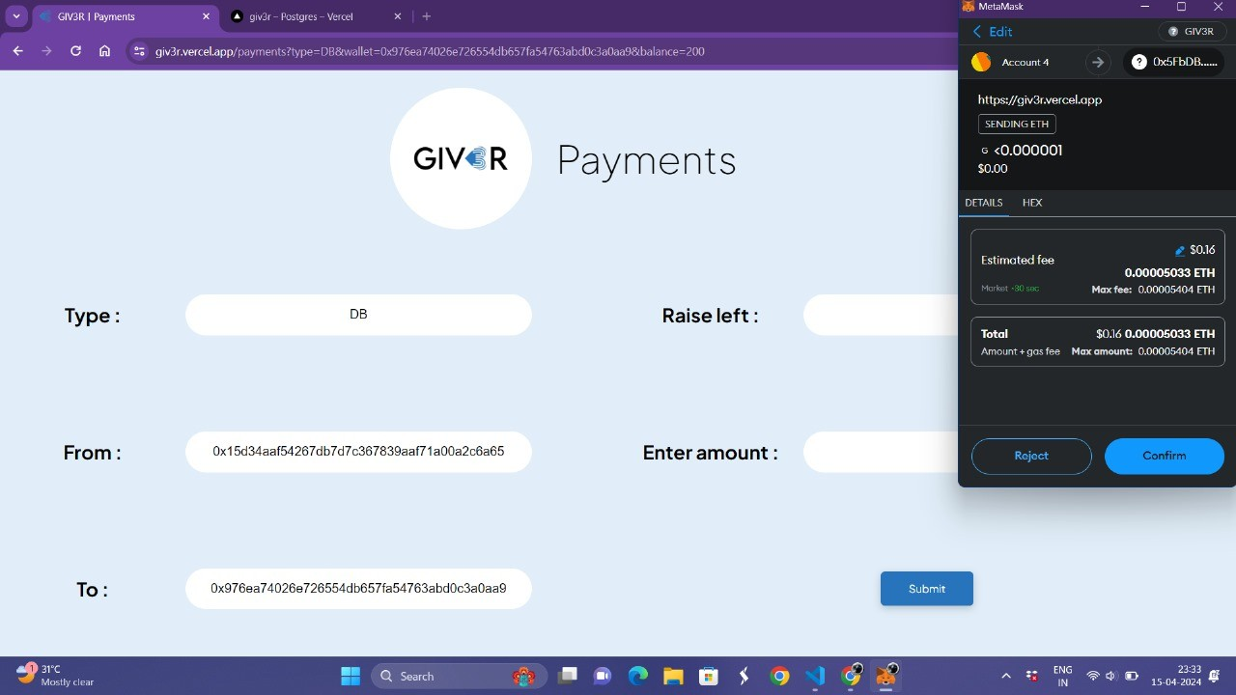
Result
Figure: Payments can be made by entering the corresponding wallet address and the amount to be donated.
31 / 37

Slide 32
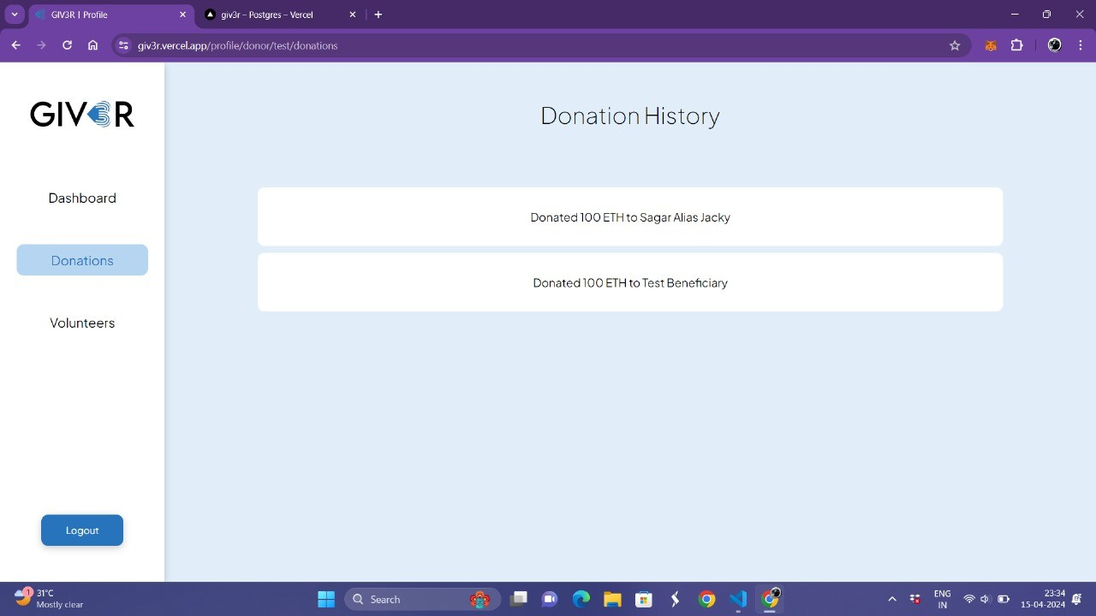
Result
Figure: Each payment made can be tracked using blockchain technology.

Slide 33
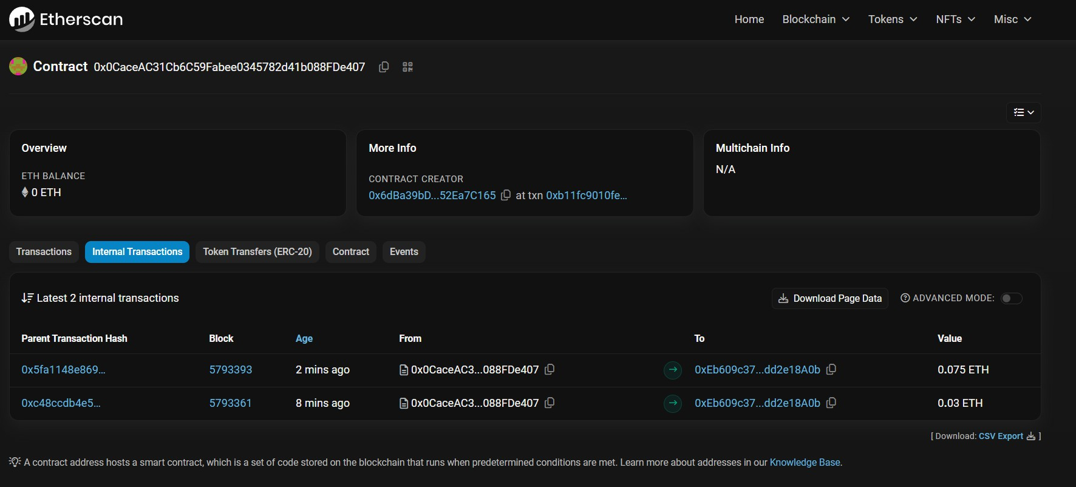
Result
Figure: Transactions recorded on the Sepolia Test Network

Slide 34
Conclusion
The decentralized charity platform, driven by Next.js, aims to redefine charitable contributions with transparency, efficiency, and community engagement.
Ongoing monitoring, user feedback, and legal compliance are pivotal for sustained success and positive impact on philanthropy.

Slide 35
Future Scope
Enhanced features and functionalities, such as advanced analytics and reporting capabilities.
Development of a dedicated mobile application for improved accessibility.
Integration with social media platforms to amplify reach and engagement.
Partnerships with charitable organizations, NGOs, and corporate entities for greater impact.
Advanced impact measurement and reporting using AI and ML.

Slide 36
References
1
Zheng, Z., Xie, S., Dai, H., Chen, X., & Wang, H. (2017, June). An overview of blockchain technology: Architecture, consensus, and future trends. In 2017 IEEE International Congress on Big Data (BigData Congress) (pp. 557-564). IEEE.
Alexopoulos, N., Daubert, J., Mu¨hlh¨auser, M., & Habib, S. M. (2017, August). Beyond the hype: On using blockchains in trust management for authentication. In 2017 IEEE Trustcom/BigDataSE/ICESS (pp. 546-553). IEEE.
Mukhopadhyay, U., Skjellum, A., Hambolu, O., Oakley, J., Yu, L., & Brooks, R. (2016, December). A brief survey of cryptocurrency systems. In 2016 14th Annual Conference on Privacy, Security and Trust (PST) (pp. 745-752). IEEE.
Lu, Q., & Xu, X. (2017). Adaptable blockchain-based systems: A case study for product traceability. IEEE Software, 34(6), 21-27.
2
3
4

Slide 37
THANK YOU

