Slide 1
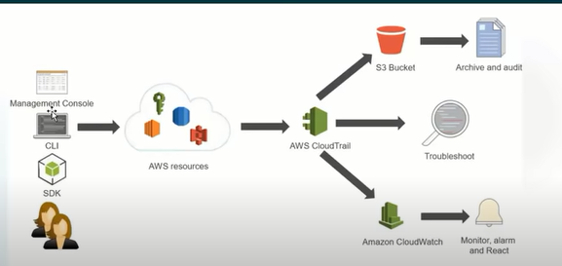
CLOUD TRIAL – Audit service

Slide 2
AWS CloudTrail is a service which records AWA API calls for you account and delivers log files to you.
The recorded inform includes
The identity of the API caller
The time of the API call.
The source Ip of the API call.
The request parameters.
Response fron AWS resources.

Slide 3
Trial creation and Important terminology
Maanagement events
For read type events response will not be tracked’
Data events
S3
Lambda
Create lambda(manage)
Invoation (data)

Slide 4
Track Access to APIs and IAM
Cloudtrail will record access to API calls and ow those API calls made.save logs in your S3 bucket.
Notifications.

Slide 5
Monitor via cloudwatch

