Slide 1
Multi Cloud Support
Openshift
Kubernetes
Rancher(POC)
Google Anthos(POC)

Slide 2
Roles and Responsibilities
Part of Health care cloud team(explain bit about HCC)
Part of Enterprise cloud architecture team where we are responsible for Building enterprise cloud eco system and Providing Architectural solutions.
Analyzing the technology stack and identifying the architecture that is best fit for organization.

Slide 3
During Technical analysis phase we will consider following aspects`
Operational Excellence
Security
Reliability
Performance Efficiency
Cost Optimization

Slide 4
Operational Excellence
Work load management
IAC ( infra as a code)
Platform stability

Slide 5
Security
Implement a strong identity foundation
Enable traceability
Apply security at all layers
Automate security best practices
Protect data in transit and at rest
Keep people away from data
Prepare for security events

Slide 6
Reliability
DR types
-
Automatically recover from failure
Test recovery procedures
Scale horizontally to increase aggregate workload availability
Stop guessing capacity
Manage change in automation
Define RTO/RPO

Slide 7
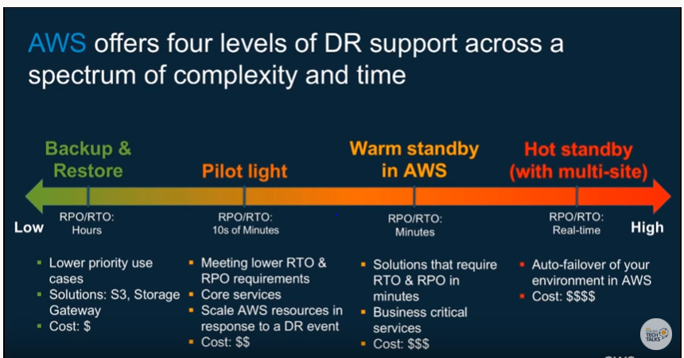
DR models

Slide 8
Performance Efficiency
Democratize advanced technologies
Go global in minutes
Use serverless architectures
Experiment more often
Consider mechanical sympat

Slide 9
Cost optimization
Implement cloud financial management
Adopt a consumption model
Measure overall efficiency
Stop spending money on undifferentiated heavy lifting
Analyze and attribute expenditure

