Slide 1

What is Cloud Computing?
Understand Cloud Computing and its Impact on the Future of Location-Based Services

Slide 2
Introduction

Slide 3
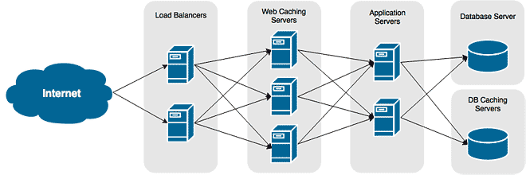
Application infrastructure flow

Slide 4
Disadvantages
High Maintenance
DR costly
No Auto scaling
Upfront Buying

Slide 5
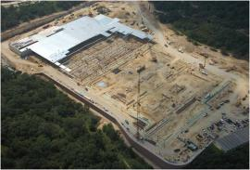
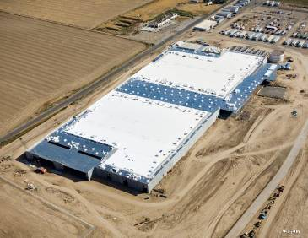
Infrastructure (Mega Datacenters)

Slide 6
Objectives of Cloud Computing
Elasticity: Ability to scale virtual machines resources up or down
On-demand usage: Ability to add or delete computing power (CPU, memory), and storage according to demand
Pay-per-use: Pay only for what you use
Multi tenancy: Ability to have multiple customers access their servers in the data center in an isolated manner
.

Slide 7
Cloud Computing – Simple Definition
Cloud Computing = Software as a Service + Platform as a Service + Infrastructure as a Service

Slide 8
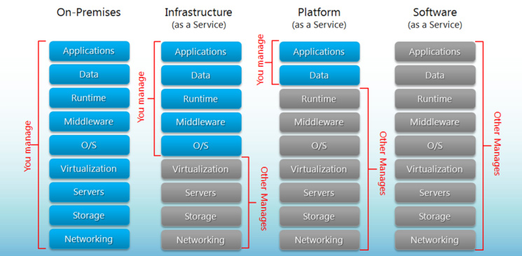

Slide 9
Cloud Computing – Simple Definition
Software as a Service (SaaS)
From end user’s point of view
Apps are located in the cloud
Software experiences are delivered through the Internet

Slide 10
Cloud Computing – Simple Definition
Platform as a Service (PaaS)
From developer’s point of view (i.e. cloud users)
Cloud providers offer an Internet-based platform to developers who want to create services but don't want to build their own cloud
Notes:
Similar to Windows Platform for ISV developers in the PC ecosystem

Slide 11
Cloud Computing – Simple Definition
Infrastructure as a Service (IaaS)
Cloud providers build datacenters
Power, scale, hardware, networking, storage, distributed systems, etc
Datacenter as a service
Cloud users rent storage, computation, and maintenance from cloud providers (pay-as-you-go; like utility)
Notes:
Similar to Windows Platform for ISV developers in the PC ecosystem

Slide 12
Summary
The real underlying value of “cloud + clients” is that it transparently makes software, data, and computing available everywhere
Be “the Platform”
Lead the revolution of LBS industry

