Slide 1

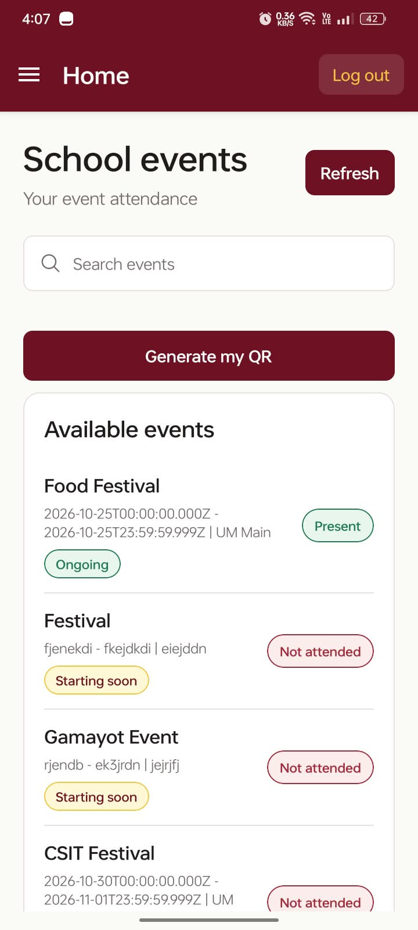
EVENTRA
School event attendance, simplified.
A faster, clearer way for officers to manage events
and for students to prove they were there.
APP PITCH | 1–2 MINUTES
From “Who attended?”
to an answer in seconds.

Slide 2
THE OPPORTUNITY
Attendance should not be a paperwork problem.
School events move quickly. Attendance tracking should move with them.
Before
With EVENTRA
The payoff
Manual lists, scattered records, and slow follow-up.
One shared source of truth for every event and attendee.
Less friction for officers. More visibility for students.
1
2
3
Create the event
Generate / scan QR
Review the record
A simple loop that replaces uncertainty with a live attendance picture.

Slide 3
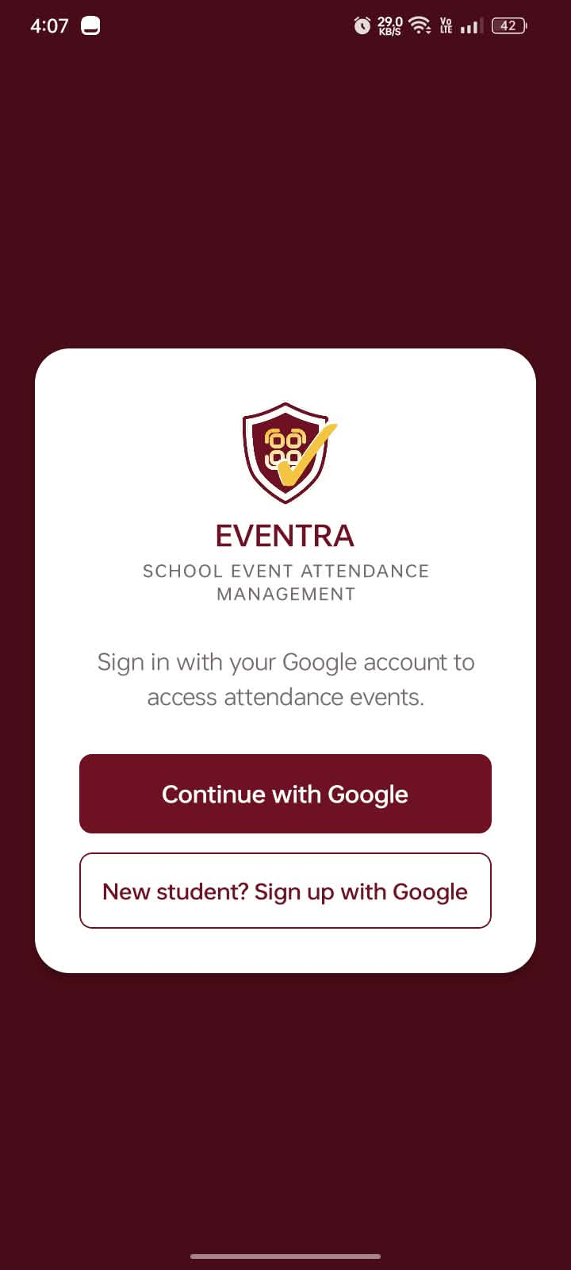
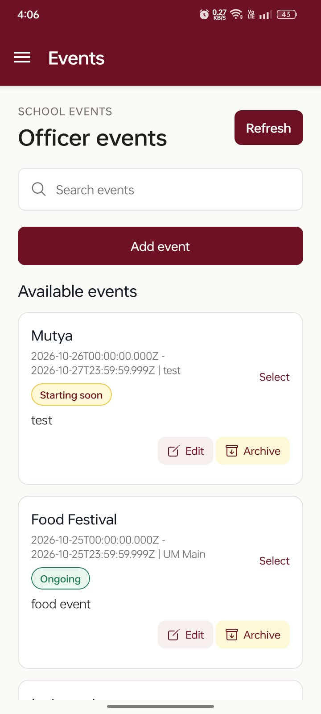
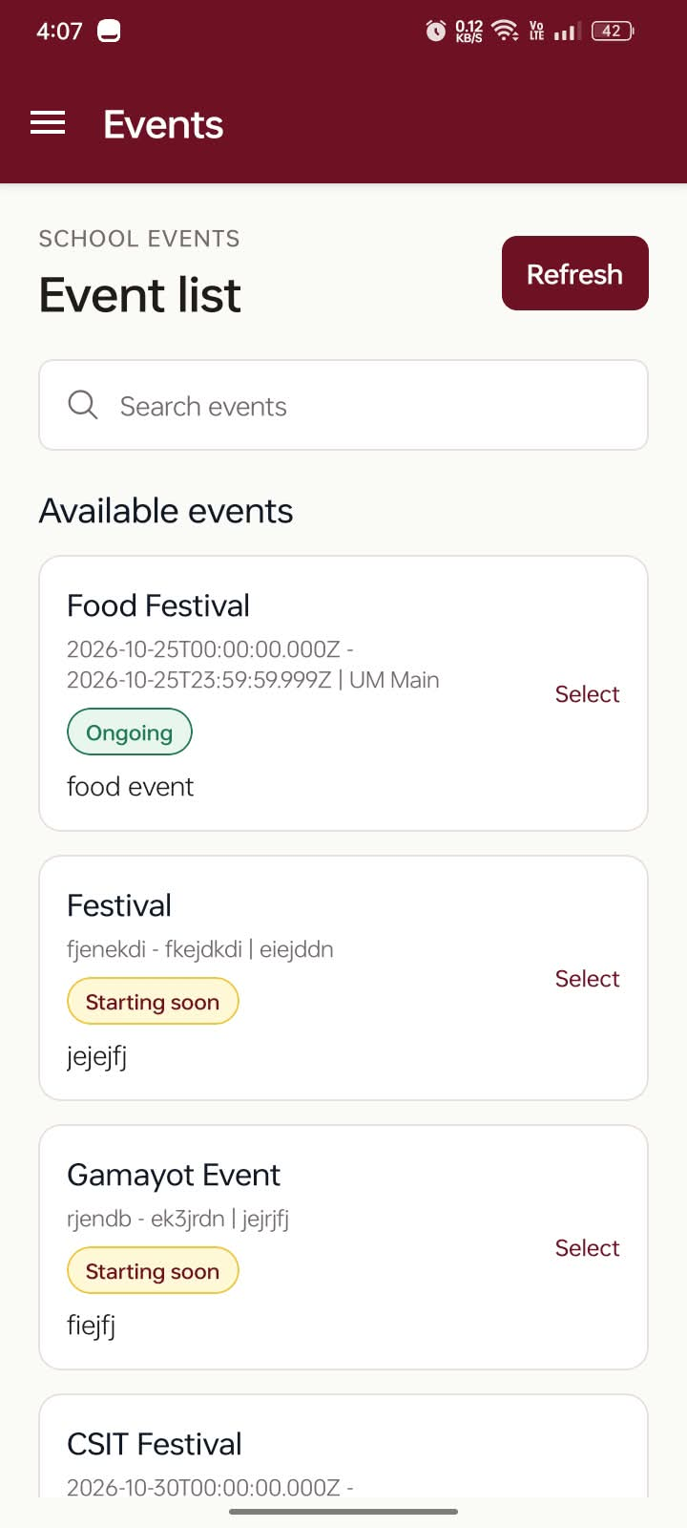
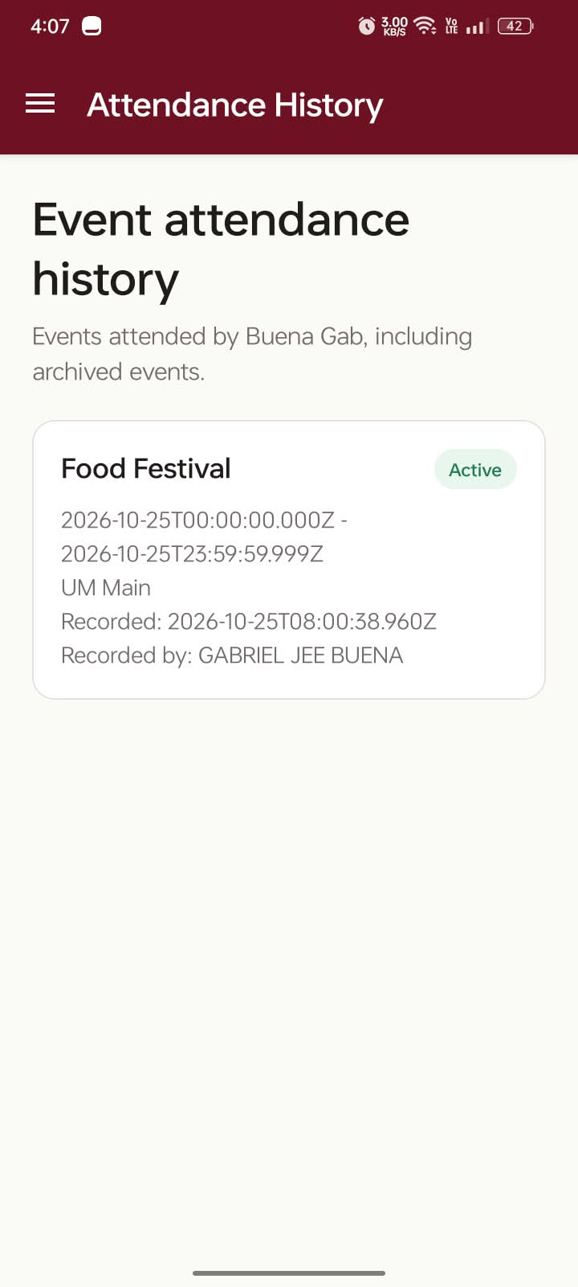
HOW IT WORKS
One app. Two perspectives. One shared record.
Designed around the actual rhythm of a school event.
→
→
→
1 Sign in securely
2 Officer creates / manages
3 Student finds the event
4 Attendance is reviewable
Google authentication • QR generation • QR scanning • Archived history

Slide 4
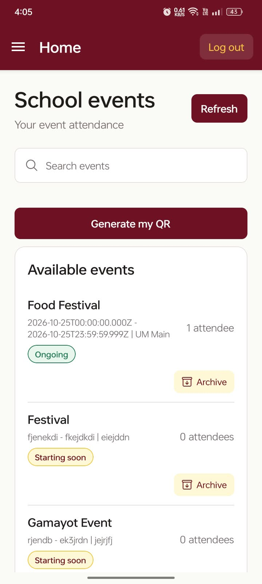
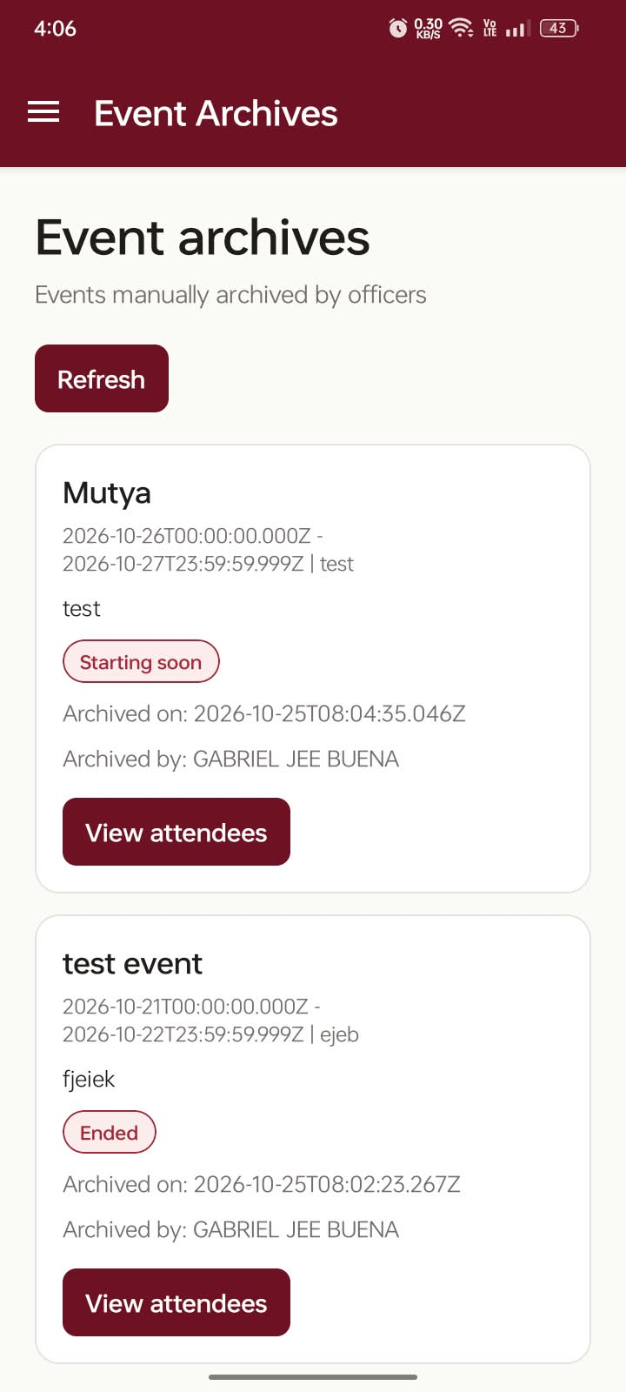
OFFICER EXPERIENCE
Control the event from one workspace.
Create, update, archive, and inspect attendance without losing the thread.
Officer toolkit
Create events
Edit details
Archive completed events
Record attendance
Scan student QR codes
Review attendee lists
The officer gets clarity at the moment it matters: before, during, and after the event.
Live event overview
Search + event management
Archived events stay useful

Slide 5
STUDENT EXPERIENCE
Attendance becomes visible, personal, and easy to verify.
Students see what is available, generate their QR, and keep a history of participation.
Present
or “Not attended” —
no guesswork.
A cleaner experience
for every participant.
Generate my QR • See status
Browse upcoming events
Review attendance history

Slide 6
EVENTRA
Make every school event
count — and count correctly.
EVENTRA connects the people who organize events
with the students who make them meaningful.
READY TO DEMO

